Slide 1
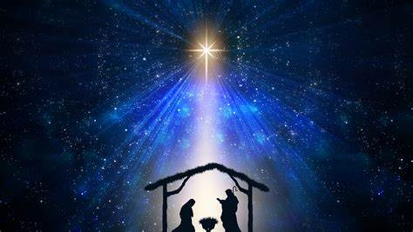
Christmas Eve Service

Slide 2
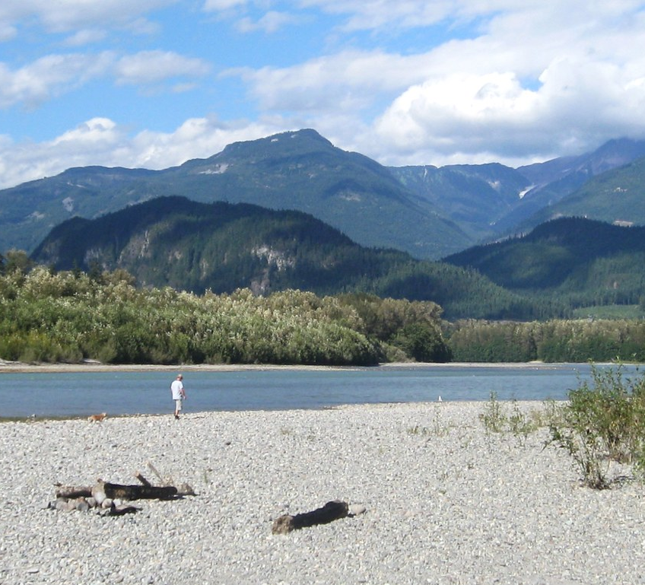
Welcome & Land Acknowledgement
Squamish United Church respectfully, and whole-heartedly acknowledge that the services we operate in Squamish, BC are on the traditional, ancestral and unceded territory of the
Skwxwú7mesh (Squamish)
Nation.
This Photo by Unknown Author is licensed under CC BY

Slide 3

Gathering Hymn
Voices United #60:
“O Come, All Ye Faithful”
Words: English translation Frederick Oakeley
Music: attrib. John Francis Wade

Slide 4
1. O come, all ye faithful, joyful and triumphant,
O come ye, O come ye to Bethlehem:
come and behold him, born the King of angels;
O come, let us adore him, O come, let us adore him,
O come, let us adore him, Christ the Lord.

Slide 5
2. God of God, light of light,
lo, he abhors not the virgin’s womb;
very God, begotten, not created:
O come, let us adore him, O come, let us adore him,
O come, let us adore him, Christ the Lord.

Slide 6
3. Sing, choirs of angels, sing in exultation,
Sing, all ye citizens of heaven above;
Glory to God in the highest:
O come, let us adore him, O come, let us adore him,
O come, let us adore him, Christ the Lord.

Slide 7
4. See how the shepherds summoned to his cradle,
leaving their flocks, draw nigh with lowly fear;
we too will thither bend our joyful footsteps;
O come, let us adore him, O come, let us adore him,
O come, let us adore him, Christ the Lord.

Slide 8
5. Yea, Lord, we greet thee, born this happy morning;
Jesus, to thee be glory given;
word of the Father, now in flesh appearing:
O come, let us adore him, O come, let us adore him,
O come, let us adore him, Christ the Lord.

Slide 9
Call to Worship
One: On this holiest of night,
All: we come, joining with the shepherds who are stunned by wonder.
One: On this most silent night,
All: we come, our hopes and dreams joining those of Mary and Joseph.
One: On this night of carols and candlelight,
All: we come, our glad songs joining with the choirs of angels over us.
One: Come find comfort today in this gathering of God’s people.
All: We come knowing that God is with us. Let us worship together.
~ revised with permission by Rev. Thom Shuman, Lectionary Liturgies. Posted on LiturgyLink. http://www.liturgylink.net/.

Slide 10
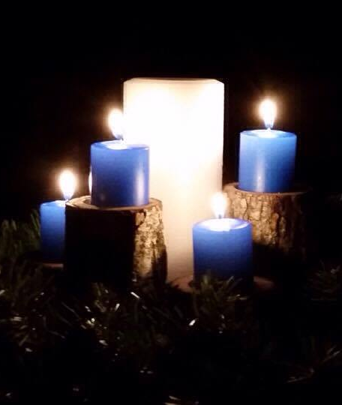
Lighting the Advent Wreath – Light of Light Liturgy
Read by Vicki & Kevin Haberl

Slide 11
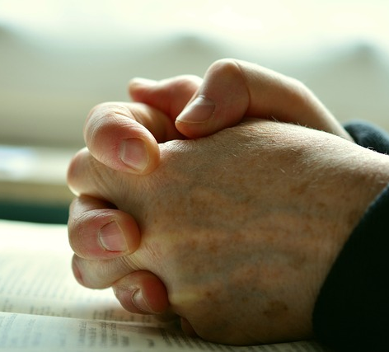
Opening Prayer

Slide 12
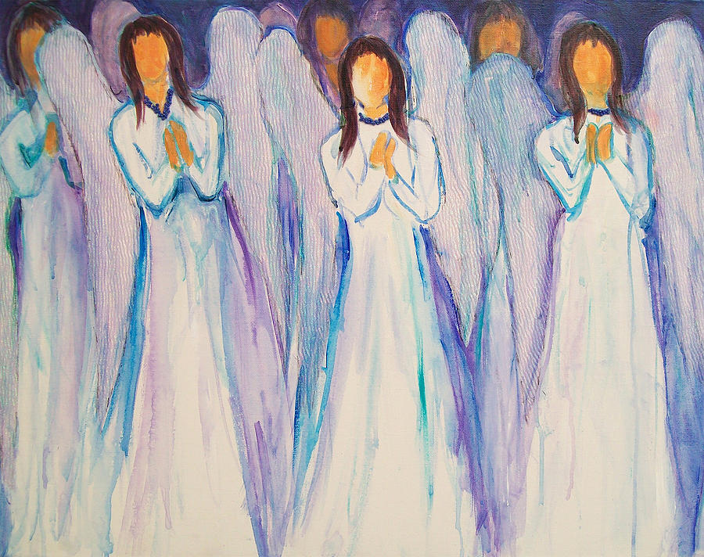
Choir Anthem
“Carols at the Manger”
arranged by Mark Shepperd

Slide 13
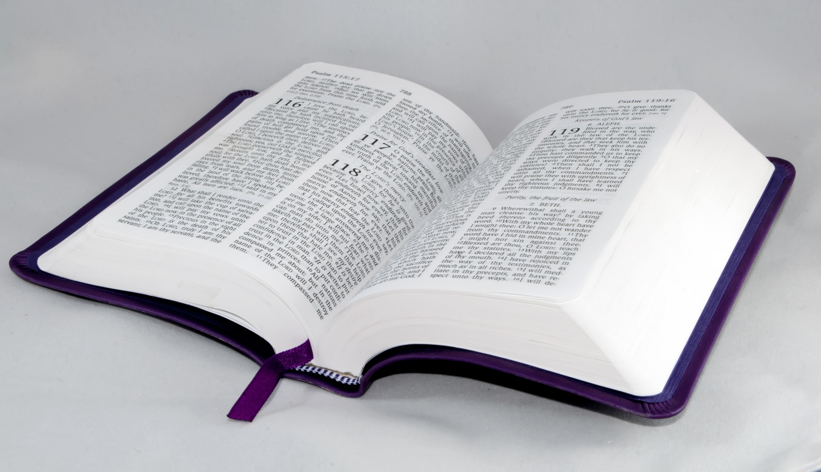
Scripture: Luke 1:26-38
Read by Bruce Larson

Slide 14
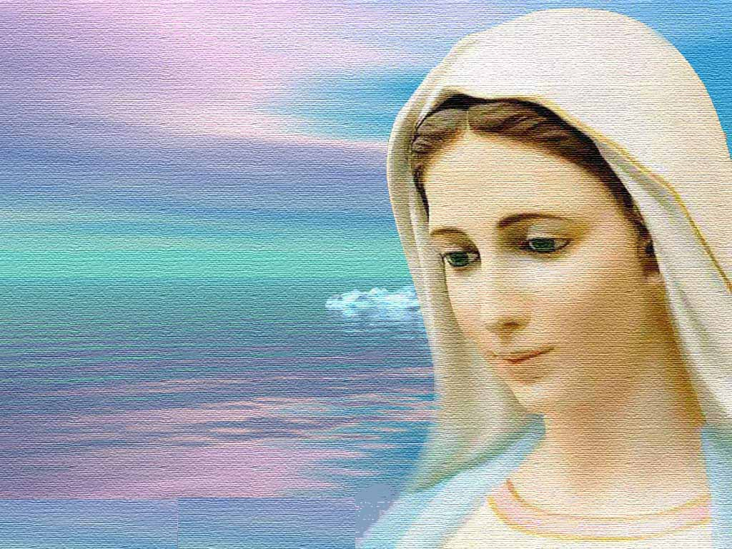
Mary’s Monologue

Slide 15
Opening Hymn
Voices United #74:
“What Child Is This?”
Words: William Chatterton Dix
Music: English Melody, attrib. John Stainer

Slide 16
1. What child is this, who laid to rest,
on Mary's lap is sleeping?
Whom angels greet with anthems sweet
while shepherds watch are keeping?
This, this is Christ the King,
whom shepherds guard and angels sing;
haste, haste to bring him laud,
the babe, the Son of Mary!

Slide 17
2. Why lies he in such mean estate
where ox and ass are feeding?
Good Christian, fear; for sinners here
the silent Word is pleading.
This, this is Christ the King,
whom shepherds guard and angels sing;
haste, haste to bring him laud,
the Babe, the Son of Mary!

Slide 18
3. So bring him incense, gold, and myrrh,
come, one and all, to own him.
The King of Kings salvation brings;
let loving hearts enthrone him.
This, this is Christ the King,
whom shepherds guard and angels sing;
haste, haste to bring him laud,
the babe, the son of Mary!

Slide 19
Scripture: Matthew 1:18-25
Read by Bruce Larson

Slide 20
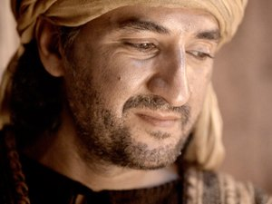
Joseph’s Monologue

Slide 21
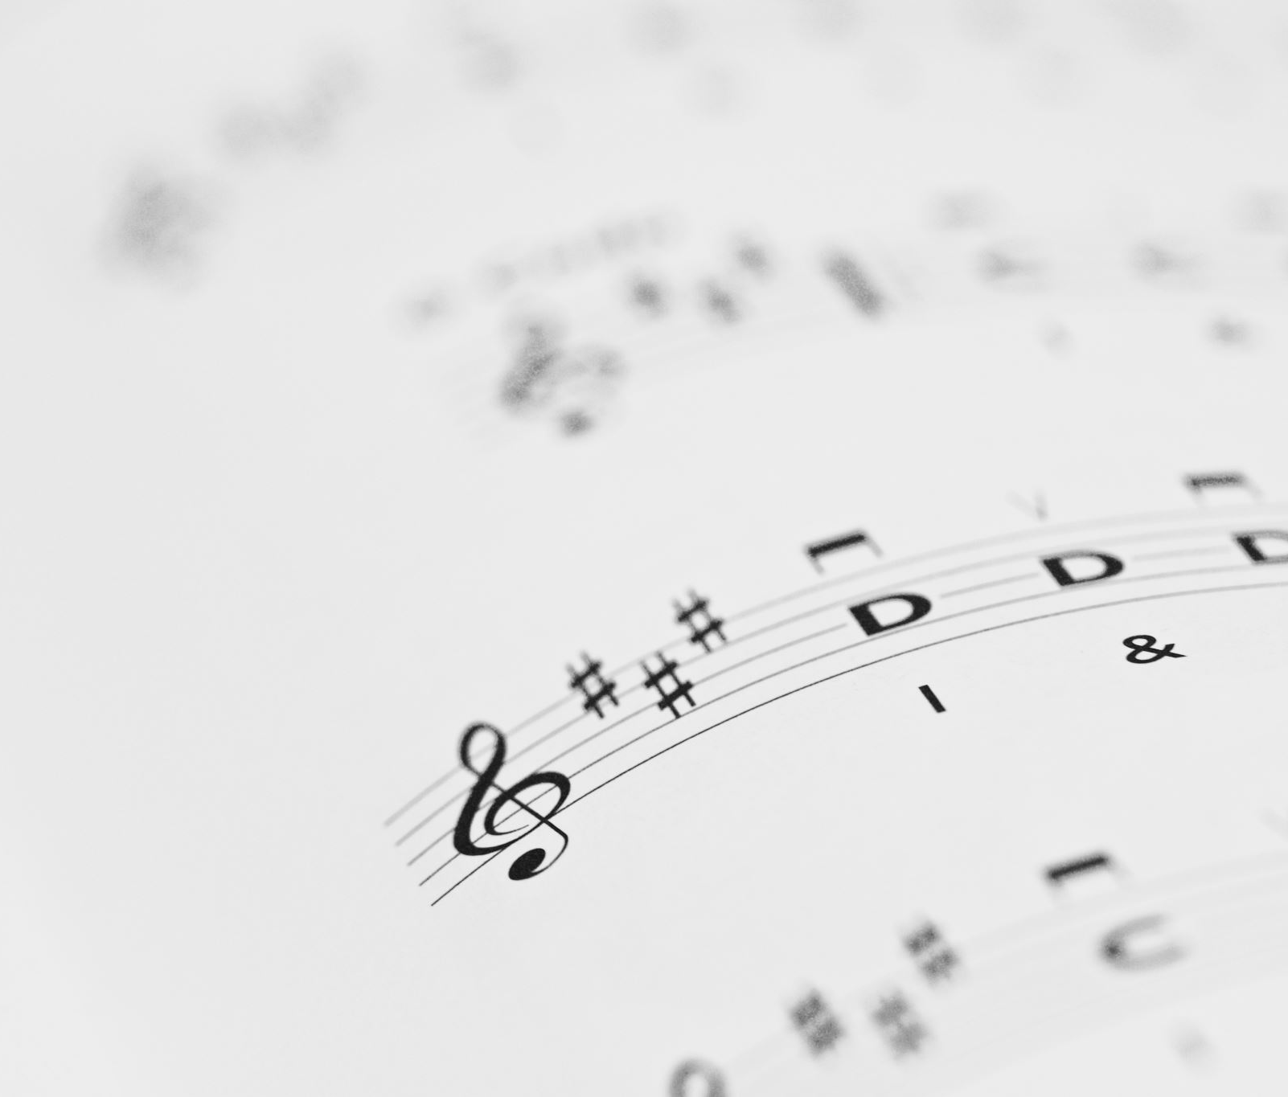
SUNG RESPONSE :
Don’t Be Afraid
MV #90
Words: John L. Bell and Graham Maule.
Music: John L. Bell, 1995
Words & Music copyright Iona Community, Scotland

Slide 22
Don’t be afraid.
My love is stronger,
my love is stronger than your fear.
Don’t be afraid. My love is stronger
and I have promised, promised to be always near.
Don’t be afraid.
My love is stronger,
my love is stronger than your fear.
Don’t be afraid. My love is stronger
and I have promised, promised to be always near.

Slide 23
Scripture: Luke 2:8-16
Read by Bruce Larson

Slide 24
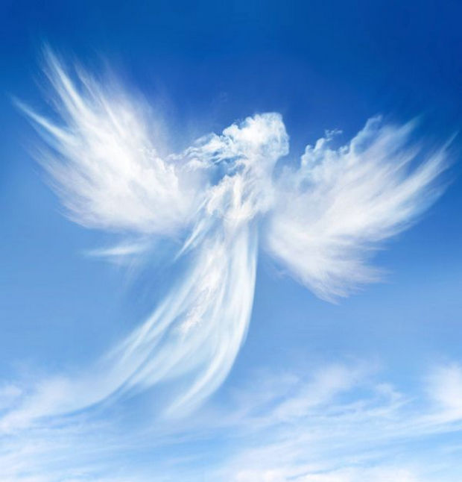
Choir
VU #38:
“Angels We Have Heard on High”
This Photo by Unknown Author is licensed under CC BY-NC-ND

Slide 25
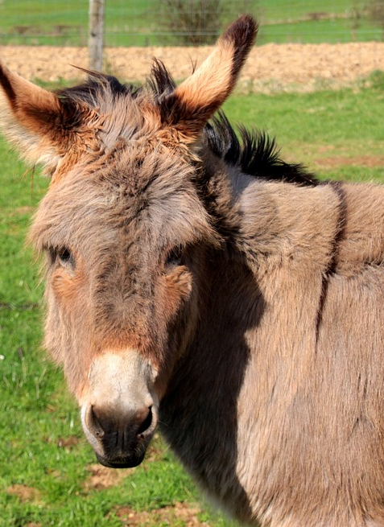
Donkey’s Monologue

Slide 26

Christmas Carol:
“Do We Really Believe?”
Composed and sung
by
Carol Grolman.

Slide 27
Chorus:
Do we really believe shepherds
sat on a hill.
The stars were so bright,
the whole world was still.
And then they suddenly heard an
angel song of great joy.
At the birth of a baby boy.
At the birth of a baby boy.

Slide 28

Scripture: Matthew 2:1-12
Read by Bruce Larson

Slide 29
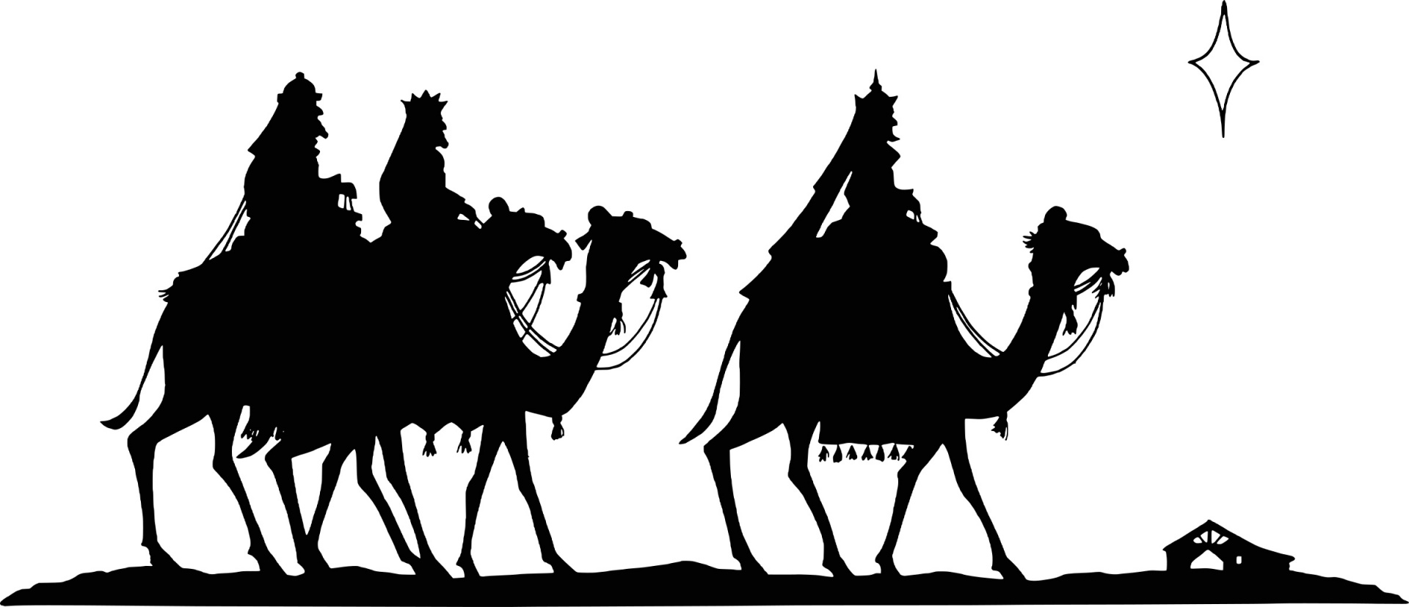
Wise One’s Monologue

Slide 30
Hymn:
“We Three Kings”
Words: John H. Hopkins, Jr.
Music: Kings of Orient, irregular meter: John H. Hopkins, Jr.

Slide 31
1. We three kings of Orient are;
bearing gifts we traverse afar,
field and fountain, moor and mountain,
following yonder star.
Oh, O star of wonder, star of light,
star with royal beauty bright,
westward leading, still proceeding,
guide us to thy perfect light.

Slide 32
2. Born a King on Bethlehem's plain,
gold I bring to crown him again,
King forever, ceasing never,
over us all to reign.
Oh, O star of wonder, star of light,
star with royal beauty bright,
westward leading, still proceeding,
guide us to thy perfect light.

Slide 33
3. Frankincense to offer have I;
incense owns a Deity nigh;
prayer and praising, voices raising,
worshiping God on high.
Oh, O star of wonder, star of light,
star with royal beauty bright,
westward leading, still proceeding,
guide us to thy perfect light.

Slide 34
4. Myrrh is mine; its bitter perfume
breathes a life of gathering gloom;
sorrowing, sighing, bleeding, dying,
sealed in the stone-cold tomb.
Oh, O star of wonder, star of light,
star with royal beauty bright,
westward leading, still proceeding,
guide us to thy perfect light.

Slide 35
Scripture: Luke 2:1-7
Read by Bruce Larson

Slide 36
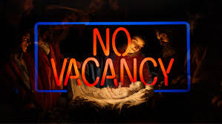
Innkeeper’s Wife
Monologue

Slide 37
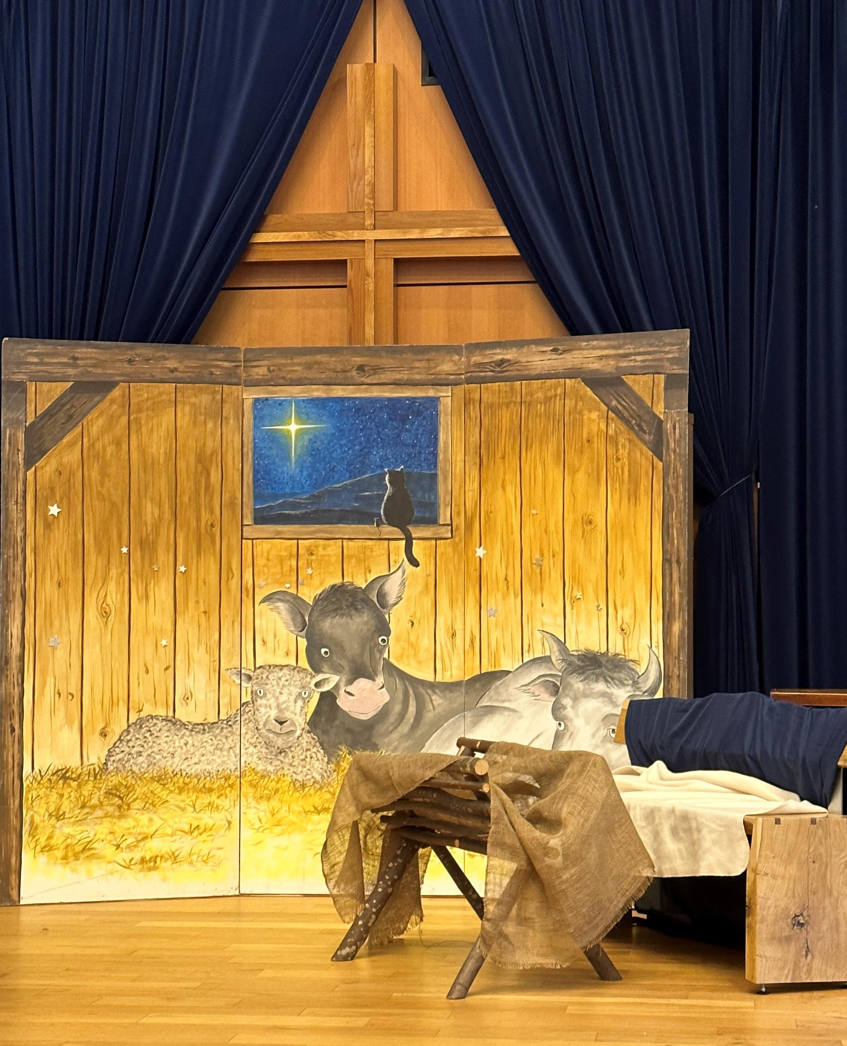
Invitation to Join the Nativity Scene

Slide 38
Opening Hymn
Hymn
Voices United #69: “Away in a Manger”
Words: Author unknown. Adapted by Louise Martin.
Music: William James Kirkpatrick ₁₈₉₅, arr. Desmond Hassell ₁₉₉₂.

Slide 39
1. Away in a manger, no crib for a bed
The little Lord Jesus lay down his sweet head.
The stars in the bright sky looked down where he lay;
The little Lord Jesus asleep on the hay.

Slide 40
Verse 2 Choir Only…Away in a manger…

Slide 41
Verse 3 Choir Only…the cattle are lowing…

Slide 42
4. Away in a manger no crib for a bed
The little Lord Jesus lay down his sweet head
The stars in the bright sky looked down where He lay
The little Lord Jesus asleep on the hay
… the little Lord Jesus asleep on the hay.

Slide 43
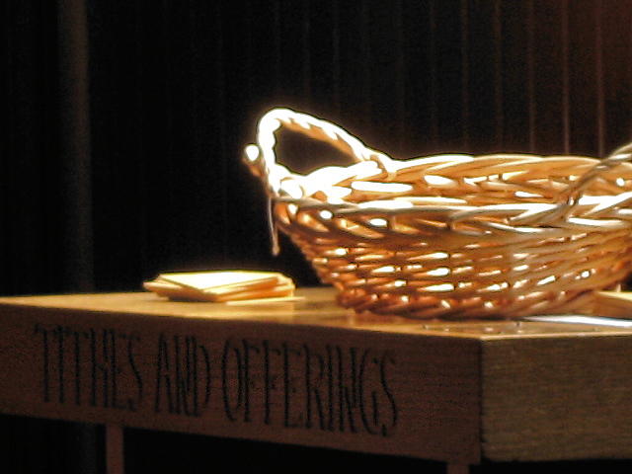
Offering

Slide 44
Doxology:
“In the Bleak Midwinter”
VU # 55
What can I give him, poor as I am?
If I were a shepherd, I would bring a lamb;
if I were a wise one, I would do my part;
yet what I can I give him -- give my heart.

Slide 45
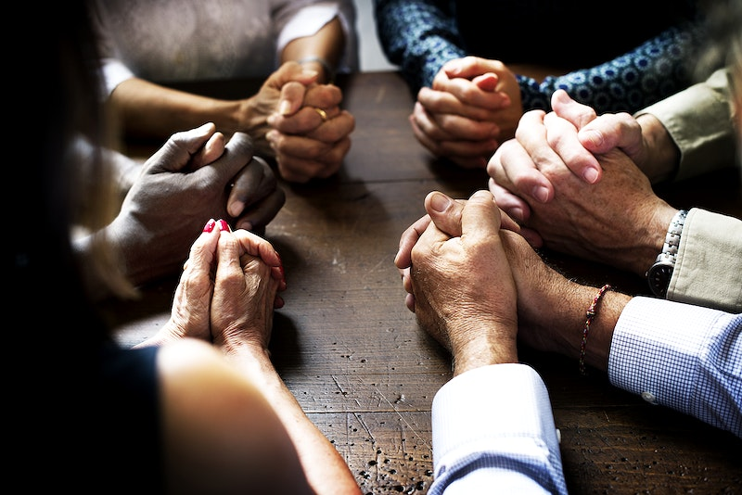
Prayers of the People

Slide 46
Prayers of the People
And so, we pray…
All: May all the world know your love and peace, O God.

Slide 47
The Lord’s Prayer
Our Father, who art in heaven, hallowed be thy Name.
Thy Kingdom come. Thy will be done on earth, as it is in heaven.
Give us this day our daily bread and forgive us our trespasses,
as we forgive those who trespass against us.
And lead us not into temptation, but deliver us from evil.
For thine is the kingdom, the power, and the glory.
For ever and ever. Amen.

Slide 48
Closing Hymn
Voices United #67:
“Silent Night, Holy Night”
Words: Joseph Mohr, English trans. John Freeman Young
Music: Franz Xavier Gruber

Slide 49
Silent night! Holy night!
All is calm, all is bright
round yon virgin mother and child.
Holy infant so tender and mild,
sleep in heavenly peace, sleep in heavenly peace.

Slide 50
2. Silent night! Holy night!
Shepherds quake at the sight:
glories stream from heaven afar,
heavenly hosts sing Hallelujah,
Christ the Saviour is born, Christ the Saviour is born.

Slide 51
3. Silent night! Holy night!
Son of God, love’s pure light
radiant beams from thy holy face,
with the dawn of redeeming grace,
Jesus, Lord, at thy birth, Jesus, Lord, at thy birth.

Slide 52
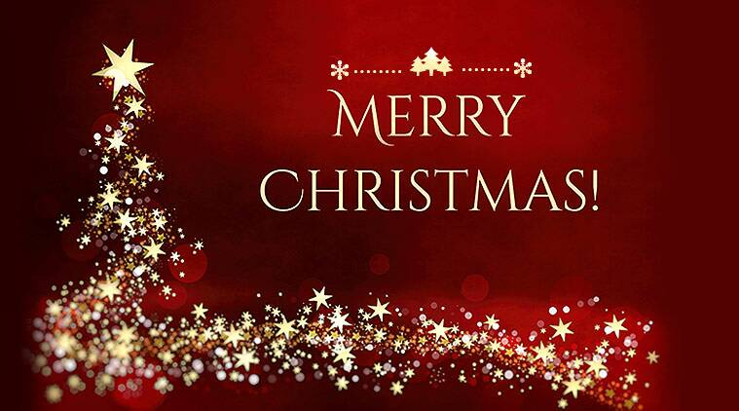
Commissioning and Benediction
Three-fold Amen

Slide 53

Thank you to all our readers
Scripture Reader: Bruce Larson
2 Sheep: Vicki and Kevin Haberl
Angel Gabriel: Arlene Robinson and our Angel Choir
Joseph: Glen Van Brummelen
Donkey: Pete Spiller
Wise One: Carlotta Liechti
Innkeeper’s Wife: Julie Larson
Liturgist & Mary: Reverend Anita Spiller

