Slide 1

ANNOUNCEMENTS
If you are new to our Church, please know, we are so blessed you are with us.

Slide 2
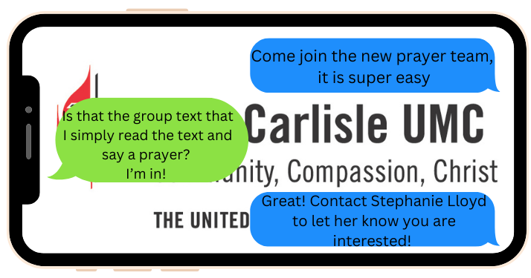
Prayer Team

Slide 3
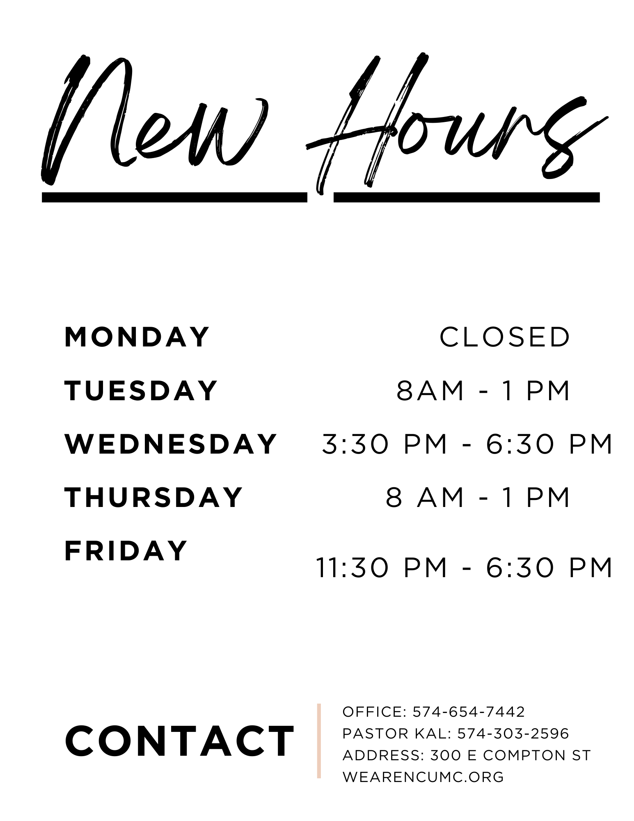
New hours begin August 25!

Slide 4


Slide 6


Slide 7


Slide 8
Broadway Christian Parish Update
June $79
July $ 25
August $ 25
YTD $470

Slide 9
Meetings
August 19 – Trustees @ 6:30
Missions meeting for August 19 is cancelled

Slide 10
COMMUNITY RESERVE NEEDS
Silverware
Kitchen Utensils
Pots and Pans
Small Appliances
Living Room Furniture
Bedroom Furniture
Dining Tables and Chairs

Slide 11
Cookie Bakers for Sunday Morning
We would appreciate more volunteers to provide Sunday morning cookies. Sign up sheet is in the Fellowship Hall.

Slide 12
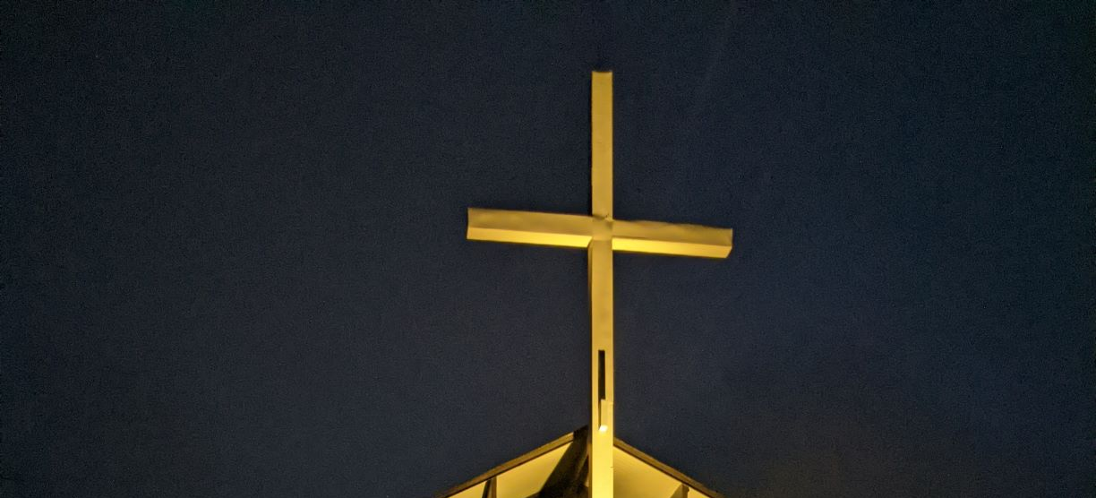
CROSS LIGHTING
The cross is being lit in honor of Jesus Christ, our Lord, who saved us from our sins.
Notes:
And

Slide 13
If you would like the cross lit in memory or in honor of someone, please let the office know. It is $10.00 a week.

Slide 14

LOOK AT NCUMC ON FACEBOOK
If you need help or would like to see something listed, please contact Ann Morrison

Slide 15
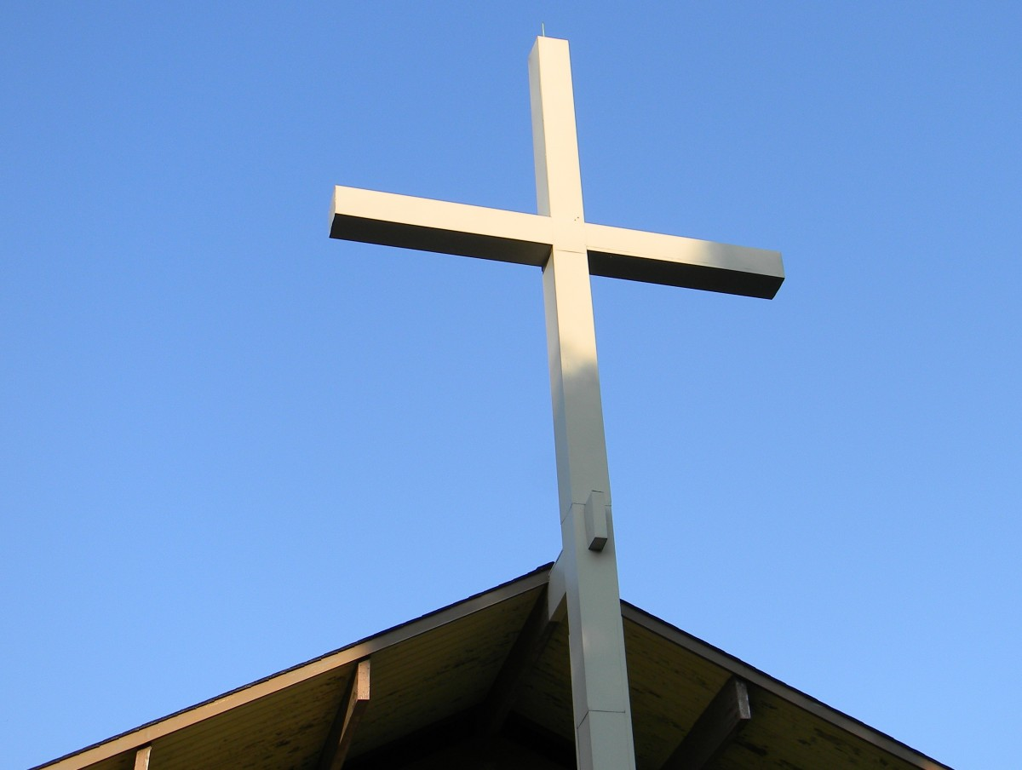
OUR WEBSITE www.wearencumc.org

Slide 16

It does not take long to ask GOD for help for someone you know or don’t know.
If you have a request, message us on Facebook, or you can text Pastor Kal or Stephanie Lloyd or call the church office and we will share it with our prayer chain.

