Slide 1

ANNOUNCEMENTS
If you are new to our Church, please know, we are so blessed you are with us.

Slide 2
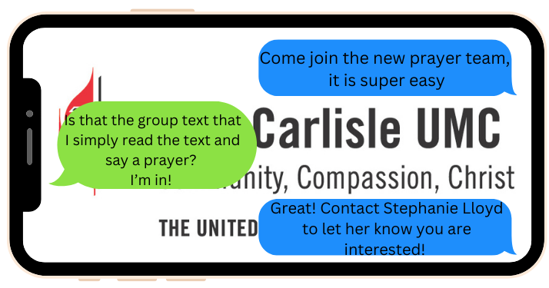
Prayer Team

Slide 3

Envelopes located near Offertory Plates

Slide 4


Slide 5
Popcorn in the Park
Wednesday August 13th helpers needed to handout the popcorn and water

Slide 6
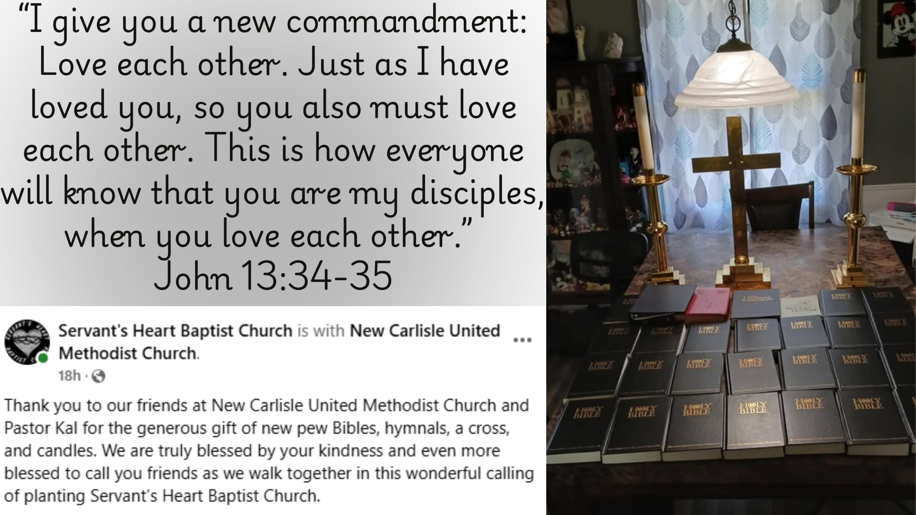

Slide 7
Tangled Threads June 2025 Donations
Threads of Hope
Plarn Sleeping Mats – 5
Plarn 4’X4’ mats (for a family shelter)
Plarn Walker pads – 6
Plarn Wheelchair pads – 6
Bibles – 7
VA Clinic
Cosmetic Bags – 3
Facial Tissue Holders – 21
Fleece Lap Robes – 2
Crocheted Lap Robes – 9
Pot Holders – 24
Soap Bags – 40
Walker Bags – 4
Wheelchair Bags – 6
Animal Shelter
Cat Toys – 7
Dog Toys – 31
Hamilton Grove
Fidget Blankets – 3
Female Dignity Bibs – 3
Male Dignity Bibs – 3
NC Library (for Children’s Area)
Fidget Blankets – 2
Quilts of Valor
Presentation Cases – 12
Ryan’s Cases for Smiles
(Children in Hospital)
Pillowcases – 66

Slide 8
Broadway Christian Parish Update
June $79
July $ 25
YTD $445

Slide 9
Meetings
August 12 – Ad Council @ 6:30
August 19 – Missions & Trustees @ 6:30

Slide 10
COMMUNITY RESERVE NEEDS
Silverware
Kitchen Utensils
Pots and Pans
Small Appliances
Living Room Furniture
Bedroom Furniture
Dining Tables and Chairs

Slide 11
Cookie Bakers for Sunday Morning
We would appreciate more volunteers to provide Sunday morning cookies. Sign up sheet is in the Fellowship Hall.

Slide 12
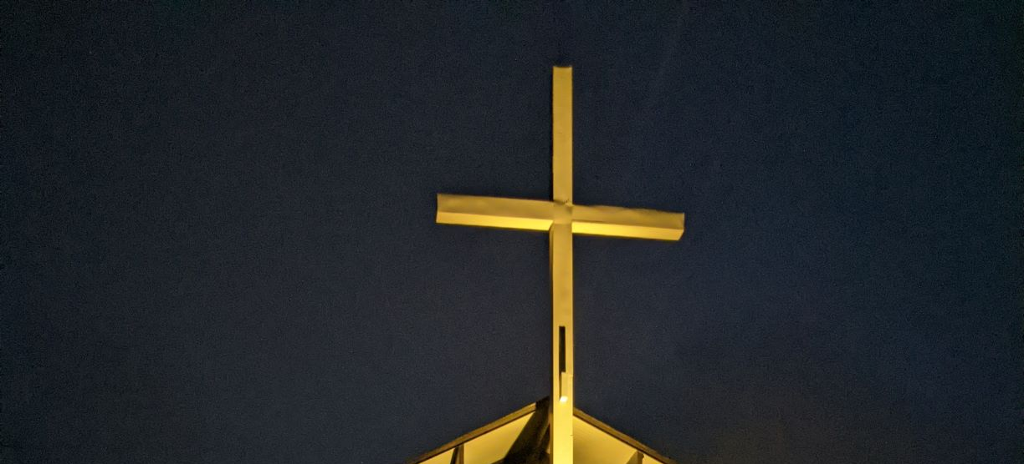
CROSS LIGHTING
The cross is being lit in honor of Jesus Christ, our Lord, who saved us from our sins.
Notes:
And

Slide 13
If you would like the cross lit in memory or in honor of someone, please let the office know. It is $10.00 a week.

Slide 14

LOOK AT NCUMC ON FACEBOOK
If you need help or would like to see something listed, please contact Ann Morrison

Slide 15

OUR WEBSITE www.wearencumc.org

Slide 16

It does not take long to ask GOD for help for someone you know or don’t know.
If you have a request, message us on Facebook, or you can text Pastor Kal or Stephanie Lloyd or call the church office and we will share it with our prayer chain.

