Slide 1

A2A is a relational movement of churches
united by a common call to multiply
disciples, leaders & churches
Notes:
Thank Caleb and Zoe
Introduce self and Sharon
3 Married children 3 Grandchildren
Planted church 31 years ago - suicides
handed over 1 year ago
Led A2A 10 years - so pleased that Discover Church is part of A2A
Also lead Exponential Australia
Mission
A2A is a relational movement of churches united by a common call to multiply disciples, leaders & churches
why is this important?
Because Australia needs more disciples, leaders and churches like this
I think we all dream of seeing the church being like we see in Acts 2:

Slide 2
So those who accepted his message were baptized, and that day about three thousand people were added.
Acts 2:41
…And the Lord added to their number daily
those who were being saved.
Acts 2:47
Notes:
In Acts we see explosive growth happening:
So those who accepted his message were baptized, and that day about three thousand people were added. Acts 2:41
…And the Lord added to their number daily those who were being saved.
Acts 2:47
Ralph Moore reading Acts
Share some good news before I share some news that may shock you

Slide 3
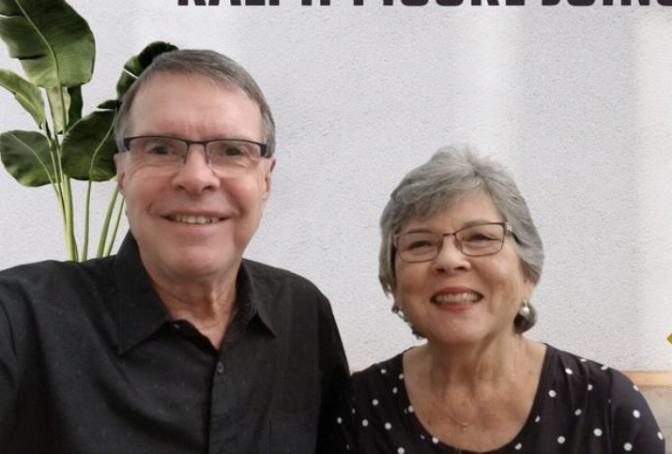
Ralph & Ruby Moore
Notes:
Ralph and Ruby
Share some good news before I share some news that may shock you

Slide 4
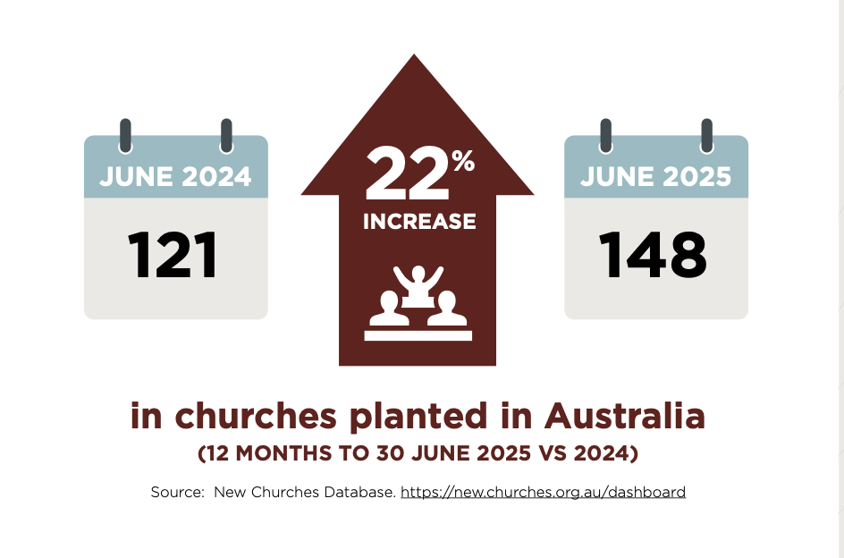
Notes:
To start with, I want to share some good news
The number of churches planted in Australia has increased 22% over the last year.
why is this good news?
Because the church in Australia has been struggling

Slide 5

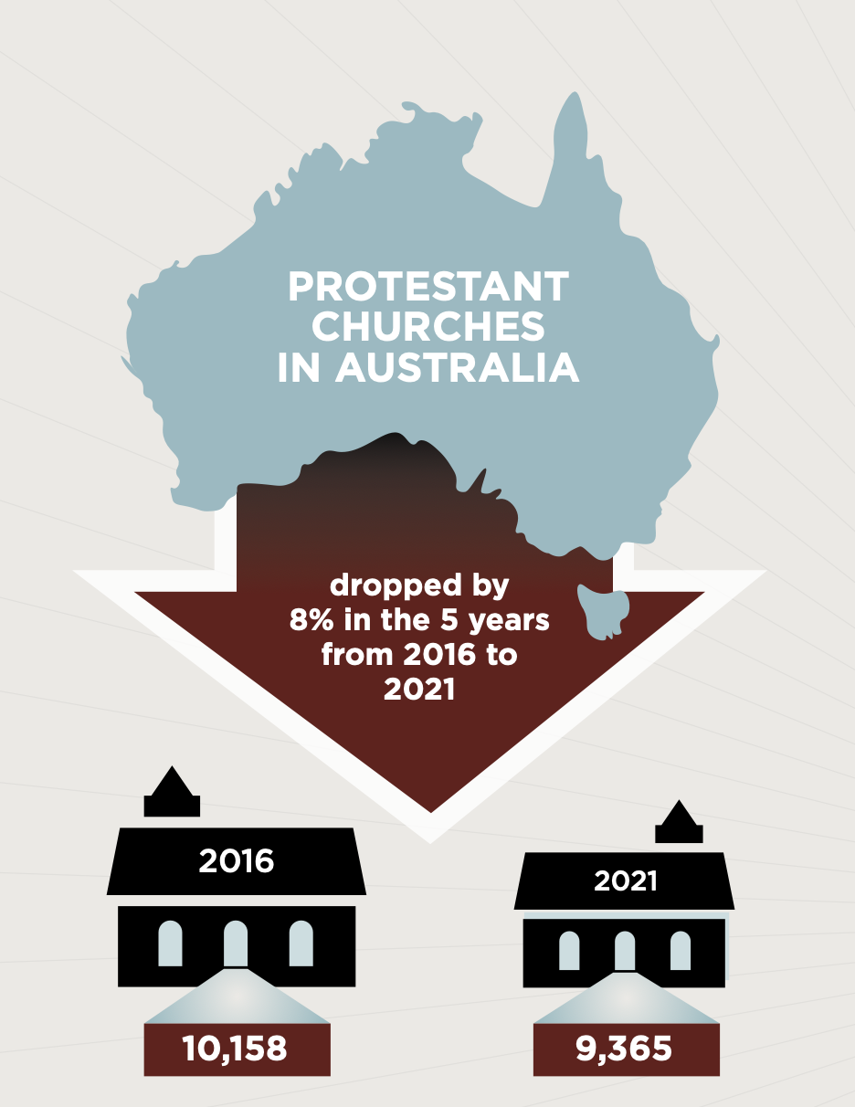
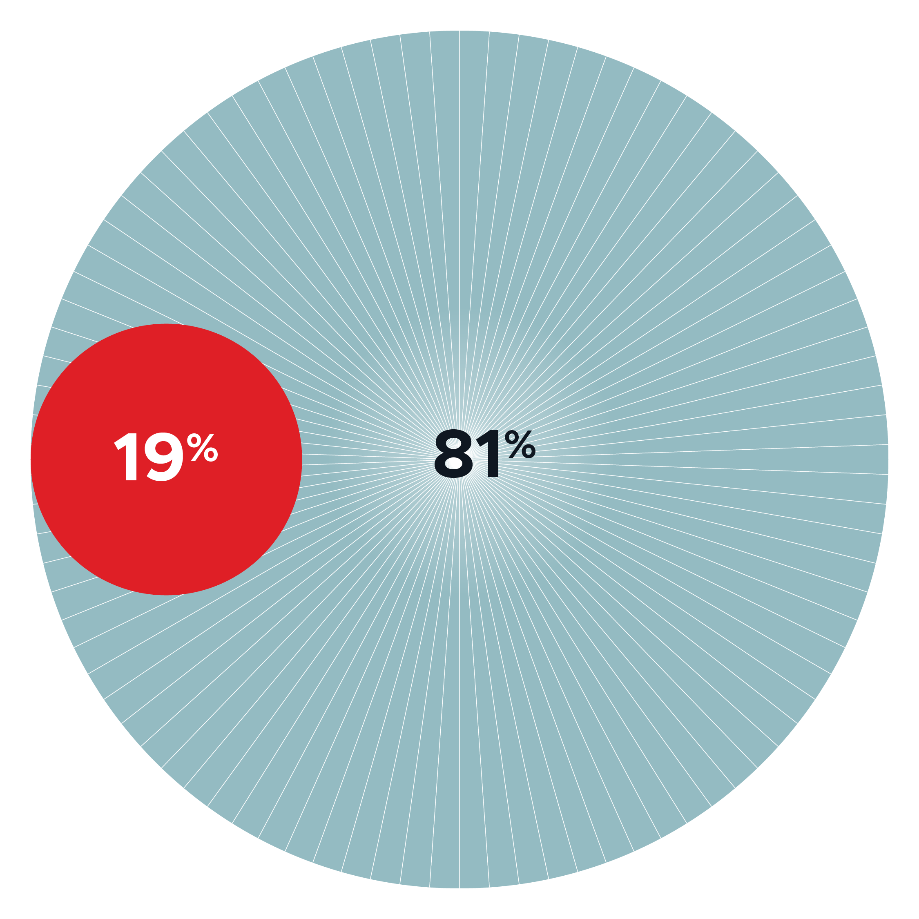
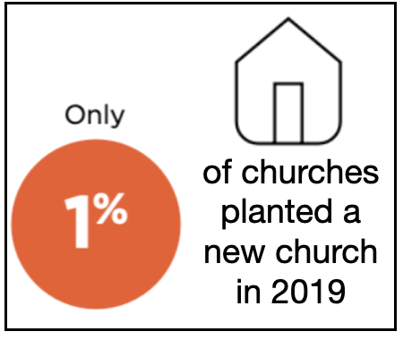
By 2021, 7 out of 10
Australian churches were in decline
Notes:
1% 2019
7 out of 10 in 2021
between 2016 and 2021 - fallen by 793 churches =>8%
19% - 81% - this is a problem!
How did we end up in this place?
80% of churches in the west have an operating system that came from 3 US churches.
They employed Executive Pastors who asked 3 key questions

Slide 6
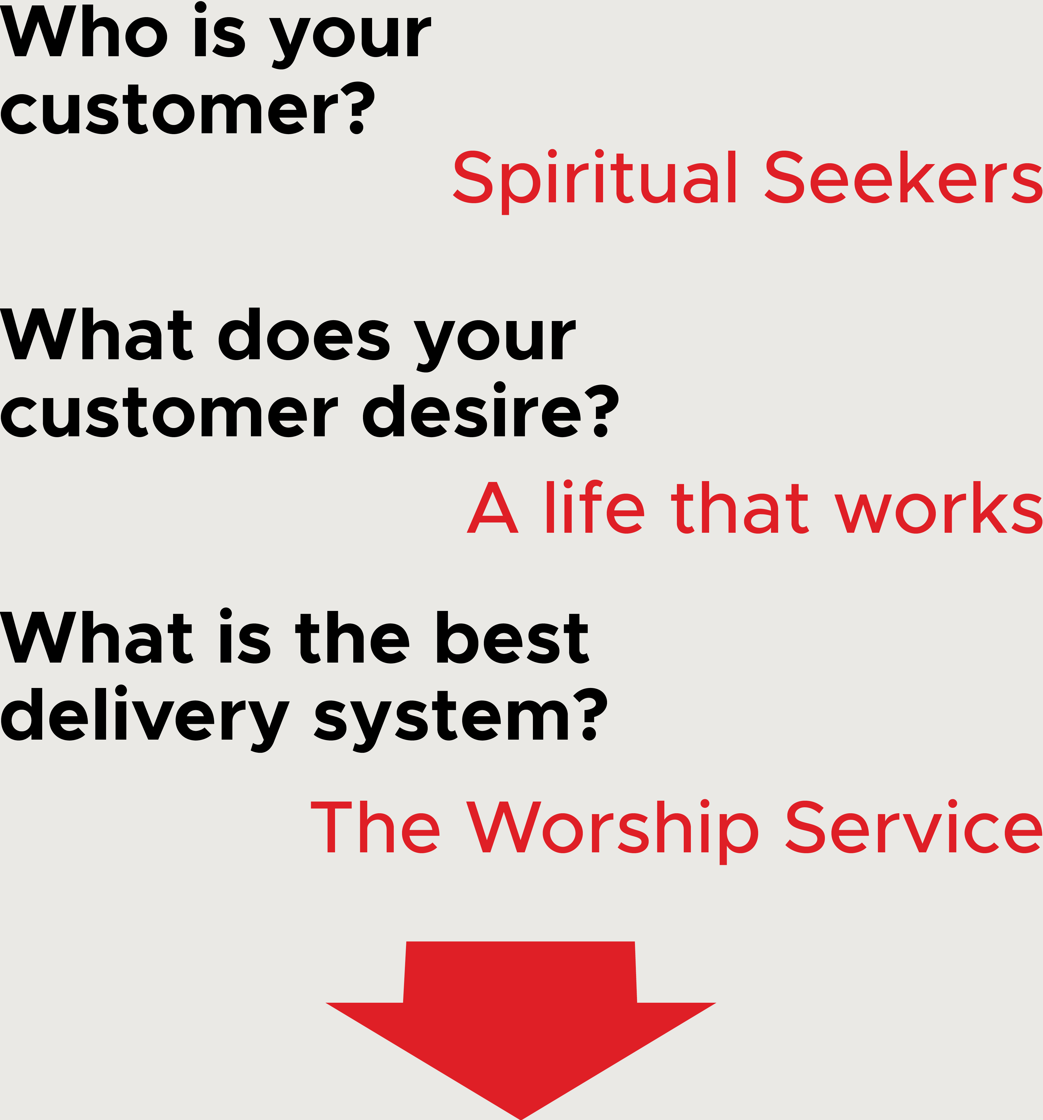
Notes:
Who is your customer?
what does your customer desire?
What is the best delivery system?

Slide 7
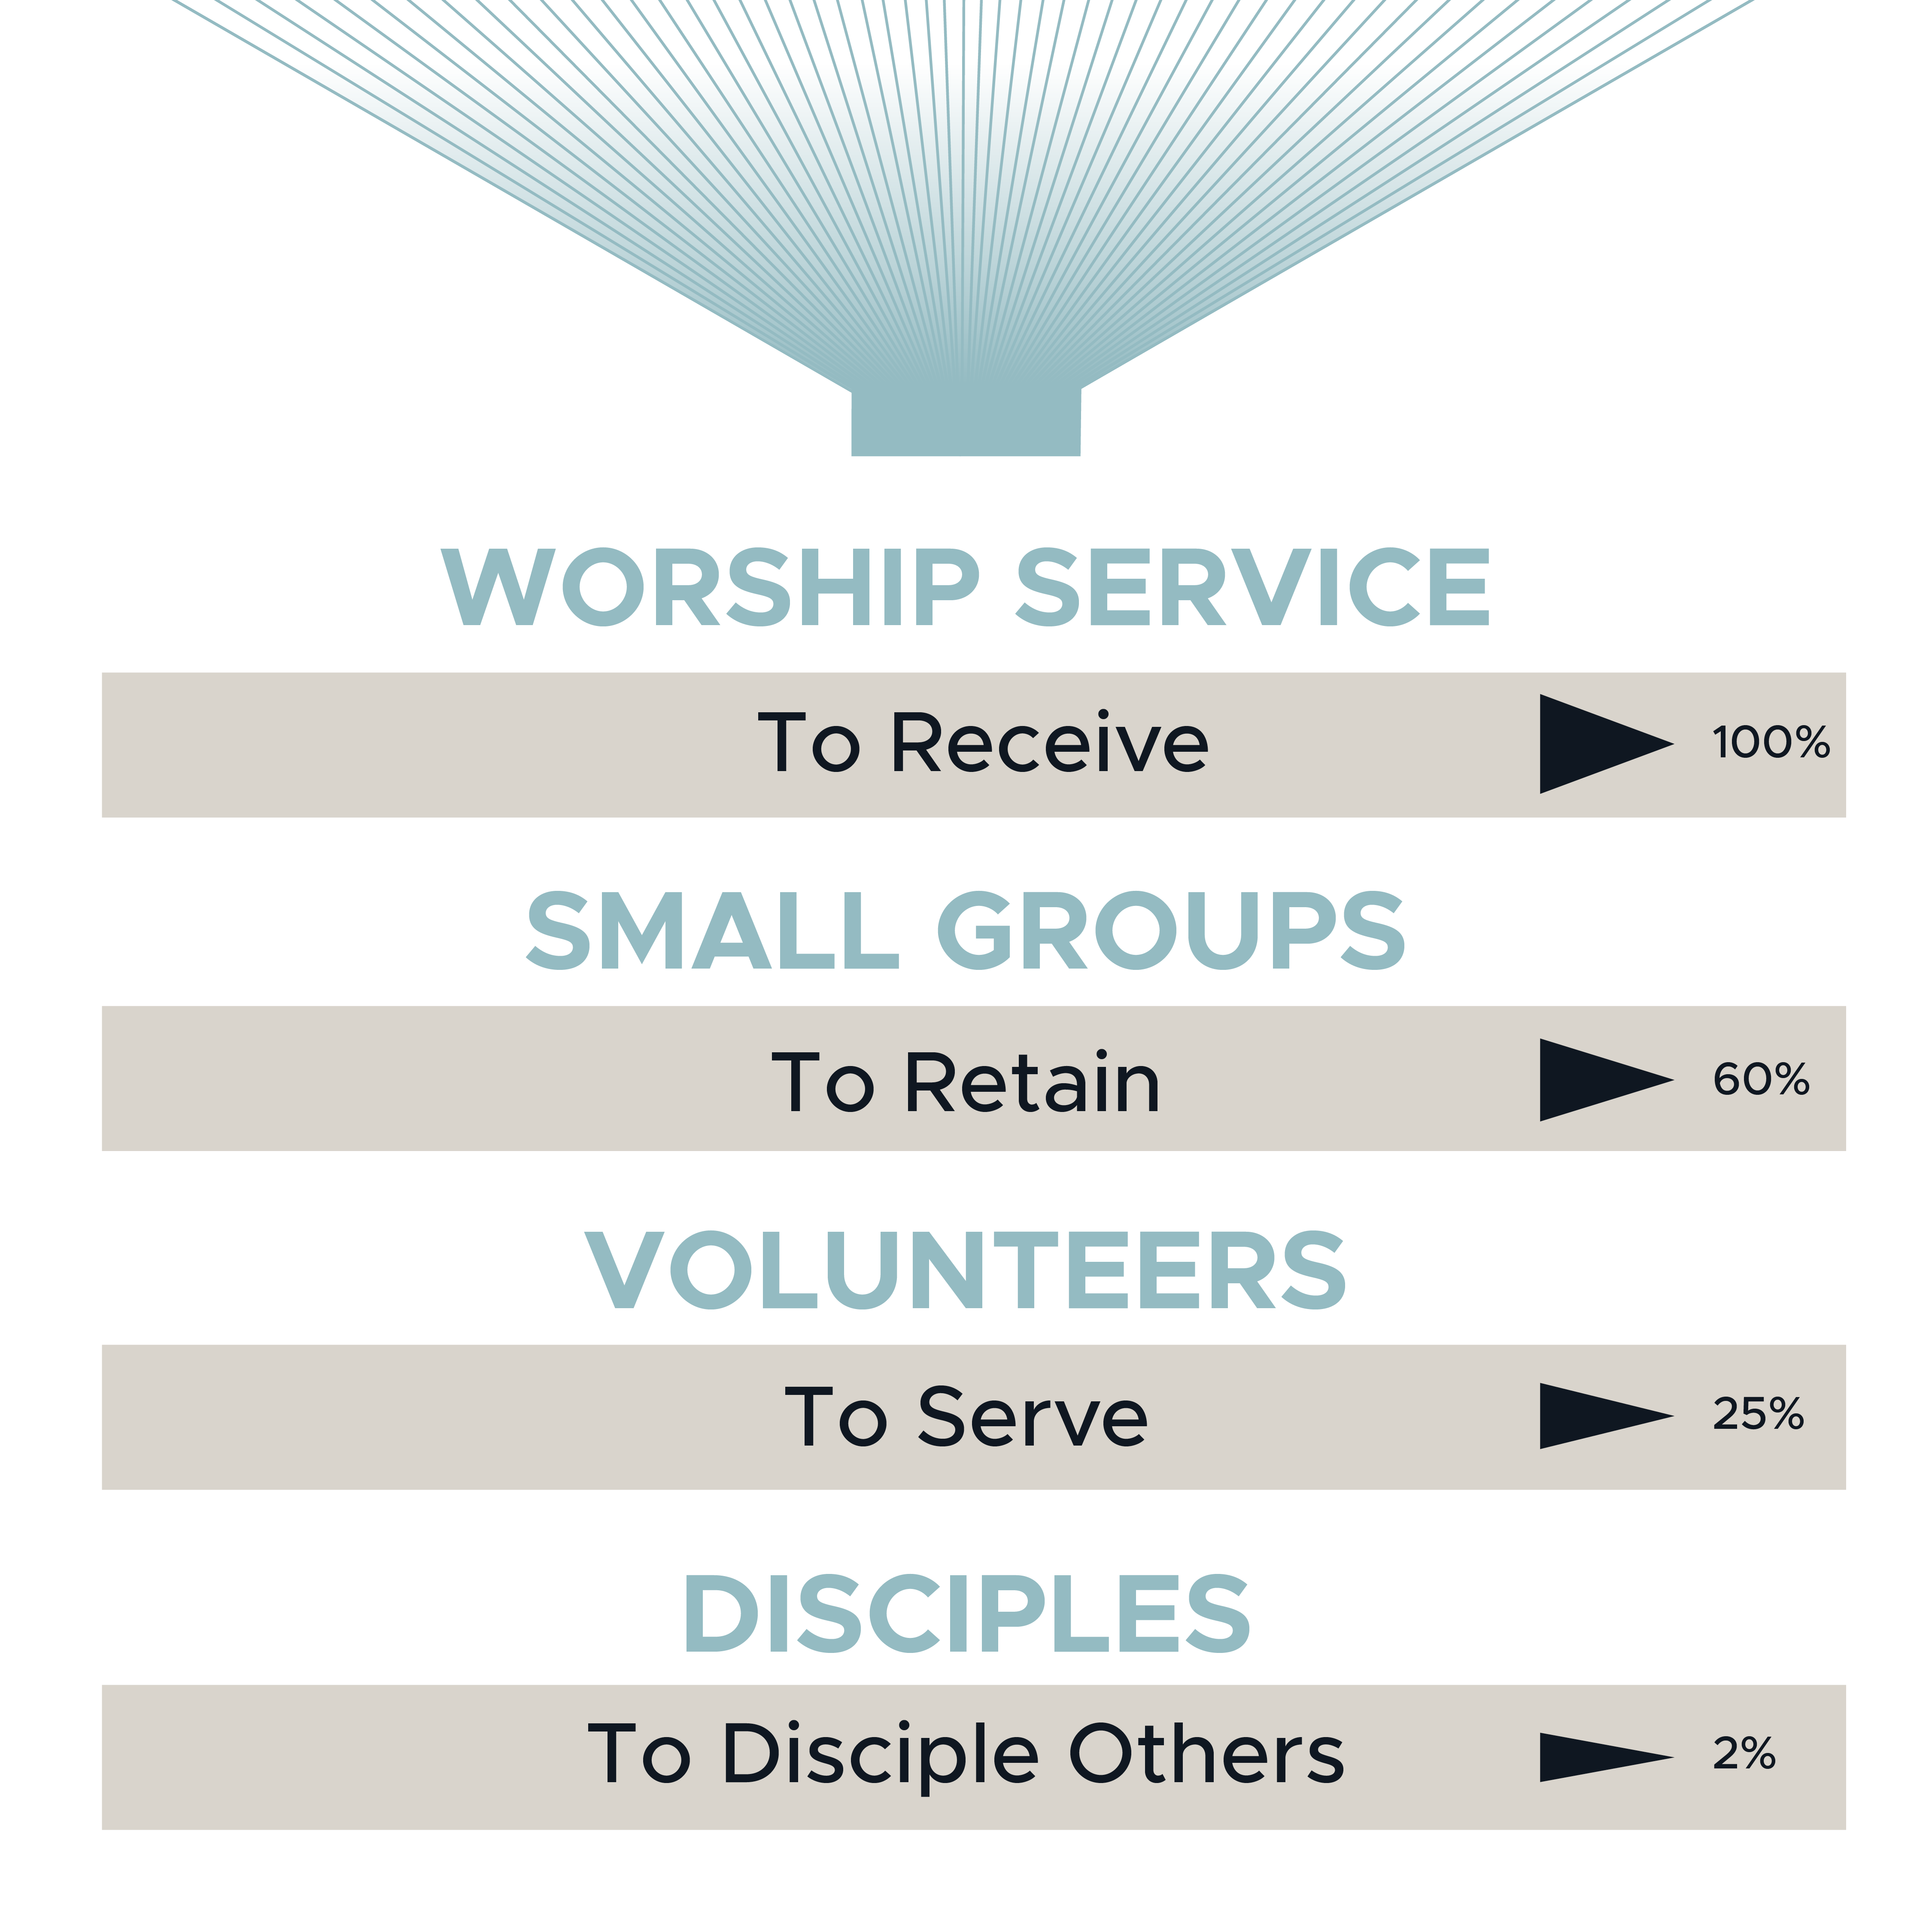
Notes:
It was worked out that for every 100 people attending a worship service,
60 people needed to be in small groups, and
25 volunteers were needed for the worship team, kids and youth ministry, to greet people etc.
This operating system helped the church to grow, but it didn’t do a good job in making disciples.

Slide 8
Notes:
In fact its been found that on average only 2 of the 100 people attending the worship service could be described as disciples. (Barna)
This is an absolute tragedy.
In many cases the western church has had the goal of seeing people won for Jesus without going to the next step of seeing them becoming disciples of Jesus.
What this operating system did was to tell people that their responsibility was to come, to belong, to serve, to give and to invite.
It re-enforced that the pastoral staff were the experts who would be the ones to bring to faith and teach anyone you brought to a service.
And the pastoral staff then had to ensure that the service was so good that you wanted to come back again next week, and the week after.
Is this operating system really working in Australia?
It may be working for 19% of the population but it’s clearly not working for the 81% of the population not connected with a church.
———————
What can we do? It comes back to reviewing the operating system behind so many churches and the practices that flow out of this.
This common operating system of the church in Western countries is so different to the operating system that we will find in church planting movements in developing countries.
They don’t rely on the same sales and marketing funnel.
Let’s go back to those 3 questions, but this time answer them differently.
If we answer the questions differently, it has the potential to change the operating system of our churches.
————
Note - George Barna
Dr. George Barna shares the state of Christian discipleship in America today. In short, only 2-3% of adult Americans hold to the standard of being true disciples of Jesus. Among the criteria for this distinction are the belief that the Bible is the true and reliable word of God, daily pursuit of Godly activities, and making a priority of a life lived in obedience to God.
https://www.youtube.com/watch?v=Lqqwvgimm_I

Slide 9
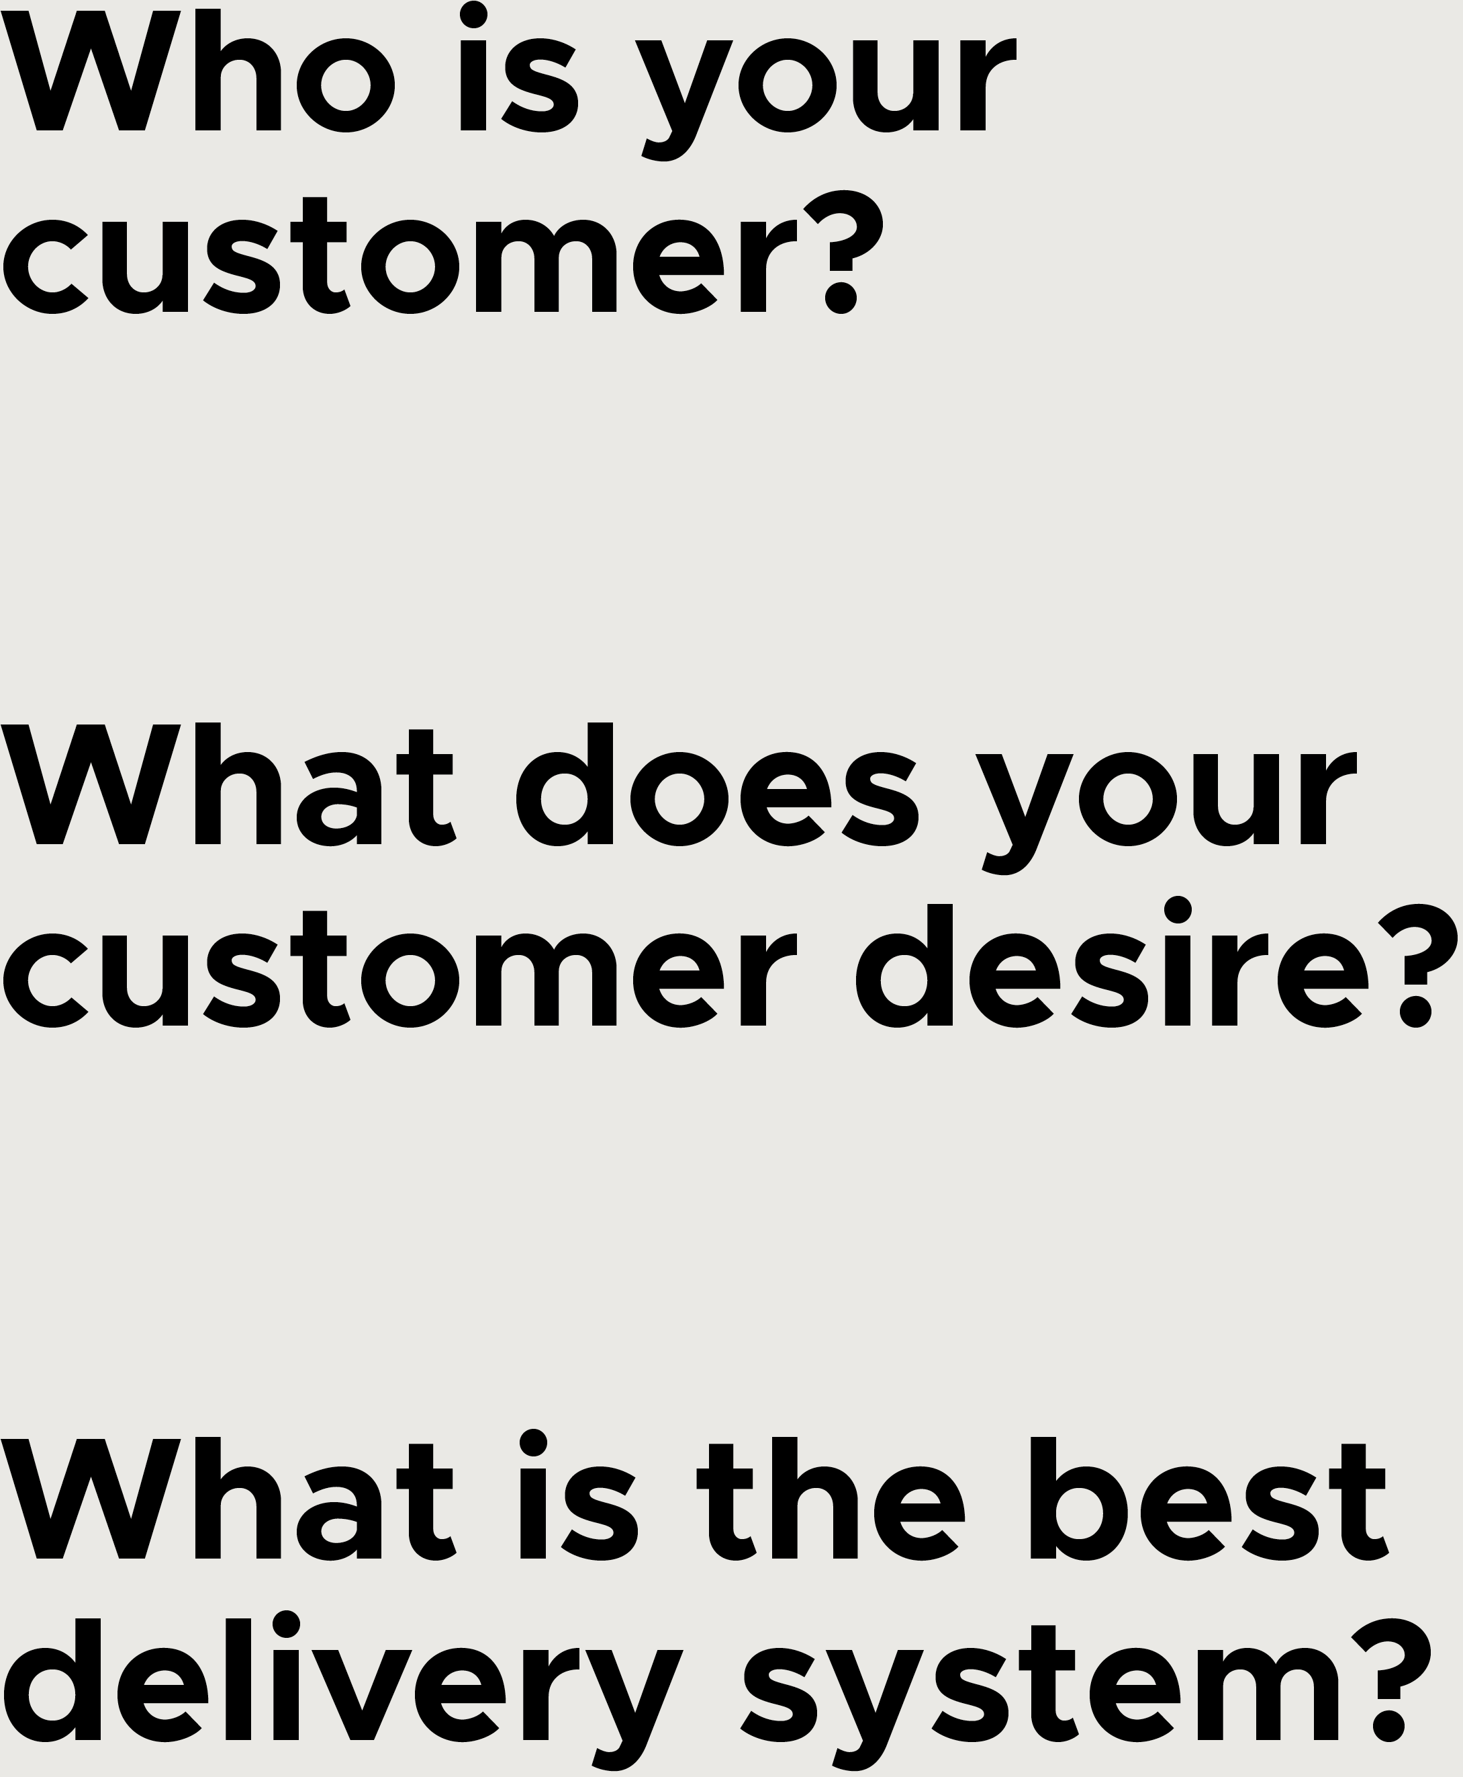
Ask the questions again:
Notes:
Review The Operating System
What if for the first question about who is your customer, or to put it another way; who do you want to please or serve, we answered that God was our customer. It was He whom we wanted to please.
What does our customer want? For us to make disciples of Jesus.
What is the best delivery system to give our customer what they want? Perhaps we might answer by saying “other disciples of Jesus who will go and make disciples.”
I think you can imagine how different the church would be if the operating system would be different.
This would then position us to Pursue Multiplication As Well As Addition
We have to get to the point of multiplication if we are to be like the church in Acts.
Saul / Paul became the main agent of multiplication in Acts
And Saul agreed completely with killing him [Stephen]. Acts 8:1

Slide 10
Preaching Adds
But
Disciple Making Multiplies
But the word of God kept on increasing and multiplying.
Acts 12:24
Notes:
Preaching Adds But Disciple Making Multiplies
But the word of God kept on increasing and multiplying. Acts 12:24
This is the natural consequence of making disciples who make disciples!
but what is a disciple? - 5 features

Slide 11
What is a disciple?
A disciple of Jesus:
1. follows His teaching
But Peter and the apostles replied, “We must obey God rather than people.
Acts 5:29
Therefore go and make disciples … teaching them to obey everything I have commanded you.
Matthew 28:19
Notes:
A disciple of Jesus follows His teaching - How we live and what we do
But Peter and the apostles replied, “We must obey God rather than people. Acts 5:29
Therefore go and make disciples … teaching them to obey everything I have commanded you. Matthew 28:19
But how do you put aside your Own desires to do what Jesus wants us to do?

Slide 12
What is a disciple?
A disciple of Jesus:
2. loves like Him
“A new command I give you: Love one another.
As I have loved you, so you must love one another.
By this everyone will know that you are my disciples, if you love one another.”
John 13:34-35
Notes:
A disciple of Jesus loves like Him
“A new command I give you: Love one another.
As I have loved you, so you must love one another.
By this everyone will know that you are my disciples, if you love one another.”
John 13:34-35
But how do you put aside your Own selfishness because love always come at a price

Slide 13
What is a disciple?
A disciple of Jesus:
3. tells people about Him and makes other disciples
But you will receive power when the Holy Spirit has come upon you, and you will be my witnesses in Jerusalem, and in all Judea and Samaria, and to the farthest parts of the earth.”
Acts 1:8
Notes:
A disciple of Jesus tells people about Him and makes other disciples
But you will receive power when the Holy Spirit has come upon you, and you will be my witnesses in Jerusalem, and in all Judea and Samaria, and to the farthest parts of the earth.” Acts 1:8
“Come, follow me,” Jesus said, “and I will send you out to fish for people.” Mark 1:17
But how do you put aside your Fears of rejection or getting it wrong - ridiculed, being made to feel a fool.
As we do these things we start becoming the person Jesus wants us to be and living the life he calls us to live - result we become transformed
But along the journey there is one more step and without taking this step our growth will come to a full stop

Slide 14
What is a disciple?
A disciple of Jesus:
4. is transformed by Him
When they saw the boldness of Peter and John, and discovered that they were uneducated and ordinary men, they were amazed and recognized these men had been with Jesus.
Acts 4:13
Notes:
A disciple of Jesus is transformed by Him
When they saw the boldness of Peter and John, and discovered that they were uneducated and ordinary men, they were amazed and recognized these men had been with Jesus. Acts 4:13
If we want to be transformed by Jesus, the old self must die and a new creation take its place.

Slide 15
What is a disciple?
A disciple of Jesus:
5. dies with Him
I have been crucified with Christ, and it is no longer I who live, but Christ lives in me…
Galatians 2:20
Notes:
A disciple of Jesus dies with Him
I have been crucified with Christ, and it is no longer I who live, but Christ lives in me… Galatians 2:20
“Whoever wants to be my disciple must deny themselves and take up their cross and follow me.
For whoever wants to save their life will lose it, but whoever loses their life for me will find it.
Matthew 16:24-25
This is the big issue - all too often we want the new life Jesus offers but dont want to let go of the old.
Now when they heard this, they were acutely distressed and said to Peter and the rest of the apostles, “What should we do, brothers?”
Peter said to them, “Repent, and each one of you be baptized in the name of Jesus Christ for the forgiveness of your sins, and you will receive the gift of the Holy Spirit.
Acts 2:37-38
To repent is to allow God’s thinking to replace your thinking.

