Slide 1

MONEY MATTERS IN MARRIAGE
Principles of Stewardship - Matthew 25:14-30

Slide 2
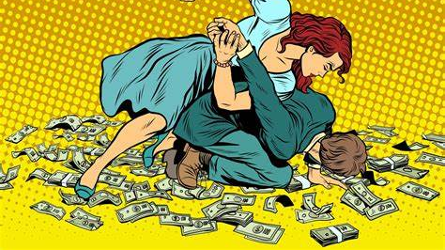
How well do you communicate about money?

Slide 3
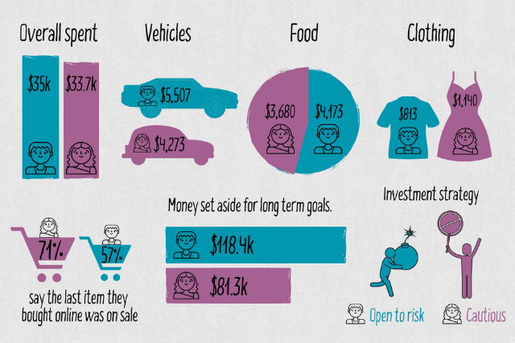
Where do men & women like to spend the most?

Slide 4

Money issues that can damage a marriage:
1. start marriage with debt
2. big spender vs big saver
3. hiding expenses
4. making financial decisions on our own
5. having different expectations
6. double standards
7. danger: lack of trust in each other
8. danger: not having access to funds
9. danger: intense monitoring

Slide 5

“In the last days there will be very difficult times, for people will love only themselves and their money…”
2 Tim 3:2

Slide 6
Principle #1-
GOD OWNS IT ALL!
GOD OWNS IT ALL!
“Master (Kyrios), YOU gave me five bags of silver to invest. And I have earned five more.” vs 20

Slide 7


Slide 8
Are we on the same spiritual page?
The LORD has complete ownership & has all the ‘rights’ - We have the ‘responsibility’ to steward what He has given us
Stewardship: the use of God given-resources for the accomplishment of God given goals
Every spending decision is a spiritual one- it indicates where our heart really is

Slide 9
Martin Luther once said:
“There are 3 conversions necessary: the conversion of the heart, the one of the mind and the one of the purse.”

Slide 10
Principle #2-
BE AWARE OF THE THREE T’S
“After a long time, their Master returned and called them to give an account of how they used HIS money.” vs19

Slide 11

Remember the important 3 T’s of life
TRAINING
He gave to each one according to his own ability…” v. 15
TESTING
“Though your riches increase do not set your heart on them…” Ps 62:10
TESTIMONY
“My God will meet all your needs according to the riches of His glory in Christ Jesus” Phil 4:19

Slide 12
Principle #3-
POOR MANAGEMENT
DISPLEASES THE LORD
“Why didn’t you deposit MY money in the bank? At least I could have gotten some interest on it.”

Slide 13
Examples of poor management:
LAZINESS
“Even while we were with you, we gave you this command: Those unwilling to work will not get to eat.” 2 Thess 3:10
BORROWING WITHOUT REPAYING
“The wicked borrows but does not pay back, but the righteous is generous and gives.” Ps 37:21
OVERSPENDING
“The wise have wealth and luxury, but fools spend whatever they get.” Prov 21:20

Slide 14

Where do we overspend?
Emotional impulse spending
Monthly subscriptions
Addictions
Get rich quick gimmicks
Paying high late credit card interest
Going overboard with gifts
Over-spending to impress others

Slide 15

Let us test ourselves:
1. Do I worry about money to the point of anxiety?
2. Do I covet what others have?
3. Have I lost appreciation for what I already have & focus on what I don’t have?
4. Have I lost the joy of giving?
5. Do I spend more time thinking about money than relationships?
6. Are most of our arguments about finances?

Slide 16
Principle #4-
WISE MANAGEMENT
IS REWARDED
“Well done, my good and faithful servant.” vs 21

Slide 17

Wise investments with eternal benefits
Tithing
“Bring all your tithes into the storehouse so there will be enough food in my Temple. If you do, I will open the windows of heaven for you!..” Malachi 3:10
Being generous
“Good will come to those who are generous & lend freely, who conduct their affairs with justice.” Ps 112:5
Joseph model
“Collect one fifth …store it away, guard it so there will be enough for the years of famine…” Gen 41: 34-36
Leave an inheritance
“A good man leaves an inheritance for his children’s children…” Prov 13:2

Slide 18

“Store your treasures in heaven, where moths & rust cannot destroy, & thieves do not break in & steal. Wherever your treasure is, there the desires of your heart will also be.”
Mt 6:20.21

Slide 19

Where do you draw your line?
“People who long to be rich fall into temptation & are trapped by many foolish & harmful desires that plunge them into ruin & destruction.” 1 Tim 6:9
“For the love of money is the root of all kinds of evil. And some people, craving money, have wandered from the true faith & pierced themselves with many sorrows.” 1Tim 6:10
“And what do you benefit if you gain the whole world but lose your own soul? Is anything worth more than your soul?” Mk 8:36, 37
“You cannot serve both God and money.”
Mt 6:24

Slide 20
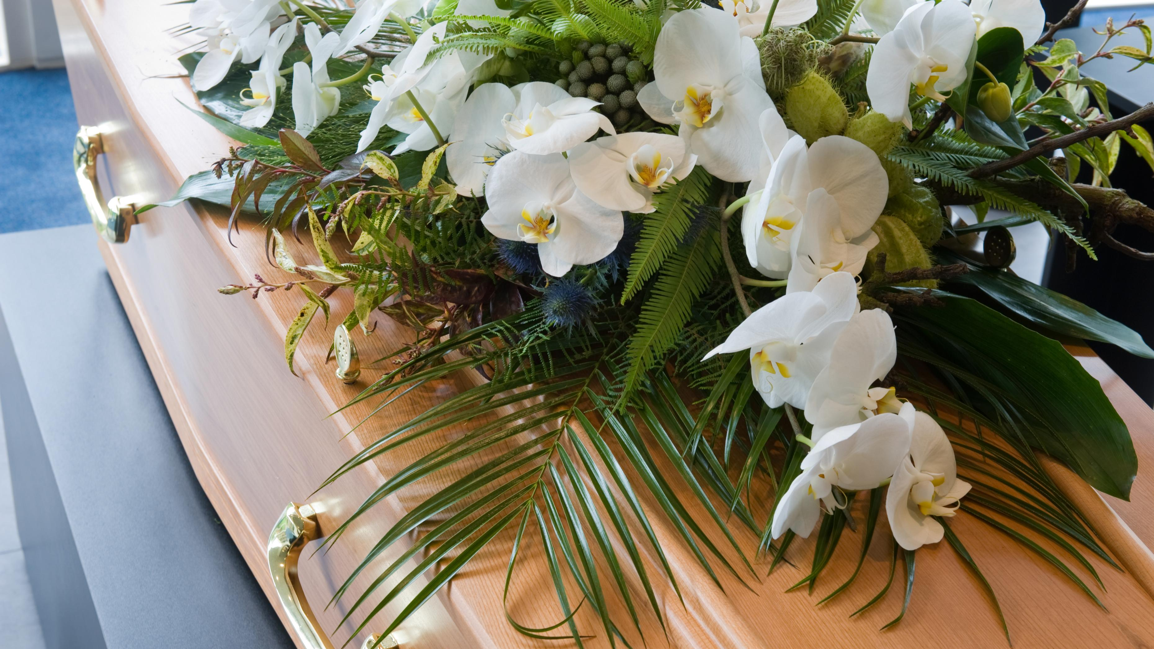
We all come to the end of our lives as naked, and empty handed as on the day we were born.
We can’t take our riches with us.
Ecclesiastes 5:15

Slide 21

In summary-
PLAN - together for a fulfilled life, not just the accumulation of things
DECIDE - together on a workable budget & stick to it
BE - transparent with each other, have frequent budget dates
AVOID – unnecessary credit debt
PRAY- for wisdom in handling the resources God has entrusted to you
AGREE to dedicate all your possessions to God first

Slide 22

The reward is out of this world!
“Well done, my good & faithful servant! You have been faithful in handling this small amount, so now I will give you many more responsibilities.
Come & share in your Master’s happiness!”

Slide 23

“I know how to live on almost nothing or with everything.
I have learned the secret of living in every situation, whether it is with a full stomach or empty, with plenty or little.
For I can do everything through Christ, who gives me strength.”
Philippians 4:12, 13

Slide 24

“It is a good thing to receive wealth from God & the good health to enjoy it.
To enjoy your work & accept your lot in life – this is indeed a gift from God!”
Ecclesiastes 5:19

