Slide 1

Spiritual Check Up
A Spiritual Exam

Slide 2
2 Corinthians 13:5 (ESV)
Examine yourselves, to see whether you are in the faith. Test yourselves. Or do you not realize this about yourselves, that Jesus Christ is in you?—unless indeed you fail to meet the test!

Slide 3
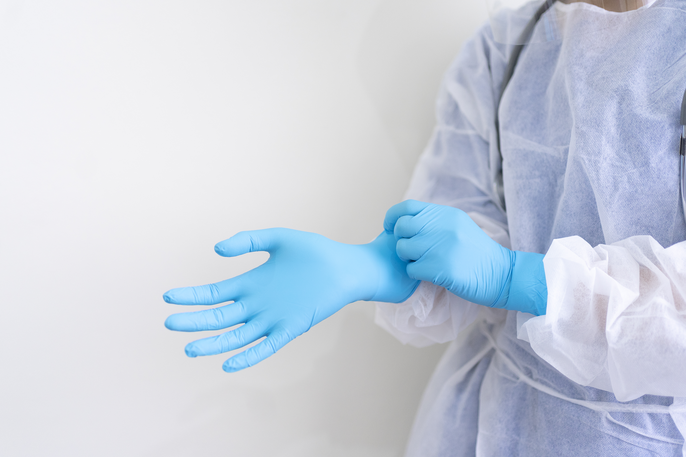
Spiritual Examination
Temperature
Blood Draw
Heart Check

Slide 4
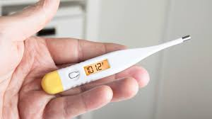
Temperature Check
Revelation 3: 15 – 16 ¹⁵ “‘I know your works: you are neither cold nor hot. Would that you were either cold or hot! ¹⁶ So, because you are lukewarm, and neither hot nor cold, I will spit you out of my mouth.
Luke 3:16 - John answered them all, saying, “I baptize you with water, but he who is mightier than I is coming, the strap of whose sandals I am not worthy to untie. He will baptize you with the Holy Spirit and fire.
Are you spiritually on Fire? Cold? Lukewarm?

Slide 5

Blood Draw
Galatians 5:22 - ²² But the fruit of the Spirit is love, joy, peace, patience, kindness, goodness, faithfulness, ²³ gentleness, self-control; against such things there is no law.

Slide 6

Love
1 Corinthians 13:13 ¹³ So now faith, hope, and love abide, these three; but the greatest of these is love.

Slide 7

Joy
Proverbs 17:22 A joyful heart is good medicine, but a crushed spirit dries up the bones.
Genesis 13:13 And God saw everything that he had made, and behold, it was very good.

Slide 8

Peace
John 14:27 “Peace I leave with you; my peace I give to you. Not as the world gives do I give to you. Let not your hearts be troubled, neither let them be afraid”.
Philippian’s 4:7 - And the peace of God, which surpasses all understanding, will guard your hearts and your minds in Christ Jesus.

Slide 9

Patience
Romans 12:12 Rejoice in hope, be patient in tribulation, be constant in prayer.

Slide 10

Kindness and Goodness
Ephesians 4:32 Be kind and compassionate to one another, forgiving each other, just as in Christ God forgave you.
Romans 12:21 Do not be overcome by evil, but overcome evil with good.

Slide 11
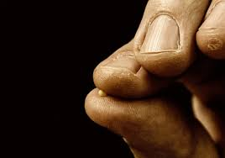
Faithfulness
Hebrews 11:6 says And without faith it is impossible to please him, for whoever would draw near to God must believe that he exists and that he rewards those who seek him.
Matthew 17:20 says He said to them, Because of your little faith. Amen I tell you, if you have faith like a mustard seed, you will say this mountain move from here to there and it will move. Nothing will be impossible for you.

Slide 12

Gentleness
Ephesians 4:2 - With all humility and gentleness, with patience, bearing with one another in love.

Slide 13

Self Control
Proverbs 25:28 – A man without self-control is like a city broken into and left without walls

Slide 14

Heart Check
Psalms 139: 23-24 - ²³ Search me, O God, and know my heart!
Try me and know my thoughts! ²⁴ And see if there be any grievous way in me, and lead me in the way everlasting!
Proverbs 3:3 - Let not steadfast love and faithfulness forsake you; bind them around your neck; write them on the tablet of your heart. Steadfast faith and love help keep our spiritual hearts healthy!

Slide 15

Jeremiah 29:13 - You will seek me and find me, when you seek me with all your heart.
Matthew 15:18 - But what comes out of the mouth proceeds from the heart, and this defiles a person.

Slide 16

Spiritual Prescription
Get in the Word!
Pray! Pray! Pray!
Praise and Worship!
Tap into the Holy Spirit!

