Slide 1
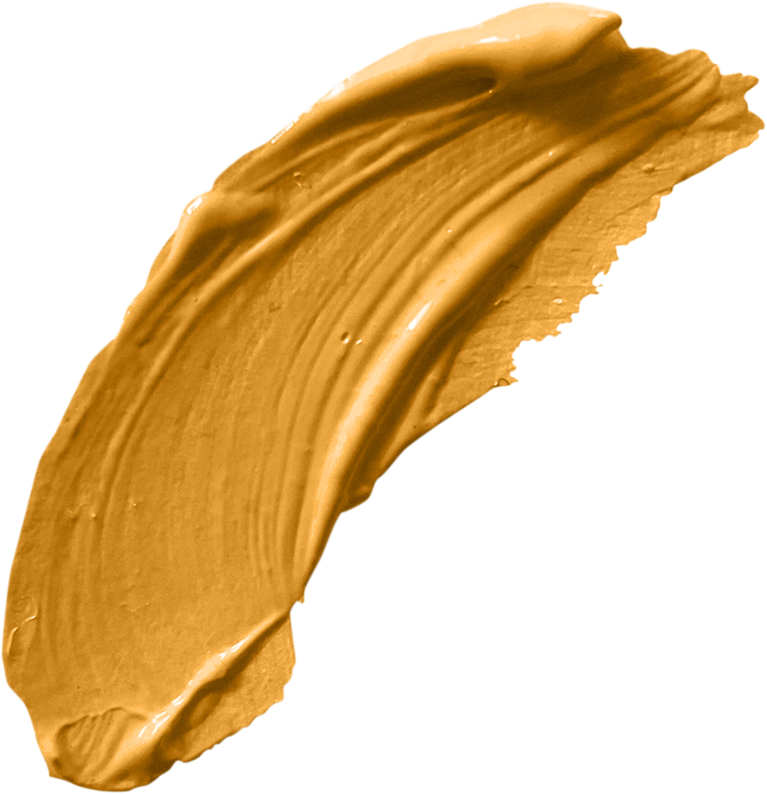
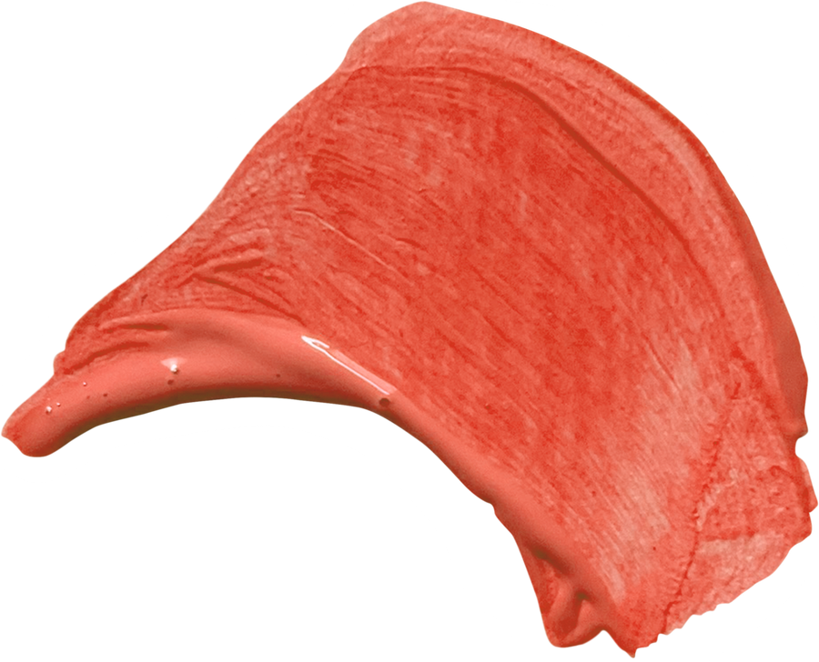

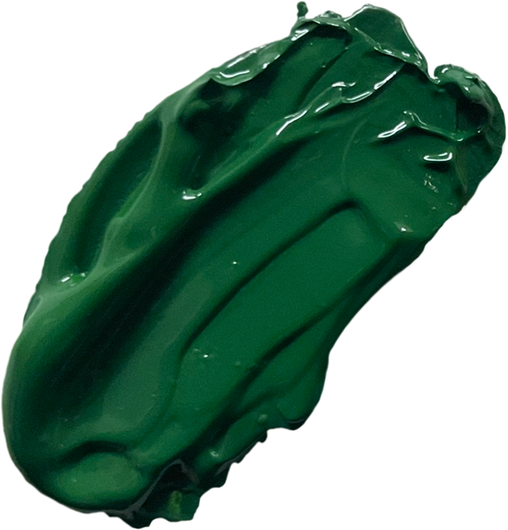

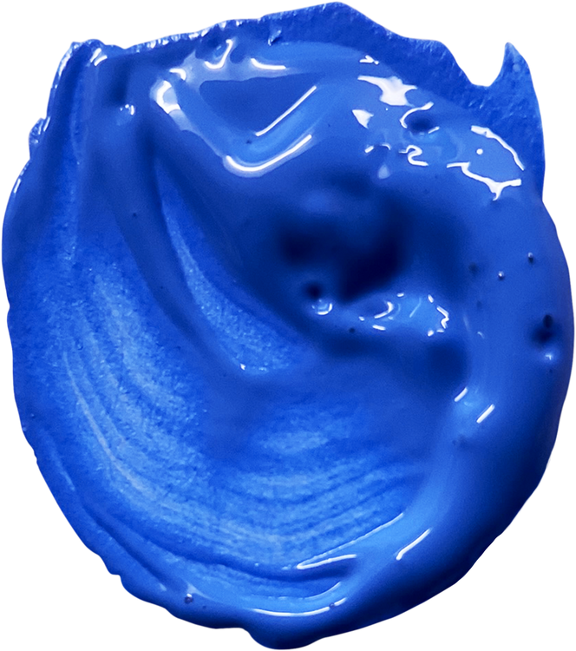

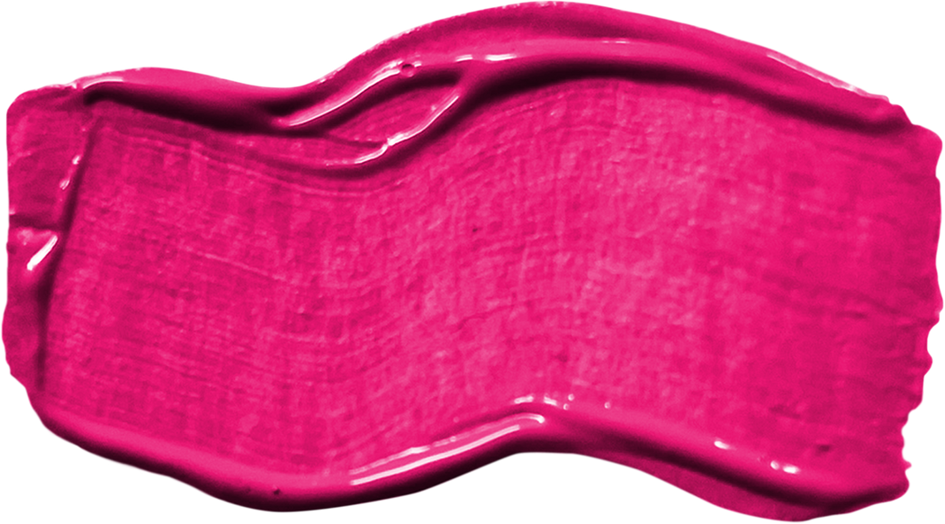
EPHESIANS 2:10
GOD’S MASTERPIECE

Slide 2

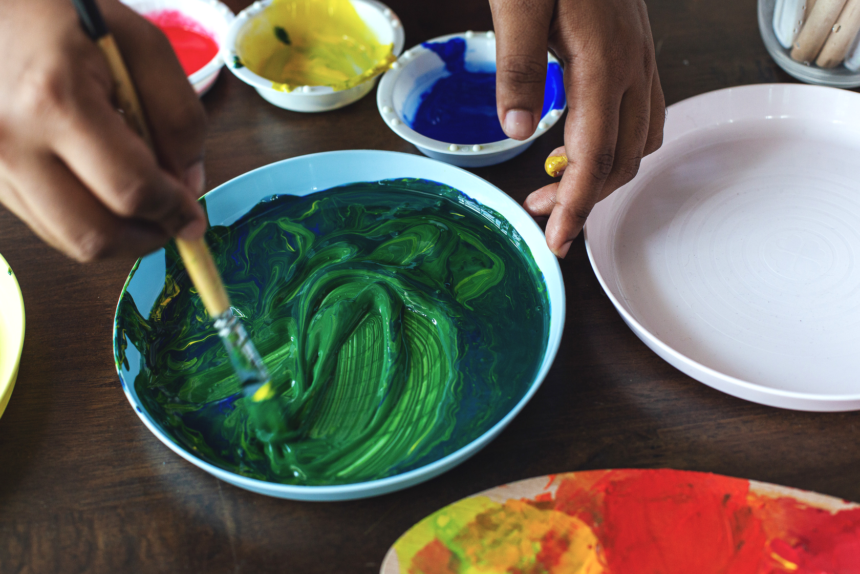
Ephesians 2:10 NIV
For we are God’s handiwork, created in Christ Jesus to do good works, which God prepared in advance for us to do.

Slide 3
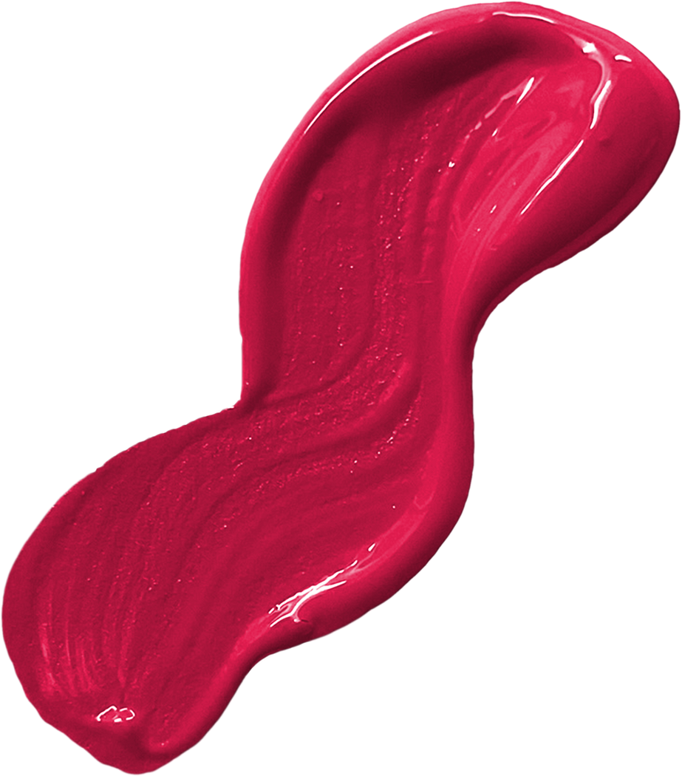
You Are Not Here By Mistake

Slide 4
Deuteronomy 32:4 NIV
He is the Rock, his works are perfect, and all his ways are just. A faithful God who does no wrong, upright and just is he.

Slide 5
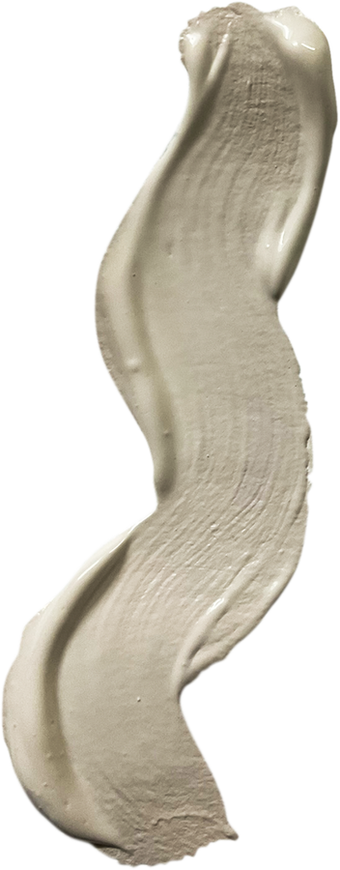
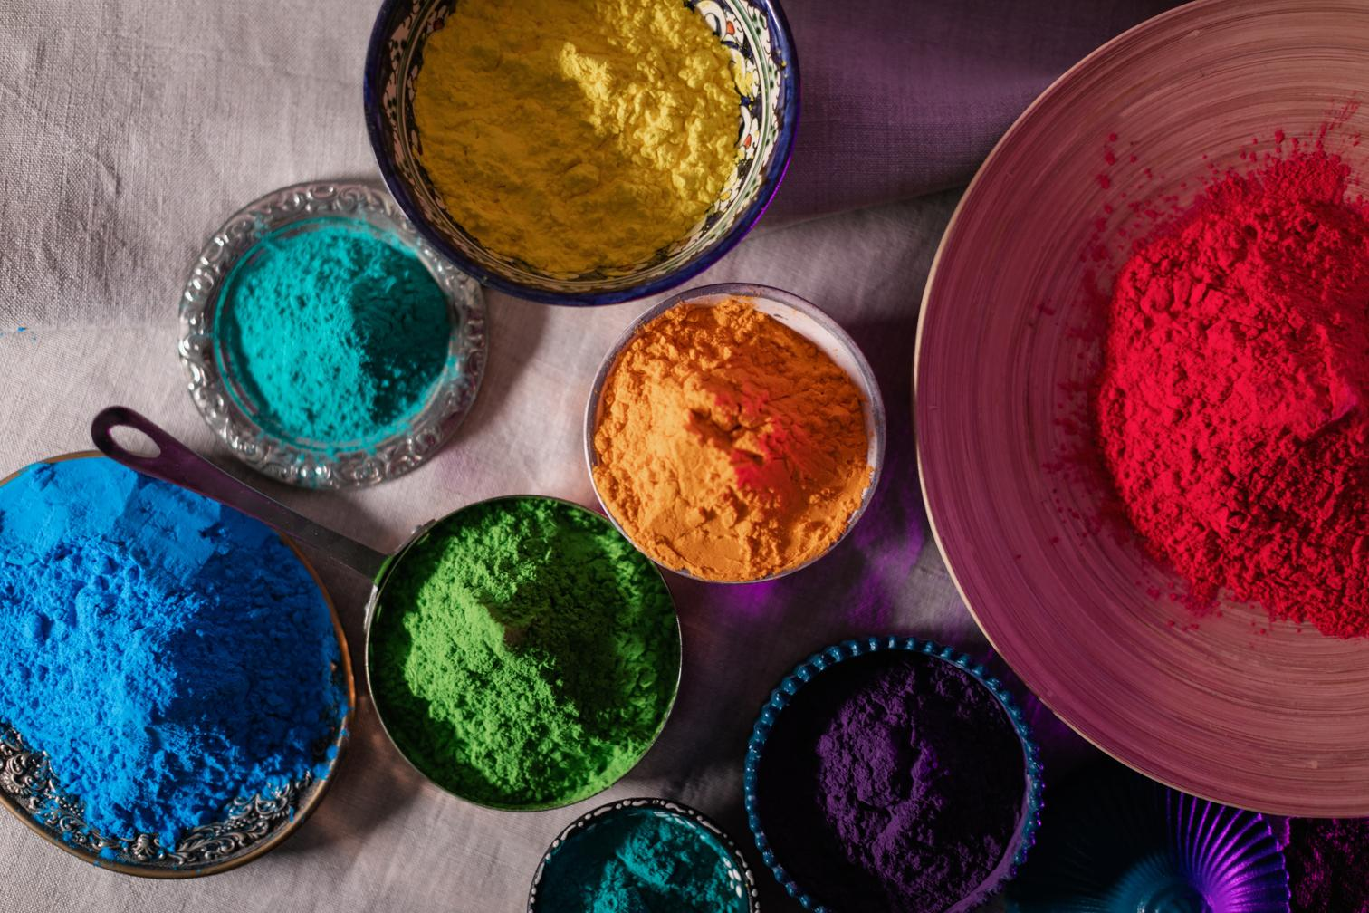
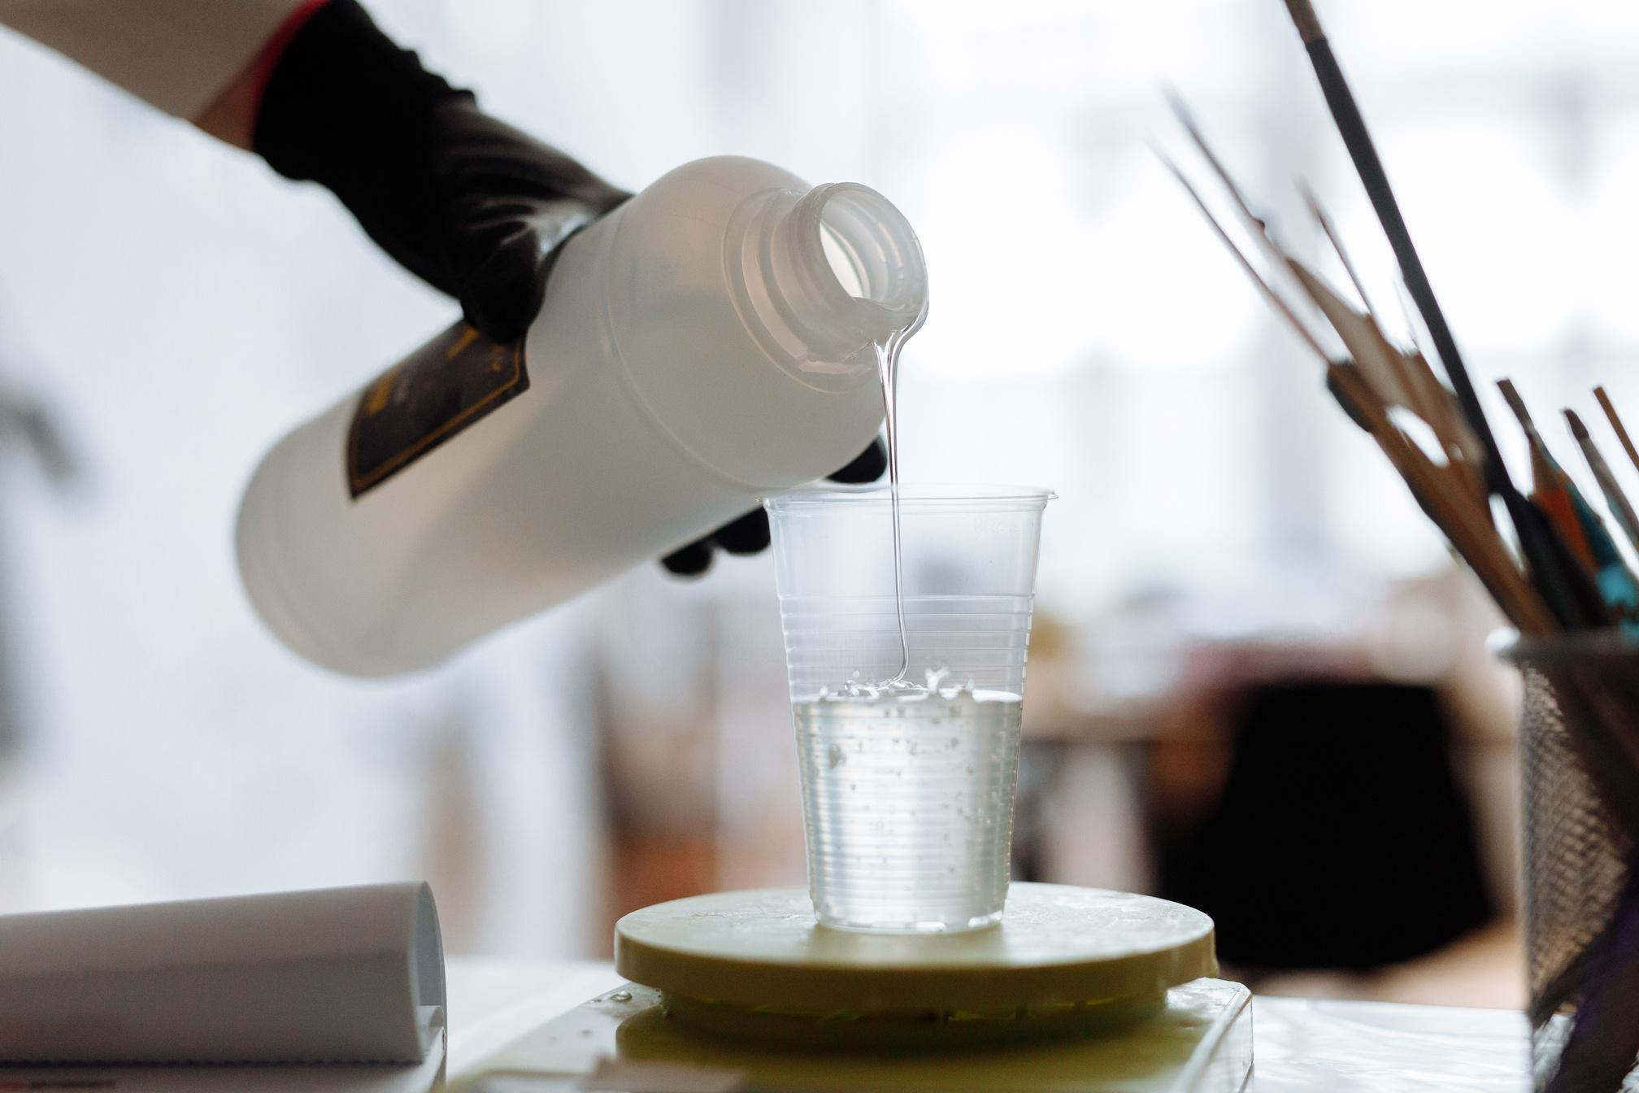
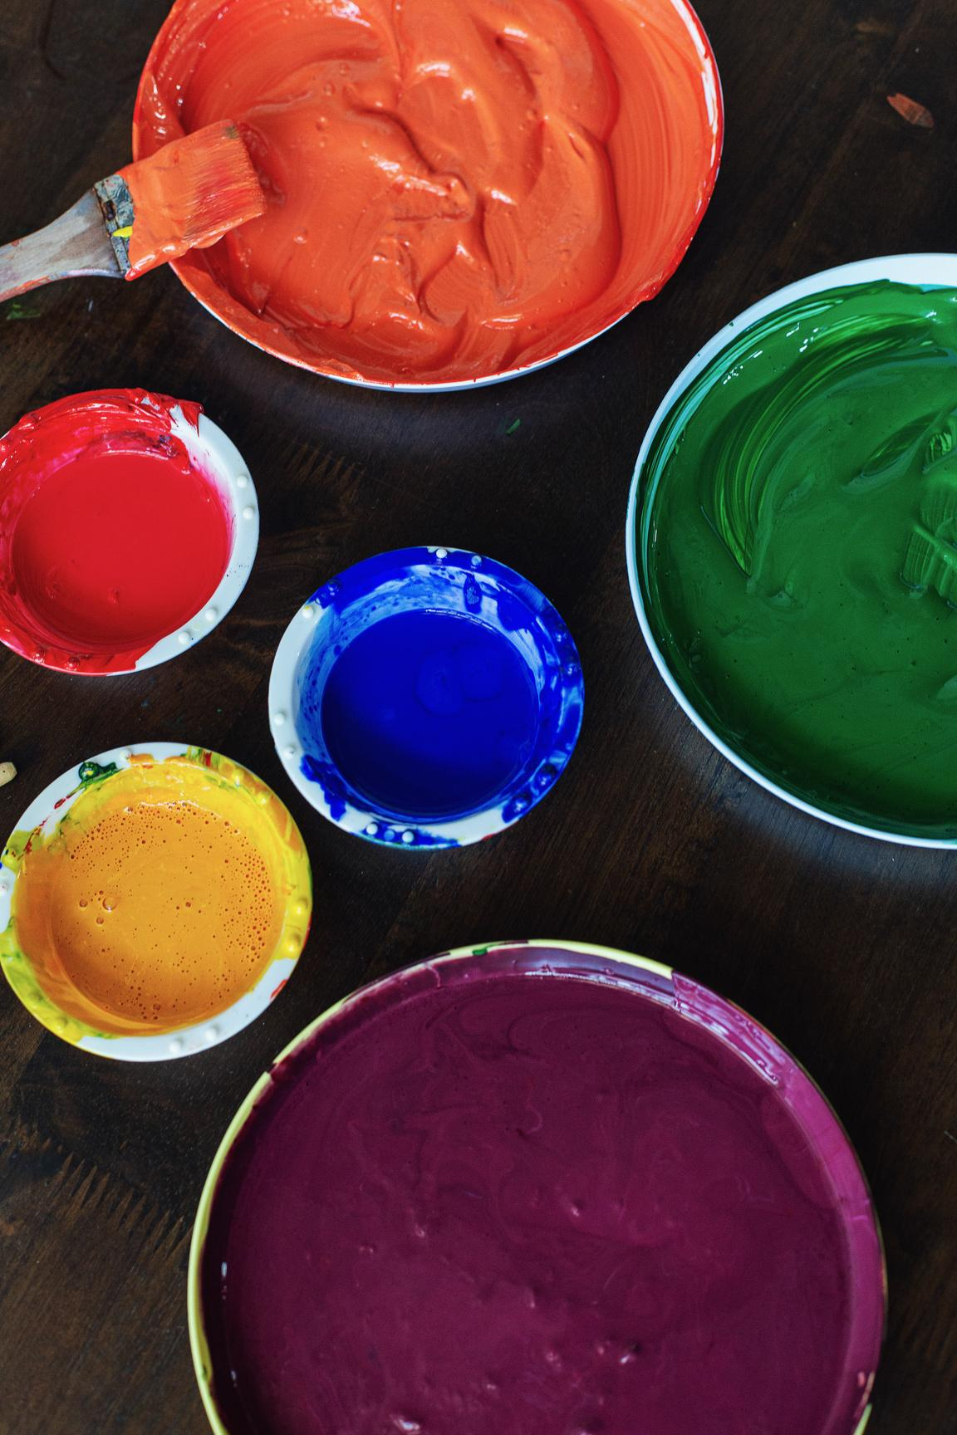
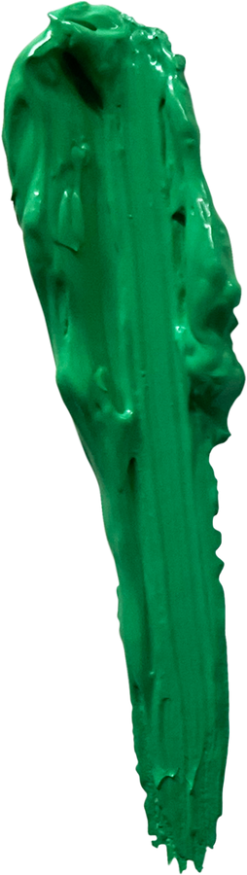
He’s Working On Us
+
=

Slide 6
Isaiah 64:8 NIV
Yet you, Lord, are our Father. We are the clay, you are the potter; we are all the work of your hand.

Slide 7
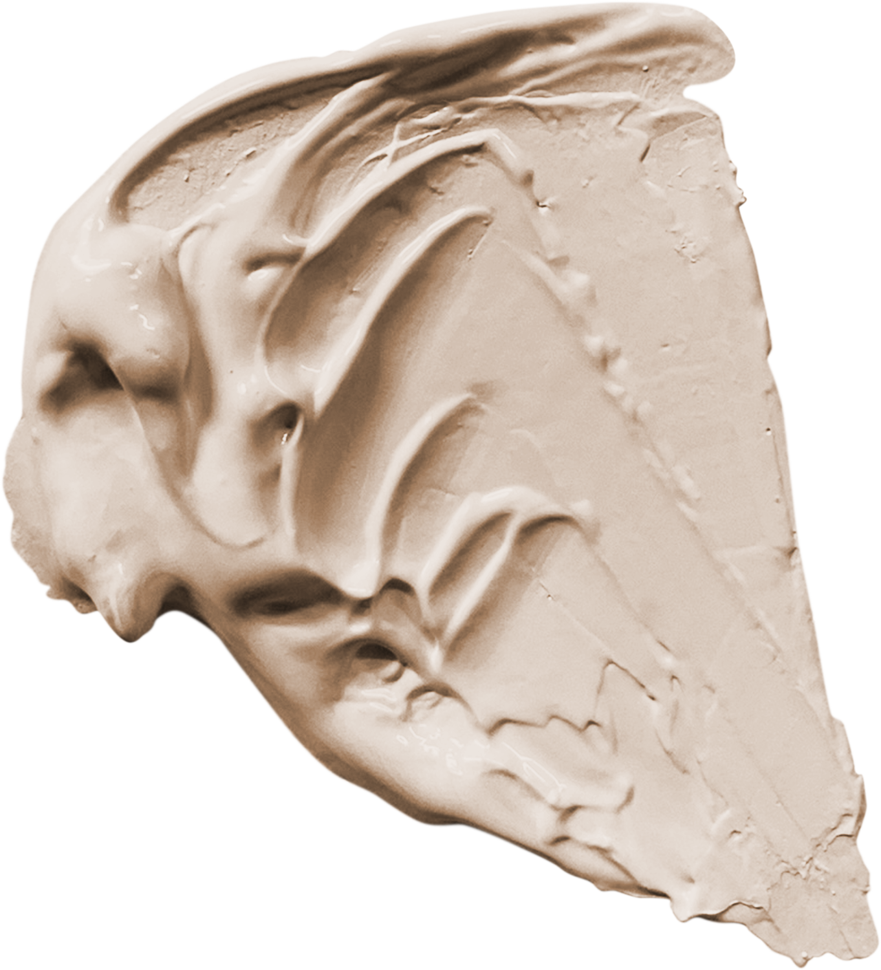

Before the standards

Slide 8
Jeremiah 1:5 NIV
“Before I formed you in the womb I knew you, before you were born I set you apart; I appointed you as a prophet to the nations.”

Slide 9
Romans 12:2 NIV
Do not conform to the pattern of this world, but be transformed by the renewing of your mind. Then you will be able to test and approve what God’s will is—his good, pleasing and perfect will.

Slide 10

He’s not done yet

Slide 11
Philippians 1:6 NIV
being confident of this, that he who began a good work in you will carry it on to completion until the day of Christ Jesus.

Slide 12

Encouragement Going Forward

Slide 13
Isaiah 46:3–4 NIV
“Listen to me, you descendants of Jacob, all the remnant of the people of Israel, you whom I have upheld since your birth, and have carried since you were born. Even to your old age and gray hairs I am he, I am he who will sustain you. I have made you and I will carry you; I will sustain you and I will rescue you.

Slide 14
EPHESIANS 2:10
GOD’S MASTERPIECE

