Slide 1



Slide 2
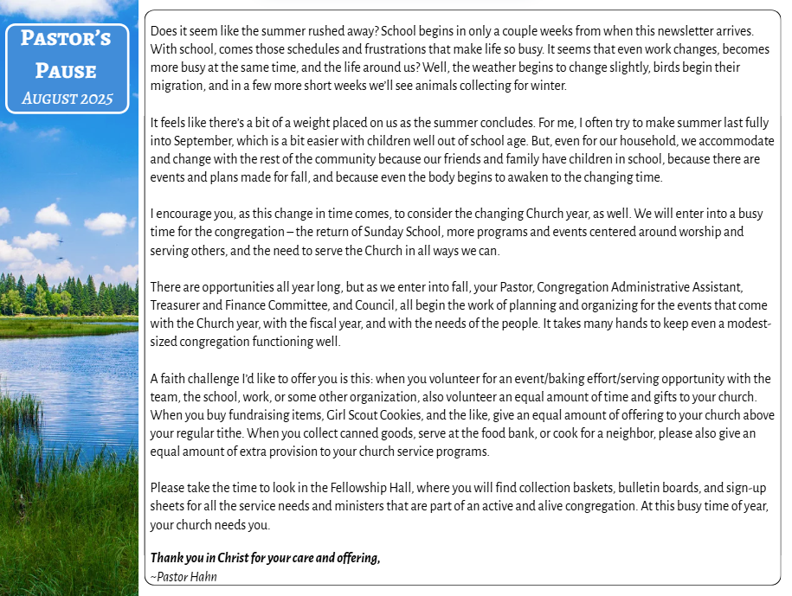

Slide 3
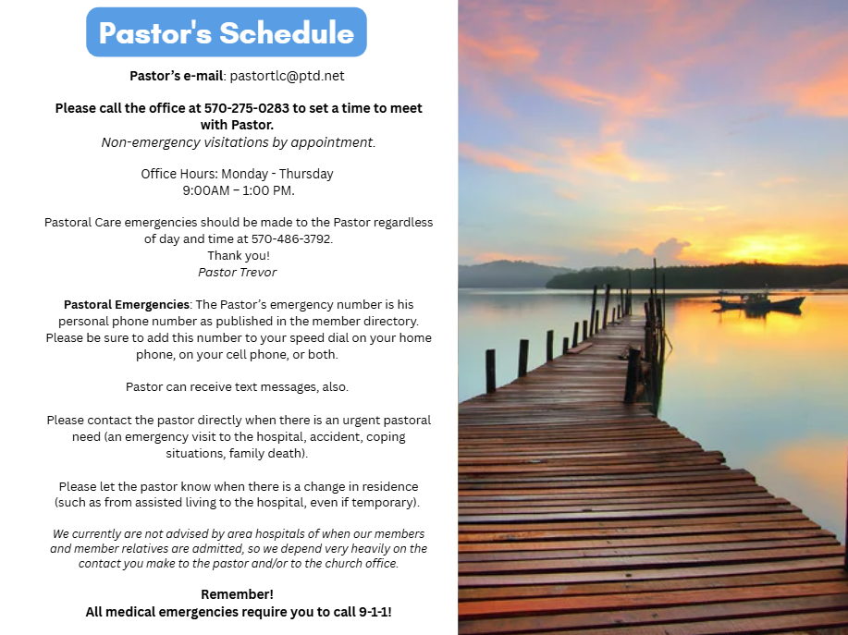
Food Insecurity: Montour County
Human Relations Department
waiving applications for all county residents.
CALL 570-271-3028 and they'll advise options.
211 – system
is up and running in PA, this is the first stop for
referrals for individuals to agencies for assistance.
National Suicide Prevention
Hotline: 1-800-273-TALK (8255)
Nacional de Prevencion del Suicidio:
1-888-628-9454
Crisis Text line: Text "PA" to 741-741
Veterans Crisis Line:
1-800-985-5990
Disaster Distress Helpline:
1-800-985-5990
Get Help Now Hotline
(for substance abuse disorders):
1-800-662-4357
PA Sexual Assault Helpline:
1-888-772-7227
Columbia-Montour Crisis Hotline
(Women's Center):
1-800-544-8293
National Domestic Violence Hotline:
1-800-799-7233
Geisinger Coronavirus Hotline:
570-284-3657
LGBT National Hotline:
1-888-843-4564
The Trevor Project
(suicide prevention, crisis intervention for LGBT youth)
1-866-488-7386
PA Mental Health Line 9-8-8
Pastoral Emergencies: The Pastor’s emergency number is his personal phone number as published in the member directory. Please be sure to add this number to your speed dial on your home phone, on your cell phone, or both. Pastor can receive text messages, also. Please contact the pastor directly when there is an urgent pastoral need (an emergency visit to the hospital, accident, coping situations, family death). Please let the pastor know when there is a change in residence (such as from assisted living to the hospital, even if temporary).
We currently are not advised by area hospitals of when
our members and member relatives are admitted, so we depend very heavily on the contact you make to the pastor and/or to the church office.
Remember! All medical emergencies require you to
call 9-1-1!

Slide 4
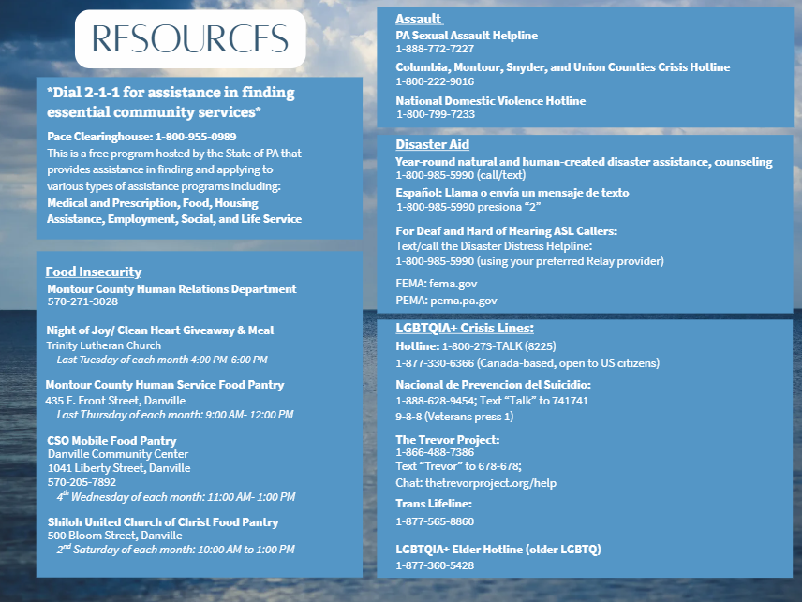

Slide 5
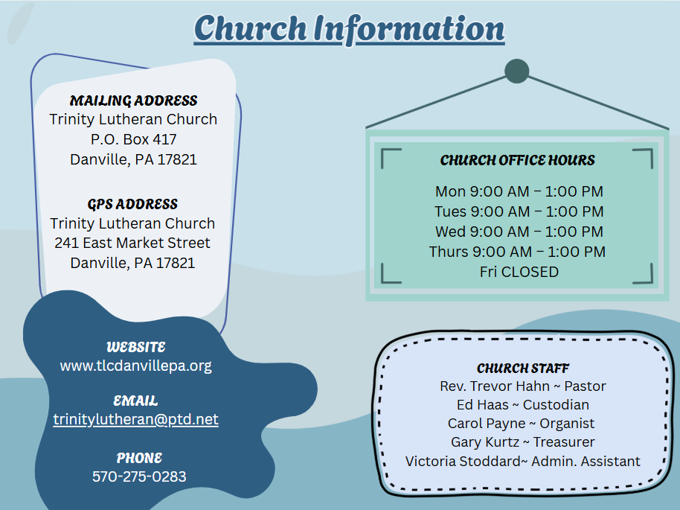
CHURCH STAFF
Rev.
Trevor J. Hahn
Pastor
Victoria Stoddard
Admin.
Assistant
Gary Kurtz
Treasurer
CHURCH OFFICE
HOURS
Mon 9:00 AM – 1:00 PM
Tues 9:00 AM – 1:00 PM
Wed 9:00 AM – 1:00 PM
Thurs 9:00 AM – 1:00 PM
Fri CLOSED
Ed Haas
Custodian
Carol Payne
Organist
WEBSITE
www.tlcdanvillepa.org
EMAIL
trinitylutheran@ptd.net
MAILING ADDRESS:
Trinity Lutheran Church
P.O. BOX 417
Danville, PA 17821
GPS ADDRESS:
Trinity Lutheran Church
241 East Market Street
Danville, PA 17821

Slide 6
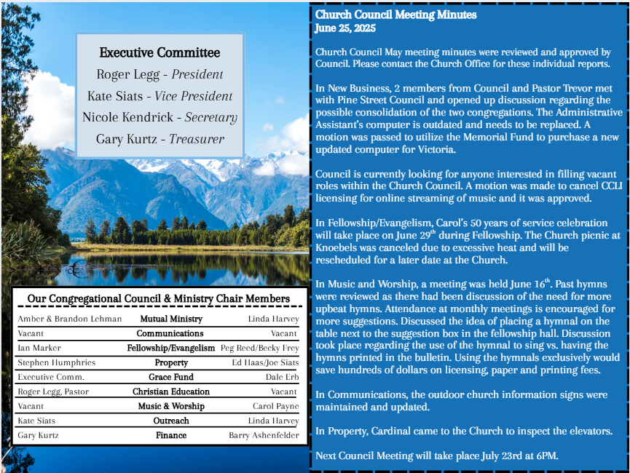

Slide 7
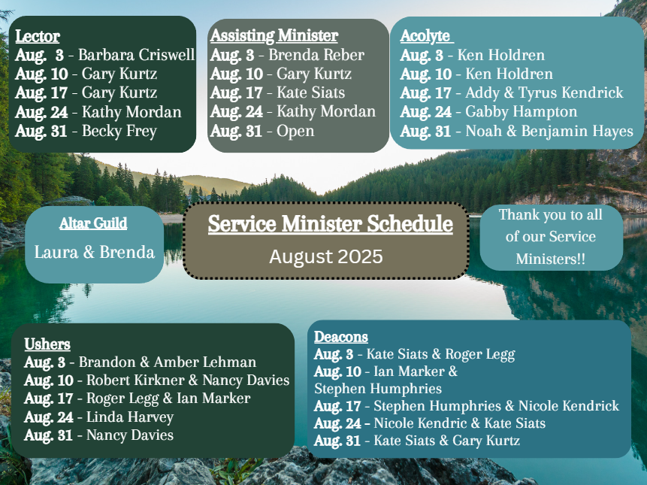

Slide 8


Slide 9
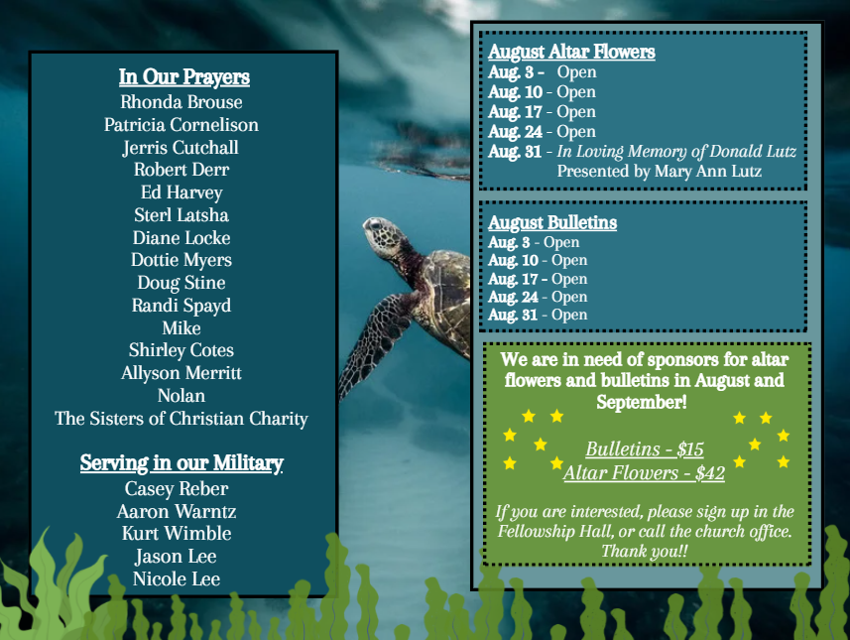
Thoughts & Prayers
Rhonda Brouse, Patricia Cornelison, Jerris Cutchall, Robert Derr, Ed Harvey, Sterl Latsha, Diane Locke, Dottie Myers, Doug Stine, Randi Spayd, Brian, Sue, Mike, Shirley Cotes, The Sisters of Christian Charity
August Altar Flowers
Aug 3
Aug 10
Aug 17
Aug 24
Aug 31
Family & Friends of:
August Bulletins
Aug 3
Aug 10
Aug 17
Aug 24
Aug 31
Serving in Our Military
Jason Lee
Nicole Lee
Casey Reber
Aaron Warntz
Kurt Wimble

Slide 10


AUGUST BIRTHDAYS
JUNE 2025
Aug 1 Megan Fitzpatrick
Aug 2 Sara Tessarvich, Madison Payne
Aug 5 Hannah Semiclose, Beth Mertz
Aug 6 Kate Siats
Aug 8 Joe Muscato, Gail Hendrickson
Wendy Weader, Gail Summers
Aug 10 Delores Madden, Vickie Lecher
Aug 11 Jodi Hendrickson
Aug 14 Griffin Reber
Aug 17 Brett Payne
Aug 20 Cathy Burger-Gray
Aug 21 Becky Frey, Robin Santucci
Aug 22 Carly Legg, Wayne Tessarvich
Erin Hayes
Aug 24 Bonnie Smith, Yvonne Burger
Sarah Swartzlander
Aug 26 David Martin
Aug 28 Julia Hayes
Aug 29 Barbara Criswell
Aug 30 Craig Santucci
Aug 31 Amber Lehman
CURRENT ACCOUNT
INCOME:
Contribution Income $ 11,811.44
Interest Income $ 3,084.62
TOTAL INCOME: $ 14,896.06
EXPENSES:
Pastor Compensation $ 8,725.96
Staff Compensation $ 3,475.62
Parish Administration $ 375.65
Church Property $ 3,380.13
Cemetery Maintenance $ 0.00 Education & Outreach $ 0.00
Music & Worship $ 480.00
Evangelism $ 0.00
Conventions & Seminars $ 0.00
Ministry Expense $ 0.00
Transfer of Funds $ 0.00
TOTAL EXPENSES: $ 16,437.36
MONTHLY TOTAL: $ -1,541.30
NET LOSS/SURPLUS
YTD ACTUAL: $ -$18,820.44

Slide 11


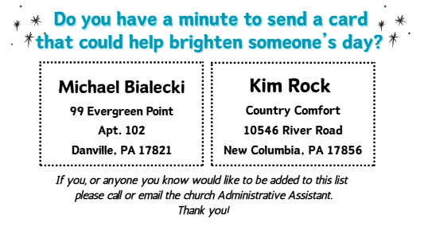


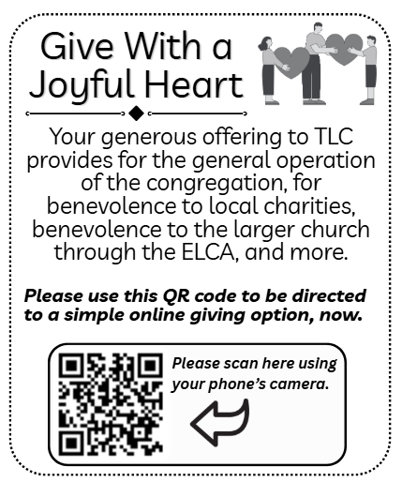



Slide 12
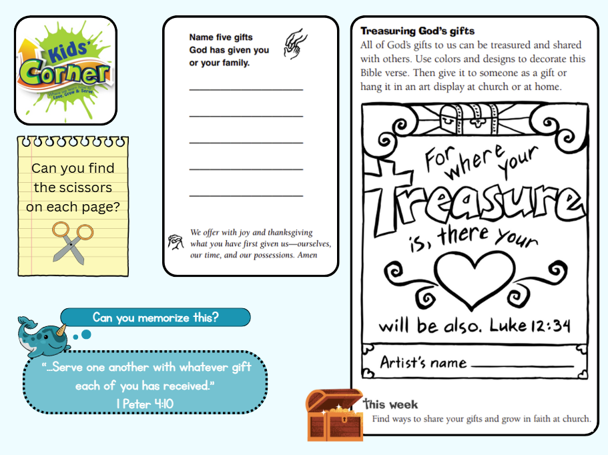
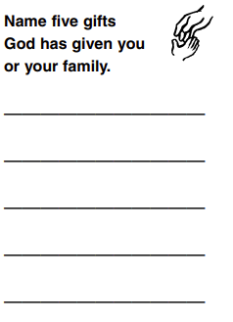
Can you find the scissors
on each page?

Slide 13
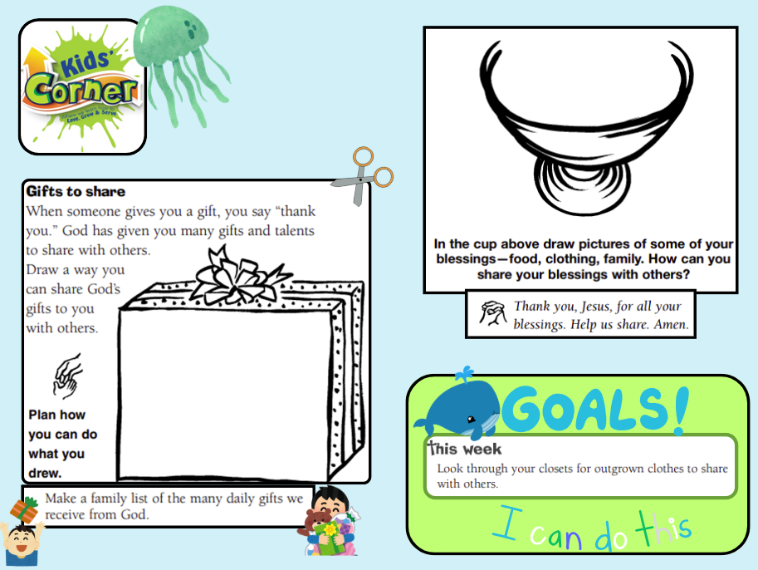
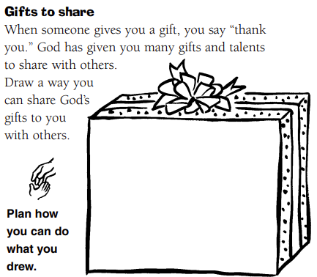


Slide 14

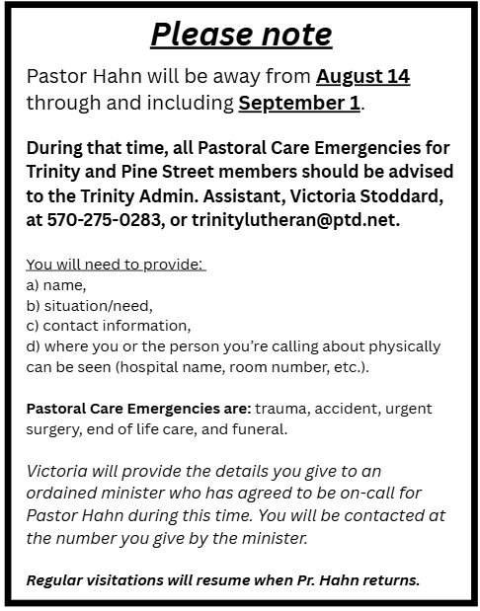



Slide 15
