Slide 1

Ephesians 5:21-33
SPIRIT GUIDED RELATIONSHIPS

Slide 2

God elevated marriage to the highest spiritual relationship by introducing the church as His bride & Himself as the groom

Slide 3

The difference between an ordinary marriage & an extra-ordinary marriage is the presence of Holy Spirit in our lives

Slide 4

Reminder of where marriage began:
“As the Scriptures say: A man leaves his father & mother and is joined to his wife, and the two are united into one.”

Slide 5



GOD–GIVEN INNATE ROLES
HUSBANDS
WIVES
To lead
To provide
To protect
To nurture
To give birth
Main caregivers

Slide 6
Essential elements of marriage
Companionship – “It is not good for the man to be alone…”
Team-work- “I will make him a helper just right for him..” Gn 2:18
Procreation- “Be fruitful and multiply…” Gn 1:28
Pleasure- “Rejoice in the wife of your youth…” Pr 5: 18

Slide 7

“Submit to one another out of reverence (fear) of God” vs 21
Marriage is a journey of submission – first to God & then to each other

Slide 8
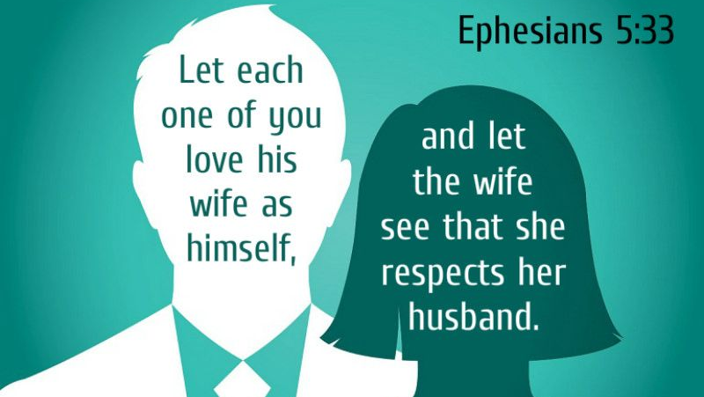
The two foundational pillars

Slide 9

“For husbands, this means love your wives just as Christ loved the church...
He gave up his life for her…”

Slide 10

Patience & kindness are the foundation of agape love

Slide 11
Because love is patient & kind, it is NOT:
Jealous or boastful
Proud
Rude
Selfish
Irritable
Keeps record of wrongs

Slide 12

“Husbands ought to love their wives as they love their own bodies…” vs 28

Slide 13

“Husbands, be considerate as you live with your wives, & treat them with respect as the weaker partner & as heirs with you of the gracious gift of life, so that nothing will hinder your prayers.” 1 Peter 3:7

Slide 14

A husband can love his wife best when he loves God more

Slide 15

“For wives, this means submit to your husbands as to the Lord.
For a husband is the head of his wife as Christ is the head of the Church.
As the church submits to Christ, so you wives should submit to your husbands in everything…” vs 22-24

Slide 16

Submission is not just about yielding to your husband; it really is a spiritual attitude:
“as to the Lord…”
“as the Church submits to Christ…”

Slide 17
Defining ‘submission’
Submission is NOT:
Submission IS:
It is not subjugation
It is not being forced to go against one’s will or conscience
It is not to endure harm
It is not to stifle one’s personality
Desire to please the Lord
It is to willingly yield to husband’s leading, as he follows God’s leading
It is to be free to be oneself & use innate talents for the benefit of the family
It is to wisely participate in the decision making & planification of family matters

Slide 18
God has an established chain of command
The principle of submission is imbedded in the Trinity
“But I want you to know that the head of every man is Christ, the head of woman is man, and the head of Christ is God.” I Cor 11:3
Man was intended for ‘headship’ since Creation
“For the first man didn’t come from the woman, but the first woman came from the man. And the man was not made for the woman, but the woman was made for the man.” I Cor 11:8, 9
Not a place of superiority, but one of responsibility & accountability to God

Slide 19

Benefits of “Spirit- led” marriage
Happier homes
Less domestic violence
More stable children
Better mental health
Longer lives
Wealthier inheritance
Higher incomes
Higher education levels

Slide 20

Jesus & His Bride
Jesus loves His Church
He gave His life for His Church
He is actively building & purifying His Church
He is preparing His Bride for His coming

Slide 21
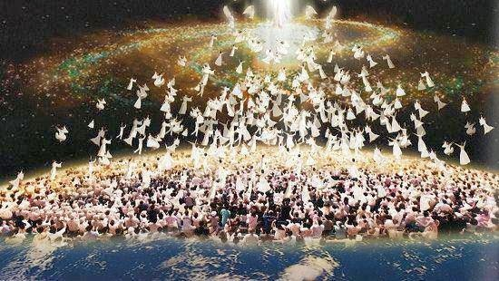
Jesus is coming back for His Bride

Slide 22

Are you coming
to the wedding feast?

