Slide 1


Slide 2
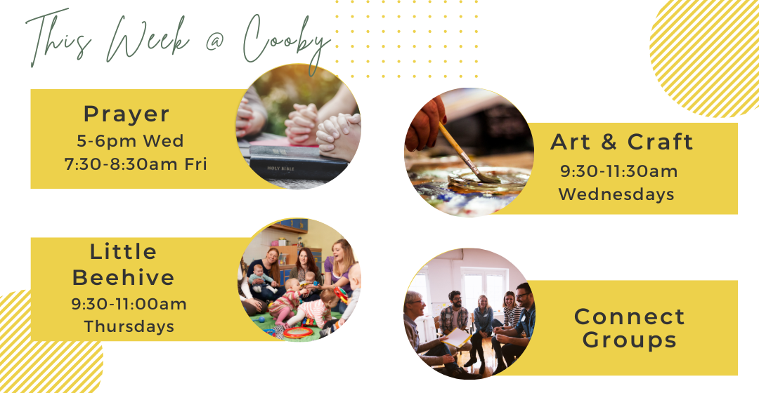

Slide 3
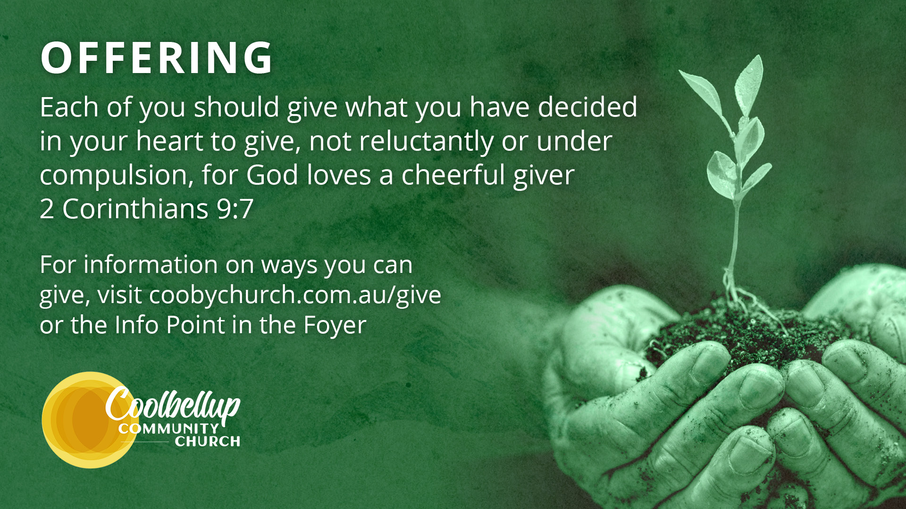

Slide 4
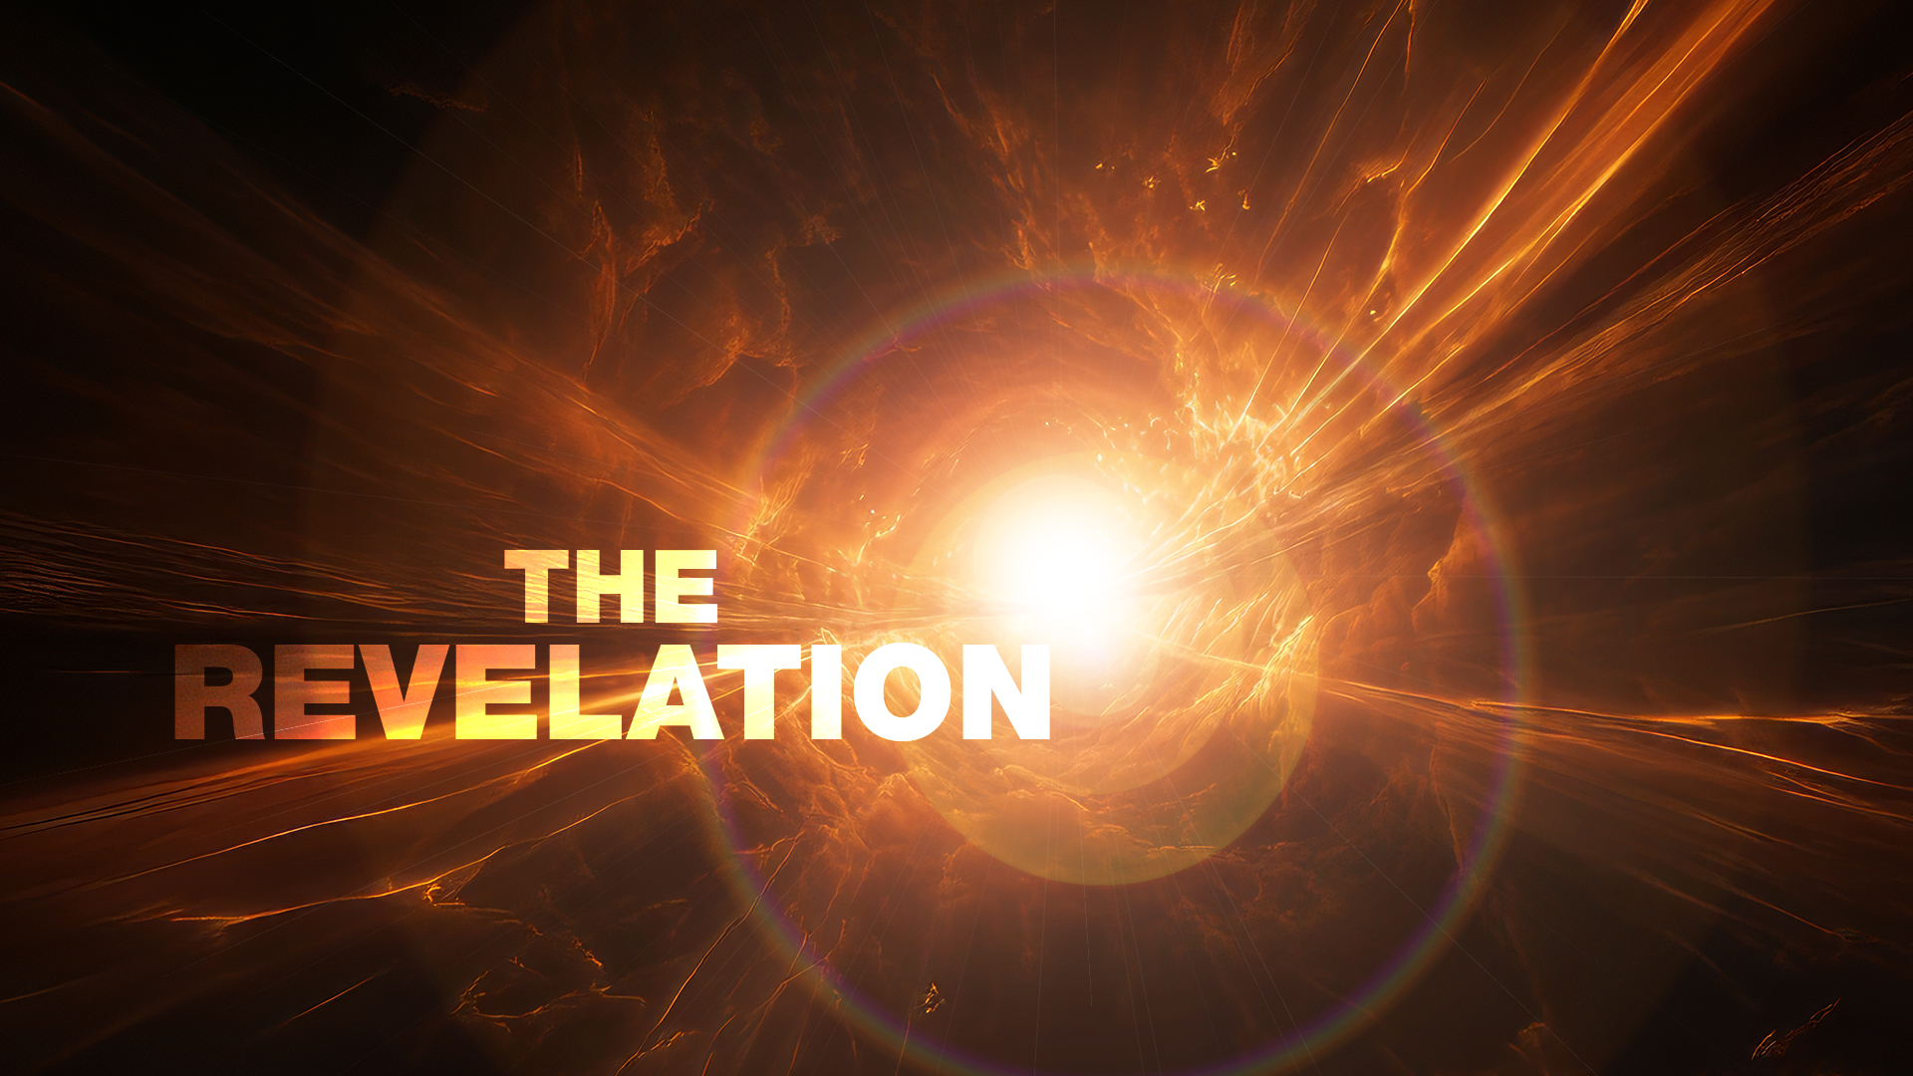
Compelled by Love
Robyn Christie

Slide 5
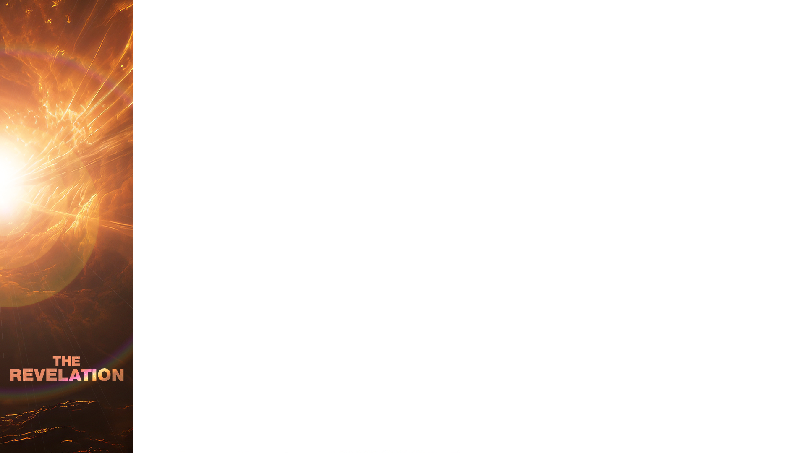
Revelation 5:8
And when he had taken it, the four living creatures and the twenty-four elders fell down before the Lamb. Each one had a harp and they were holding golden bowls full of incense, which are the prayers of God’s people.
Compelled

Slide 6
Colossians 4:2
Devote yourselves to prayer, being watchful and thankful.
1 Thess 5:16-18
Rejoice always, pray continually, give thanks in all circumstances; for this is God’s will for you in Christ Jesus.
Compelled

Slide 7
Philippians 4:4-7
Rejoice in the Lord always. I will say it again: Rejoice! Let your gentleness be evident to all. The Lord is near. Do not be anxious about anything, but in every situation, by prayer and petition, with thanksgiving, present your requests to God. And the peace of God, which transcends all understanding, will guard your hearts and your minds in Christ Jesus.
Compelled

Slide 8
…one quarter of those who describe themselves as “non religious” admit that, in fact they take part in some spiritual activity each month, typically prayer… It is no exaggeration to say that to be human is to pray.
PETE GREIG
How To Pray
Compelled

Slide 9
Now, we must not think of prayer as a flat, dull, one-dimensional experience. Far from it! Prayer is a dance, a love feast, a wrestling match, a high, hilarious party… I could continue adding metaphors for some time. Prayer is so rich and varied and individualised a reality…. The heart of God is open wide to receive us; we are welcome to come home.
- RICHARD FOSTER
Compelled

Slide 10
I pray because I can't help myself. I pray because I'm helpless. I pray because the need flows out of me all the time, waking and sleeping. It doesn't change God. It changes me...
- C.S. LEWIS
Compelled

Slide 11
The priority of prayer is found in one way or another on almost every page of the Bible and in every chapter of church history. It is neither a peripheral theme nor an optional extra for the desperate and the devout. It does not belong to some other time in history, nor to some other type of person more spiritual or disciplined or experienced than you and me.
- PETE GREIG
Compelled

Slide 12
Prayer is nothing at all unless it is a matter of vast and all-consuming importance for each one of us.
“Prayer is more than a lighted candle,” insists the theologian George A. Buttrick. “It is the contagion of health. It is the pulse of Life.” A real relationship with God means walking with him daily, like Adam and Eve in the Garden of Eden.
- PETE GREIG
Compelled

Slide 13
It means talking with him intimately, like Moses, with whom “the Lord would speak … face to face, as one speaks to a friend.” And it means listening attentively to his voice because, as Jesus said, “My sheep listen to my voice; I know them, and they follow me.”
- PETE GREIG
Compelled

Slide 14
2 Corinthians 5:14 -15
For Christ’s love compels us, because we are convinced that one died for all, and therefore all died. And he died for all, that those who live should no longer live for themselves but for him who died for them and was raised again.
Compelled

Slide 15
Exodus 2:23-24
During that long period, the king of Egypt died. The Israelites groaned in their slavery and cried out, and their cry for help because of their slavery went up to God. God heard their groaning and he remembered his covenant with Abraham, with Isaac and with Jacob.
Compelled

Slide 16
Ephesians 3:14-19
For this reason I kneel before the Father, from whom every family in heaven and on earth derives its name. I pray that out of his glorious riches he may strengthen you with power through his Spirit in your inner being, so that Christ may dwell in your hearts through faith. And I pray that you, being rooted and established in love…
Compelled

Slide 17
Ephesians 3:14-19 continued
may have power, together with all the Lord’s holy people, to grasp how wide and long and high and deep is the love of Christ, and to know this love that surpasses knowledge—that you may be filled to the measure of all the fullness of God.
Compelled

Slide 18
Romans 8:22–27
We know that the whole creation has been groaning as in the pains of childbirth right up to the present time. Not only so, but we ourselves, who have the firstfruits of the Spirit, groan inwardly as we wait eagerly for our adoption to sonship, the redemption of our bodies. For in this hope we were saved. But hope that is seen is no hope at all. Who hopes for what they already have?
Compelled

Slide 19
Romans 8:22–27 continued
But if we hope for what we do not yet have, we wait for it patiently. In the same way, the Spirit helps us in our weakness. We do not know what we ought to pray for, but the Spirit himself intercedes for us through wordless groans. And he who searches our hearts knows the mind of the Spirit, because the Spirit intercedes for God’s people in accordance with the will of God.
Compelled

Slide 20
John 14:13–14
And I will do whatever you ask in my name, so that the Father may be glorified in the Son. You may ask me for anything in my name, and I will do it.
Compelled

Slide 21
You can build every program without presence, preach thousands of sermons without surrender, and gather crowds without His glory.
But the moment a people pray in true communion with God, the kingdom of darkness shakes. The enemy doesn’t fear our lights, our logos, or our livestreams. He fears our intercession. Because where there is prayer, there is real power.
Compelled

Slide 22
We also know that God’s nature is love. He does not love us any more when we do everything right and he does not love us any less when we do everything wrong. He just loves us; that’s who he is. Prayer is keeping company with the God who loves us.
- TREVOR MILLER
Compelled

Slide 23
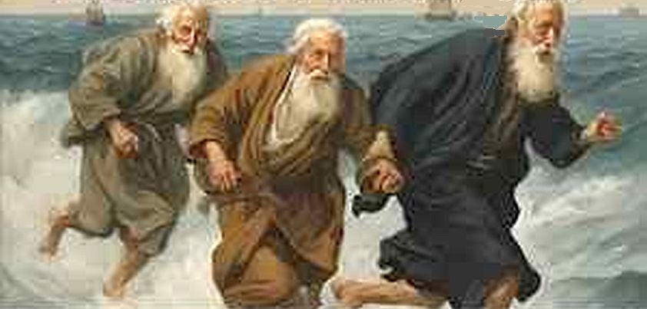
Compelled

Slide 24


Slide 25
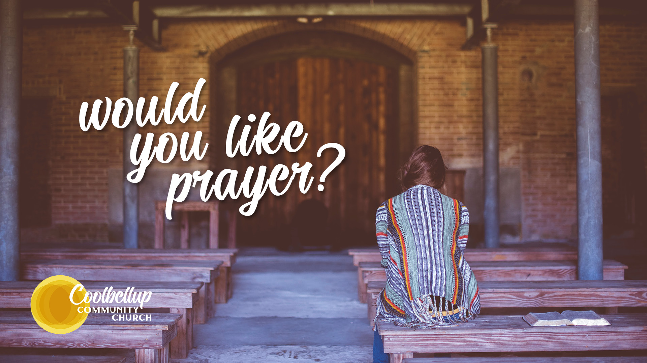

Slide 26


