Slide 1
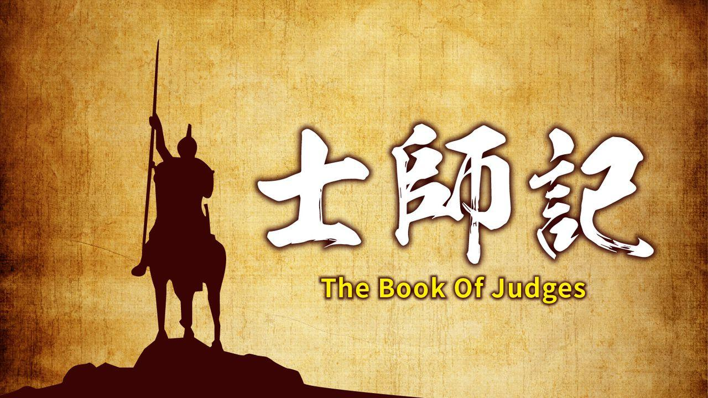


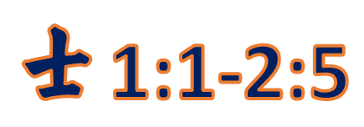
當信仰漸褪色
士1:1-2:5
不求完全,妥協安逸
Notes:
當信仰漸褪色
「那時以色列中沒有王」（17:6，18:1，19:1，21:25）
各人照自己眼中看為對的去做——“生活原則----自己認為對
描述當時社會的一種狀況
Author: Unknown, though certain sections may derive from the prophet Samuel 本師記的作者: 不詳, 大部份學者認為是先知撒母耳
Theme: Through leaders known as “judges,” God again and again delivers the Israelites, who are in danger of losing the promised land through their unfaithfulness.
當以色列人因不忠而瀕臨失去應許之地的危機時，神透過新一代的領袖「士師」，多次施行拯救……但其中有條件/共通的特質……….。
士師的角色：¹⁶ 耶和華興起士師，士師就拯救他們脫離搶奪他們之人的手。¹⁶ Then the Lord raised up judges,^{[c]} who saved them out of the hands of these raiders. （入侵者）
摩西是一代的開始……卻未結束，就是蒙神呼召, 帶領以色列人離開埃及, 進入曠野……邁向迦南應許之地。
約書亞是一代的結束，將第二代的以色人領進迦南應許之地
1 After the death of Joshua, the Israelites asked the Lord, “Who of us is to go up first to fight against the Canaanites?”
² The Lord answered, “Judah shall go up; I have given the land into their hands.”
以十二位民族英雄的功績為中心

Slide 2

士師記 1:1-2
¹約書亞死後，以色列人求問耶和華說：「我們中間誰當首先上去攻打迦南人，與他們爭戰呢？」²耶和華說：「猶大要先上去。看哪，我已將那地交在他手中。」
Notes:
Author: Unknown, though certain sections may derive from the prophet Samuel 本師記的作者: 不詳, 大部份學者認為是先知撒母耳
Theme: Through leaders known as “judges,” God again and again delivers the Israelites, who are in danger of losing the promised land through their unfaithfulness.
當以色列人因不忠而瀕臨失去應許之地的危機時，神透過新一代的領袖「士師」，多次施行拯救……但其中有條件/共通的特質……….。
士師的角色：¹⁶ 耶和華興起士師，士師就拯救他們脫離搶奪他們之人的手。¹⁶ Then the Lord raised up judges,^{[c]} who saved them out of the hands of these raiders. （入侵者）
摩西是一代的開始……卻未結束，就是蒙神呼召, 帶領以色列人離開埃及, 進入曠野……邁向迦南應許之地。
約書亞是一代的結束，將第二代的以色人領進迦南應許之地
1 After the death of Joshua, the Israelites asked the Lord, “Who of us is to go up first to fight against the Canaanites?”
² The Lord answered, “Judah shall go up; I have given the land into their hands.”

Slide 3

士師記 1:3-4
³猶大對他哥哥西緬說：「請你同我上到我抽籤所得之地，與迦南人爭戰；我也同你去你抽籤所得之地。」於是西緬與他同去。⁴猶大就上去，耶和華把迦南人和比利洗人交在他們手中。他們在比色擊殺了一萬人。
Notes:
³ The men of Judah then said to the Simeonites their fellow Israelites, “Come up with us into the territory allotted to us, to fight against the Canaanites. We in turn will go with you into yours.” So the Simeonites went with them. ⁴ When Judah attacked, the Lord gave the Canaanites and Perizzites into their hands, and they struck down ten thousand men at Bezek.
兄弟同心, 同行!
1. 攻打迦南人Canaanites,
2. 比利洗人Perizzites。

Slide 4
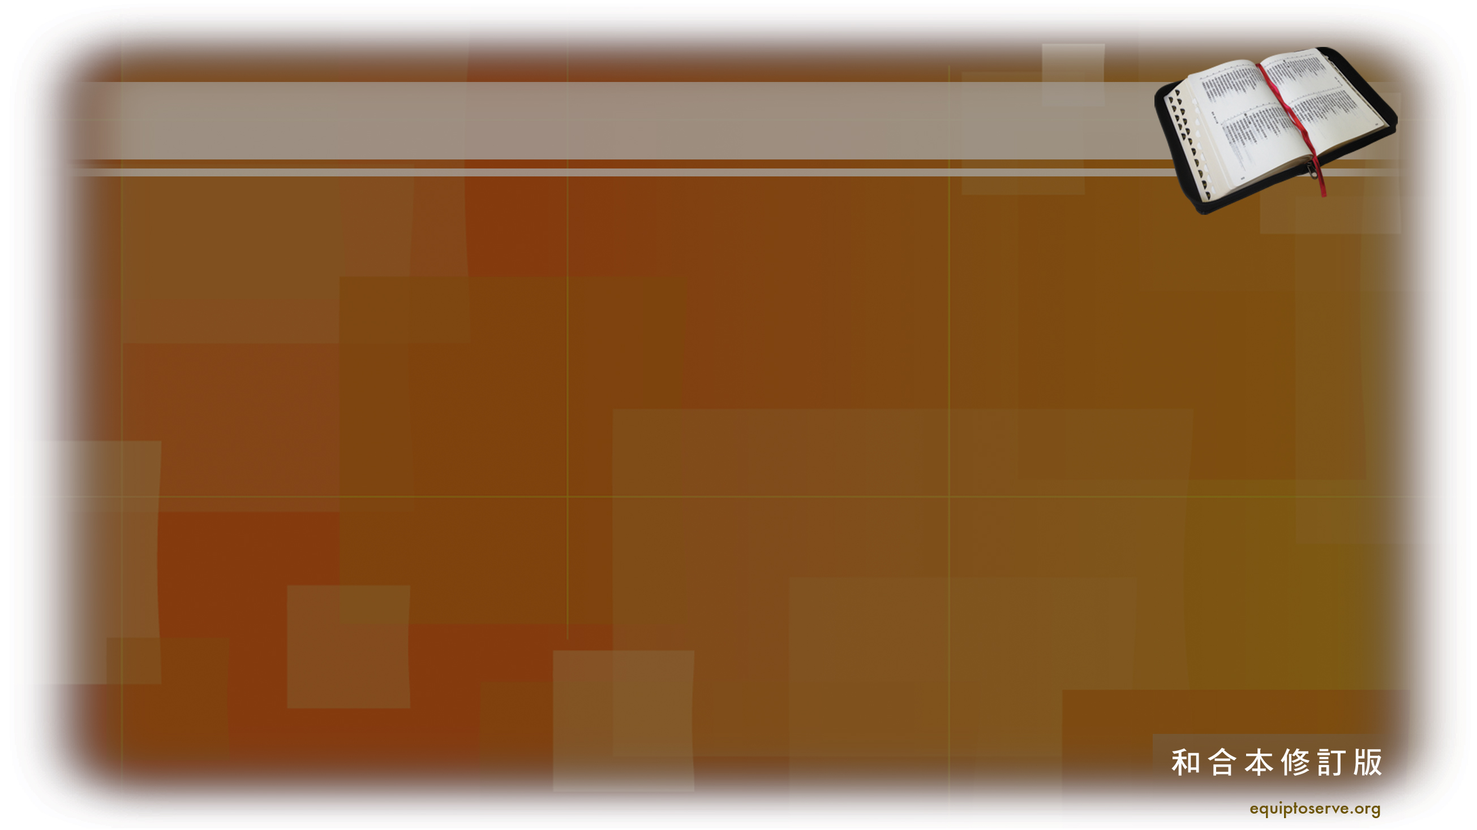
士師記 1:5-6
⁵他們在比色遇見亞多尼‧比色，與他爭戰，擊敗了迦南人和比利洗人。 ⁶亞多尼‧比色逃跑，他們追趕他，捉住他，砍斷他大拇指和大腳趾。
Notes:
⁵ It was there that they found Adoni-Bezek and fought against him, putting to rout the Canaanites and Perizzites. ⁶ Adoni-Bezek fled, but they chased him and caught him, and cut off his thumbs and big toes.

Slide 5
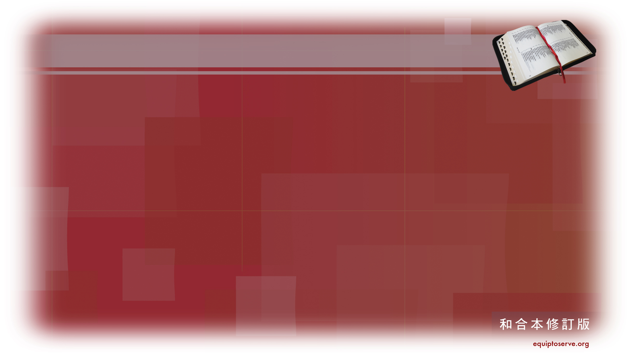
士師記 1:7
亞多尼‧比色說：「從前有七十個王，大拇指和大腳趾都被我砍斷，在我桌子底下拾取零碎食物。現在神照著我所做的報應我了。」他們把亞多尼‧比色帶到耶路撒冷，他就死在那裏。
Notes:
⁷ Then Adoni-Bezek said, “Seventy kings with their thumbs and big toes cut off have picked up scraps under my table. Now God has paid me back for what I did to them.” They brought him to Jerusalem, and he died there.
視為以眼還眼的審判與報應，也反映了古代戰爭的殘酷與神聖審判的觀念

Slide 6
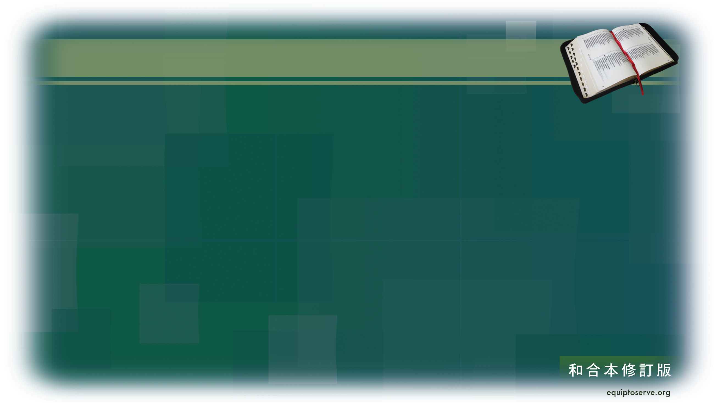
士師記 1:8-9
⁸猶大人攻打耶路撒冷，奪取了它，用刀殺城內的人，並且放火燒城。
⁹後來猶大人下去，與住山區、
尼革夫和低地的迦南人爭戰。
Notes:
⁸ The men of Judah attacked Jerusalem also and took it. They put the city to the sword and set it on fire.
⁹ After that, Judah went down to fight against the Canaanites living in the hill country, the Negev and the western foothills.
放火燒城的作用在那裏？
1. 攻打迦南人Canaanites,
2. 比利洗人Perizzites
3. 攻打耶路撒冷
4.住山區、尼革夫和低地的迦南人

Slide 7

士師記 1:10-11
¹⁰猶大去攻打住希伯崙的迦南人，殺了示篩、亞希幔、撻買。希伯崙從前名叫基列‧亞巴。 ¹¹猶大從那裏去攻擊底壁的居民。底壁從前名叫基列‧西弗。
Notes:
¹⁰ They advanced against the Canaanites living in Hebron (formerly called Kiriath Arba 「亞巴」是亞納族的祖先之一（書 14:15）, 被征服後, 改名為”希伯崙”) and defeated Sheshai, Ahiman and Talmai. ¹¹ From there they advanced against the people living in Debir (formerly called Kiriath Sepher 意思是「書之城」或「文獻之城」。).
1. 攻打迦南人Canaanites,
2. 比利洗人Perizzites
3. 攻打耶路撒冷
4.住山區、尼革夫和低地的迦南人
5.希伯崙：改名基列‧亞巴： 亞衲族中最尊大的人， 亞巴的城
6.底壁: 文獻之城」書卷之城: 知識與啟示

Slide 8
士師記 1:12-13
¹²迦勒說：「誰能攻打基列‧西弗，奪取那城，我就把我女兒押撒嫁給他。」¹³迦勒的弟弟基納斯的
兒子俄陀聶奪取了那城，迦勒就把女兒押撒嫁給他。
Notes:
¹² And Caleb said, “I will give my daughter Aksah in marriage to the man who attacks and captures Kiriath Sepher.” ¹³ Othniel son of Kenaz, Caleb’s younger brother, took it; so Caleb gav
1. 攻打迦南人Canaanites,
2. 比利洗人Perizzites
3. 攻打耶路撒冷
4.住山區、尼革夫和低地的迦南人
5.希伯崙：改名基列‧亞巴： 亞衲族中最尊大的人， 亞巴的城
6.底壁: 文獻之城」書卷之城: 知識與啟示
e his daughter Aksah to him in marriage.

Slide 9
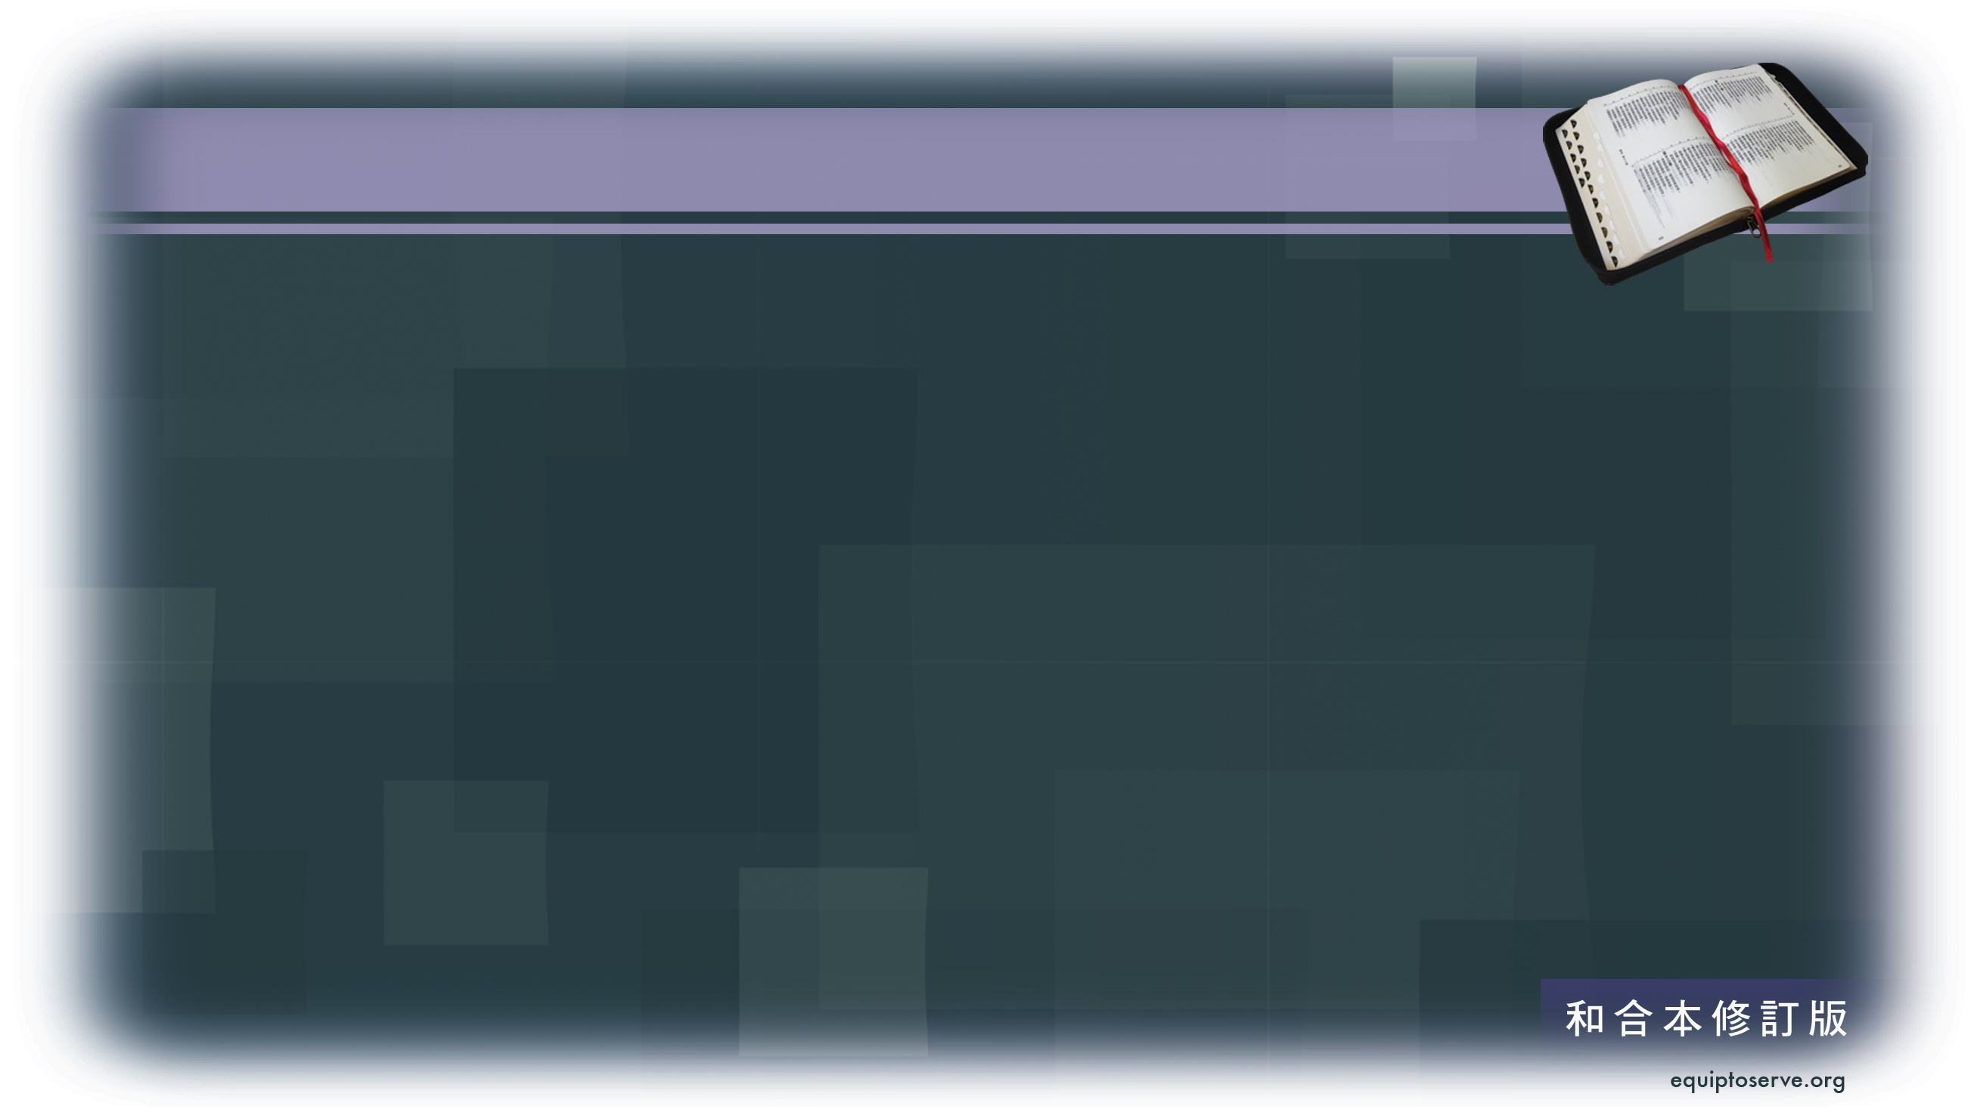
士師記 1:14-15
¹⁴押撒來的時候，催促丈夫向她父親要一塊田。押撒一下驢，迦勒就對她說：「你要甚麼？」¹⁵她對迦勒說：「求你賜我福分；你既然把尼革夫給了我，求你也給我水泉。」迦勒就把上泉和下泉都賜給她。
Notes:
¹⁴ One day when she came to Othniel, she urged him^{[a]} to ask her father for a field. When she got off her donkey, Caleb asked her, “What can I do for you?”
¹⁵ She replied, “Do me a special favor. Since you have given me land in the Negev, give me also springs of water.” So Caleb gave her the upper and lower springs.

Slide 10
士師記 1:16-17
¹⁶摩西的岳父是基尼人，他的子孫與猶大人一起上到棕樹城，往亞拉得以南的猶大曠野去，住在百姓當中。 ¹⁷猶大和他哥哥西緬同去，擊殺了住洗法的迦南人，將城徹底毀滅。因此，那城名叫何珥瑪。
Notes:
¹⁶ The descendants of Moses’ father-in-law, the Kenite, went up from the City of Palms^{[b]} with the people of Judah to live among the inhabitants of the Desert of Judah in the Negev near Arad.
¹⁷ Then the men of Judah went with the Simeonites their fellow Israelites and attacked the Canaanites living in Zephath, and they totally destroyed^{[c]} the city. Therefore it was called Hormah.^{[d]}

Slide 11
士師記 1:18-19
¹⁸猶大攻取了迦薩和所屬的領土，
亞實基倫和所屬的領土，以革倫和所屬的領土。¹⁹耶和華與猶大同在，猶大取得了山區，卻不能趕出平原的居民，因為他們有鐵的戰車。
Notes:
¹⁸ Judah also took^{[e]} Gaza, Ashkelon and Ekron—each city with its territory.
¹⁹ The Lord was with the men of Judah. They took possession of the hill country, but they were unable to drive the people from the plains, because they had chariots fitted with iron.

Slide 12
士師記 1:20-21
²⁰以色列人照摩西所說的，把希伯崙給了迦勒。迦勒從那裏趕出亞衲
的三支後裔。 ²¹至於住耶路撒冷的
耶布斯人、便雅憫人沒有把他們
趕出。於是，耶布斯人與便雅憫人同住在耶路撒冷，直到今日。
Notes:
²⁰ As Moses had promised, Hebron was given to Caleb, who drove from it the three sons of Anak. ²¹ The Benjamites, however, did not drive out the Jebusites, who were living in Jerusalem; to this day the Jebusites live there with the Benjamites.

Slide 13

士師記 1:22-24
²²約瑟家也上到伯特利去，耶和華與他們同在。²³約瑟家去窺探伯特利，那城起先名叫路斯。²⁴探子看見一個人從城裏出來，就對他說：「請你把進城的路指示我們，我們會厚待你。」
Notes:
²² Now the tribes of Joseph attacked Bethel, and the Lord was with them. ²³ When they sent men to spy out Bethel (formerly called Luz), ²⁴ the spies saw a man coming out of the city and they said to him, “Show us how to get into the city and we will see that you are treated well.”

Slide 14
士師記 1:25-26
²⁵那人把進城的路指示他們。他們就用刀擊殺了城中的居民，卻放走那人和他的全家。 ²⁶那人往赫人之地去，建造了一座城，起名叫路斯。那城到如今還叫這名。
Notes:
²⁵ So he showed them, and they put the city to the sword but spared the man and his whole family. ²⁶ He then went to the land of the Hittites, where he built a city and called it Luz, which is its name to this day.

Slide 15
士師記 1:27
瑪拿西沒有趕出伯‧善和所屬
鄉鎮的居民，他納和所屬鄉鎮的居民，多珥和所屬鄉鎮的居民，
以伯蓮和所屬鄉鎮的居民，米吉多和所屬鄉鎮的居民；迦南人仍堅持住在這地。
Notes:
²⁷ But Manasseh did not drive out the people of Beth Shan or Taanach or Dor or Ibleam or Megiddo and their surrounding settlements, for the Canaanites were determined to live in that land.

Slide 16
士師記 1:28-29
²⁸以色列強盛的時候，就叫迦南人做苦工，沒有把他們全然趕走。
²⁹以法蓮沒有趕出住基色的迦南人。於是迦南人仍住在基色，在以法蓮中間。
Notes:
²⁸ When Israel became strong, they pressed the Canaanites into forced labor but never drove them out completely. ²⁹ Nor did Ephraim drive out the Canaanites living in Gezer, but the Canaanites continued to live there among them.

Slide 17
士師記 1:30
西布倫沒有趕出基倫的居民和
拿哈拉的居民。於是迦南人仍住在西布倫中間，成了服勞役的人。
Notes:
³⁰ Neither did Zebulun drive out the Canaanites living in Kitron or Nahalol, so these Canaanites lived among them, but Zebulun did subject them to forced labor.

Slide 18
士師記 1:31-32
³¹亞設沒有趕出亞柯的居民和西頓的居民，以及亞黑拉、亞革悉、
黑巴、亞弗革和利合的居民。
³²亞設人因為沒有趕出那地的居民迦南人，就住在他們中間。
Notes:
³¹ Nor did Asher drive out those living in Akko or Sidon or Ahlab or Akzib or Helbah or Aphek or Rehob. ³² The Asherites lived among the Canaanite inhabitants of the land because they did not drive them out.

Slide 19
士師記 1:33
拿弗他利沒有趕出伯‧示麥和
伯‧亞納的居民。於是拿弗他利就住在那地的居民迦南人中，而
伯‧示麥和伯‧亞納的居民卻成了為他們服勞役的人。
Notes:
³³ Neither did Naphtali drive out those living in Beth Shemesh or Beth Anath; but the Naphtalites too lived among the Canaanite inhabitants of the land, and those living in Beth Shemesh and Beth Anath became forced laborers for them.

Slide 20
士師記 1:34-36
³⁴亞摩利人強逼但人住在山區，不准他們下到平原。³⁵亞摩利人仍堅持住在希烈山、亞雅崙和沙賓；然而約瑟家權勢強盛的時候，他們成為服勞役的人。³⁶亞摩利人的地界是從亞克拉濱斜坡，從西拉延伸而上。
Notes:
³⁴ The Amorites confined the Danites to the hill country, not allowing them to come down into the plain. ³⁵ And the Amorites were determined also to hold out in Mount Heres, Aijalon and Shaalbim, but when the power of the tribes of Joseph increased, they too were pressed into forced labor. ³⁶ The boundary of the Amorites was from Scorpion Pass to Sela and beyond.

Slide 21
士師記 2:1
耶和華的使者從吉甲上到波金，說：「我領你們從埃及上來，帶你們到我向你們列祖起誓應許之地。我曾說：『我永不廢棄我與你們的約。
Notes:
2 The angel of the Lord went up from Gilgal to Bokim and said, “I brought you up out of Egypt and led you into the land I swore to give to your ancestors. I said, ‘I will never break my covenant with you,

Slide 22
士師記 2:2-3
²你們不可與這地的居民立約，要拆毀他們的祭壇。』³你們竟沒有聽從我的話。你們為何這樣做呢！ ⁴因此我說：『我必不將他們從你們面前趕出。他們必作你們肋下的荊棘，他們的神明必成為你們的圈套。』」
Notes:
² and you shall not make a covenant with the people of this land, but you shall break down their altars.’ Yet you have disobeyed me. Why have you done this? ³ And I have also said, ‘I will not drive them out before you; they will become traps for you, and their gods will become snares to you.’”

Slide 23
士師記 2:4-5
⁴耶和華的使者向以色列眾人說這些話的時候，百姓放聲大哭。⁵於是他們給那地方起名叫波金，並在那裏向耶和華獻祭。
Notes:
⁴ When the angel of the Lord had spoken these things to all the Israelites, the people wept aloud, ⁵ and they called that place Bokim.^{[a]} There they offered sacrifices to the Lord.

Slide 24
中心思想：

Slide 25
 | 士師名字 | 主要事蹟 | 做士師的年期 | 《舊約聖經》出處
1 | 俄陀聶 | 帶領以色列人打敗美索不達米亞人 | 40年 | 《士師記》三章7～11節
2 | 以笏 | 帶領以色列人擊敗摩押人 | 80年 | 《士師記》三章12～30節
3 | 珊迦 | 帶領以色列人擊敗非利士人 | 10年 | 《士師記》三章31節
4 | 底波拉 | 女性士師，帶領以色列人擊敗迦南人 | 40年 | 《士師記》四章～五章
5 | 基甸 | 帶領以色列人擊敗米甸人 | 40年 | 《士師記》六章～九章
6 | 陀拉 |  | 23年 | 《士師記》十章1～2節
7 | 睚珥 |  | 22年 | 《士師記》十章3～-5節
8 | 耶弗他 | 帶領以色列人擊敗亞捫人 | 6年 | 《士師記》十章6節～十二章7節
9 | 以比讚 |  | 7年 | 《士師記》十二章8～10節
10 | 以倫 |  | 10年 | 《士師記》十二章11～12節
11 | 押頓 |  | 8年 | 《士師記》十二章13～15節
12 | 參孫 | 帶領以色列人擊敗非利士人 | 20年 | 《士師記》十三章～十六章
13 | 以利 | 同時亦是示羅的大祭司 | 40年 | 《撒母耳記上》一章～四章18節
14 | 撒母耳 | 膏立以色列首兩位王掃羅與大衛 |  | 《撒母耳記上》一章～至廿五章1節

Slide 26
士師記 1:1-2
¹約書亞死後，以色列人求問耶和華說：「我們中間誰當首先上去攻打迦南人，與他們爭戰呢？」²耶和華說：「猶大要先上去。看哪，我已將那地交在他手中。」
Notes:
Author: Unknown, though certain sections may derive from the prophet Samuel 本師記的作者: 不詳, 大部份學者認為是先知撒母耳
Theme: Through leaders known as “judges,” God again and again delivers the Israelites, who are in danger of losing the promised land through their unfaithfulness.
當以色列人因不忠而瀕臨失去應許之地的危機時，神透過新一代的領袖「士師」，多次施行拯救……但其中有條件/共通的特質……….。
士師的角色：¹⁶ 耶和華興起士師，士師就拯救他們脫離搶奪他們之人的手。¹⁶ Then the Lord raised up judges,^{[c]} who saved them out of the hands of these raiders. （入侵者）
摩西是一代的開始……卻未結束，就是蒙神呼召, 帶領以色列人離開埃及, 進入曠野……邁向迦南應許之地。
約書亞是一代的結束，將第二代的以色人領進迦南應許之地
1 After the death of Joshua, the Israelites asked the Lord, “Who of us is to go up first to fight against the Canaanites?”
² The Lord answered, “Judah shall go up; I have given the land into their hands.”

Slide 27
士師記 1:3-4
³猶大對他哥哥西緬說：「請你同我上到我抽籤所得之地，與迦南人爭戰；我也同你去你抽籤所得之地。」於是西緬與他同去。⁴猶大就上去，耶和華把迦南人和比利洗人交在他們手中。他們在比色擊殺了一萬人。
Notes:
³ The men of Judah then said to the Simeonites their fellow Israelites, “Come up with us into the territory allotted to us, to fight against the Canaanites. We in turn will go with you into yours.” So the Simeonites went with them. ⁴ When Judah attacked, the Lord gave the Canaanites and Perizzites into their hands, and they struck down ten thousand men at Bezek.
兄弟同心, 同行!
1. 攻打迦南人Canaanites, 比利洗人Perizzites。

Slide 28
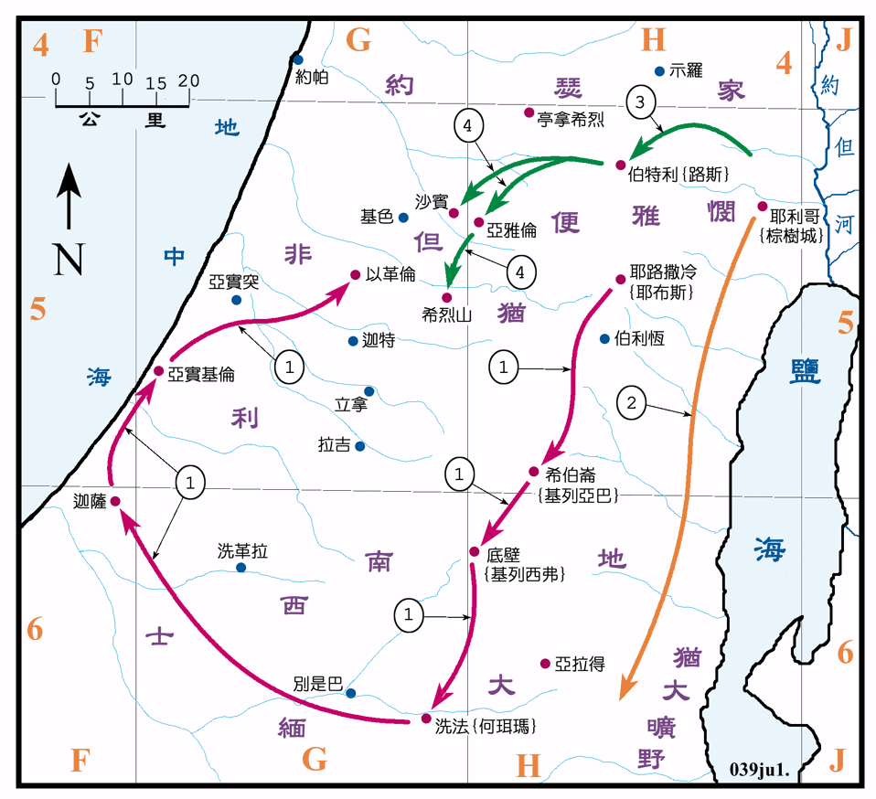
攻取南部之地
Notes:
梁天樞聖經地圖地名列表 https://bible.fhl.net/LMAP/list.php
https://bible.fhl.net/LMAP/index.php?gb=0&engs=Judg&chap=2 攻取南部之地
當以色列人因不忠而瀕臨失去應許之地的危機時，神透過新一代的領袖「士師」，多次施行拯救……但其中有條件/共通的特質……….。
士師的角色：¹⁶ 耶和華興起士師，士師就拯救他們脫離搶奪他們之人的手。¹⁶ Then the Lord raised up judges,^{[c]} who saved them out of the hands of these raiders. （入侵者）
摩西是一代的開始……卻未結束，就是蒙神呼召, 帶領以色列人離開埃及, 進入曠野……邁向迦南應許之地。
約書亞是一代的結束，將第二代的以色人領進迦南應許之地

Slide 30
士師記 1:5-7
⁵他們在比色遇見亞多尼‧比色，與他爭戰，擊敗了迦南人和比利洗人。 ⁶亞多尼‧比色逃跑，他們追趕他，捉住他，砍斷他大拇指和大腳趾。 ⁷亞多尼‧比色說：「從前有七十個王，大拇指和大腳趾都被我砍斷，在我桌子底下拾取零碎食物。現在神照著我所做的報應我了。」他們把亞多尼‧比色帶到耶路撒冷，他就死在那裏。
Notes:
⁵ It was there that they found Adoni-Bezek and fought against him, putting to rout the Canaanites and Perizzites. ⁶ Adoni-Bezek fled, but they chased him and caught him, and cut off his thumbs and big toes.

Slide 31
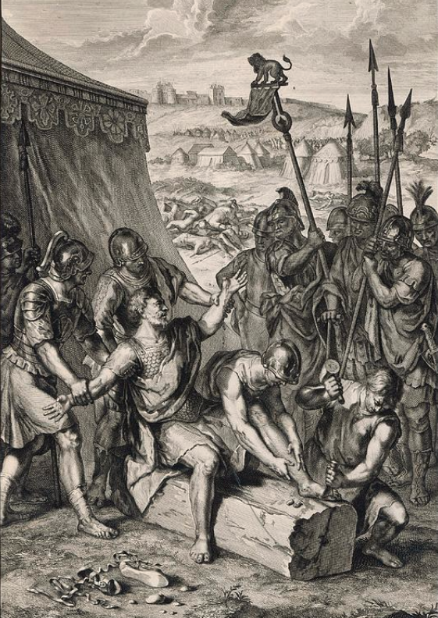
砍斷他大拇指和大腳趾?
使敵人失去作戰能力
Notes:
失去武力與行動能力——廢了武功
在金庸、古龍等武俠作品中，挑斷手筋腳筋常被用來「廢除武功」，使人失去戰鬥能力。
“斷手筋及及腳筋”

Slide 32
砍斷他大拇指和大腳趾?
使敵人失去作戰能力
記念征服敵人的戰蹟
Notes:
失去武力與行動能力——廢了武功
在金庸、古龍等武俠作品中，挑斷手筋腳筋常被用來「廢除武功」，使人失去戰鬥能力。
“斷手筋及及腳筋”

Slide 33
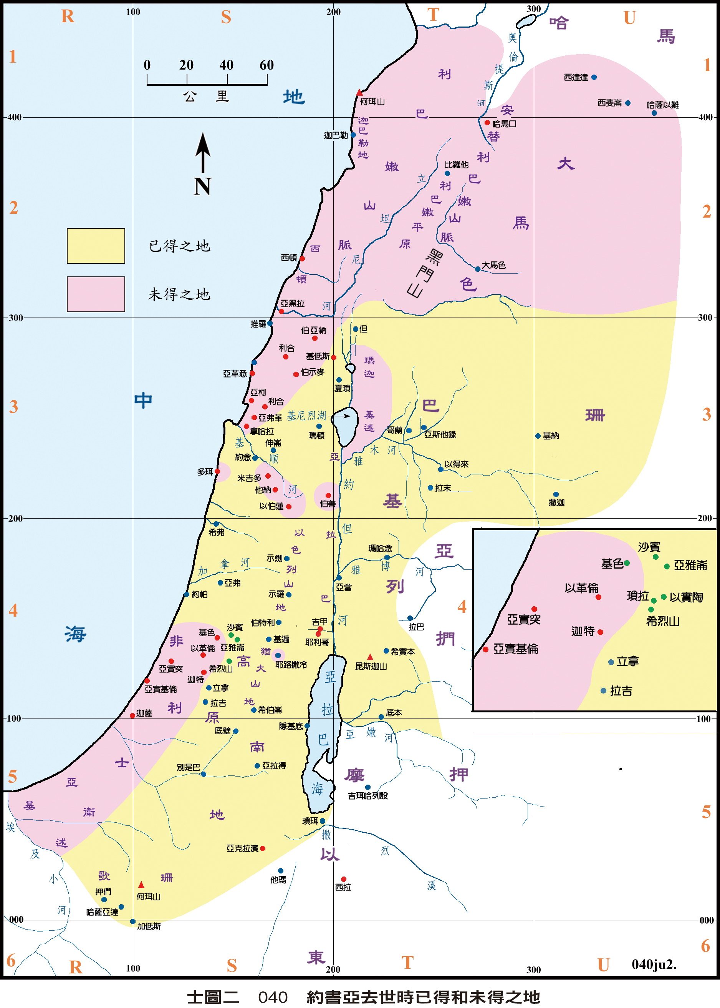
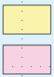
約書亞去世時,
已得和未得之地的分佈
已得的地
未得的地
Notes:
梁天樞聖經地圖地名列表 https://bible.fhl.net/LMAP/list.php

Slide 34
 | 士師名字 | 主要事蹟 | 做士師的年期 | 《舊約聖經》出處
1 | 俄陀聶 | 帶領以色列人打敗美索不達米亞人 | 40年 | 《士師記》三章7～11節
2 | 以笏 | 帶領以色列人擊敗摩押人 | 80年 | 《士師記》三章12～30節
3 | 珊迦 | 帶領以色列人擊敗非利士人 | 10年 | 《士師記》三章31節
4 | 底波拉 | 女性士師，帶領以色列人擊敗迦南人 | 40年 | 《士師記》四章～五章
5 | 基甸 | 帶領以色列人擊敗米甸人 | 40年 | 《士師記》六章～九章
6 | 陀拉 |  | 23年 | 《士師記》十章1～2節
7 | 睚珥 |  | 22年 | 《士師記》十章3～-5節
8 | 耶弗他 | 帶領以色列人擊敗亞捫人，並於戰勝後向上帝獻上女兒為燔祭。 | 6年 | 《士師記》十章6節～十二章7節
9 | 以比讚 |  | 7年 | 《士師記》十二章8～10節
10 | 以倫 |  | 10年 | 《士師記》十二章11～12節
11 | 押頓 |  | 8年 | 《士師記》十二章13～15節
12 | 參孫 | 帶領以色列人擊敗非利士人 | 20年 | 《士師記》十三章～十六章
13 | 以利 | 同時亦是示羅的大祭司 | 40年 | 《撒母耳記上》一章～四章18節
14 | 撒母耳 | 膏立以色列首兩位王掃羅與大衛 |  | 《撒母耳記上》一章～至廿五章1節

Slide 35
士師記 1:12-13
¹²迦勒說：「誰能攻打基列‧西弗，奪取那城，我就把我女兒押撒嫁給他。」¹³迦勒的弟弟基納斯的
兒子俄陀聶奪取了那城，迦勒就把女兒押撒嫁給他。
Notes:
¹² And Caleb said, “I will give my daughter Aksah in marriage to the man who attacks and captures Kiriath Sepher.” ¹³ Othniel son of Kenaz, Caleb’s younger brother, took it; so Caleb gav
1. 攻打迦南人Canaanites,
2. 比利洗人Perizzites
3. 攻打耶路撒冷
4.住山區、尼革夫和低地的迦南人
5.基列‧亞巴：希伯崙：改名基列‧亞巴： 亞衲族中最尊大的人， 亞巴的城
6.基列‧西弗：底壁: 文獻之城」書卷之城: 知識與啟示 :底璧,＂意為“神的啟示,＂
e his daughter Aksah to him in marriage.
迦勒希望女婿也具備同樣的信心與戰鬥精神，能在艱難中--為神爭戰。一種信仰的延續（後代)

Slide 36
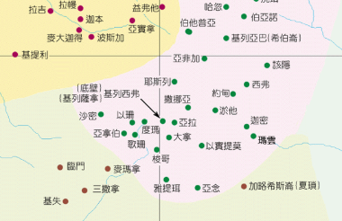
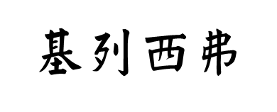
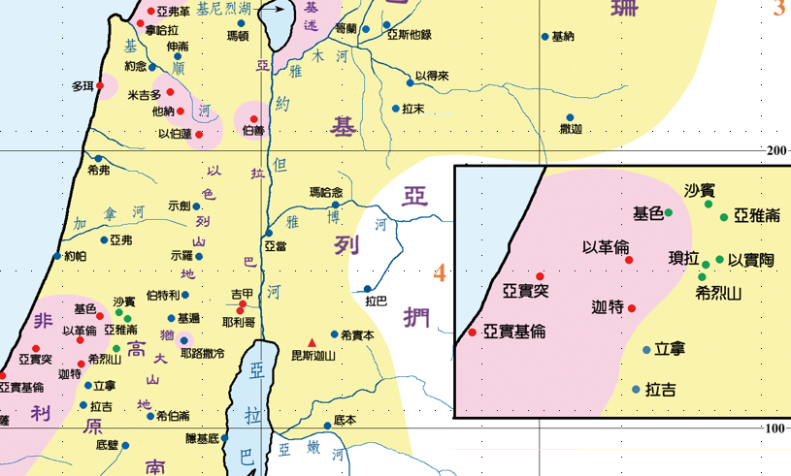
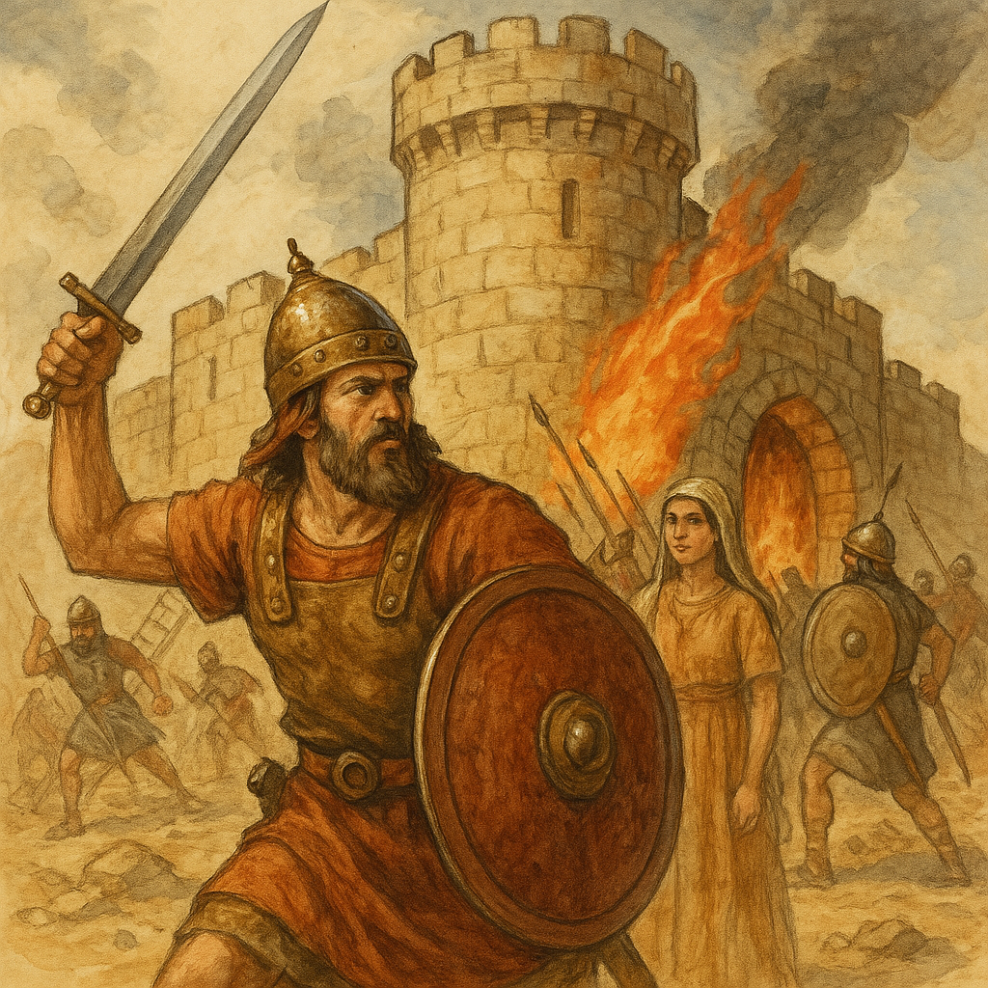
迦勒招慕
女婿的條件？
Notes:
迦勒招女婿的條件?

Slide 37
士師記 1:18-19
¹⁸猶大攻取了迦薩和所屬的領土，
亞實基倫和所屬的領土，以革倫和所屬的領土。¹⁹耶和華與猶大同在，猶大取得了山區，卻不能趕出平原的居民，因為他們有鐵的戰車。
Notes:
¹⁸ Judah also took^{[e]} Gaza, Ashkelon and Ekron—each city with its territory.
¹⁹ The Lord was with the men of Judah. They took possession of the hill country, but they were unable to drive the people from the plains, because they had chariots fitted with iron.
1. 攻打迦南人Canaanites,
2. 比利洗人Perizzites
3. 攻打耶路撒冷
4.住山區、尼革夫和低地的迦南人
5.希伯崙：改名基列‧亞巴： 亞衲族中最尊大的人， 亞巴的城
6.底壁: 文獻之城」書卷之城: 知識與啟示
7.迦薩和所屬的領土
8. 亞實基倫和所屬的領土

Slide 38
士師記 1:20-21
²⁰以色列人照摩西所說的，把希伯崙給了迦勒。迦勒從那裏趕出亞衲
的三支後裔。 ²¹至於住耶路撒冷的
耶布斯人、便雅憫人沒有把他們
趕出。於是，耶布斯人與便雅憫人同住在耶路撒冷，直到今日。
Notes:
²⁰ As Moses had promised, Hebron was given to Caleb, who drove from it the three sons of Anak. ²¹ The Benjamites, however, did not drive out the Jebusites, who were living in Jerusalem; to this day the Jebusites live there with the Benjamites.

Slide 39
總結: 猶大攻城略地的戰蹟
1. 攻打迦南人Canaanites,
2. 比利洗人Perizzites
3. 攻打耶路撒冷
4. 住山區、尼革夫和低地的迦南人
5. 基列‧亞巴（希伯崙） 亞衲族中最尊大的人，稱為
亞巴的城
6. 基列‧西弗（底壁） 文獻之城，書卷之城
7. 迦薩和所屬的領土
8. 亞實基倫和所屬的領土

Slide 40
士師記 1:22-24
²²約瑟家也上到伯特利去，耶和華與他們同在。²³約瑟家去窺探伯特利，那城起先名叫路斯。²⁴探子看見一個人從城裏出來，就對他說：「請你把進城的路指示我們，我們會厚待你。」
Notes:
²² Now the tribes of Joseph attacked Bethel, and the Lord was with them. ²³ When they sent men to spy out Bethel (formerly called Luz), ²⁴ the spies saw a man coming out of the city and they said to him, “Show us how to get into the city and we will see that you are treated well.”

Slide 41
士師記 1:25-26
²⁵那人把進城的路指示他們。他們就用刀擊殺了城中的居民，卻放走那人和他的全家。 ²⁶那人往赫人之地去，建造了一座城，起名叫路斯。那城到如今還叫這名。
Notes:
²⁵ So he showed them, and they put the city to the sword but spared the man and his whole family. ²⁶ He then went to the land of the Hittites, where he built a city and called it Luz, which is its name to this day.
放走那人：重建路斯之城; 赫人之地去

Slide 42
總結: 約瑟家攻城略地的戰蹟
1. 路斯：改名為伯特利
2. 放走那人：重建路斯之城
3. 攻打耶路撒冷
4. 住山區、尼革夫和低地的迦南人
5. 基列‧亞巴（希伯崙） 亞衲族中最尊大的人，稱為
亞巴的城
6. 基列‧西弗（底壁） 文獻之城，書卷之城
7. 迦薩和所屬的領土
8. 亞實基倫和所屬的領土

Slide 43
士師記 1:27
瑪拿西沒有趕出伯‧善和所屬
鄉鎮的居民，他納和所屬鄉鎮的居民，多珥和所屬鄉鎮的居民，
以伯蓮和所屬鄉鎮的居民，米吉多和所屬鄉鎮的居民；迦南人仍堅持住在這地。
Notes:
²⁷ But Manasseh did not drive out the people of Beth Shan or Taanach or Dor or Ibleam or Megiddo and their surrounding settlements, for the Canaanites were determined to live in that land.

Slide 44
總結: 瑪拿西攻城略地的戰蹟
1. 沒有趕出城內的人
a. 伯‧善和所屬鄉鎮的居民
b. 他納和所屬鄉鎮的居民
c. 多珥和所屬鄉鎮的居民
d. 以伯蓮和所屬鄉鎮的居民
e. 米吉多和所屬鄉鎮的居民
* 迦南人仍堅持住在這地
4. 住山區、尼革夫和低地的迦南人
5. 基列‧亞巴（希伯崙） 亞衲族中最尊大的人，稱為
亞巴的城
6. 基列‧西弗（底壁） 文獻之城，書卷之城
7. 迦薩和所屬的領土
8. 亞實基倫和所屬的領土
Notes:
But Manasseh did not drive out the people

Slide 45
士師記 1:28-29
²⁸以色列強盛的時候，就叫迦南人做苦工，沒有把他們全然趕走。
²⁹以法蓮沒有趕出住基色的迦南人。於是迦南人仍住在基色，在以法蓮中間。
Notes:
²⁸ When Israel became strong, they pressed the Canaanites into forced labor but never drove them out completely. ²⁹ Nor did Ephraim drive out the Canaanites living in Gezer, but the Canaanites continued to live there among them.

Slide 46
士師記 1:30
西布倫沒有趕出基倫的居民和
拿哈拉的居民。於是迦南人仍住在西布倫中間，成了服勞役的人。
Notes:
³⁰ Neither did Zebulun drive out the Canaanites living in Kitron or Nahalol, so these Canaanites lived among them, but Zebulun did subject them to forced labor.

Slide 47
士師記 1:31-32
³¹亞設沒有趕出亞柯的居民和西頓的居民，以及亞黑拉、亞革悉、
黑巴、亞弗革和利合的居民。
³²亞設人因為沒有趕出那地的居民迦南人，就住在他們中間。
Notes:
³¹ Nor did Asher drive out those living in Akko or Sidon or Ahlab or Akzib or Helbah or Aphek or Rehob. ³² The Asherites lived among the Canaanite inhabitants of the land because they did not drive them out.

Slide 48
士師記 1:33
拿弗他利沒有趕出伯‧示麥和
伯‧亞納的居民。於是拿弗他利就住在那地的居民迦南人中，而
伯‧示麥和伯‧亞納的居民卻成了為他們服勞役的人。
Notes:
³³ Neither did Naphtali drive out those living in Beth Shemesh or Beth Anath; but the Naphtalites too lived among the Canaanite inhabitants of the land, and those living in Beth Shemesh and Beth Anath became forced laborers for them.

Slide 49
總結: 西布倫, 亞設, 拿弗他利
攻城略地的戰蹟
1. 沒有趕出城內的人
a. * 迦南人住在他們中間
b. 成了服役的人
4. 住山區、尼革夫和低地的迦南人
5. 基列‧亞巴（希伯崙） 亞衲族中最尊大的人，稱為
亞巴的城
6. 基列‧西弗（底壁） 文獻之城，書卷之城
7. 迦薩和所屬的領土
8. 亞實基倫和所屬的領土
Notes:
But Manasseh did not drive out the people

Slide 50
士師記 1:34-36
³⁴亞摩利人強逼但人住在山區，不准他們下到平原。³⁵亞摩利人仍堅持住在希烈山、亞雅崙和沙賓；然而約瑟家權勢強盛的時候，他們成為服勞役的人。³⁶亞摩利人的地界是從亞克拉濱斜坡，從西拉延伸而上。
Notes:
³⁴ The Amorites confined the Danites to the hill country, not allowing them to come down into the plain. ³⁵ And the Amorites were determined also to hold out in Mount Heres, Aijalon and Shaalbim, but when the power of the tribes of Joseph increased, they too were pressed into forced labor. ³⁶ The boundary of the Amorites was from Scorpion Pass to Sela and beyond.
亞摩利人控制平原：亞摩利人擁有鐵戰車（士1:19），在平原上佔有軍事優勢，使但支派無法進入並定居。
也象徵他們在軍事與政治上處於劣勢。

Slide 51
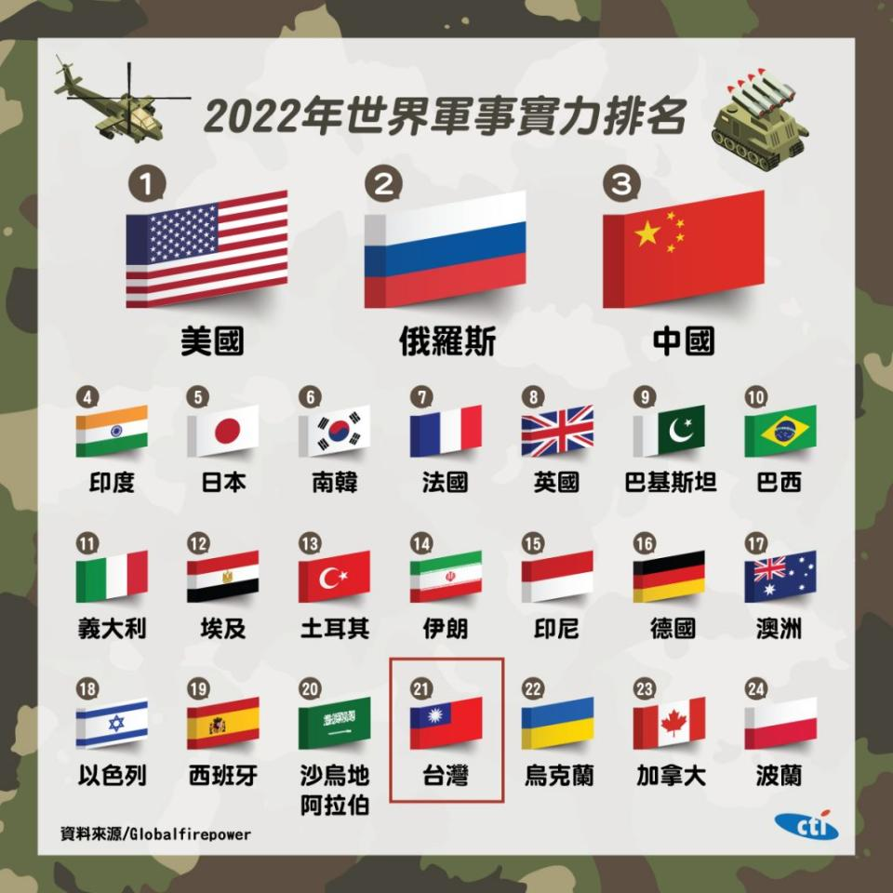
總結: 但攻城略地的戰蹟
1. 沒有趕出住在平原的亞摩利人
a. 因為亞摩利人有戰車 (1:19)
b. 後來約瑟家勝過他們， 也成成了服役的人。
(1:36)
4. 住山區、尼革夫和低地的迦南人
5. 基列‧亞巴（希伯崙） 亞衲族中最尊大的人，稱為
亞巴的城
6. 基列‧西弗（底壁） 文獻之城，書卷之城
7. 迦薩和所屬的領土
8. 亞實基倫和所屬的領土
Notes:
But Manasseh did not drive out the people

Slide 52
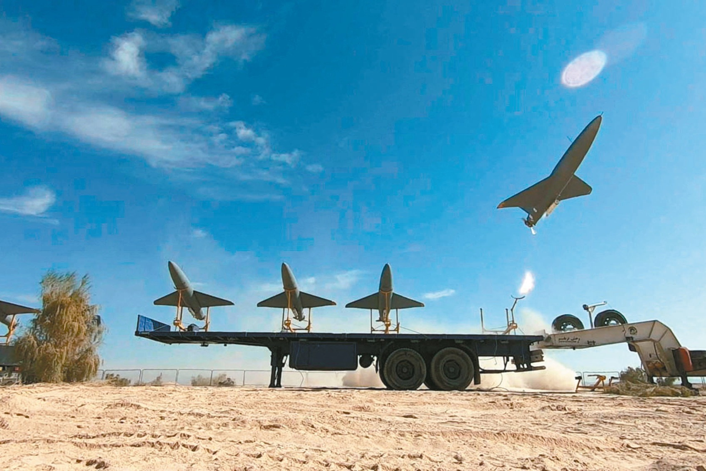
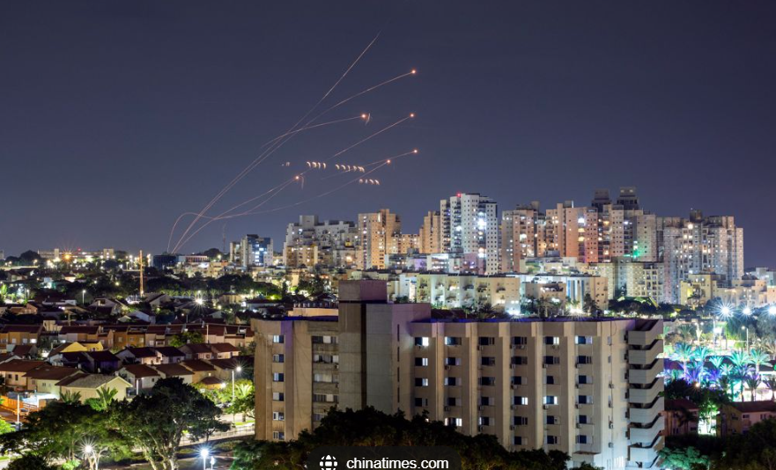


以伊戰爭
以巴衝突
Notes:
伊朗無人機

Slide 53
士師記 2:1
耶和華的使者從吉甲上到波金，說：「我領你們從埃及上來，帶你們到我向你們列祖起誓應許之地。我曾說：『我永不廢棄我與你們的約。
Notes:
2 The angel of the Lord went up from Gilgal to Bokim and said, “I brought you up out of Egypt and led you into the land I swore to give to your ancestors. I said, ‘I will never break my covenant with you,

Slide 54
士師記 2:1-3
¹耶和華的使者從吉甲上到波金，說：「我領你們從埃及上來，帶你們到我向你們列祖起誓應許之地。我曾說：『我永不廢棄我與你們的約。
²你們不可與這地的居民立約，要拆毀他們的祭壇。』³你們竟沒有聽從我的話。你們為何這樣做呢！ ⁴因此我說：『我必不將他們從你們面前趕出。他們必作你們肋下的荊棘，他們的神明必成為你們的圈套。』」
Notes:
² and you shall not make a covenant with the people of this land, but you shall break down their altars.’ Yet you have disobeyed me. Why have you done this? ³ And I have also said, ‘I will not drive them out before you; they will become traps for you, and their gods will become snares to you.’”

Slide 55
士師記 2:4-5
⁵於是他們給那地方起名叫波金，並在那裏向耶和華獻祭。
波金 (Bochim)
吉甲附近一地名，「哭」的意思。以色列人定居迦南後違背神的意旨，沒有拆毀原住民的祭壇，並與他們立約，耶和華派天使告訴以色列人必將為此受到懲罰。百姓放聲痛哭，該地因此得名。(士2:1-5)案:有研究者說波金是「伯特利」的別名。(~以斯拉培訓網絡提供)
Notes:
⁴ When the angel of the Lord had spoken these things to all the Israelites, the people wept aloud, ⁵ and they called that place Bokim.^{[a]} There they offered sacrifices to the Lord.

Slide 56
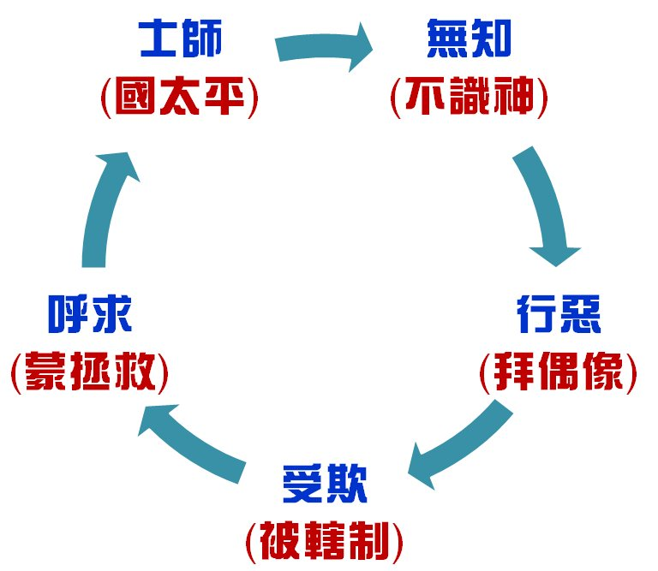

循環的模式

Slide 57
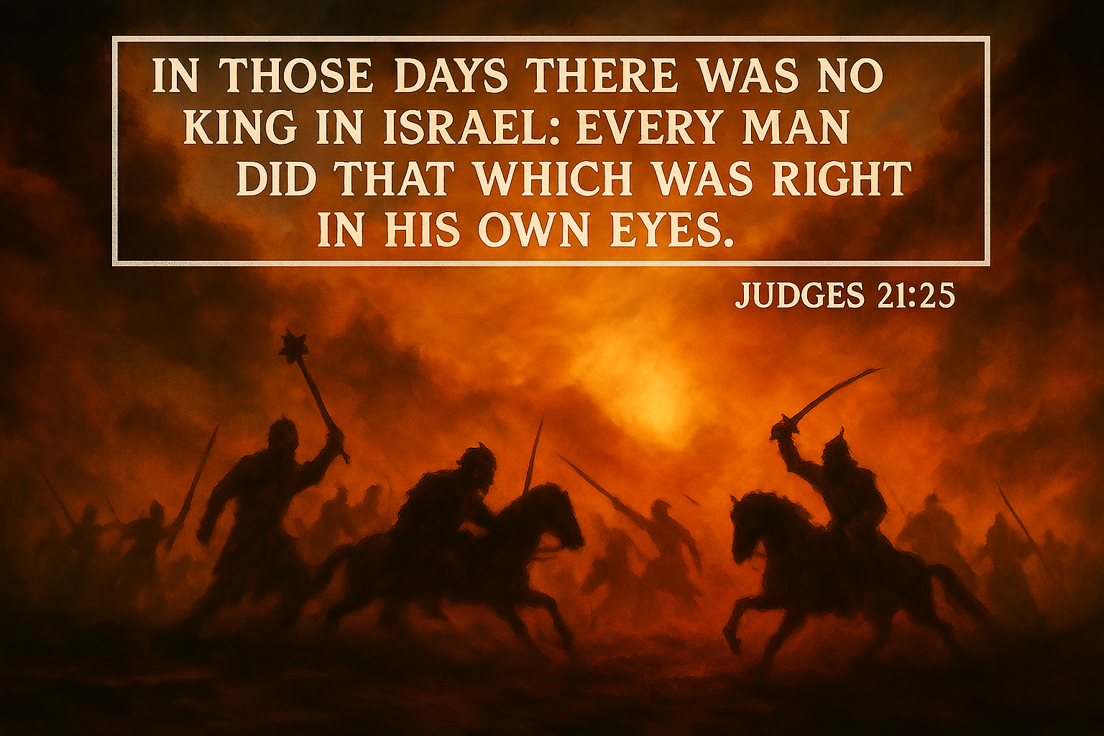

那時以色列中沒有王，各人任意而行。

Slide 58
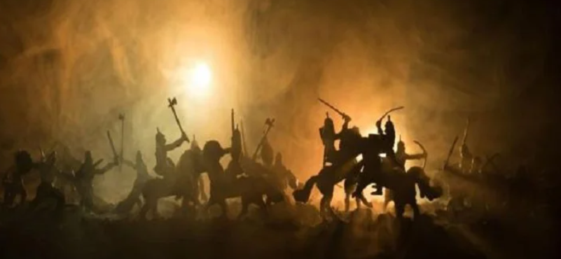
默想：1. 士師記的主題和我今天的時代和生活有甚麼關聯？
2. 各支派如何分地為業，有何啟發你對信仰的反思？

