Slide 1

ANNOUNCEMENTS
If you are new to our Church, please know, we are so blessed you are with us.

Slide 2
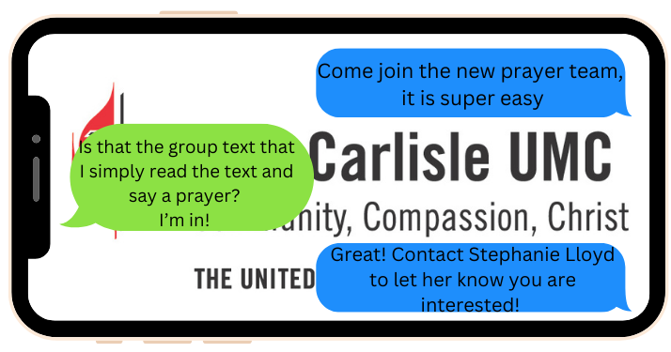
Prayer Team

Slide 3

Envelopes located near Offertory Plates

Slide 4
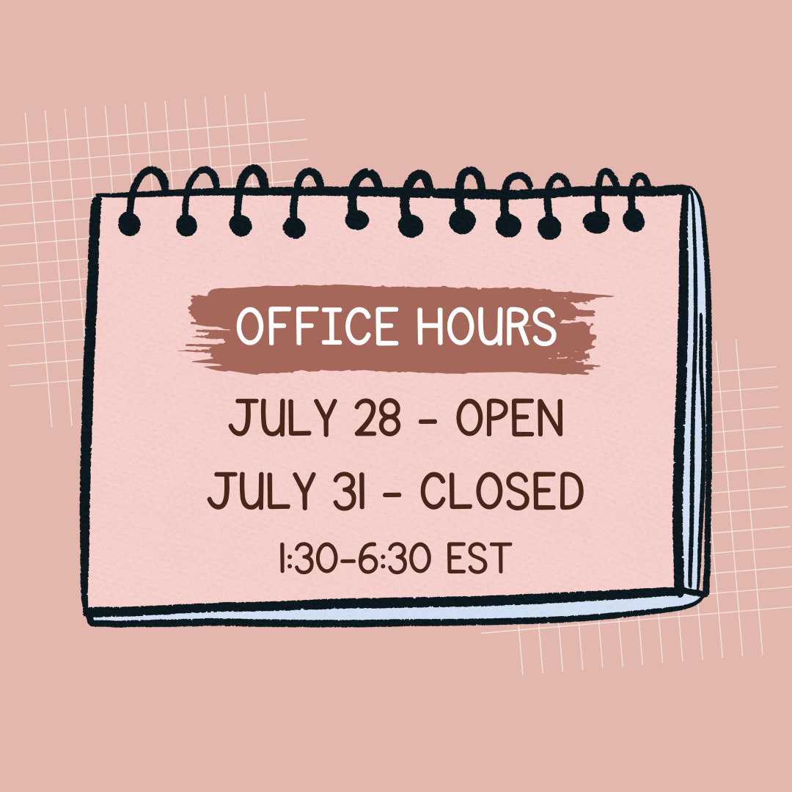

Slide 5
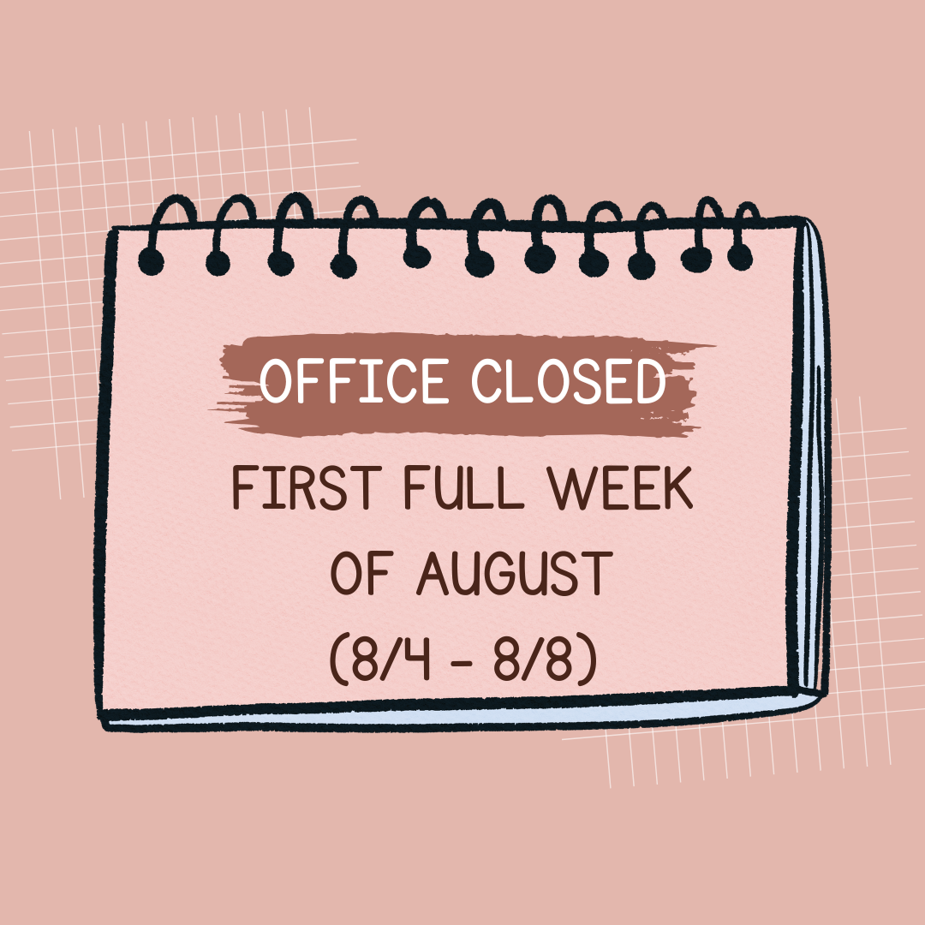

Slide 6
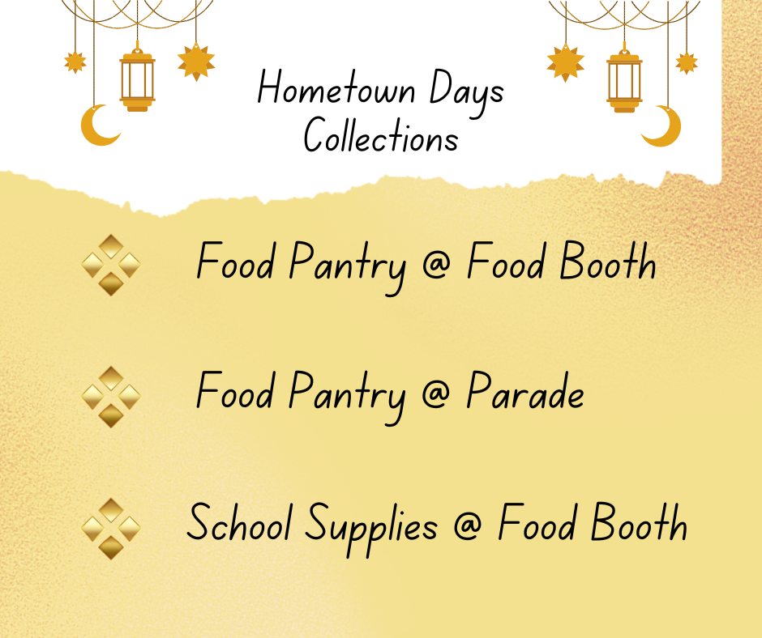

Slide 7
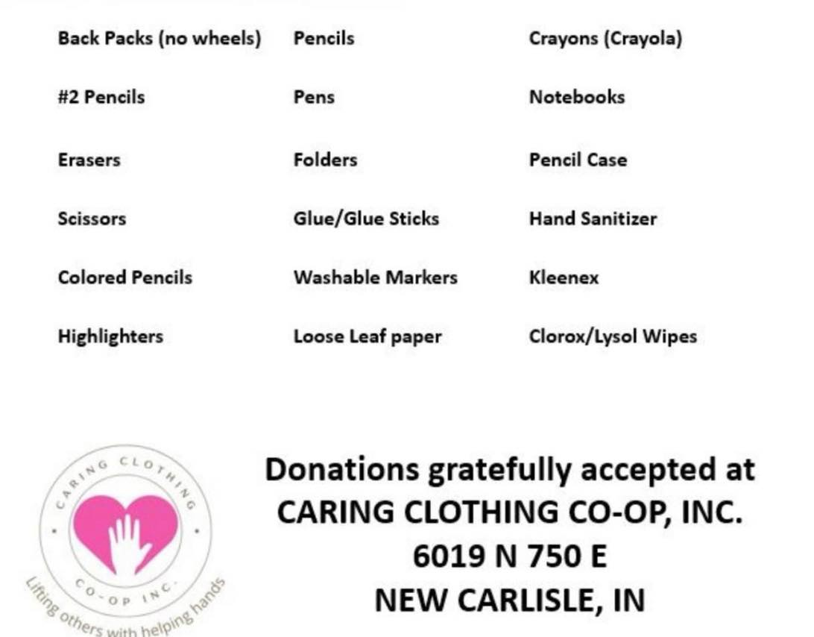
Back To School
Supply Drive Requests

Slide 8
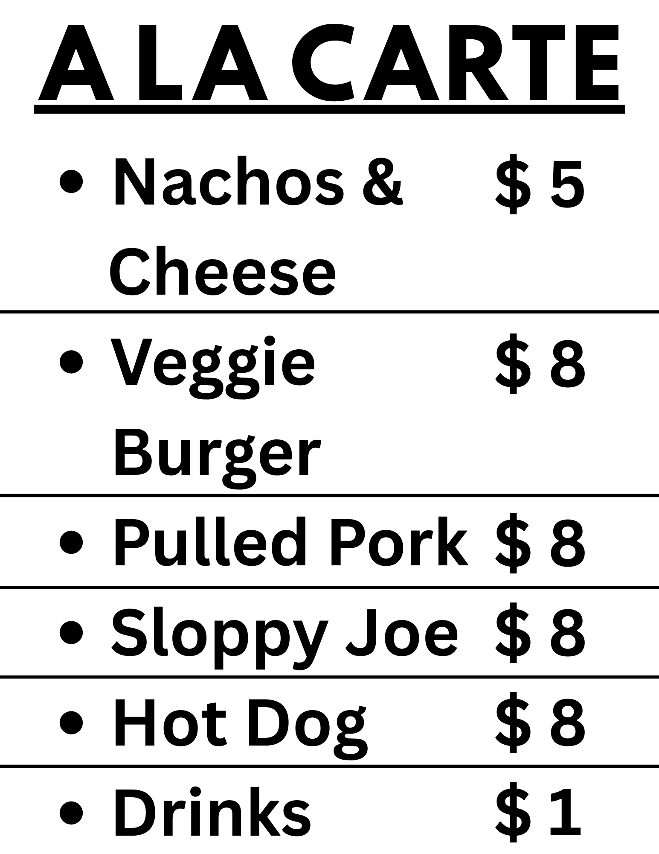


Slide 9
Broadway Christian Parish Update
April $ 104
May $ 58
YTD $341

Slide 10
Meetings
July 15 – Trustees
@ 6:30
August 5 – Finance @ 6:30
August 12 – Ad Council @ 6:30

Slide 11
COMMUNITY RESERVE NEEDS
Silverware
Kitchen Utensils
Pots and Pans
Small Appliances
Living Room Furniture
Bedroom Furniture
Dining Tables and Chairs

Slide 12
Cookie Bakers for Sunday Morning
We would appreciate more volunteers to provide Sunday morning cookies. Sign up sheet is in the Fellowship Hall.

Slide 13
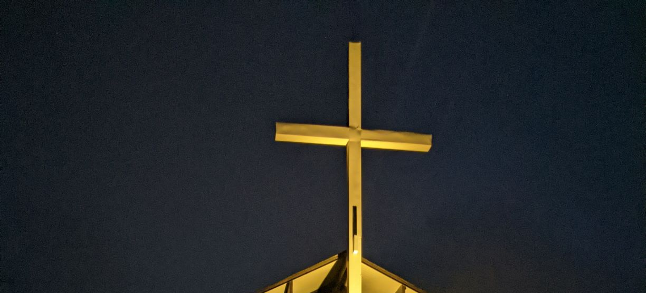
CROSS LIGHTING
The cross is being lit in honor of Jesus Christ, our Lord, who saved us from our sins.
Notes:
And

Slide 14
If you would like the cross lit in memory or in honor of someone, please let the office know. It is $10.00 a week.

Slide 15

LOOK AT NCUMC ON FACEBOOK
If you need help or would like to see something listed, please contact Ann Morrison

Slide 16
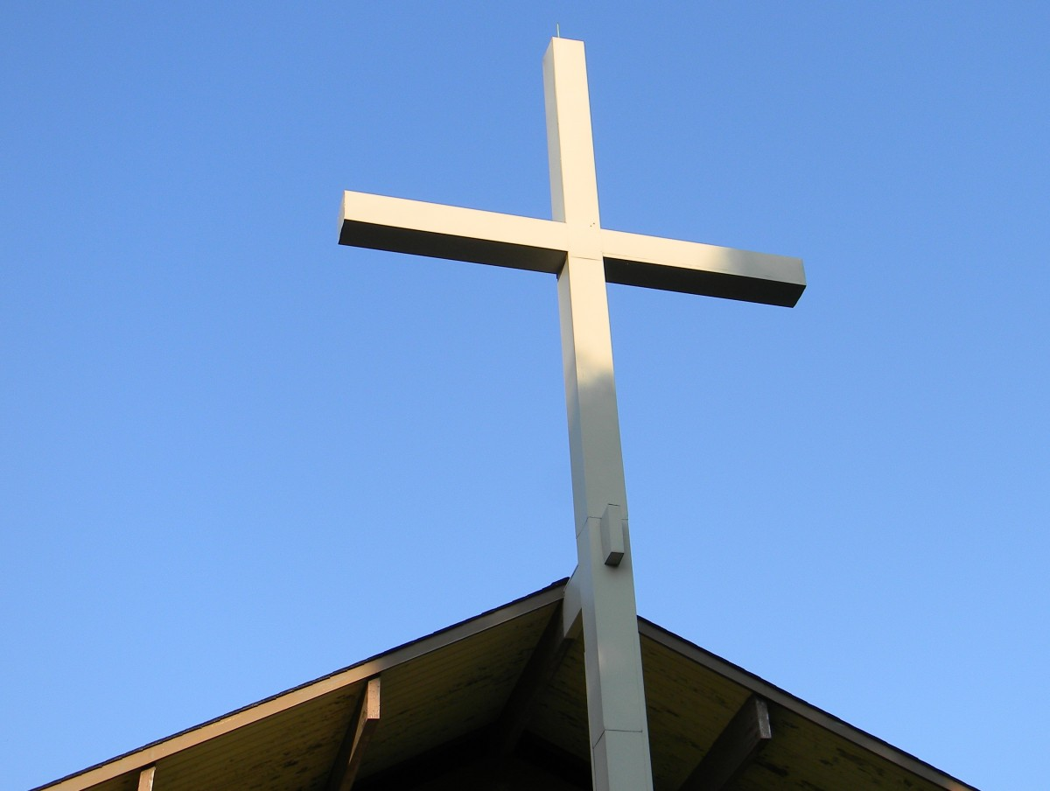
OUR WEBSITE www.wearencumc.org

Slide 17

It does not take long to ask GOD for help for someone you know or don’t know.
If you have a request, message us on Facebook, or you can text Pastor Kal or Stephanie Lloyd or call the church office and we will share it with our prayer chain.

