Slide 1


Slide 2
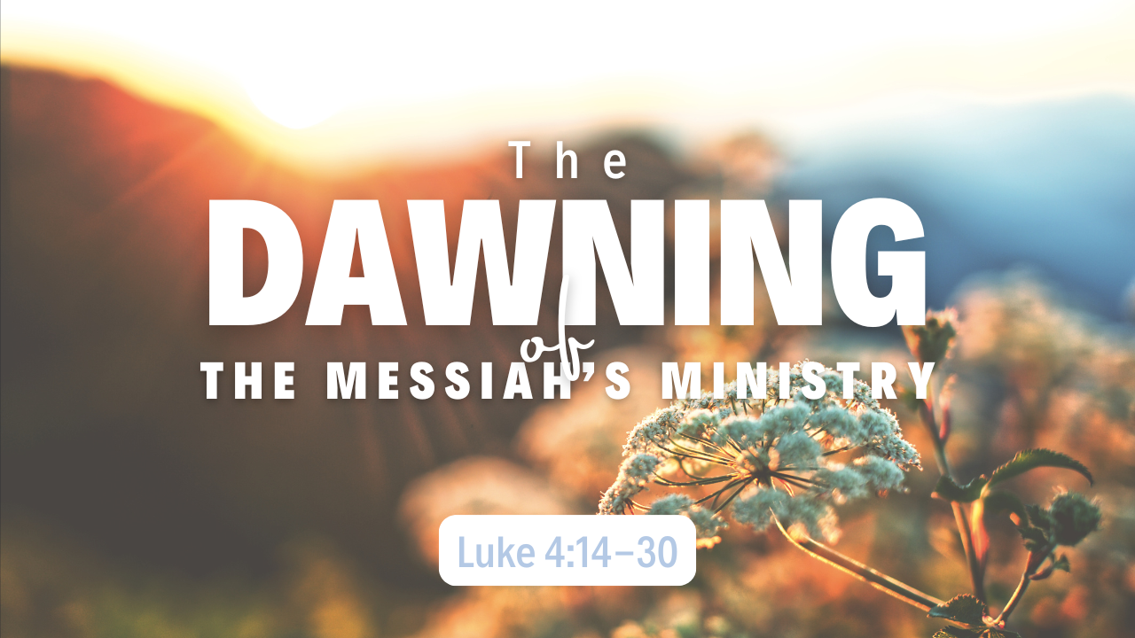

Slide 3
Outline:
A Prelude of Fame (14-15)
A Proclamation of Fulfillment (16-21)
A Priority of Faith (22-27)
A Predicted Fury (28-29)
A Providential Fearlessness (30)

Slide 4
Luke 4:14-15
14 And Jesus returned in the power of the Spirit to Galilee, and a report about him went out through all the surrounding country. 15 And he taught in their synagogues, being glorified by all.

Slide 5
Luke 4:16
16 And he came to Nazareth, where he had been brought up. And as was his custom, he went to the synagogue on the Sabbath day, and he stood up to read.

Slide 6
Luke 4:17-19
17 And the scroll of the prophet Isaiah was given to him. He unrolled the scroll and found the place where it was written, 18 “The Spirit of the Lord is upon me, because he has anointed me to proclaim good news to the poor. He has sent me to proclaim liberty to the captives and recovering of sight to the blind, to set at liberty those who are oppressed, 19 to proclaim the year of the Lord’s favor.”

Slide 7
Luke 4:20-21
20 And he rolled up the scroll and gave it back to the attendant and sat down. And the eyes of all in the synagogue were fixed on him. 21 And he began to say to them, “Today this Scripture has been fulfilled in your hearing.”

Slide 8
Luke 4:22
22 And all spoke well of him and marveled at the gracious words that were coming from his mouth. And they said, “Is not this Joseph’s son?”

Slide 9
Luke 4:23-24
23 And he said to them, “Doubtless you will quote to me this proverb, ‘“Physician, heal yourself.” What we have heard you did at Capernaum, do here in your hometown as well.’” 24 And he said, “Truly, I say to you, no prophet is acceptable in his hometown.

Slide 10
Luke 4:25-26
25 But in truth, I tell you, there were many widows in Israel in the days of Elijah, when the heavens were shut up three years and six months, and a great famine came over all the land, 26 and Elijah was sent to none of them but only to Zarephath, in the land of Sidon, to a woman who was a widow.

Slide 11
Luke 4:27
27 And there were many lepers in Israel in the time of the prophet Elisha, and none of them was cleansed, but only Naaman the Syrian.”

Slide 12
Luke 4:28-30
28 When they heard these things, all in the synagogue were filled with wrath. 29 And they rose up and drove him out of the town and brought him to the brow of the hill on which their town was built, so that they could throw him down the cliff. 30 But passing through their midst, he went away.

Slide 14
I. A Prelude of Fame
14 And Jesus returned in the power of the Spirit to Galilee, and a report about him went out through all the surrounding country. 15 And he taught in their synagogues, being glorified by all.

Slide 15
I. A Prelude of Fame
14 And Jesus returned in the power of the Spirit to Galilee, and a report about him went out through all the surrounding country. 15 And he taught in their synagogues, being glorified by all.
Luke 1:26; Matthew 2:22-23; Isaiah 9:1-2.

Slide 16
I. A Prelude of Fame
14 And Jesus returned in the power of the Spirit to Galilee, and a report about him went out through all the surrounding country. 15 And he taught in their synagogues, being glorified by all.
Luke 3:22; Isaiah 11:2-3.

Slide 17
I. A Prelude of Fame
14 And Jesus returned in the power of the Spirit to Galilee, and a report about him went out through all the surrounding country. 15 And he taught in their synagogues, being glorified by all.
Luke 4:42-44.

Slide 18
I. A Prelude of Fame
14 And Jesus returned in the power of the Spirit to Galilee, and a report about him went out through all the surrounding country. 15 And he taught in their synagogues, being glorified by all.
John 7:46; Matthew 7:28-29; Ezekiel 33:30-32.

Slide 19
I. A Prelude of Fame
14 And Jesus returned in the power of the Spirit to Galilee, and a report about him went out through all the surrounding country. 15 And he taught in their synagogues, being glorified by all.
Mark 1:33; Matthew 4:24-25; Matthew 14:21; Acts 26:26.

Slide 20
II. A Proclamation of Fulfillment
16 And he came to Nazareth, where he had been brought up. And as was his custom, he went to the synagogue on the Sabbath day, and he stood up to read.

Slide 21
II. A Proclamation of Fulfillment
16 And he came to Nazareth, where he had been brought up. And as was his custom, he went to the synagogue on the Sabbath day, and he stood up to read.
Psalm 145-150; Numbers 6:24-26; Ephesians 1:3.

Slide 22
II. A Proclamation of Fulfillment
17 And the scroll of the prophet Isaiah was given to him. He unrolled the scroll and found the place where it was written, 18 “The Spirit of the Lord is upon me, because he has anointed me to proclaim good news to the poor. He has sent me to proclaim liberty to the captives and recovering of sight to the blind, to set at liberty those who are oppressed, 19 to proclaim the year of the Lord’s favor.”
Isaiah 61:1-2.

Slide 23
II. A Proclamation of Fulfillment
20 And he rolled up the scroll and gave it back to the attendant and sat down. And the eyes of all in the synagogue were fixed on him. 21 And he began to say to them, “Today this Scripture has been fulfilled in your hearing.”

Slide 24
II. A Proclamation of Fulfillment
20 And he rolled up the scroll and gave it back to the attendant and sat down. And the eyes of all in the synagogue were fixed on him. 21 And he began to say to them, “Today this Scripture has been fulfilled in your hearing.”
Luke 4:22.

Slide 25
II. A Proclamation of Fulfillment
17 And the scroll of the prophet Isaiah was given to him. He unrolled the scroll and found the place where it was written, 18 “The Spirit of the Lord is upon me, because he has anointed me to proclaim good news to the poor. He has sent me to proclaim liberty to the captives and recovering of sight to the blind, to set at liberty those who are oppressed, 19 to proclaim the year of the Lord’s favor.”
Luke 6:20-22; Matthew 5:3.

Slide 26
II. A Proclamation of Fulfillment
17 And the scroll of the prophet Isaiah was given to him. He unrolled the scroll and found the place where it was written, 18 “The Spirit of the Lord is upon me, because he has anointed me to proclaim good news to the poor. He has sent me to proclaim liberty to the captives and recovering of sight to the blind, to set at liberty those who are oppressed, 19 to proclaim the year of the Lord’s favor.”
John 8:34; Romans 6:6; Titus 3:3; 2 Timothy 2:26.

Slide 27
II. A Proclamation of Fulfillment
17 And the scroll of the prophet Isaiah was given to him. He unrolled the scroll and found the place where it was written, 18 “The Spirit of the Lord is upon me, because he has anointed me to proclaim good news to the poor. He has sent me to proclaim liberty to the captives and recovering of sight to the blind, to set at liberty those who are oppressed, 19 to proclaim the year of the Lord’s favor.”
Ephesians 1:18; Acts 26:18; John 17:3.

Slide 28
II. A Proclamation of Fulfillment
17 And the scroll of the prophet Isaiah was given to him. He unrolled the scroll and found the place where it was written, 18 “The Spirit of the Lord is upon me, because he has anointed me to proclaim good news to the poor. He has sent me to proclaim liberty to the captives and recovering of sight to the blind, to set at liberty those who are oppressed, 19 to proclaim the year of the Lord’s favor.”
Matthew 11:28-30; Isaiah 42:3; Psalm 72:12-14; Acts 10:38.

Slide 29
II. A Proclamation of Fulfillment
17 And the scroll of the prophet Isaiah was given to him. He unrolled the scroll and found the place where it was written, 18 “The Spirit of the Lord is upon me, because he has anointed me to proclaim good news to the poor. He has sent me to proclaim liberty to the captives and recovering of sight to the blind, to set at liberty those who are oppressed, 19 to proclaim the year of the Lord’s favor.”
Matthew 11:28-30; Isaiah 42:3; Psalm 72:12-14; Acts 10:38.

Slide 30
II. A Proclamation of Fulfillment
20 And he rolled up the scroll and gave it back to the attendant and sat down. And the eyes of all in the synagogue were fixed on him. 21 And he began to say to them, “Today this Scripture has been fulfilled in your hearing.”
Matthew 5:17; John 5:39-40; John 4:25-26; Mark 1:15.

Slide 31
