Slide 1
ANNOUNCEMENTS
If you are new to our Church, please know, we are so blessed you are with us.

Slide 2
Envelopes located near Offertory Plates

Slide 3
Prayer Team

Slide 4
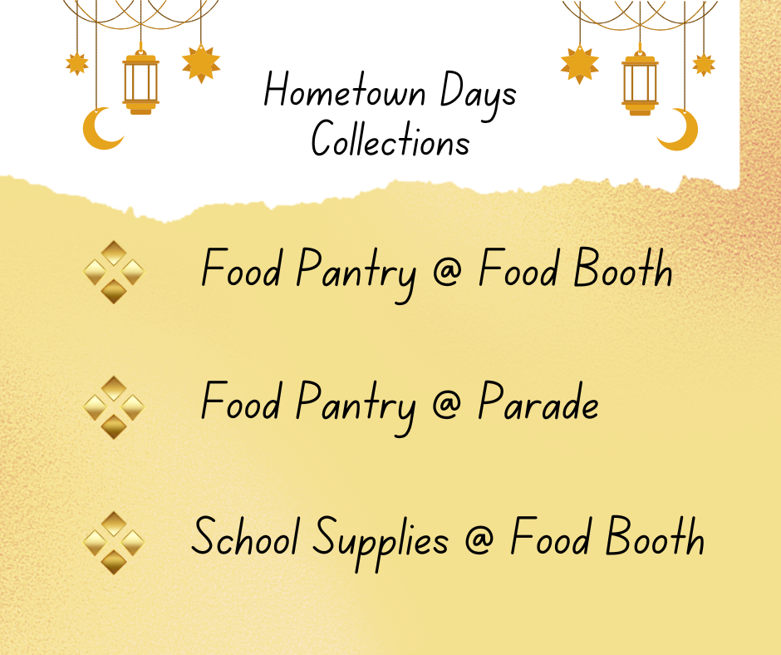

Slide 5
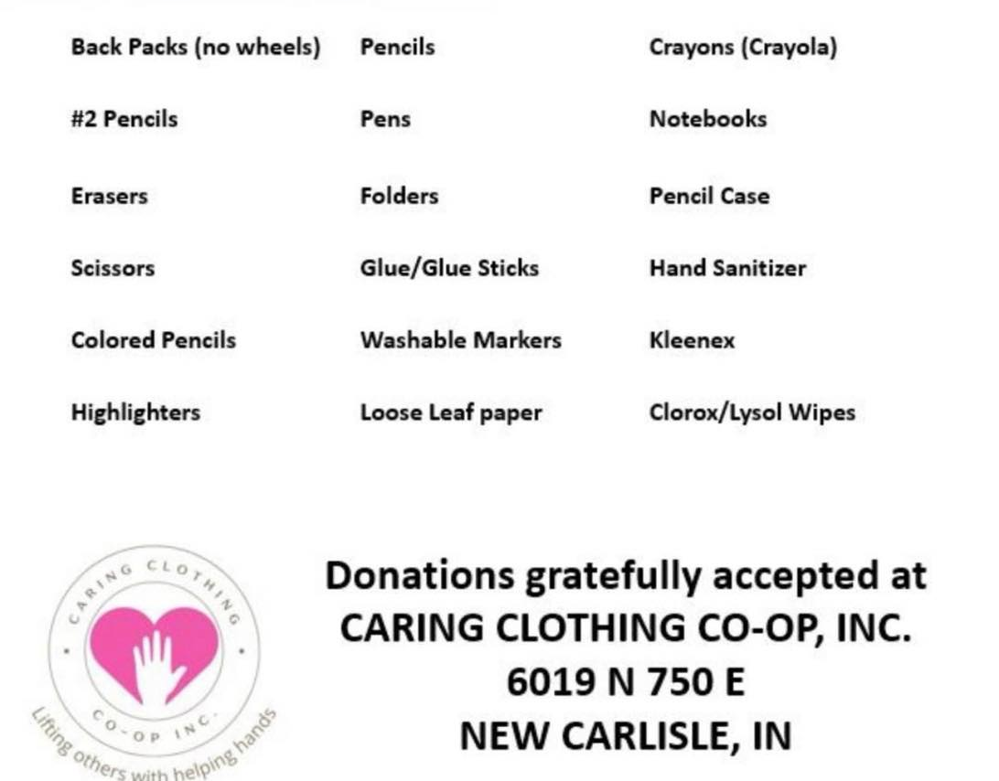
Back To School
Supply Drive Requests

Slide 6
Broadway Christian Parish Update
April $ 104
May $ 58
YTD $341

Slide 7
Meetings
July 1 – Finance @ 6:30
July 8 – Ad Council
@ 6:30
July 15 – Trustees
@ 6:30

Slide 8
COMMUNITY RESERVE NEEDS
Silverware
Kitchen Utensils
Pots and Pans
Small Appliances
Living Room Furniture
Bedroom Furniture
Dining Tables and Chairs

Slide 9
Cookie Bakers for Sunday Morning
We would appreciate more volunteers to provide Sunday morning cookies. Sign up sheet is in the Fellowship Hall.

Slide 10
CROSS LIGHTING
The cross is being lit in Memory of all the fathers who are no longer with us, the wedding anniversary of Dodi and Larry Allen, and the life of Jack Curl
Notes:
And

Slide 11
If you would like the cross lit in memory or in honor of someone, please let the office know. It is $10.00 a week.

Slide 12
LOOK AT NCUMC ON FACEBOOK
If you need help or would like to see something listed, please contact Ann Morrison

Slide 13
OUR WEBSITE www.wearencumc.org

Slide 14
It does not take long to ask GOD for help for someone you know or don’t know.
If you have a request, message us on Facebook, or you can text Pastor Kal or Stephanie Lloyd or call the church office and we will share it with our prayer chain.

