Slide 1

Wake up!
Michael Christie

Slide 2

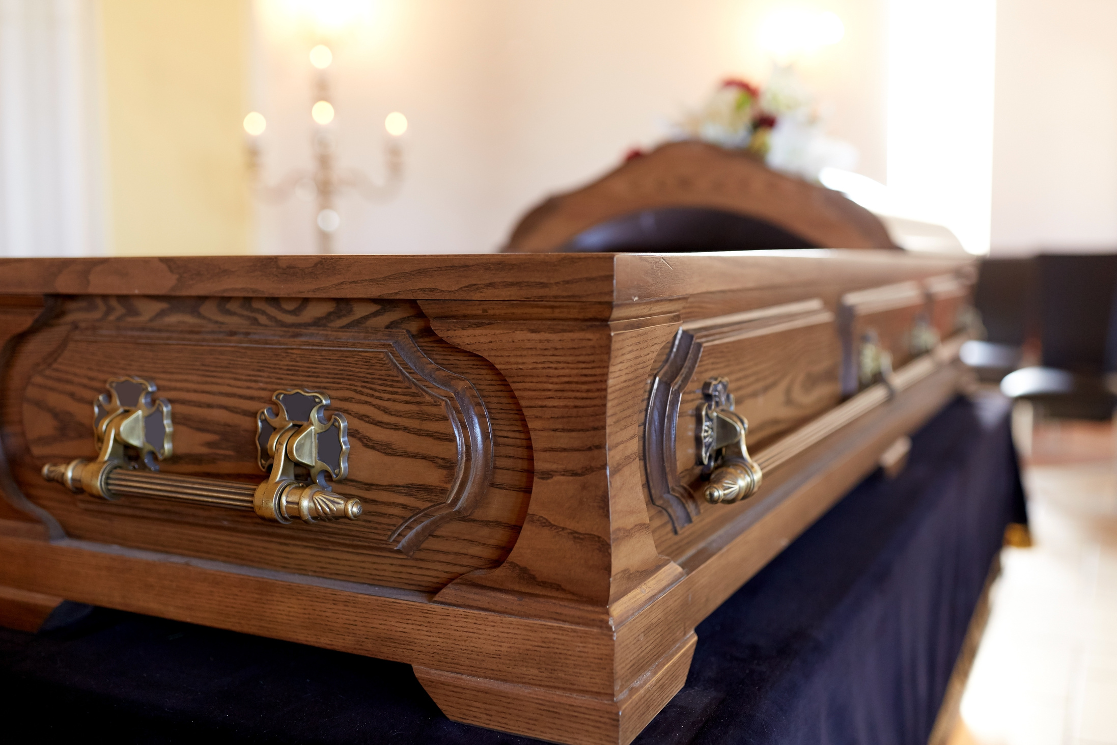

Slide 3
“Woe to you, teachers of the law and Pharisees, you hypocrites! You are like whitewashed tombs, which look beautiful on the outside but on the inside are full of the bones of the dead and everything unclean. In the same way, on the outside you appear to people as righteous but on the inside you are full of hypocrisy and wickedness.”
- MATTHEW 23:27-28

Slide 4
REVELATION 3:1-6
¹ “To the angel of the church in Sardis write:
These are the words of him who holds the seven spirits of God and the seven stars. I know your deeds; you have a reputation of being alive, but you are dead.

Slide 5
² Wake up! Strengthen what remains and is about to die, for I have found your deeds unfinished in the sight of my God.
³ Remember, therefore, what you have received and heard; hold it fast, and repent. But if you do not wake up, I will come like a thief, and you will not know at what time I will come to you.

Slide 6
⁴ Yet you have a few people in Sardis who have not soiled their clothes. They will walk with me, dressed in white, for they are worthy.
⁵ The one who is victorious will, like them, be dressed in white. I will never blot out the name of that person from the book of life, but will acknowledge that name before my Father and his angels.

Slide 7
⁶ Whoever has ears, let them hear what the Spirit says to the churches.

Slide 8


Slide 9
To receive again a life which has almost expired; to rekindle into a flame the vital spark which was nearly extinguished.
- CHARLES SPURGEON

Slide 10
DIAGNOSIS: LIFELESS
To the angel of the church in Sardis write: These are the words of him who holds the seven spirits of God and the seven stars. I know your deeds; you have a reputation of being alive, but you are dead.
- REVELATION 3:1

Slide 11



Slide 12
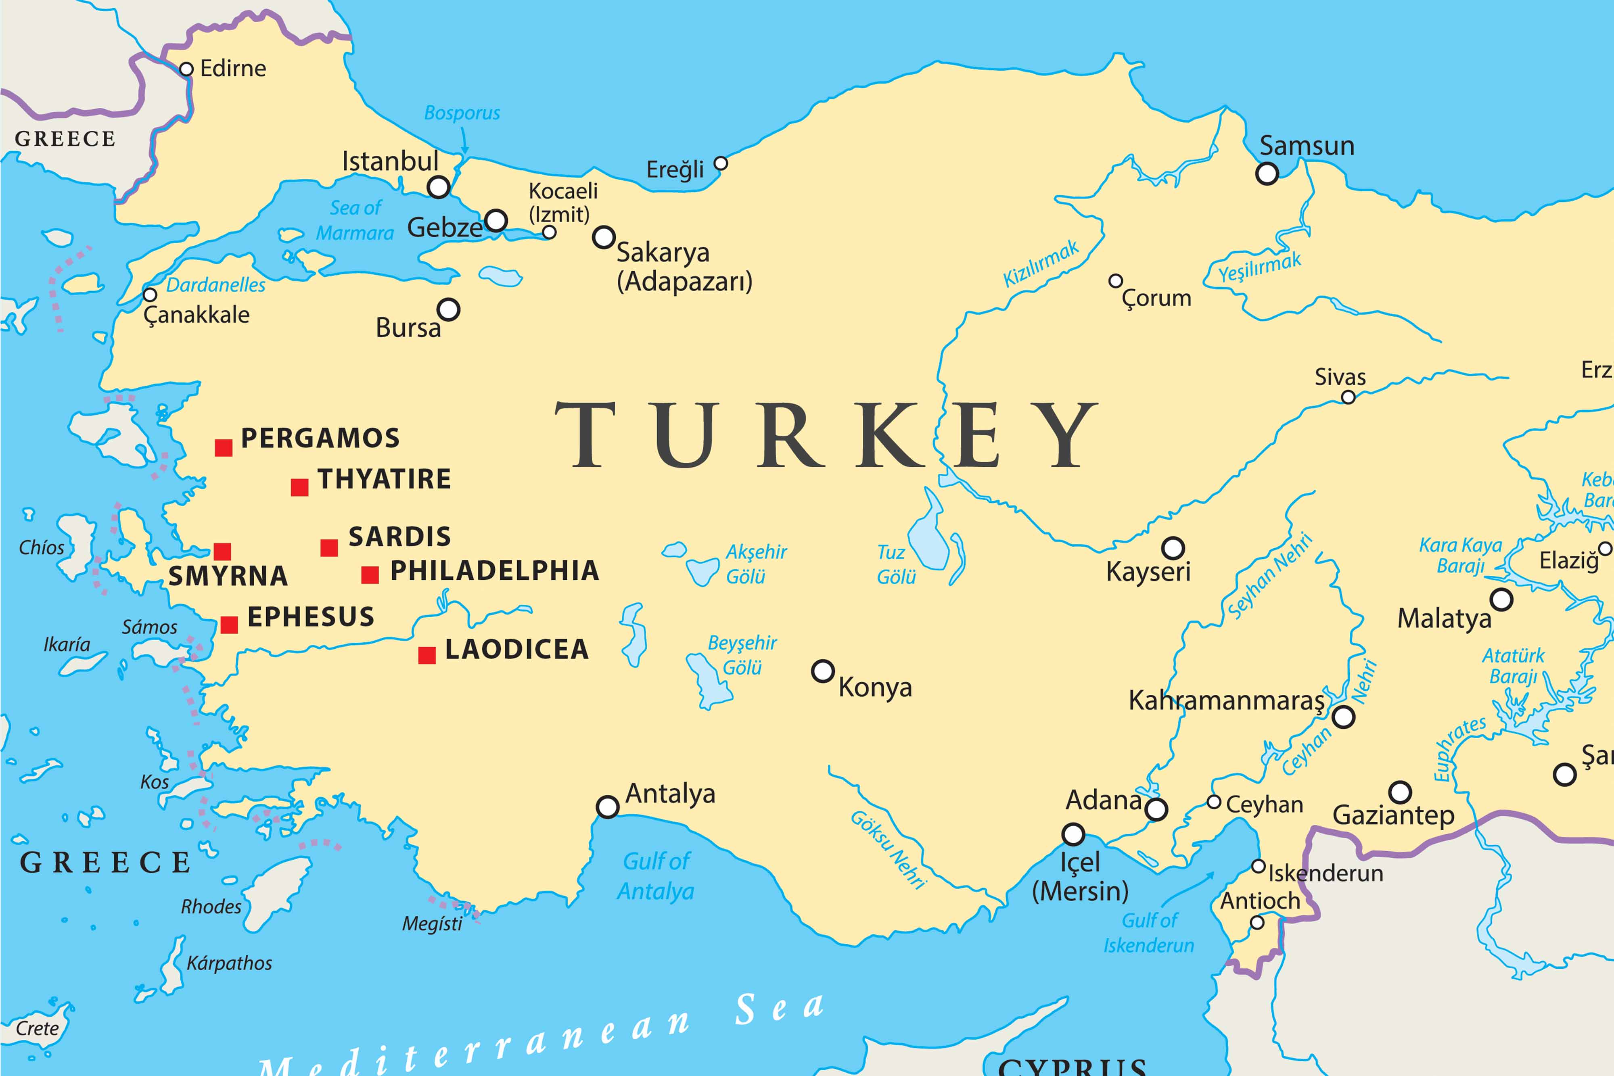

Patmos

Slide 13
The Lord does not look at the things people look at. People look at the outward appearance, but the Lord looks at the heart.
- 1 SAMUEL 16:7

Slide 14


Slide 15
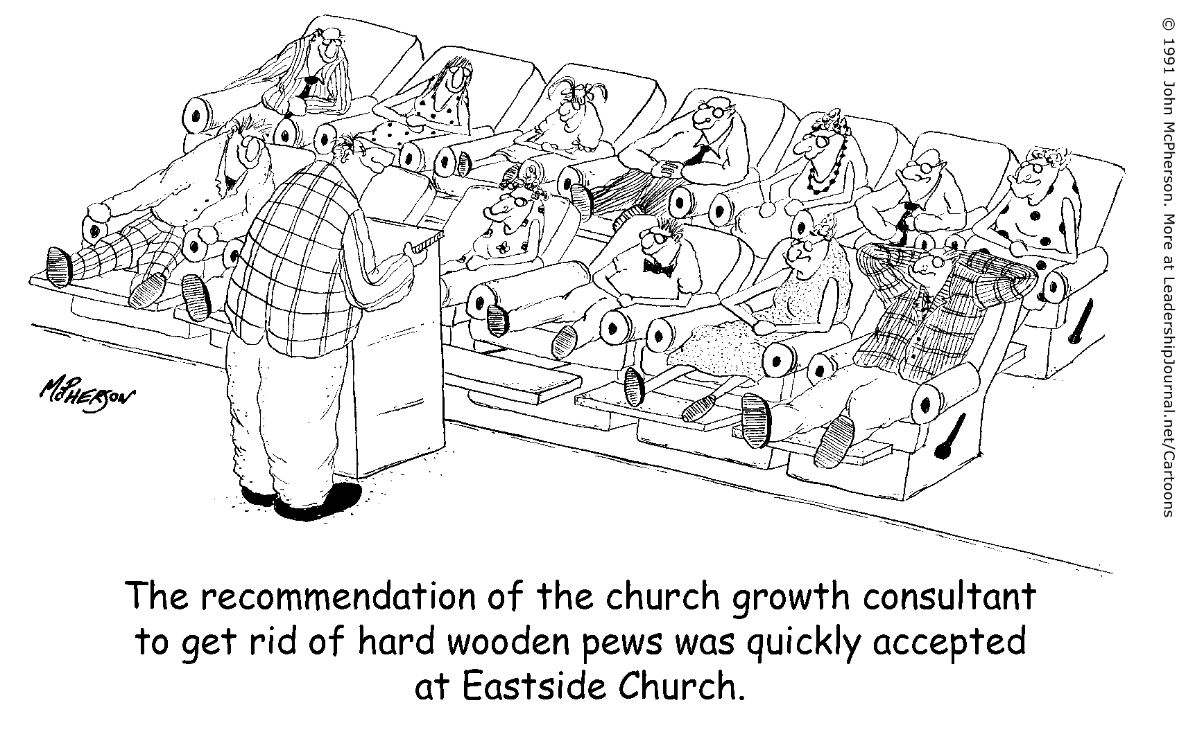

Slide 16
A church is in danger of death when it begins to worship its own past; when it is more concerned with forms than with life; when it loves systems more than it loves Jesus; when it is more concerned with material than it is with spiritual things.
- WILLIAM BARCLAY

Slide 17
Do not be deceived: God cannot be mocked. A man reaps what he sows. Whoever sows to please their flesh, from the flesh will reap destruction; whoever sows to please the Spirit, from the Spirit will reap eternal life. Let us not become weary in doing good, for at the proper time we will reap a harvest if we do not give up.
- GALATIANS 6:7-9

Slide 18
TREATMENT: WAKE UP
Wake up! Strengthen what remains and is about to die, for I have found your deeds unfinished in the sight of my God. Remember, therefore, what you have received and heard; hold it fast, and repent. But if you do not wake up, I will come like a thief, and you will not know at what time I will come to you.
- REVELATION 3:2-3

Slide 19
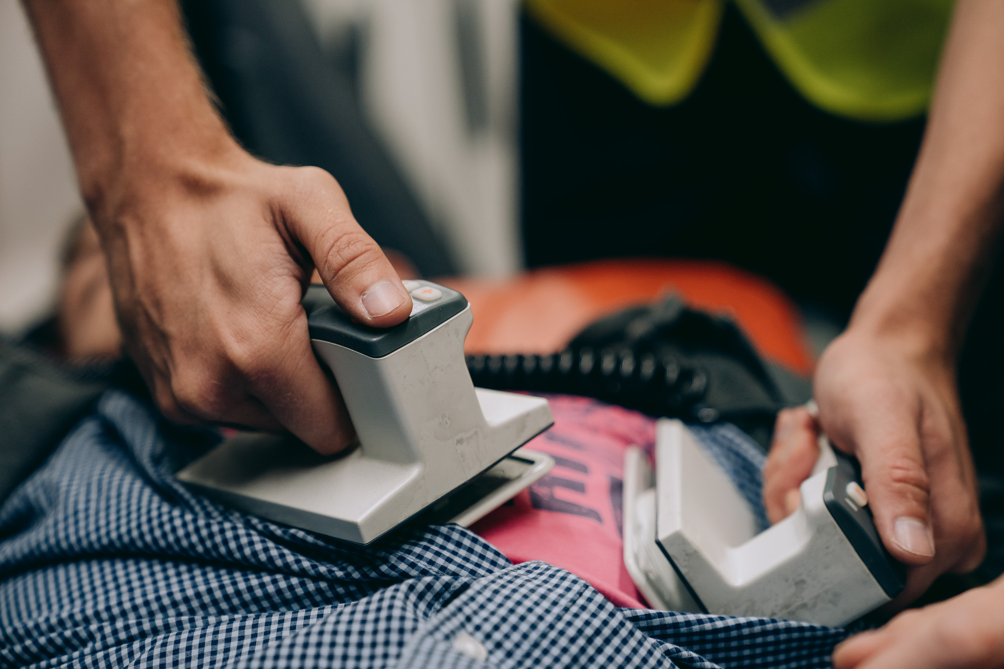

Slide 20
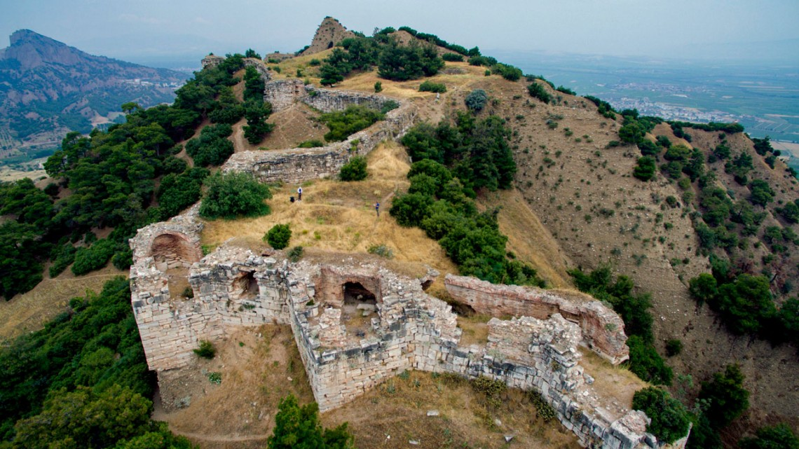
A drone image of a segment of wall on the Sardis acropolis, in what is now Turkey.
c. Ben Anderson; https://news.cornell.edu/stories/2020/04/new-lecture-series-introduces-research-ancient-sardis

Slide 21
Wake up, O sleeper, rise from the dead, and Christ will shine on you. Be very careful, then, how you live – not as unwise but as wise… be filled with the Holy Spirit.
- EPHESIANS 5:14-15, 18

Slide 22
Revival is not something that God does first among the unconverted, but among His people. Revival simply means new life, and that implies that there is already life there, but that the life has ebbed. The unconverted do not need revival for there is not any life there to revive. It is the Christians who need revival.
- ROY HESSION

Slide 23
PROGNOSIS: LIFE
Yet you have a few people in Sardis who have not soiled their clothes. They will walk with me, dressed in white, for they are worthy. The one who is victorious will, like them, be dressed in white. I will never blot out the name of that person from the book of life, but will acknowledge that name before my Father...
- REVELATION 3:4-5

Slide 24


Slide 25


