Slide 1
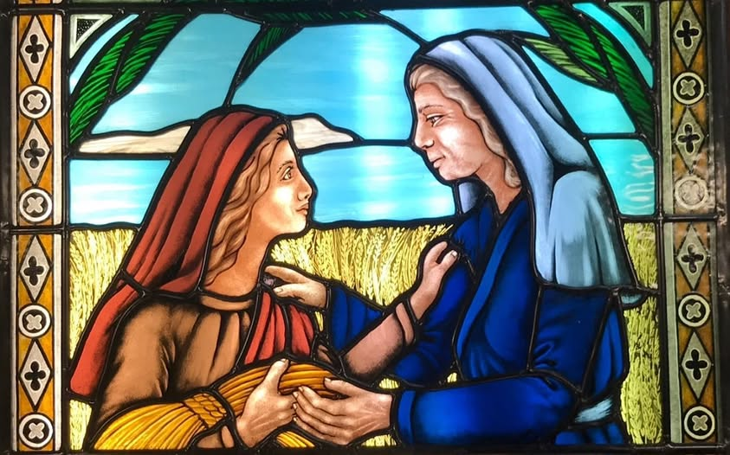
Ruth: Setting the Scene
Ruth 1:1-5

Slide 2

Things to be aware of:
Ruth is an oddity.
- God is not present as a character
- The book is written from an unusual perspective.
Though this book has a happy ending, it starts during the time of the Judges!

Slide 3
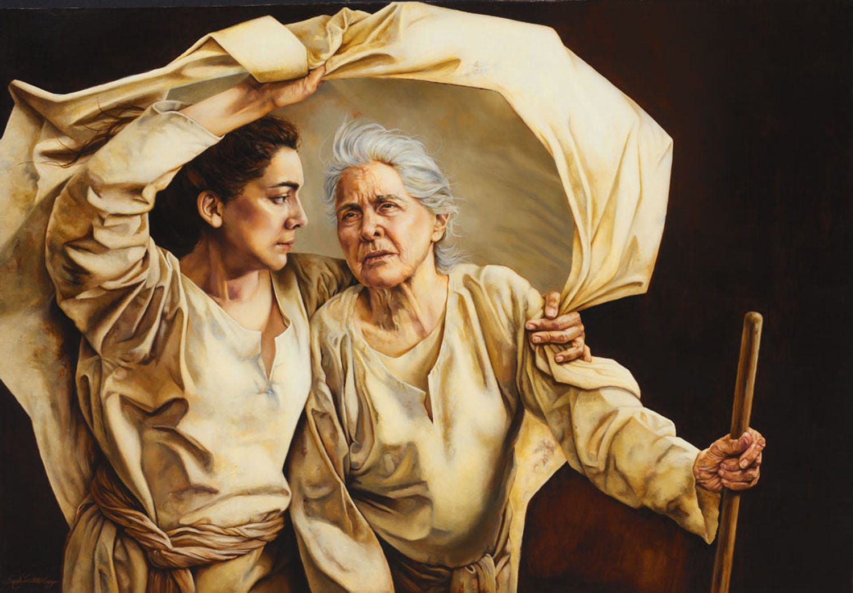
Hey Bru, Hebrew!
Names are important in Hebrew!
ר֑וּת (Rut): Feminine name, derived from(?):
רֵ֗עַ (Rea’): Friend or companion.
נָעֳמִי (Naomi): Pleasantness
מָּרָ֔ה (Mara): Bitter
אֱלִימֶלֶךְ (Elimelech): My God is King
אֱלִימֶלֶךְ (Mahlon): Weakness
כִּלְיוֹן (Chilion): Wasting away

Slide 4
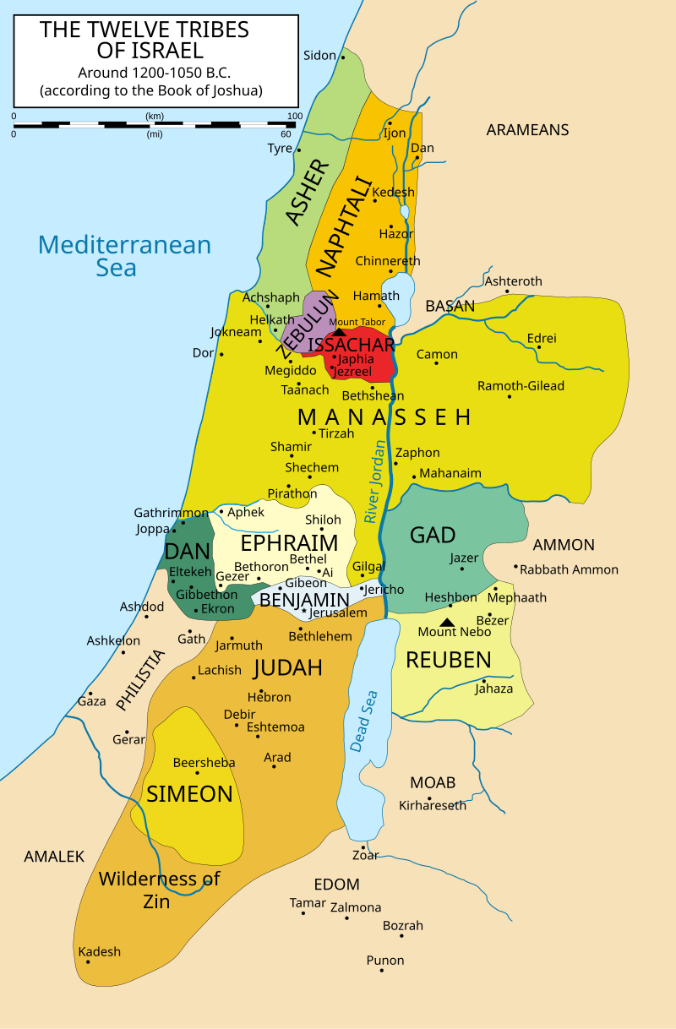
Ruth: Getting to know our friends
When? Approx 12th Century BC (though it is hard to be exact).
Who? Elimelech, Naomi and their sons (Israelites from Bethlehem, in Judea).
Where? From Judah to Moab and back again.
What happened? Elimelech died; his sons married Orpah and Ruth, and they also died.

Slide 5
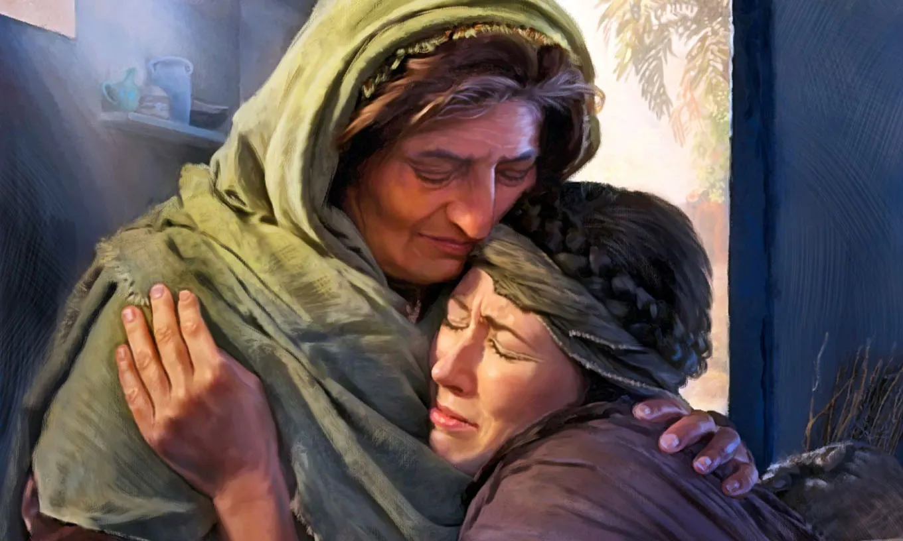
Naomi/Mara – Bitter beginnings
3 funerals, 3 widows, no children, no legacy.
Naomi is left with nothing; what she does have is foreign, uncertain and painful.
She is not just a destitute widow, she has two daughters-in-law for whom she is responsible.

Slide 6
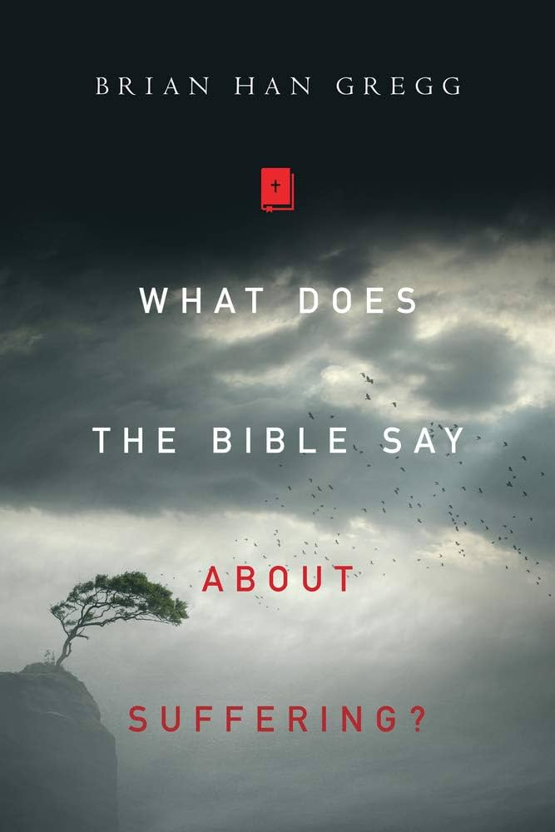
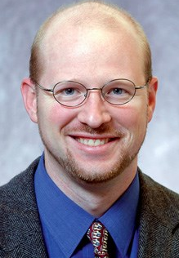
Did Naomi and Elimelech deserve their fate?
Some Jewish writers suggest that Naomi and Elimelech faced judgement from God for travelling to Moab.
Scripture does not say this.
It may be everyday misfortune.
The problem of Theodicy: If God is good and powerful, why do bad things happen to good people?
Brian Han Gregg: “in spite of the fact that the Bible clearly has a lot to say about suffering, it still involves a great degree of mystery.”

Slide 7
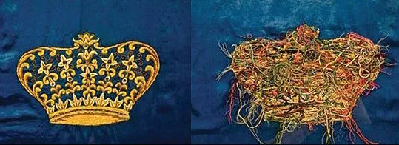
Elimelech: God is still in control!
God is silent; no dreams, no angels, no miracles, just hard life.
What evidence do we have that God is King?
Nothing happens by accident.
Although God does not WANT suffering, nothing happens without his permission.
Beneath the chaos God is at work.

Slide 8
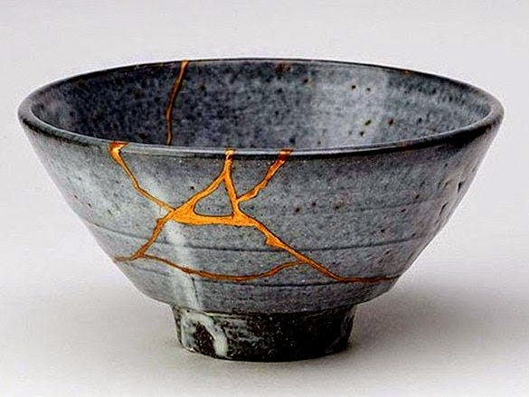
Kintsugi – “Golden Joinery”

Slide 9
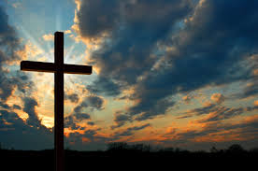
What does this mean for us?
We may be broken in many ways – in our own “Ruth 1” moment.
Naomi’s healing did not come immediately, and God did not undo her losses.
Instead he transformed her losses into something reflecting his grace more deeply.
He can – and will – do the same for us.
Our most important loss is the loss of relationship with God.

