Slide 1

We Exist to Influence a Community and Transform Lives

Slide 2
“The modern-day church has been built on a ‘NEEDS’ based ministry model, while the true New Testament church was designed to be built on an INHERITANCE based model.”

Slide 3
The Highest order of REVELATION we could ever have:
GOD IS OUR FATHER

Slide 4
The Highest order of BLESSING we could ever have:
WE ARE HIS CHILDREN

Slide 5
Galatians 3:26 – For in Christ Jesus, you are all sons and daughters of God

Slide 6
GOD is WHAT He is …
FATHER is WHO He is! …

Slide 7
The Highest order of our Spiritual Walk is…
FAITH

Slide 8

We never grow beyond the GOSPEL …
we simply grow more deeply into the GOSPEL.
This Photo by Unknown Author is licensed under CC BY-SA-NC

Slide 9

FAITH – Divinely Persuaded

Slide 10
Faith is not something I do … it’s something I let happen.
P
U
R
S
U
A
D
E
D
D
I
V
I
N
E
L
Y

Slide 11

“The modern-day church has been built on a ‘NEEDS’ based ministry model, while the true New Testament church was designed to be built on an INHERITANCE based model.”
If we can connect people to their IDENTITY IN CHRIST, and the Inheritance available to His children, the built-in mechanism is NEEDS WILL BE MET.

Slide 12
EVERYTHING WE COULD EVER NEED IS BOUND WITHIN THE GOSPEL…
As we grow in the GOSPEL,
FAITH HAPPENS!

Slide 13

The Opposite of Faith is Suspicion

Slide 14

Hebrews 11:1 - Now faith is the assurance of things hoped for, the conviction of things not seen. ² For by it the men of old gained approval.
³ By faith we understand that the worlds were prepared by the word of God, so that what is seen was not made out of things which are visible.

Slide 15
… By faith Abel offered to God a better sacrifice than Cain, through which he obtained the testimony that he was righteous, God testifying about his gifts, and through faith, though he is dead, he still speaks.

Slide 16

Galatians 4:6 - And because we are his sons, God has sent the Spirit of his Son into our hearts, so now we can rightly speak of God as our dear Father. ⁷ Now we are no longer slaves but God’s own sons. And since we are his sons, everything he has belongs to us, for that is the way God planned.

Slide 17

The Highest Order in our SOUL-ish Life is Peace

Slide 18
We are TRIUNE (three-part) beings:
SPIRIT
SOUL
BODY
We are SPIRIT
We possess a SOUL
We Live in a BODY

Slide 19

2 CORINITHIANS 10:3 - For though we live in the world, we do not wage war as the world does.⁴ The weapons we fight with are not the weapons of the world. On the contrary, they have divine power to demolish strongholds. ⁵ We demolish arguments and every pretension that sets itself up against the knowledge of God, and we take captive every thought to make it obedient to Christ. ⁶ And we will be ready to punish every act of disobedience, once your obedience is complete.

Slide 20

Proverbs 4:23 – With all diligence, guard your heart, for from it flow the issues of life.
NLT – Guard your heart above all else, for it determines the course of your life.

Slide 21

CJB – Above everything else guard your heart; for it is the source of life’s consequences.
GNT – Be careful how you think; your life is shaped by your thoughts.

Slide 22
3 John 1:2 – Beloved, I pray that you may prosper in all things and be in health, just as your soul prospers.

Slide 23
CONSCIENCE
FELLOWSHIP
INTUITION
SPIRIT

Slide 24
MIND
WILL
EMOTIONS
SOUL

Slide 25
TASTE
TOUCH
SIGHT
SMELL
HEARING
BODY

Slide 26
As your soul goes, so goes your life …
For the Soul to Prosper, PEACE must become the authority

Slide 27
THE GREATEST PART OF VICTORY AND FREEDOM IS FOUND IN THE PLACE OF EMOTIONS

Slide 28
CAPTIVE
Your MIND will tell the story.
Your become Captivated (CAPTIVE-ATED) by your EMOTIONS with the story.
You WILL-fully CHOOSE how you will participate in the story.

Slide 29
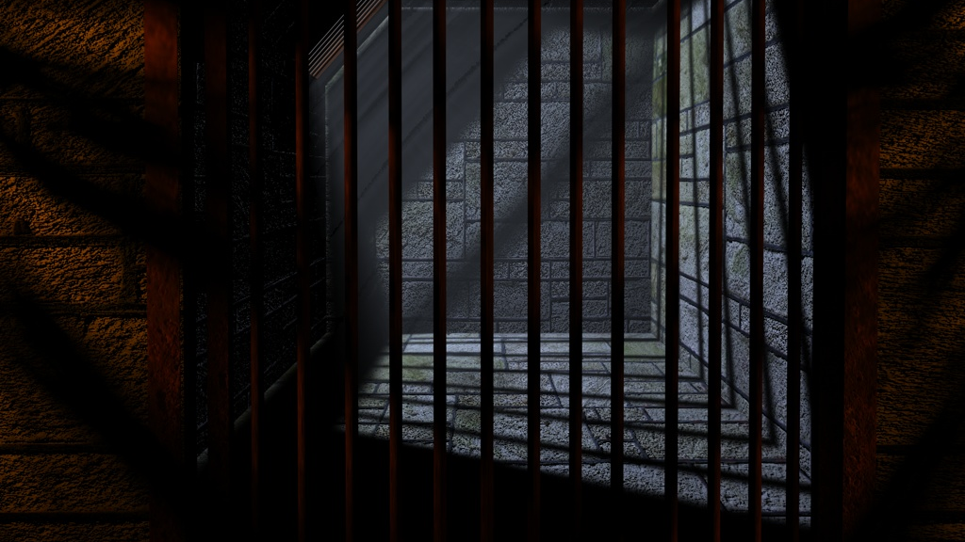
Captivity begins at the point of EMOTIONS…
This Photo by Unknown Author is licensed under CC BY-SA-NC

Slide 30
The Karen Effect
The Failure to control your emotions to the point that it ignites a relentless craving to control other people.

Slide 31

Mastering your emotions doesn’t mean you live without them … It means you engage your SPIRIT to GUIDE your SOUL

Slide 32

Without Spiritual Insight, we suffer a deficit in emotional foresight

Slide 33

If you can’t control your thoughts, you can’t control your emotions.
If you can’t control your emotions, you can’t control your choices.
If you can’t control your choices, you can’t control your life.

Slide 34
Don’t Discount the Power you Possess
2 Corinthians 10:4-5
Ephesians 6:10-18
Any thought patterns and ideas that are contrary to God’s thoughts about you are warring against the Knowledge of God.

Slide 35

2 CORINITHIANS 10:3 - For though we live in the world, we do not wage war as the world does.⁴ The weapons we fight with are not the weapons of the world. On the contrary, they have divine power to demolish strongholds. ⁵ We demolish arguments and every pretension that sets itself up against the knowledge of God, and we take captive every thought to make it obedient to Christ. ⁶ And we will be ready to punish every act of disobedience, once your obedience is complete.

Slide 36
2 Corinthians 10:5b
Don’t Discount the Power in your MOUTH
…and WE TAKE CAPTIVE EVERY THOUGHT to make it obedient to Christ.

Slide 37
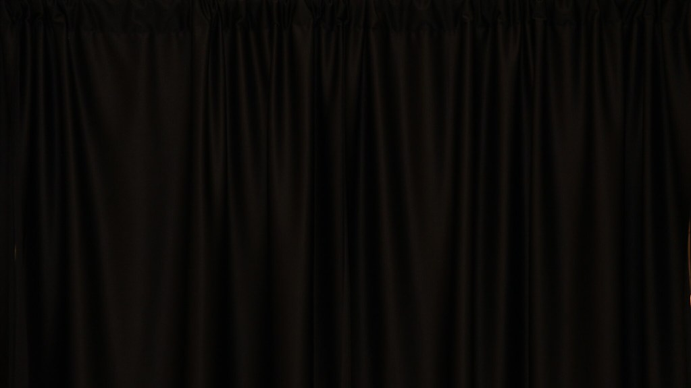
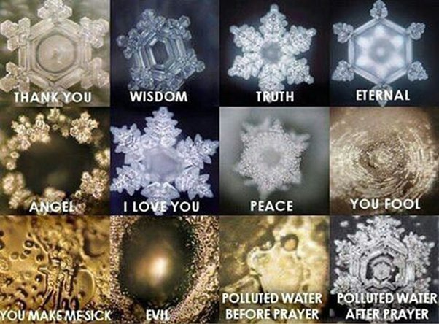

Slide 38
Hebrews 4:14-16
Don’t Forget You’re Not in this alone
…but one who in every respect has been tempted as we are…

Slide 39
Hebrews 4:14 - Since then we have a great high priest who has passed through the heavens, Jesus, the Son of God, let us hold fast our confession. ¹⁵ For we do not have a high priest who is unable to sympathize with our weaknesses, but one who in every respect has been tempted as we are, yet without sin. ¹⁶ Let us then with confidence draw near to the throne of grace, that we may receive mercy and find grace to help in time of need.

