Slide 1

THE RISE OF A KING PATIENCE AND TRUST IN GOD’S TIMING 2 Samuel 1: 1 – 2: 11
Sermon 1 in “THE HEART OF A KING” series
27TH April 2025
CLIC@FEDERATION UNIVERISITY BERWICK

Slide 2

AN OVERVIEW 2 SAMUEL 1:1 – 5:25
1:1 - 10 | THE DEATH OF KING SAUL
1: 11- 27 | DAVID’S GRIEF & TRIBUTE TO THE FALLEN
2: 1 - 7 | DAVID IS APPOINTED KING OVER JUDAH
2: 8 – 11 | ISH-BOSHETH IS MADE KING OVER ISRAEL
2: 12 - 32 | THE BATTLE OF GIBEON
3: 1 – 5 | A LONG WAR…DAVID’S POWER GROWS STEADILY STRONGER
3: 6 – 30 | ABNER’S DEFECTION AND SUBSEQUENT MURDER
3: 31 – 37 | DAVID MOURNS FOR ABNER
4: I - 12 | ISH-BOSETH IS MURDERED; JUDGEMENT IS ENACTED
5: 1 – 5 | DAVID IS ANOINTED KING OVER ISRAEL
5: 6 – 25 | JERUSALEM CAPTURED, JEBUSITES DEFEATED, TREATY WITH TYRE, PHILISTINES DEFEATED

Slide 3
“NOW IT CAME ABOUT AFTER THE DEATH OF SAUL, WHEN DAVID HAD RETURNED FROM THE SLAUGHTER OF THE AMALEKITES, THAT DAVID REMAINED TWO DAYS IN ZIKLAG” 2 SAMUEL 1:1 (NASB)
A DEFEAT,
A VICTORY,
&
A TIME OF WAITING

Slide 4
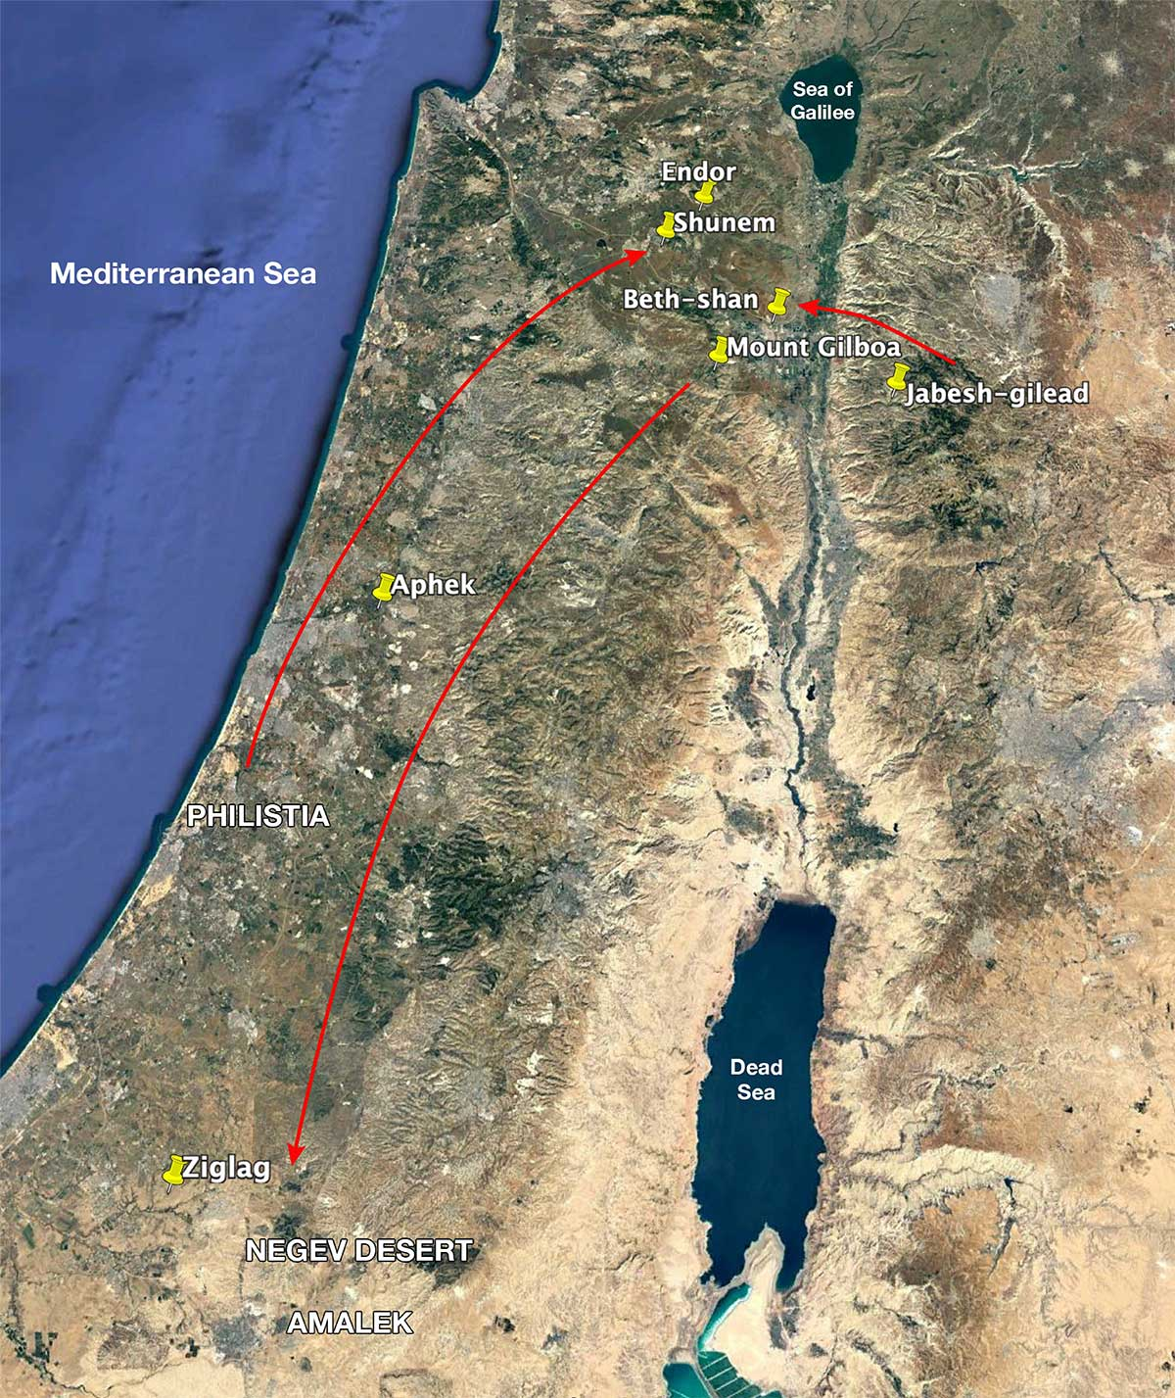

https://ibiblemaps.com/saul-killed-by-philistines-at-mt-gilboa/

Slide 5
2 battles : the battle between Israel & the Philistines & the battle against the Amalekites
The battle up north was disastrous
(1 Samuel 31: 1-10)
but
David recovered all
that the Amalekites had taken
(1 Samuel 30:18)

Slide 6
TWO DAYS THAT CHANGED EVERYTHING
“DAVID REMAINED TWO DAYS IN ZIKLAG”
TWO DAYS WHEN “THERE WAS NO KING IN ISRAEL” (Judges 21:25)
TWO DAYS OF UNCERTAINTY – AT LEAST TO THOSE WHO WERE AFRAID AND WAITING FOR WHATEVER WAS TO COME
TWO DAYS WHEN HOPE SEEMED LOST
TWO DAYS BETWEEN THE DEATH OF SAUL AND THE EMERGENCE OF DAVID “ON THE THIRD DAY”
TWO DAYS BEFORE
THE RISE OF A KING

Slide 7


WHO WAS THIS KING THEY CALL DAVID?

Slide 8
HE WAS NOT THE PEOPLE’S CHOICE FOR KING – BUT HE WAS CHOSEN OUT OF A VERY DIFFERENT PURPOSE – GOD’S OWN HEART
“..THE LORD HAS SOUGHT OUT FOR HIMSELF A MAN AFTER HIS OWN HEART..”
1 SAMUEL 13:14 (NASB)

Slide 9
NO ORDINARY KING
A MAN WHO KNEW THE HEART OF GOD
A MAN SOUGHT OUT BY GOD FOR HIMSELF
A MAN WHO WAS IN NO HURRY TO GRASP THE CROWN FOR HIMSELF

Slide 10
DAVID WAS A MAN WHO HONOURED THE THINGS OF GOD. HE WAS MORE CONCERNED WITH GOD’S GLORY THAN SAUL’S CROWN. HE KNEW BETTER THAN TO LAY HIS HAND ON THE LORD’S ANOINTED. HE DID NOT TAKE MATTERS INTO HIS OWN HANDS
2 Samuel 1: 14,16

Slide 11
HE WAS A MAN WHO CHOSE TO HONOUR THE MAN WHO HAD PERSECUTED & TRIED TO KILL HIM. HE TELLS NO LIES ABOUT SAUL’S VIRTUES, & GRACIOUSLY NEGLECTS TO NAME SAUL’S FAULTS
2 Samuel 1: 17 – 27 (NASB)

Slide 12
DAVID DID NOT JUST GRIEVE FOR HIS FATHER-IN-LAW AND HIS FRIEND. HE WEPT “FOR THE PEOPLE OF THE LORD AND THE HOUSE OF ISRAEL” BECAUSE OF THE DISASTER THAT HAD COME ON THOSE WHO BEAR THE LORD’S NAME
2 Samuel 1: 11, 12 (NASB)

Slide 13

DO NOT DELIGHT IN THE MISFORTUNE OF OTHERS, ESPECIALLY YOUR ENEMIES
‘NEVER DELIGHT IN THE MISFORTUNE OF OTHERS HOWEVER MUCH YOU MIGHT FEEL THEY DESERVE IT’ Dr. Matthew Jacoby, 2016.
“Do not rejoice when your enemy falls. And do not let your heart be glad when he stumbles”
(Proverbs 24: 17; NASB)

Slide 14
DAVID WAS SO CONSUMED BY A PASSION FOR GOD’S NAME THAT HE WAS IN NO HURRY TO PLACE SAUL’S CROWN ON HIS OWN HEAD
2 Samuel 2: 1 (NASB)

Slide 15
“THEN* IT CAME ABOUT AFTERWARDS THAT DAVID ENQUIRED OF THE LORD, SAYING, “SHALL I GO UP TO ONE OF THE CITIES OF JUDAH?” AND THE LORD SAID TO HIM, “GO UP.” SO DAVID SAID, “WHERE SHALL I GO UP?” AND HE SAID ,“TO HEBRON.” 2 SAMUEL 2:1 (NASB)
*”After this” (ESV)

Slide 16
WHY HEBRON?
Located on a mountain ridge in Judah approx. 31km south-southeast of Jerusalem
It was the place where Abraham settled – “by the oaks of Mamre” and he built an alter to the LORD (Genesis 13:18; 14:13). It was where “the LORD appeared to him” to say that he would have a son through Sarah (Genesis 18: 1 -15).
Hebron is where Abraham, Sarah, Issac, Rebekah, Jacob & Leah are all buried.
Hebron is where Israel’s life in the land of God’s promise began. It is the first part of the land to be given to Abraham & his descendants as promised by the LORD (Genesis 12: 1; 15:7, 18 -21)

Slide 17
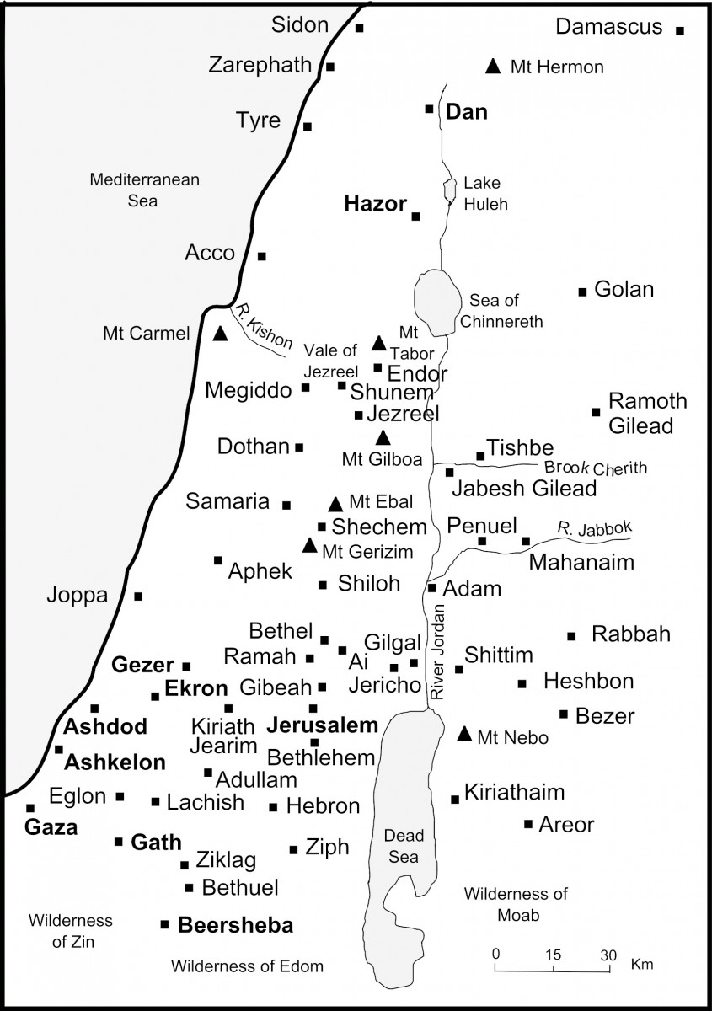
https://www.thebiblejourney.org/biblejourney2/22-the-world-of-the-old-testament-journeys/ancient-israel/

Slide 18
DAVID WAS AN OBEDIENT MAN – NOT ONLY DID HE GO, BUT HE BROUGHT HIS FAMILY AS WELL AS HIS MEN AND THEIR FAMILIES & THEY STAYED
2 Samuel 2: 2, 3 (NASB)

Slide 19
“THEN THE MEN OF JUDAH CAME AND THERE ANOINTED DAVID KING OVER THE HOUSE OF JUDAH”
2 Samuel 2: 4, 11 (NASB)

Slide 20
OBEDIENCE TO THE WORD OF THE LORD
DAVID’S ASCENT TO THE THRONE WAS BECAUSE OF HIS OBEDIENCE TO THE WORD OF THE LORD
“..now therefore listen to the words of the LORD”
(1 SAMUEL 15:1; ESV)

Slide 21
FROM LITTLE THINGS BIG THINGS GROW (i)
IT WAS A SMALL BEGINNING, BUT A SIGNIFICANT ONE NEVERTHELESS.
IT WAS THE RECOGNITION AND PUBLIC AFFIRMATION OF THE ANOINTING THAT DAVID HAD RECEIVED SO MANY YEARS AGO.
(1 SAMUEL 16:13)
THE MAN ON WHOM THE LORD HAD SET HIS HEART (1 Samuel 13:14) TO BE KING (1 Samuel 16:1b) HAD BEGUN TO REIGN.

Slide 22
FROM LITTLE THINGS BIG THINGS GROW (ii)
IT WAS A SMALL BEGINNING, BUT THE KING HAS BEEN ANOINTED. THE KINGDOM OF GOD HAS COME – VISIBLY ALBEIT HIDDEN IN THE HILLS OF JUDAH
THE KINGDOM OF GOD IS LIKE A MUSTARD SEED (Matthew 13: 31, 32)
IT WAS ONLY THE BEGINNING OF GOD’S MOVE. “DO NOT DESPISE THESE SMALL BEGININGS, FOR THE LORD REJOICES TO SEE THE WORK BEGIN” (Zechariah 4: 10, NLT)

Slide 23

https://www.istockphoto.com/

Slide 24
WHAT IS IT THAT YOU DESIRE MOST?

Slide 25


DO YOU INSIST ON FULFILLING THAT WHICH IS IN YOUR HEART? DO YOU HAVE A PLAN FOR YOUR LIFE? HOW FAR WILL YOU GO TO SEE YOUR HOPES AND DREAMS FULFILLED?

Slide 26
DO NOT INSIST ON HAVING YOUR OWN WAY
ISRAEL’S INSISTENCE ON HAVING A KING BASED ON THEIR CRITERIA (1 Samuel 8) HAD SERIOUS CONSEQUENCES.
INSISTING ON HAVING THEIR WAY AND CRITERIA WAS (& IS) BASICALLY A CONFLICT WITH THE DESIRES OF GOD
THE PEOPLE GOT THEIR WAY AND WHAT THEY WANTED BUT WAS NOT GOOD FOR THE NATION OVER THE LONG TERM.

Slide 27
There's trouble all around the world Well, it looks that way to me People don't know what to do They don't know where they should be But just one question still remains To which we must respond Two roads lead from where we are
CHORUS:
Which side are you on, boys Which side are you on Which side are you on, boys Which side are you on
Arlo Guthrie @1979, BMG Publishing

Slide 28
WHICH SIDE ARE YOU ON?
ARLO GUTHRIE
1979
Moses crossed the desert With a band of weary men For forty years they wandered through The hot and burning sand And Moses went and prayed alone The weary vagabond And lightning wrote these words in stone Which side are you on
CHORUS
Jesus stumbling through the streets On the road to Calvary Nailed high to testify With other local thieves And as they hung there dying One asked what lay beyond That all depends the master said Which side are you on CHORUS
Some men work for little things And some men work for more Some men work for anything And some don't work at all And me mysef I'm satisfied To sing for God's own son And ask you what I ask myself Which side are you on
CHORUS

Slide 29
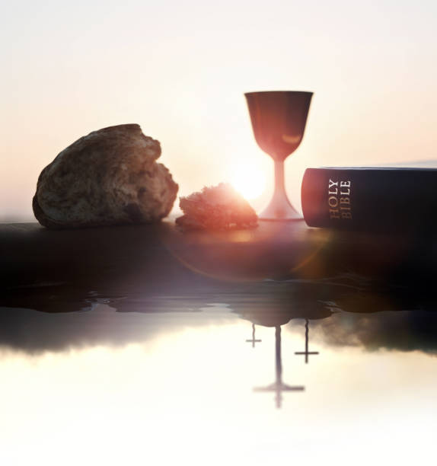
MATTHEW 26: 26 - 29
https://www.istockphoto.com/

Slide 30
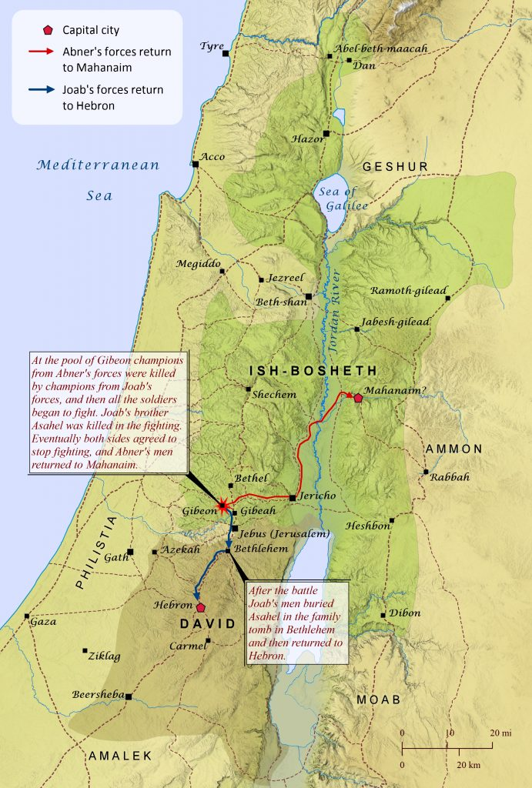
NEXT SUNDAY
May 4th 2025
10:00 am
CLIC@FedUni
2 Samuel
2: 8 – 5:5
https://biblemapper.com/blog/index.php/2023/01/22/david-and-ish-bosheth/

Slide 31
www.clichurch.com

