Slide 1


Slide 2
Good Soil
Mark 4:1-12

Slide 3
Again Jesus began to teach by the lake. The crowd that gathered around him was so large that he got into a boat and sat in it out on the lake, while all the people were along the shore at the water’s edge.
Mark 4:1-12 NIV

Slide 4
2 He taught them many things by parables, and in his teaching said: 3 Listen!
A farmer went out to sow his seed.
Mark 4:1-12 NIV

Slide 5
4 As he was scattering the seed, some fell along the path, and the birds came and ate it up. 5 Some fell on rocky places, where it did not have much soil. It sprang up quickly,
because the soil was shallow.
Mark 4:1-12 NIV

Slide 6
6 But when the sun came up, the plants were scorched, and they withered because they had no root. 7 Other seed fell among thorns, which grew up and choked the plants,
so that they did not bear grain.
Mark 4:1-12 NIV

Slide 7
8 Still other seed fell on good soil.
It came up, grew and produced a crop,
some multiplying thirty, some sixty,
some a hundred times.”
Mark 4:1-12 NIV

Slide 8
9 Then Jesus said,
“Whoever has ears to hear, let them hear.”
Mark 4:1-12 NIV

Slide 9
10 When he was alone, the Twelve and the others around him asked him about the parables. 11 He told them,
“The secret of the kingdom of God
has been given to you.”
Mark 4:1-12 NIV

Slide 10
But to those on the outside everything is said in parables 12 so that,
“‘they may be ever seeing but never perceiving,
and ever hearing but never understanding;
Otherwise, they might turn and be forgiven!’”
Mark 4:1-12 NIV

Slide 11
Good Soil
Tend Your Soil
(Heart)

Slide 12
15 Some people are like seed along the path, where the word is sown.
As soon as they hear it,
Satan comes and takes away
the word that was sown in them.
Mark 4:15 NIV

Slide 13
16 Others, like seed sown on rocky places, hear the word and at once receive it with joy. 17 But since they have no root, they last only a short time.
When trouble or persecution comes because of the word, they quickly fall away.
Mark 4:16-17 NIV

Slide 14
18 Still others, like seed sown among thorns, hear the word;
19 but the worries of this life, the deceitfulness of wealth and the desires for other things
come in and choke the word,
making it unfruitful.
Mark 4:18-19 NIV

Slide 15
20 Others, like seed sown on good soil, hear the word, accept it, and produce
a crop—some thirty, some sixty, some a hundred times what was sown.”
Mark 4:20 NIV

Slide 16
Watch over your heart with all diligence,
For from it flow the springs of life.
Proverbs 4:23 NASB

Slide 17
Good Soil
Earnestly Seek
to Learn

Slide 18
9 Then Jesus said,
“Whoever has ears to hear,
let them hear.”
Mark 4:9 NIV

Slide 19
10 When he was alone,
the Twelve and the others around him asked him about the parables.
11 He told them,
“The secret of the kingdom of God
has been given to you.”
Mark 4:10-11 NIV

Slide 20
‘Call to me and I will answer you
and tell you great and unsearchable things
you do not know.’
Jeremiah 33:3 NIV

Slide 21
Good Soil
Sow God’s Seed

Slide 22
4 As he was scattering the seed, some fell along the path, and the birds came and ate it up. 5 Some fell on rocky places, where it did not have much soil. It sprang up quickly,
because the soil was shallow.
Mark 4:4-5 NIV

Slide 23
8 Still other seed fell on good soil.
It came up, grew and produced a crop,
some multiplying thirty, some sixty,
some a hundred times.”
Mark 4:8 NIV

Slide 24
6 I planted the seed, Apollos watered it,
but God has been making it grow.
1 Corinthians 3:6 NIV

Slide 25
Good Soil
Conclusion:
The differing results were not based on the seed, but the kind of soil the seed fell on. Ensure His Word is falling on good soil. Pray for God to seal and grow that seed planted in your heart and others. Be sowers of the seed, and trust God with the results.

Slide 26
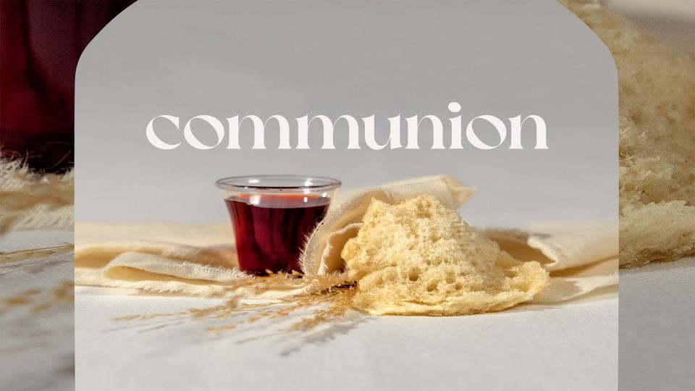

Slide 27


Slide 28


