Slide 1

Enjoying God’s Presence through Serving Him

Slide 2







Slide 3
Bible Verse
Ephesians 2:8-10 NIV
For it is by grace you have been saved, through faith—and this is not from yourselves, it is the gift of God— not by works, so that no one can boast. For we are God’s handiwork, created in Christ Jesus to do good works, which God prepared in advance for us to do.

Slide 4


Three Life Stages of Moses
  Pharoah’s Palace
  Prince
  Pride, Self-Suffiency
40
  Desert
  Shepherd
  Insecurity, Self-Doubt
80
  Desert
  Deliverer
  God-Dependence
120

Slide 5

Principle #1
Joy in Surrender

Slide 6
Have you surrendered every part of your life to Jesus?

Slide 7
Anything we have that we cannot let go of when God asks us to,
is a problem in our lives.

Slide 8
Bible Verse
Proverbs 3:5-6 NIV
Trust in the Lord with all your heart and lean not on your own understanding; in all your ways submit to Him, and He will make your paths straight.

Slide 9

Principle #2
Purpose over Comfort

Slide 10
Bible Verse
Hebrews 12:1-2 NIV
And let us run with perseverance the race marked out for us, fixing our eyes on Jesus, the pioneer and perfecter of faith. For the joy set before Him He endured the cross, scorning its shame, and sat down at the right hand of the throne of God

Slide 11
Are you allowing your desire for comfort and ease to hold you back from stepping into the purpose God has called you to?

Slide 12
  I’m not good enough.
  Who am I to do this?
  I don’t have all the answers.
  People won’t believe me.
  I’m not qualified.

Slide 13
When God calls you to something bigger than yourself, it’s never about what you can do on your own.

Slide 14

Principle #3
Powered by Presence

Slide 15
Bible Verse
Matthew 11:28-30 NIV
Come to me, all you who are weary and burdened, and I will give you rest. Take my yoke upon you and learn from me, for I am gentle and humble in heart, and you will find rest for your souls. For my yoke is easy and my burden is light.

Slide 16
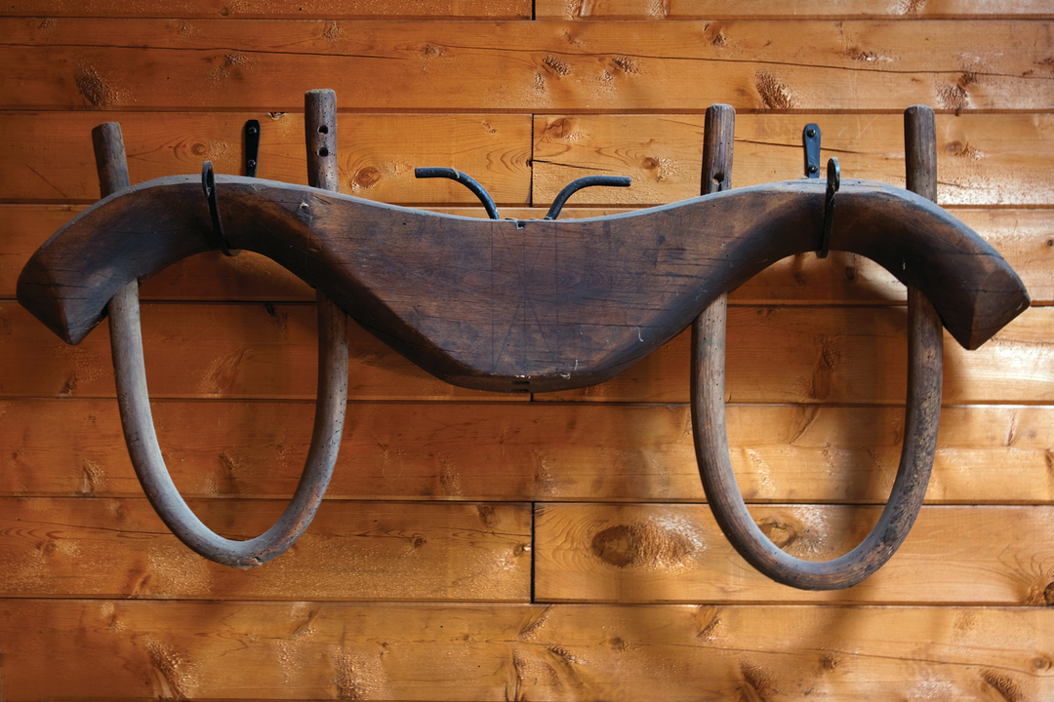
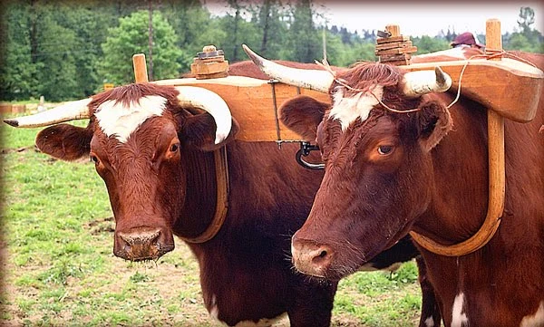

Slide 17
Am I still yoked to Jesus or have I drifted away from Him?

Slide 18
The power of the Christian life is the person of the Holy Spirit.

Slide 19



Slide 20
Moses faithfully served God’s purpose in his generation, and God is calling you to do the same for your generation.
How will you respond to that call?

