Slide 2
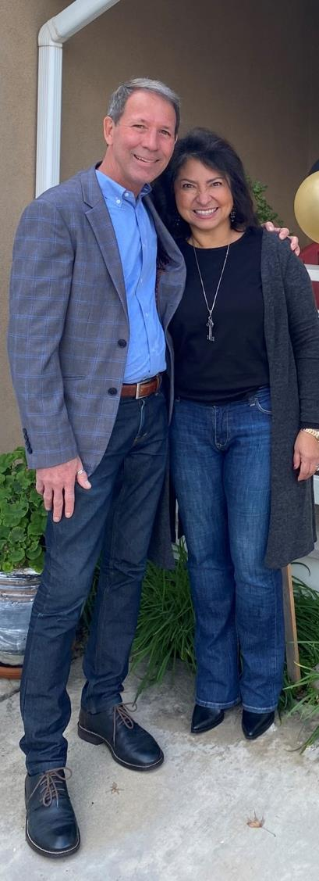




Nathan & Joanna Zug
HAPPY NEW YEAR

Slide 3
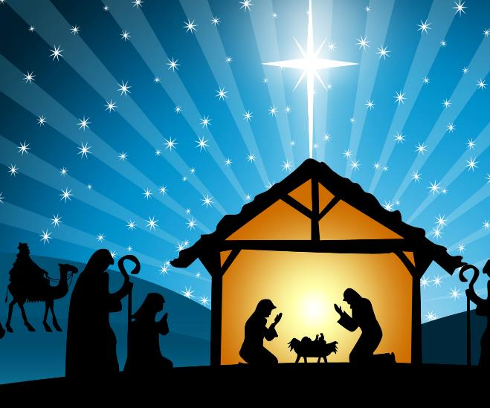
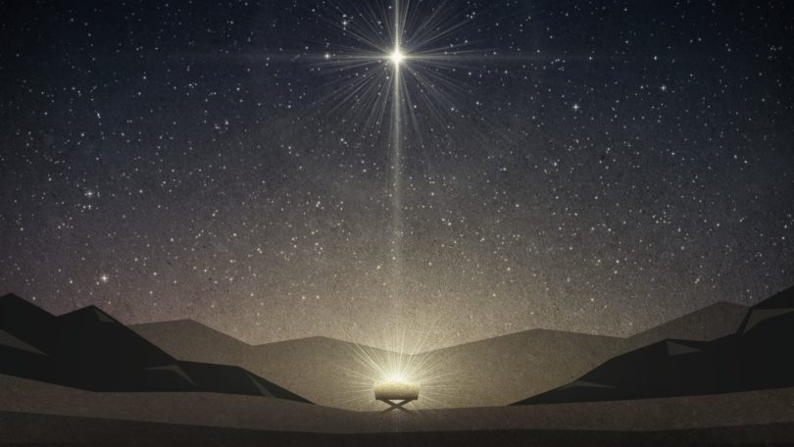

The Names of Jesus
Wonderful Counselor, Everlasting Father, Prince of Peace
Isa. 9:1-7
KING

Slide 4
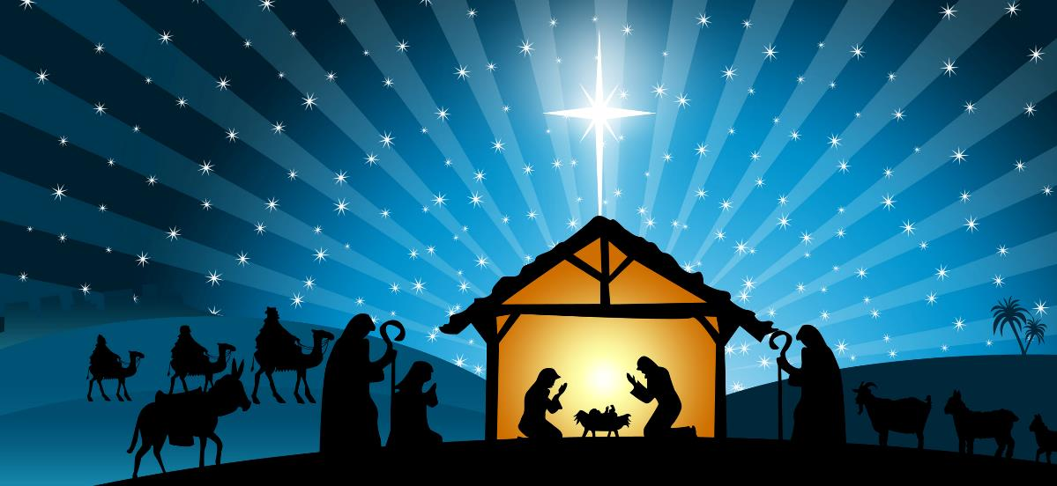
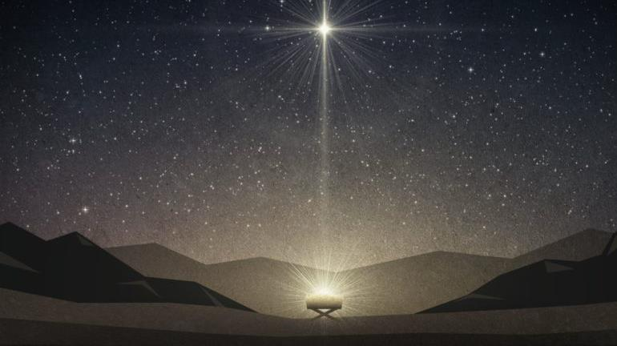
The Names of Jesus
RABBI
New Testament

Slide 5
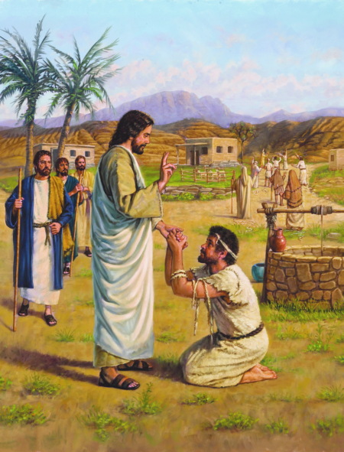
John 13:1-20
RABBI
“Now that you know these things You will be blessed
if you do them…”
“May you be covered in the dust of your Rabbi.”

Slide 6
YOU Matter!
God made you uniquely Psalm 139:13-16
God wants to sustain you John 10:10
God Loves YOU! John 3:16-17

Slide 7
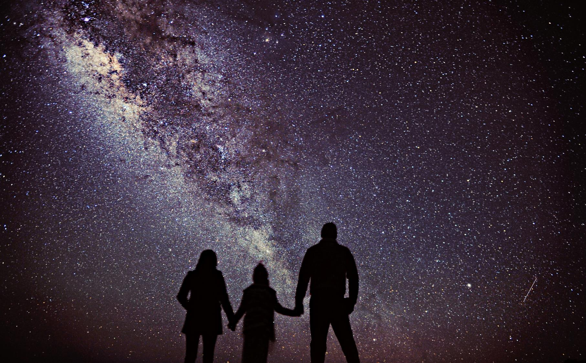
GOD PICKED YOU!
2025
YOU MATTER!!
200,000,000,000,000,000,000,000
110,000,000,000

Slide 8
YOU
MATTER!!
ZIP
CODES
DNA
Psalm 139:13-18
Acts 17:24-31
John 10:10
John 3:16
LOVE

Slide 9
Psalm 139:13-16
For you created my inmost being; you knit me together in my mother’s womb.¹⁴ I praise you because I am fearfully and wonderfully made; your works are wonderful, I know that full well. ¹⁵ My frame was not hidden from you when I was made in the secret place, when I was woven together in the depths of the earth. ¹⁶ Your eyes saw my unformed body; all the days ordained for me were written in your book before one of them came to be..

Slide 10
John 10:10
10 The thief comes only to steal and kill and destroy; I have come that they may have life, and have it to the fullest.

Slide 11
John 3:16-17
¹⁶ For God so loved the world that he gave his one and only Son, that whoever believes in him shall not perish but have eternal life. ¹⁷ For God did not send his Son into the world to condemn the world, but to save the world through him.

Slide 12
2. YOU are a Disciple &
a Disciple Maker?!
Christian or Disciple?
(3) (261)
Floss or ROPE

Slide 13
2. YOU are a Disciple &
a Disciple Maker?!
Discipling Opportunity
Discipling Relationship

Slide 14
2. YOU are a Disciple &
a Disciple Maker?!
Spiritual -- Task /// Task -- Spiritual (Relationships)

Slide 15
2. YOU are a Disciple &
a Disciple Maker?!
WHAT:
Fellowship / Meaningful Time (eating, activities)
Service: meeting needs at MBC and in community
Learning & Growing: Prayer, Study of Scripture, processing life and its circumstances

Slide 16
3. YOU Good?
Love God / Love Others! (Great Commandment)
Matthew 22:36-40
GO!! Make Disciples!! (Great Commission)
Matthew 28:18-20
Obey God & Serve Others!
“Now that you know these things, you will be blessed if you do them!”

Slide 17
Matthew 22:36-40 (Great Commandment)
³⁶ “Teacher, which is the greatest commandment in the Law?” ³⁷ Jesus replied: “‘Love the Lord your God with all your heart and with all your soul and with all your mind.’^{[c]} ³⁸ This is the first and greatest commandment. ³⁹ And the second is like it: ‘Love your neighbor as yourself.’^{[d]} ⁴⁰ All the Law and the Prophets hang on these two commandments.”

Slide 18
Matthew 28:19-20 (Great Commission)
¹⁸ Then Jesus came to them and said, “All authority in heaven and on earth has been given to me. ¹⁹ Therefore go and make disciples of all nations, baptizing them in the name of the Father and of the Son and of the Holy Spirit, ²⁰ and teaching them to obey everything I have commanded you. And surely I am with you always, to the very end of the age.”

Slide 19
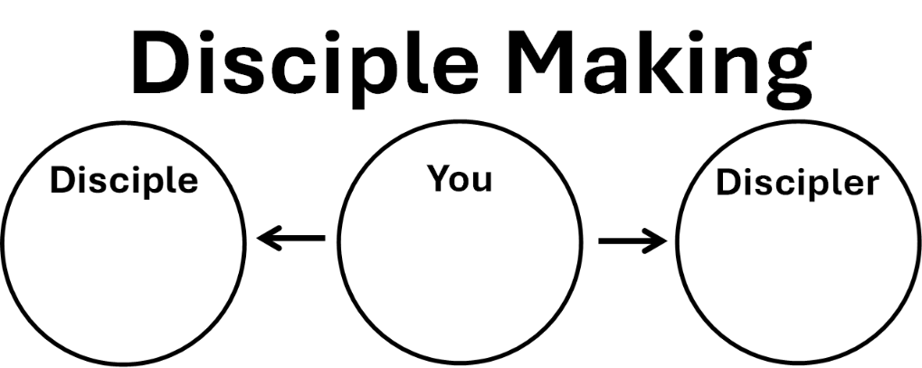
GO!! Make Disciples!! (Great Commission)
Matthew 28:18-20

Slide 20
GO!! Make Disciples!! (Great Commission)
Matthew 28:18-20
Joanna
Joe
Dustin
Nathan
Joanna
Paul
John

Slide 21
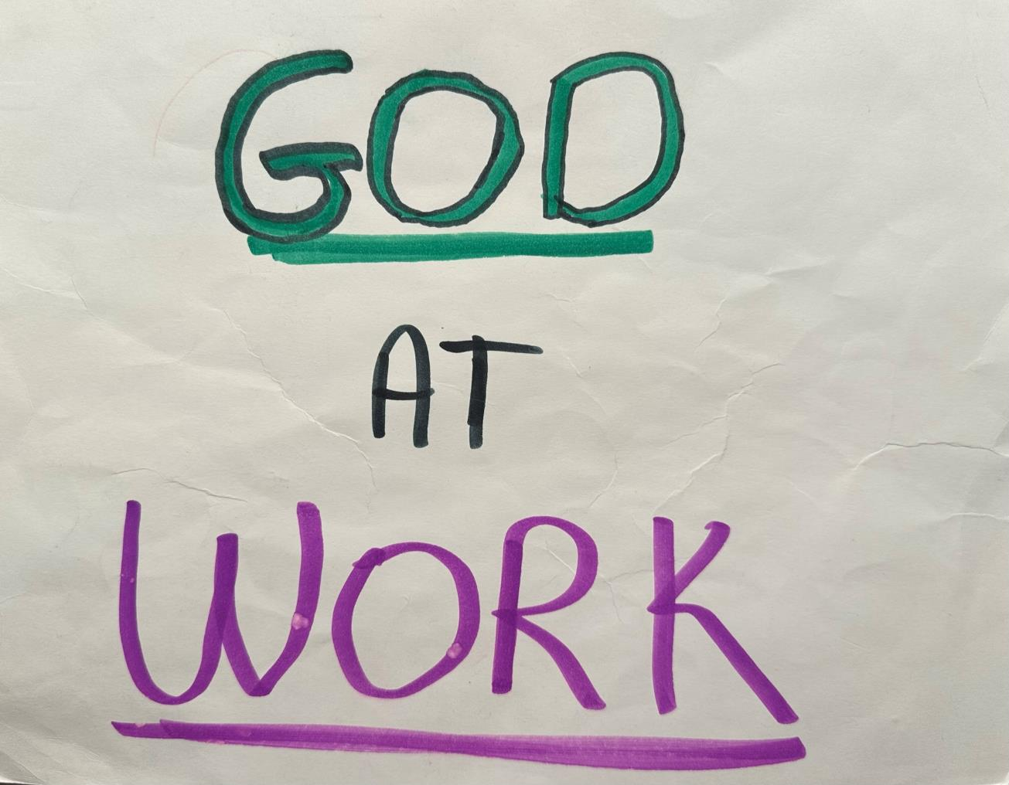

Slide 22
John 13:1-20
RABBI
“Now that you know these things You will be blessed
if you do them…”
“May you be covered in the dust of your Rabbi.”

