Slide 1
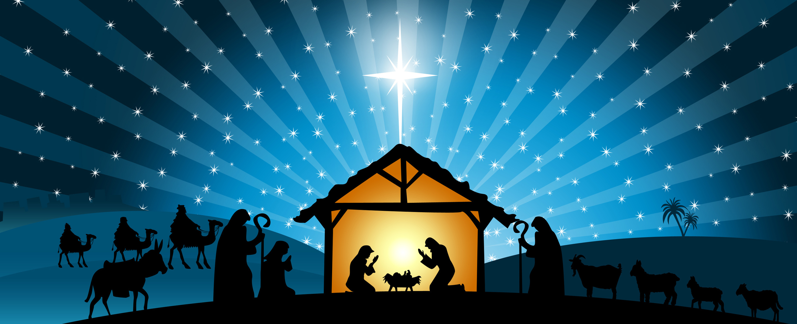
The Names of Jesus
Message 2: Wonderful Counselor
Isa. 9:1-7

Slide 2
Focus Question
What does it mean that Jesus is the wonderful counselor?

Slide 3
1. He is a divine counselor.

Slide 4
Judges 13:17-18
Then Manoah asked the angel of the LORD, “What is your name? For when all this comes true, we want to honor you.”
“Why do you ask my name?” the angel of the LORD replied. “It is too wonderful for you to understand.”

Slide 5
Matthew 12:42
"The Queen of the South will rise at the judgment with this generation and condemn it; for she came from the ends of the earth to listen to Solomon’s wisdom, and now something greater than Solomon is here."

Slide 6
2. He is an empathetic counselor.

Slide 7
Hebrews 4:15-16
"For we do not have a high priest who is unable to empathize with our weaknesses, but we have one who has been tempted in every way, just as we are—yet he did not sin.

Slide 8
Hebrews 4:15-16
"Let us then approach God’s throne of grace with confidence, so that we may receive mercy and find grace to help us in our time of need."

Slide 9
3. He is a counselor who restores us.

Slide 10
Matthew 11:28-29
Come to me, all who labor and are heavy laden, and I will give you rest. ²⁹ Take my yoke upon you, and learn from me, for I am gentle and lowly in heart, and you will find rest for your souls. ³⁰ For my yoke is easy, and my burden is light.”

Slide 11
4. He is a counselor who speaks graciously and truthfully to us.

Slide 12
John 1:14
And the Word became flesh and dwelt among us, and we have seen his glory, glory as of the only Son from the Father, full of grace and truth.

Slide 13
Application
This first week of advent read and reread the Sermon on the Mount from Matthew 5-7. Take in the words of Jesus. Reflect on them and above all put them into practice. Experience for yourself how he is a wonderful counselor.

