Slide 1


The Method of Outreach - Sowing Seeds Sharing the Gospel
MATTHEW 13:1-23
SUNDAY SERMON · DANIEL LEE

Slide 2
MATTHEW 28:18-20 NLT
18 Jesus came and told his disciples, “I have been given all authority in heaven and on earth.19 Therefore, go and make disciples of all the nations,[b] baptizing them in the name of the Father and the Son and the Holy Spirit. 20 Teach these new disciples to obey all the commands I have given you. And be sure of this: I am with you always, even to the end of the age.”

Slide 3
THE GREAT COMMISSION - COME WITH
  AUTHORITY!
  Call to obey
  We will not be alone – He is with us.

Slide 4
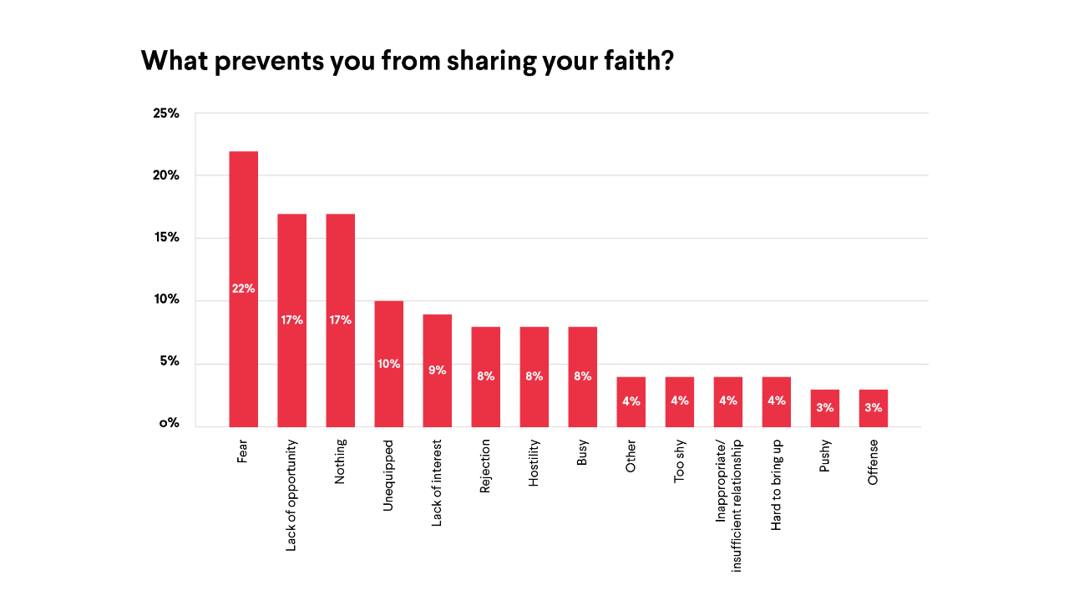


Slide 5
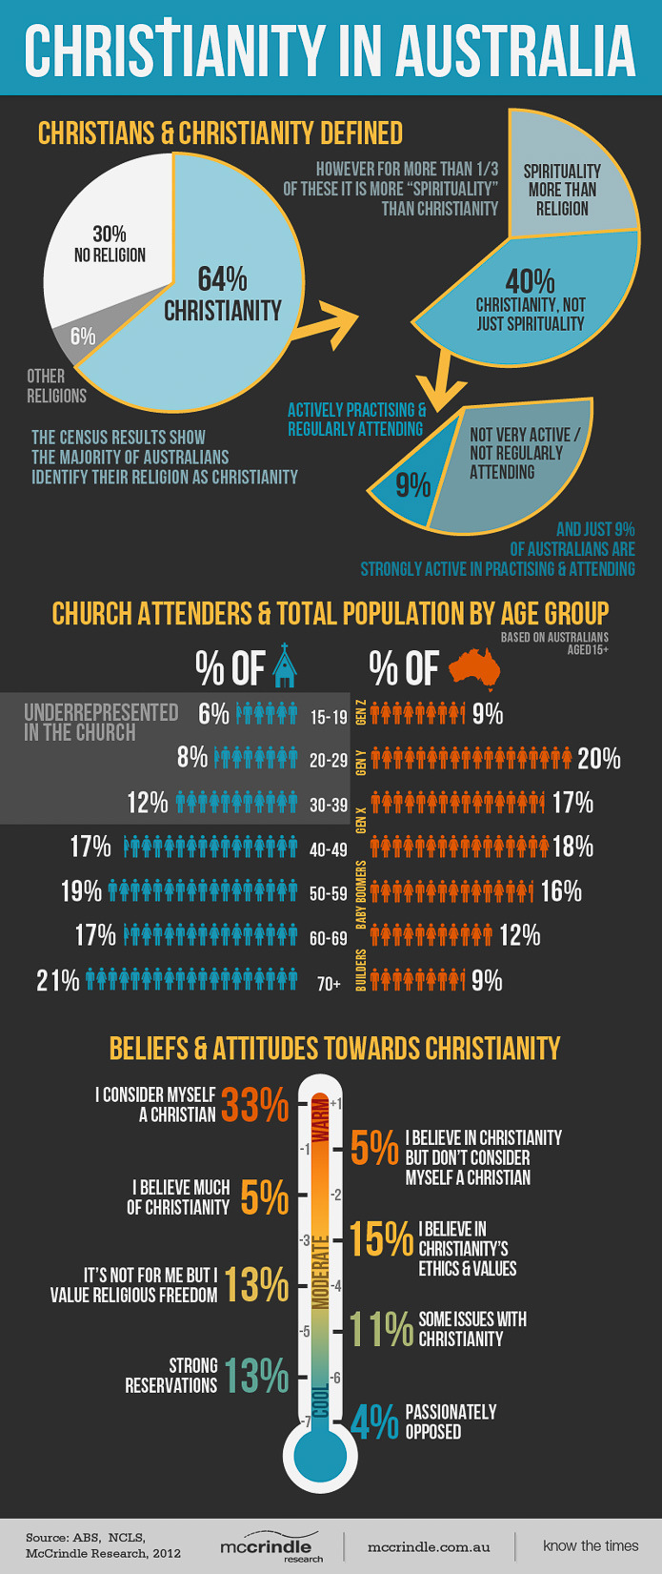

Slide 6
MATT 13:1-23 NLT
“Listen! A farmer went out to plant some seeds. 4 As he scattered them across his field, some seeds fell on a footpath, and the birds came and ate them. 5 Other seeds fell on shallow soil with underlying rock. The seeds sprouted quickly because the soil was shallow.6 But the plants soon wilted under the hot sun, and since they didn’t have deep roots, they died.

Slide 7

7 Other seeds fell among thorns that grew up and choked out the tender plants. 8 Still other seeds fell on fertile soil, and they produced a crop that was thirty, sixty, and even a hundred times as much as had been planted! 9 Anyone with ears to hear should listen and understand.”

Slide 8
11 He replied, “You are permitted to understand the secrets[a] of the Kingdom of Heaven, but others are not. 12 To those who listen to my teaching, more understanding will be given, and they will have an abundance of knowledge. But for those who are not listening, even what little understanding they have will be taken away from them. 13 That is why I use these parables,

Slide 9
16 “But blessed are your eyes, because they see; and your ears, because they hear. 17 I tell you the truth, many prophets and righteous people longed to see what you see, but they didn’t see it. And they longed to hear what you hear, but they didn’t hear it.

Slide 10
18 “Now listen to the explanation of the parable about the farmer planting seeds: 19 The seed that fell on the footpath represents those who hear the message about the Kingdom and don’t understand it. Then the evil one comes and snatches away the seed that was planted in their hearts. 20 The seed on the rocky soil represents those who hear the message and immediately receive it with joy.

Slide 11
21 But since they don’t have deep roots, they don’t last long. They fall away as soon as they have problems or are persecuted for believing God’s word.22 The seed that fell among the thorns represents those who hear God’s word, but all too quickly the message is crowded out by the worries of this life and the lure of wealth, so no fruit is produced. 23 The seed that fell on good soil represents those who truly hear and understand God’s word and produce a harvest of thirty, sixty, or even a hundred times as much as had been planted!”

Slide 12

Jesus is teaching and equipping His disciples for their future mission of sharing the Good News.

Slide 13



  THE SOWER
  GOOD SOIL
  SEED

Slide 14

PREPARING FOR EVANGELISM

Slide 15

FARMER WHO PREPARE BEFORE SOWING.
SOWING THE SEED THROUGH PRAYER

Slide 16
SOWING THE SEED THROUGH PRAYER
We’re called to “sow in prayer,” to plant spiritual seeds in the lives of others through prayer.

Slide 17
SET ASIDE A TIME AND PLACE
Just like in any activity, practical planning and consistent effort are more likely to lead to success than doing things randomly.

Slide 18
JOIN WITH OTHERS
Mt 18:19-20 NIV
"Again I say to you, if two of you agree on earth about anything they ask, it will be done for them by my Father in heaven. For where two or three are gathered in my name, there am I in the midst of them"

Slide 19
There is power in prayer

Slide 20
CULTIVATING THE SOIL:
EXPLORING DIFFERENT APPROACHES TO EVANGELISM

Slide 21
MASS EVANGELISM
Mass evangelism refers to the process of sharing the gospel with large groups of people, typically through large-scale evangelistic campaigns or events.

Slide 22
RANDOM EVANGELISM
This form of witnessing is done by individuals or pairs of Christians, who offer a presentation of the gospel or a personal testimony to strangers.

Slide 23
EVERYDAY EVANGELISM
Everyday evangelism involves influencing others toward the kingdom of God in our daily environments.

Slide 24
SPREADING THE SEEDS
In the parable of the Sower, we see that the farmer scatters seeds everywhere—on the footpath, rocky ground, thorny ground, and good soil.

Slide 25
1 CORINTHIANS 3:6-9 NLT
6 I planted the seed in your hearts, and Apollos watered it, but it was God who made it grow. It’s not important who does the planting, or who does the watering. What’s important is that God makes the seed grow. The one who plants and the one who waters work together with the same purpose. And both will be rewarded for their own hard work. For we are both God’s workers. And you are God’s field. You are God’s building.

Slide 26
Mark 4:26-29 NLT
26 He also said, “This is what the kingdom of God is like. A man scatters seed on the ground. Night and day, whether he sleeps or gets up, the seed sprouts and grows, though he does not know how. All by itself the soil produces grain—first the stalk, then the head, then the full kernel in the head. As soon as the grain is ripe, he puts the sickle to it, because the harvest has come.”

Slide 27
1 CORINTHIANS 2:4-5 NLT
My message and my preaching were not with wise and persuasive words, but with a demonstration of the Spirit’s power, so that your faith might not rest on human wisdom, but on God’s power.

Slide 28
Acts 1:8 NLT
But you will receive power when the Holy Spirit comes upon you. And you will be my witnesses, telling people about me everywhere—in Jerusalem, throughout Judea, in Samaria, and to the ends of the earth.”

Slide 29
Mark 4:20 NLT
Others, like seed sown on good soil, hear the word, accept it, and produce a crop—some thirty, some sixty, some a hundred times what was sown.”

Slide 30
Hear it – Come and hear
Accept it – Come and see
Act on it. – Come follow Me.

