Slide 1
ANDEAN GrOUp GOOD NEWS

Slide 2
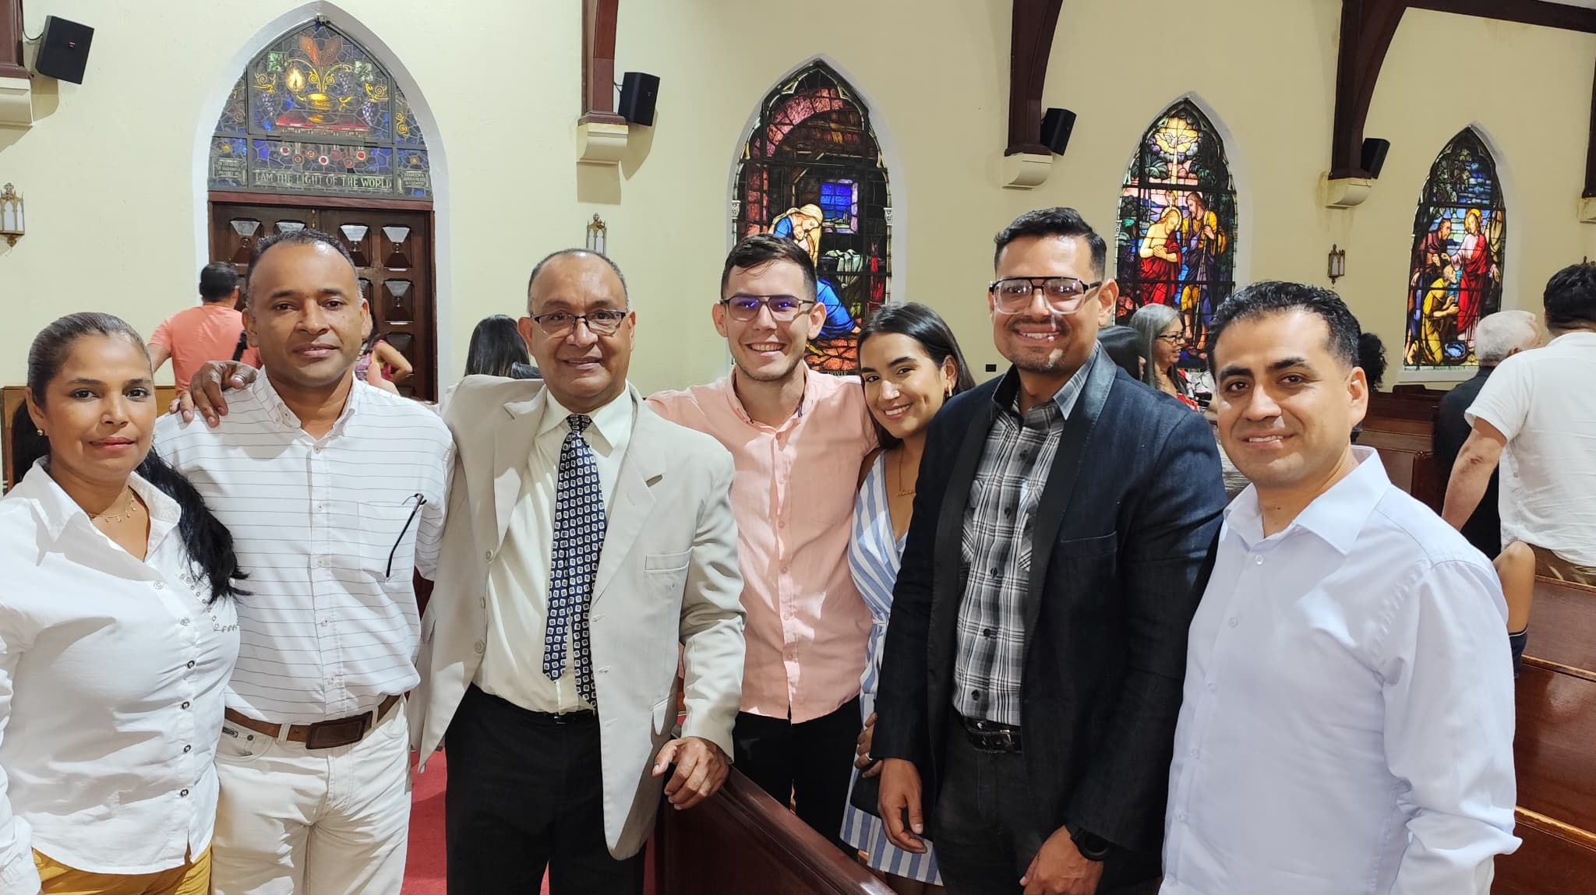
A new CHURCH IN
Valencia,
Venezuela
Church in Valencia,
the 2nd largest city in Venezuela,
was added to our family of Churches on May 11th, 2024

Slide 3
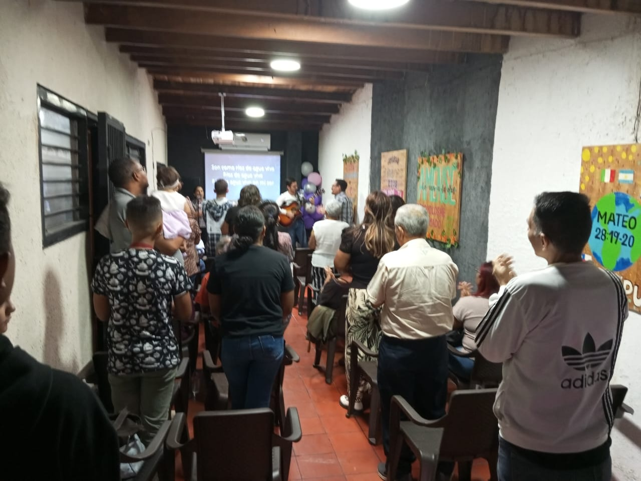
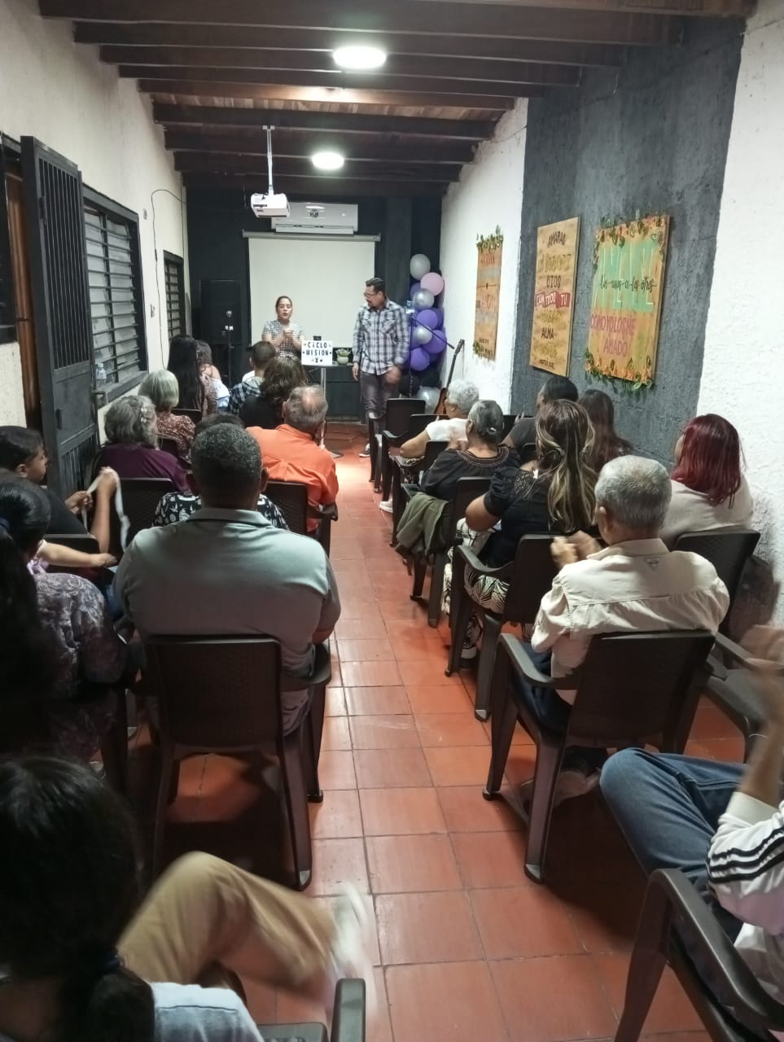
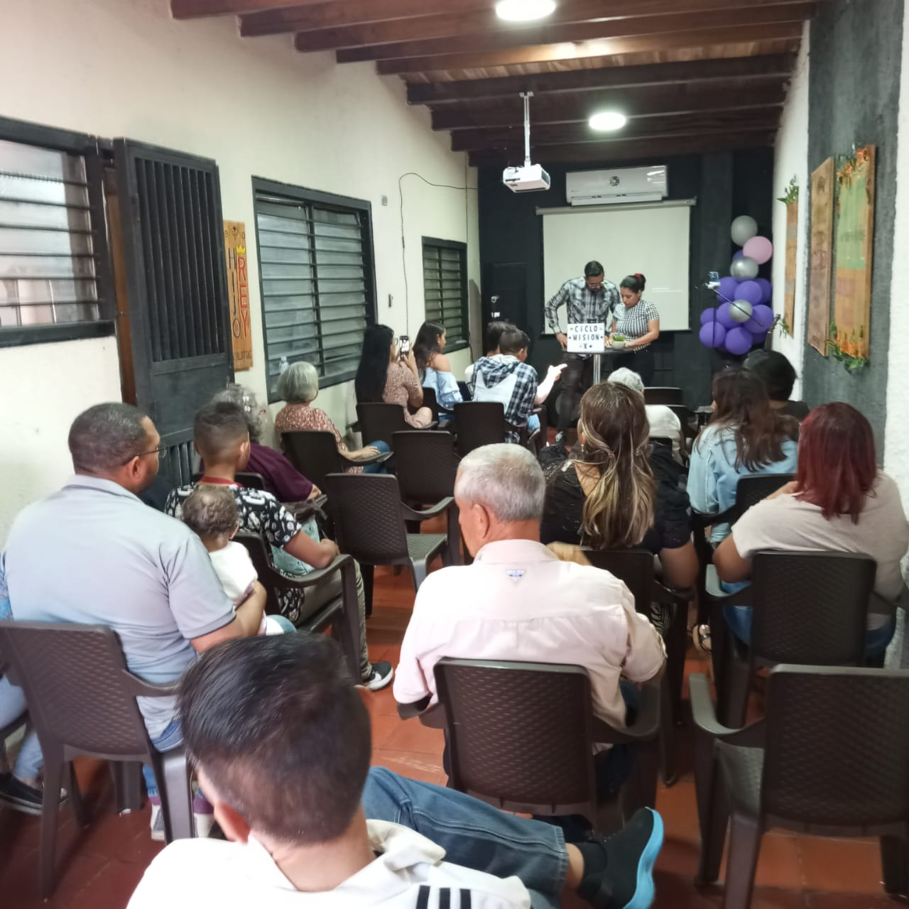
Valencia, venezuela church
Images of some activities and gatherings during 2024

Slide 4
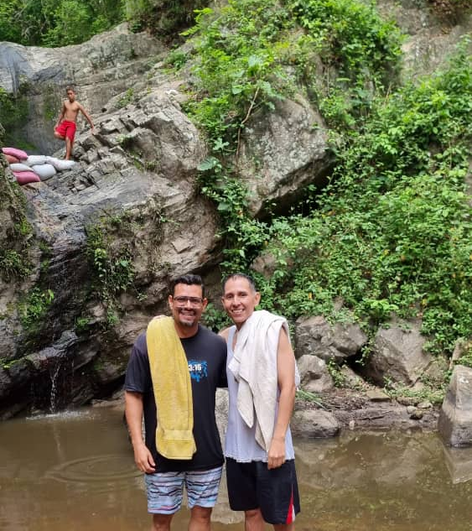
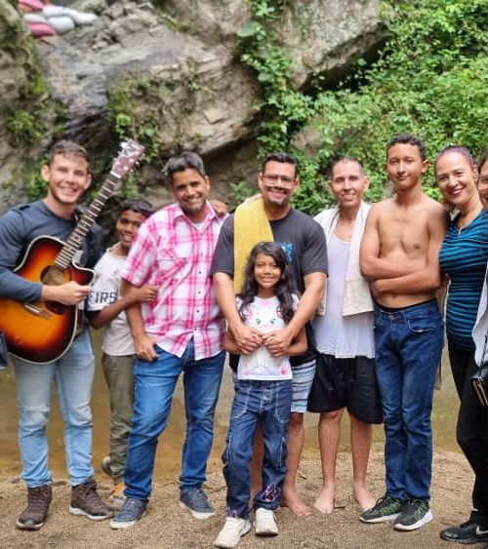
Baptism iN VALENCIA, venezuela

Slide 5
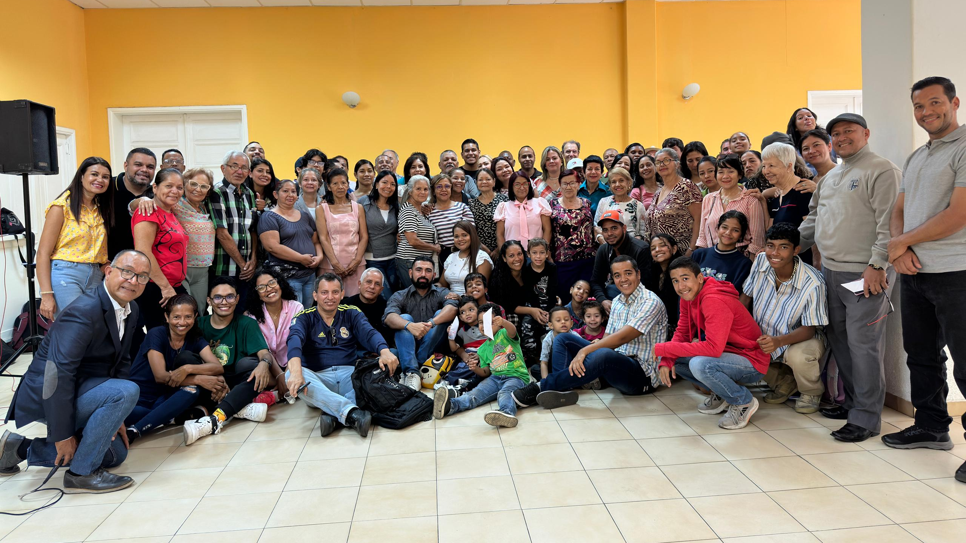
CARACAS, VENEZUELA Church

Slide 6
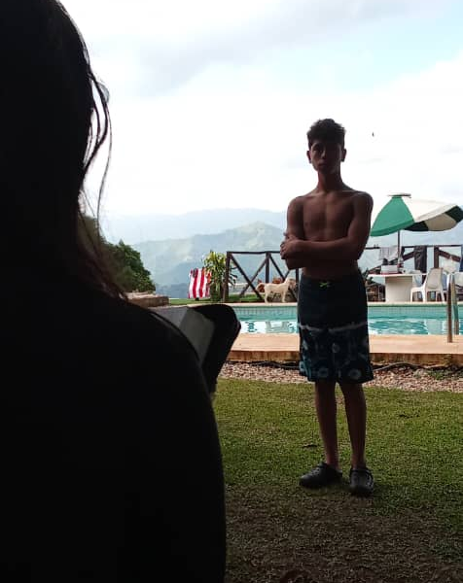
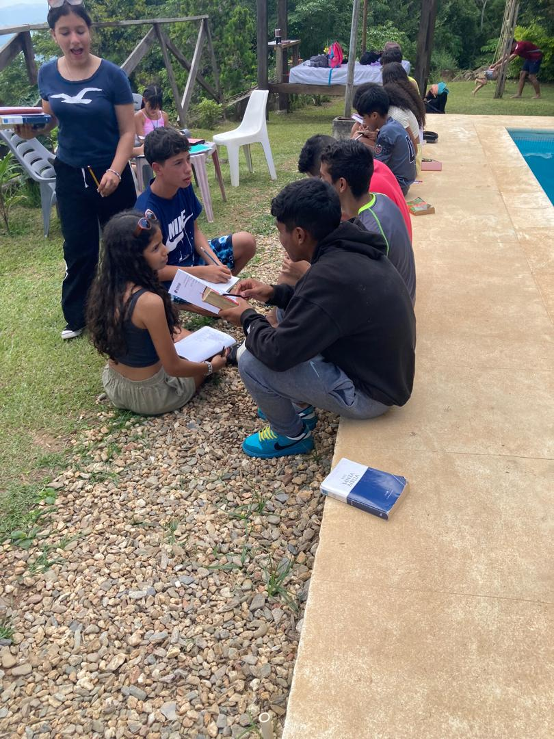
- baptism of juan David González
- teens retreat
Caracas, vzla Church

Slide 7
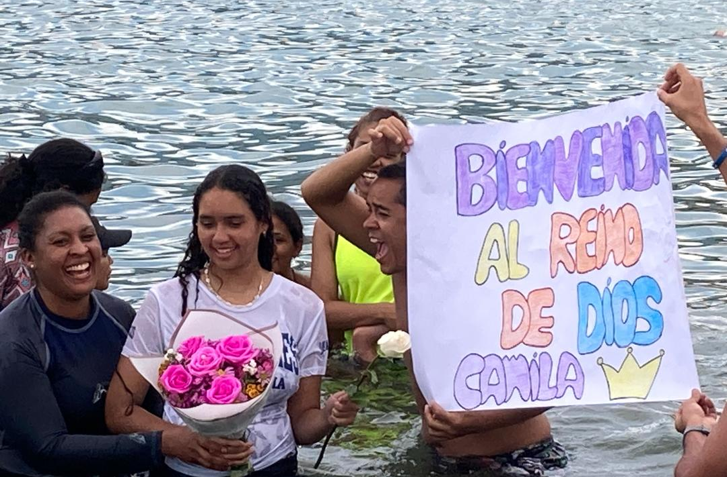
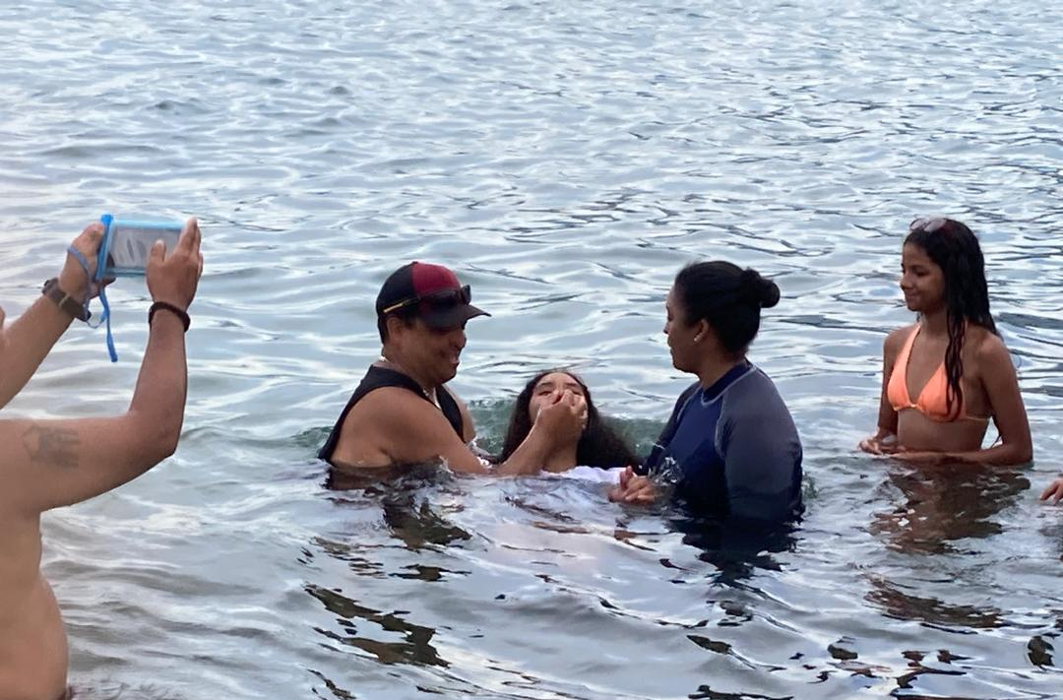
BApism of CAMILA CHACÓN sept 8th, 2024
caracas, Venezuela Church

Slide 8
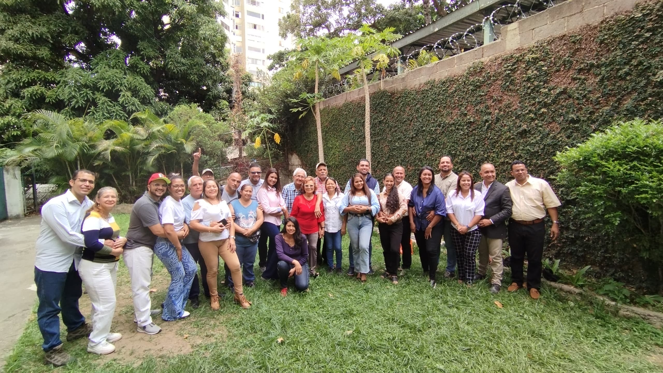
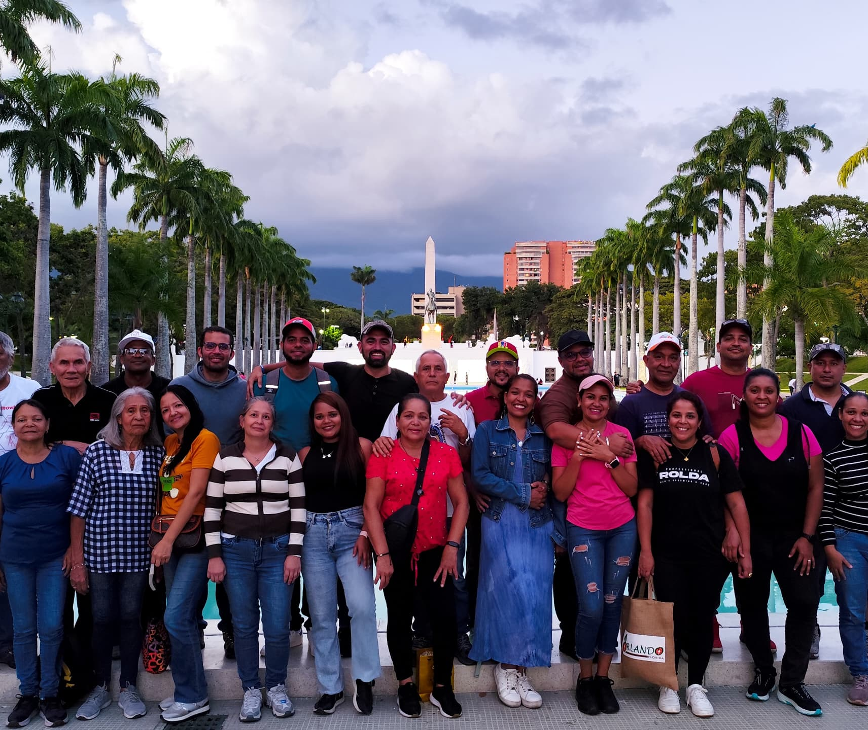
Marriage workshop - Saturday Sept 14^{th,} 2024
caracas, Venezuela Church

Slide 9
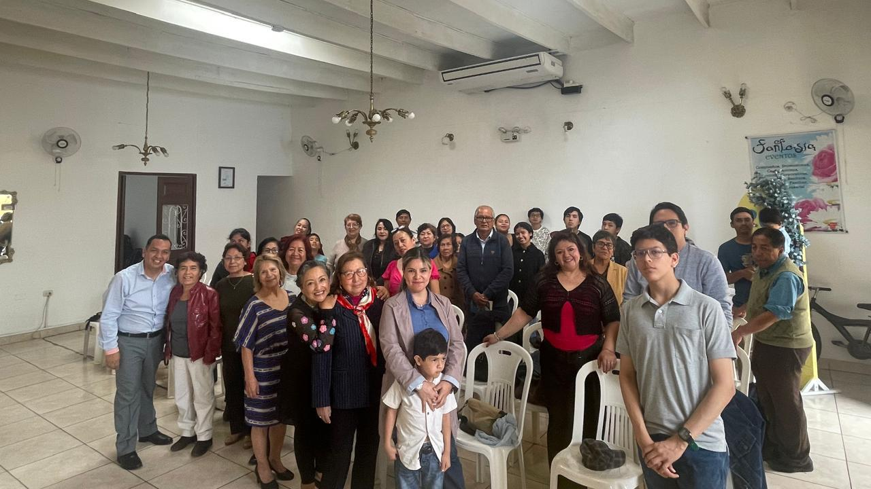
TRUJILLO, PERÚ Church

Slide 10
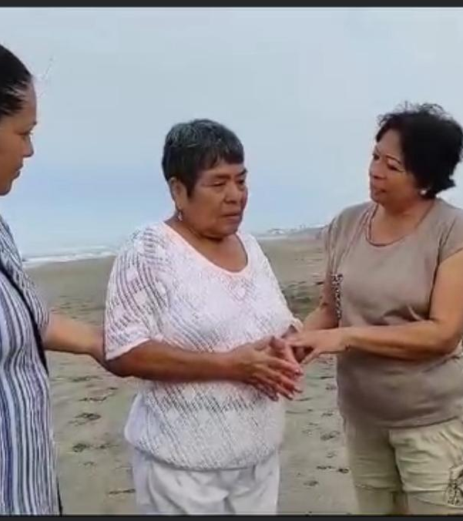
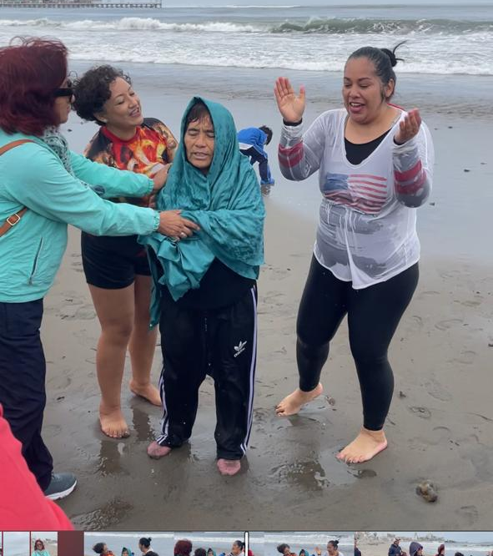
Two baptisms
Isabel rebase and Liliana rodriguez – January & August of 2024
TRUJILLO, Perú Church

Slide 11
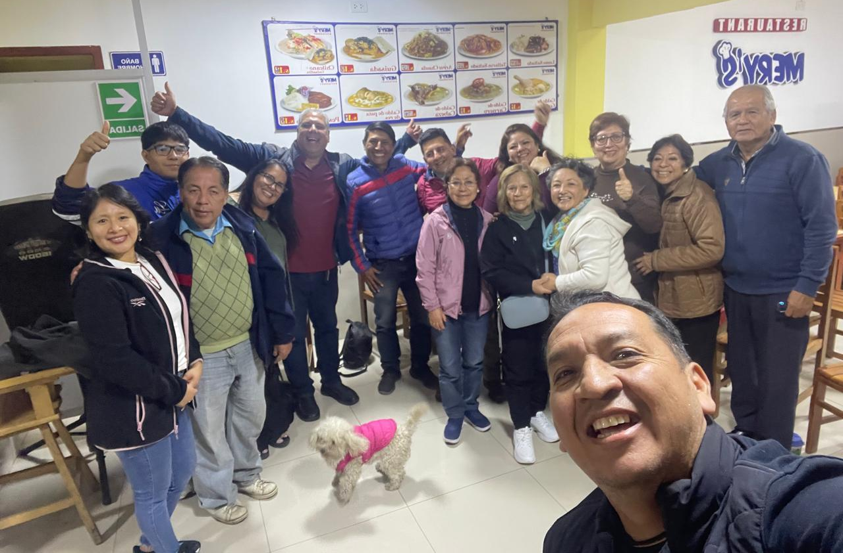
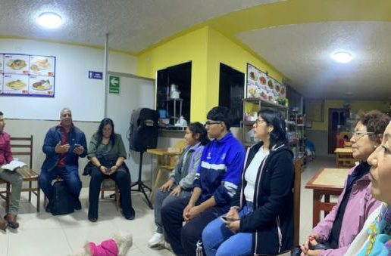
NELSON & CAROLINA BARRETO travel to encourage the church
Trujillo, Perú Church

Slide 12
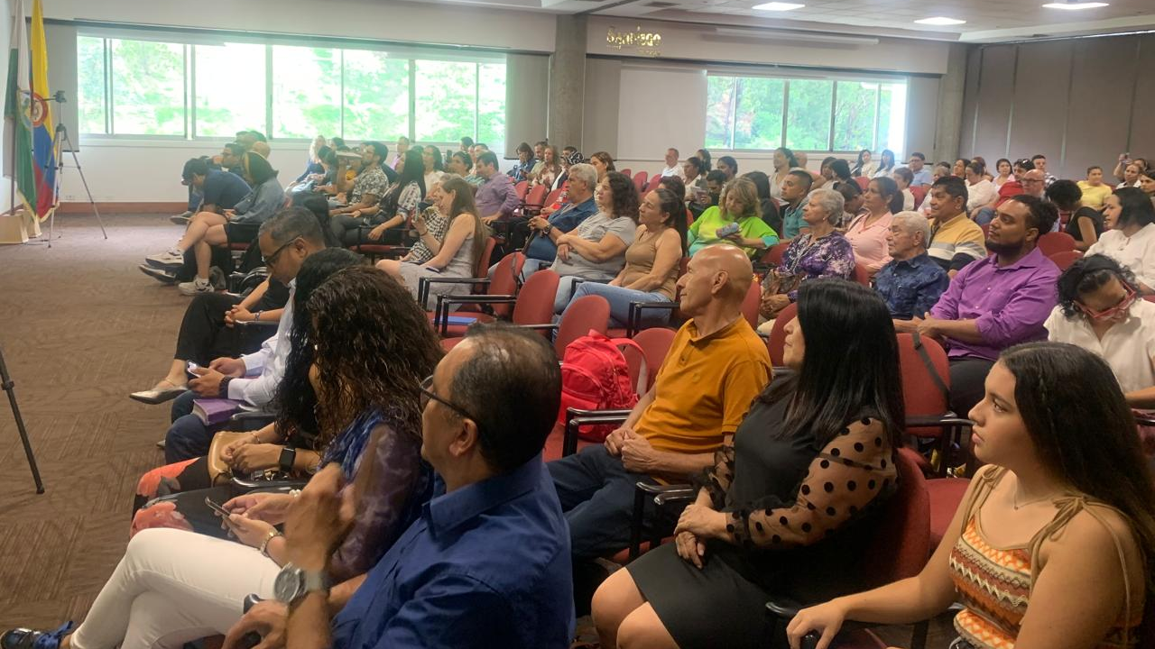
MEDELLIN, Colombia Church

Slide 13
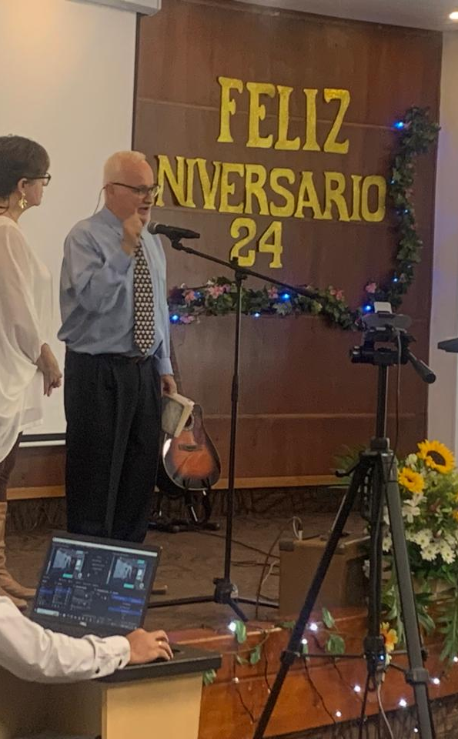
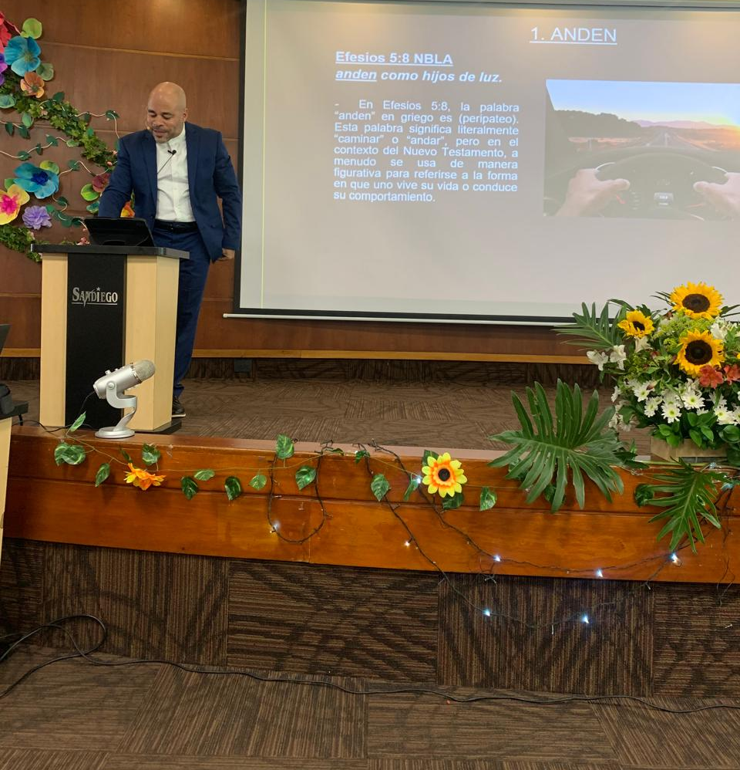
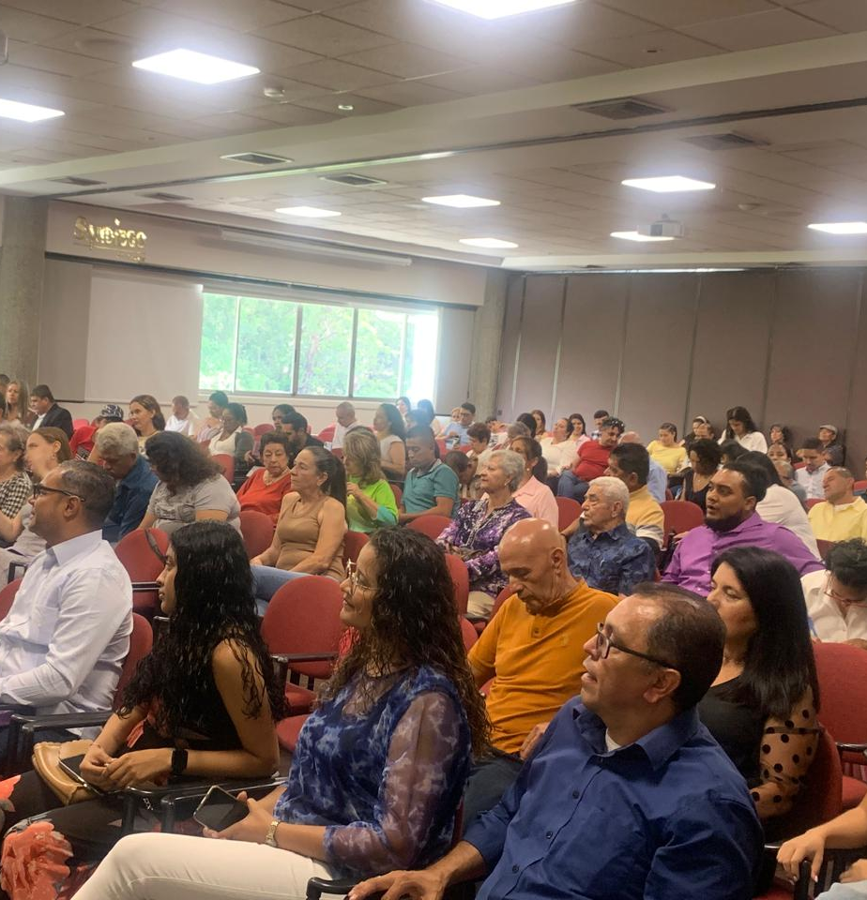

Medellin, Colombia
Church
24th anniversary
Mayo 26th 2024
Special visit from Angel Martinez, evangelist of the Church in Santo Domingo, Dominican Republic.
God blessed us with over 200 in attendance.

Slide 14
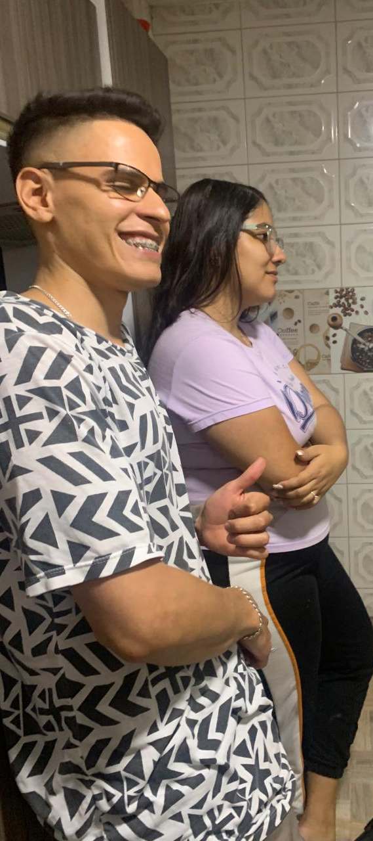
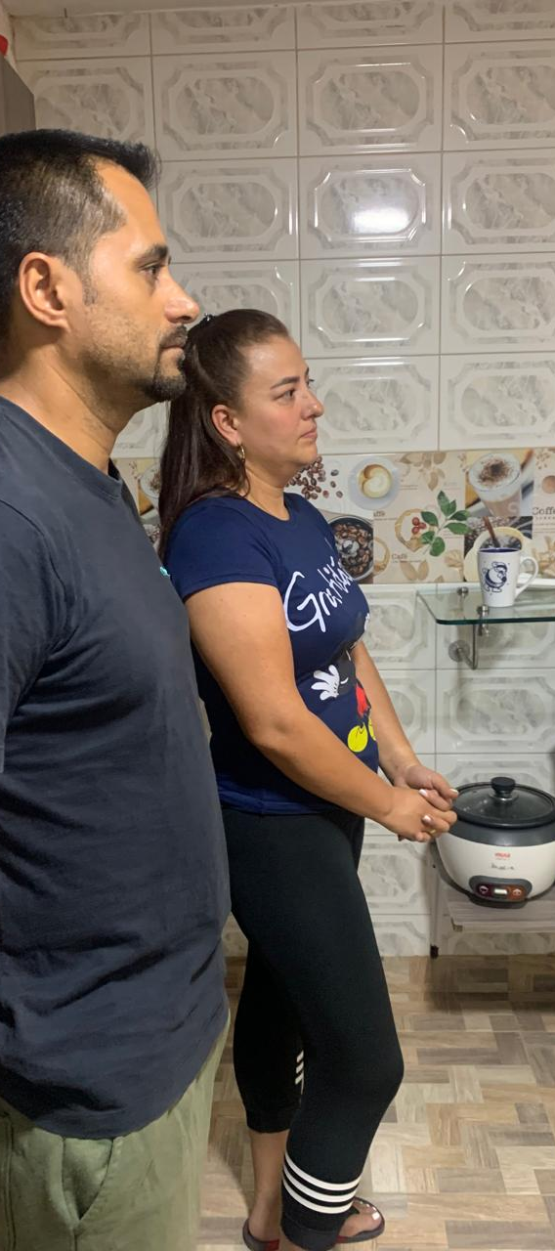
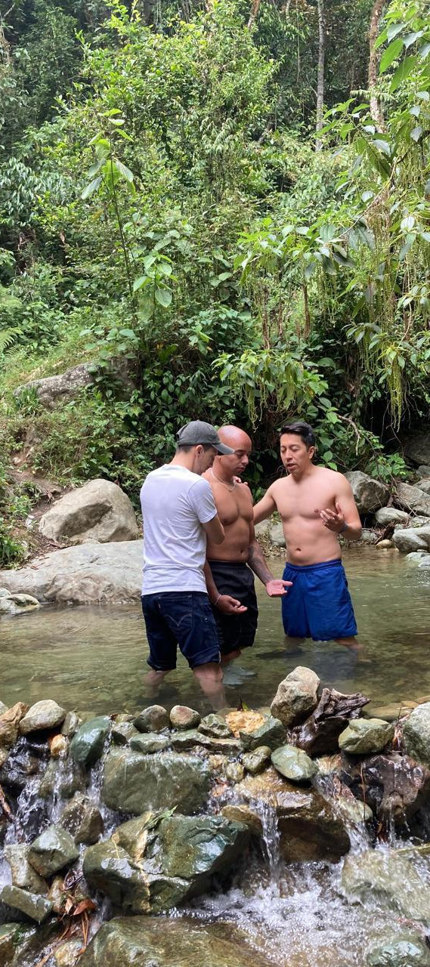
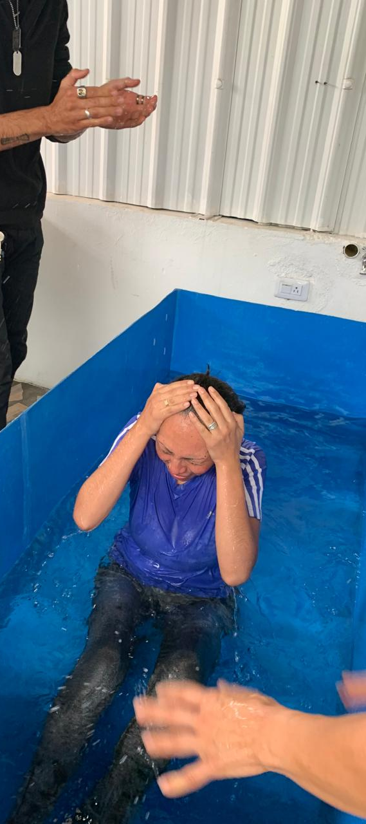
Six baptisms and one restoration
Medellin, Colombia Church

Slide 15
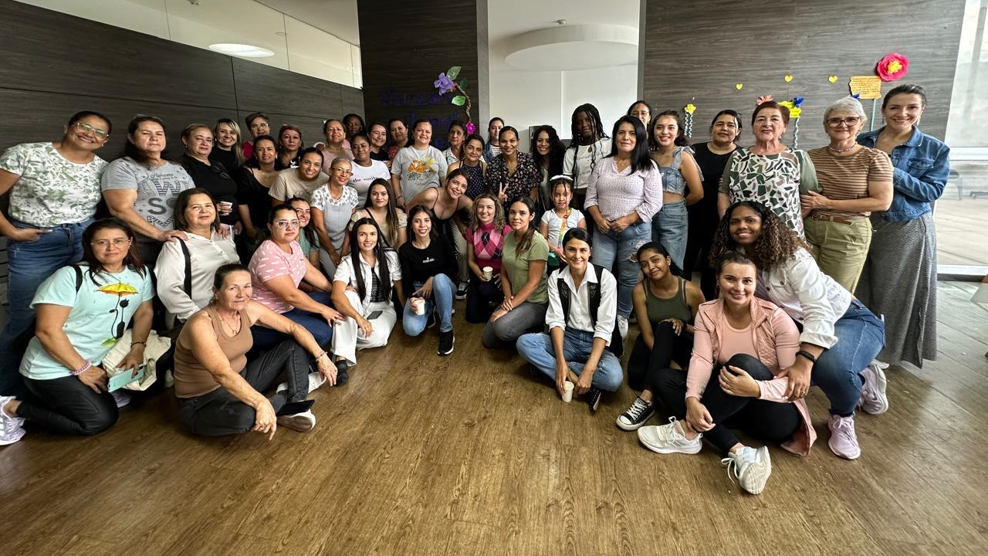
Women Devotional
“overcome evil with good”
Mayo 18th 2024
Medellin, Colombia Church

Slide 16
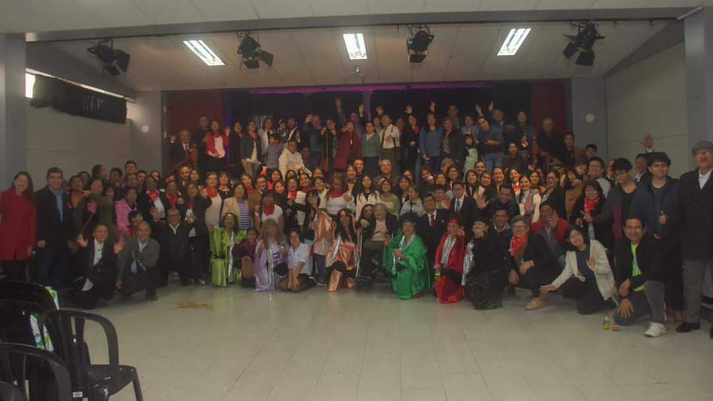
lima, Perú Church

Slide 17
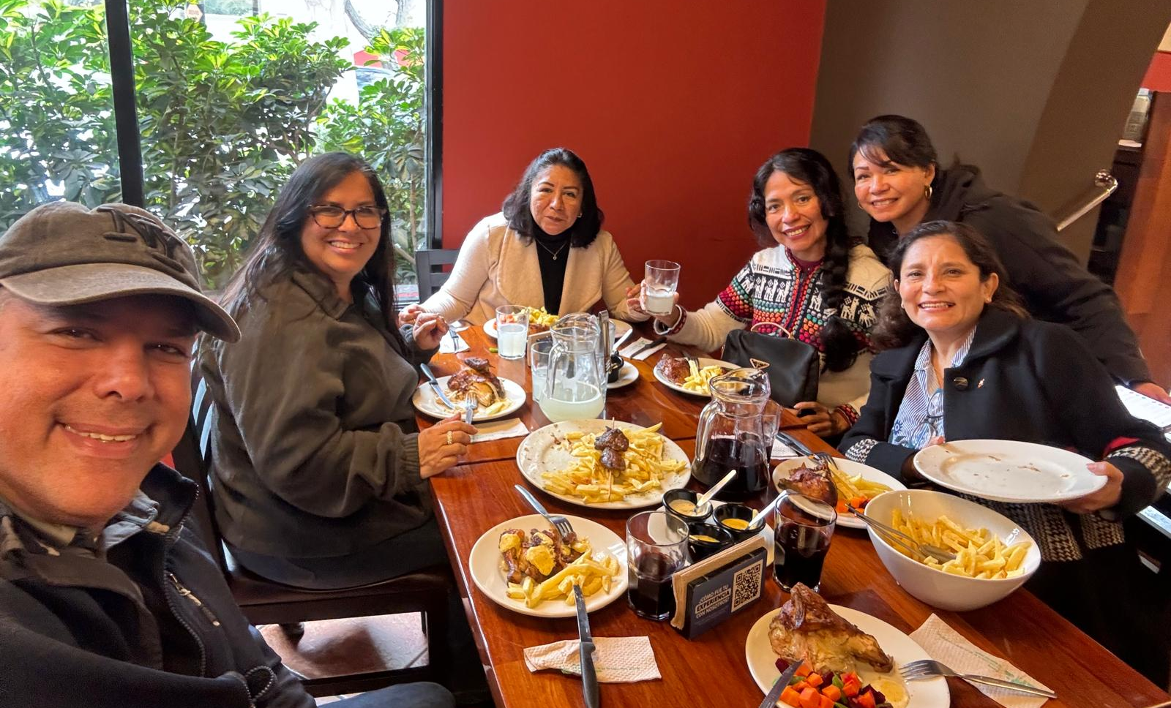
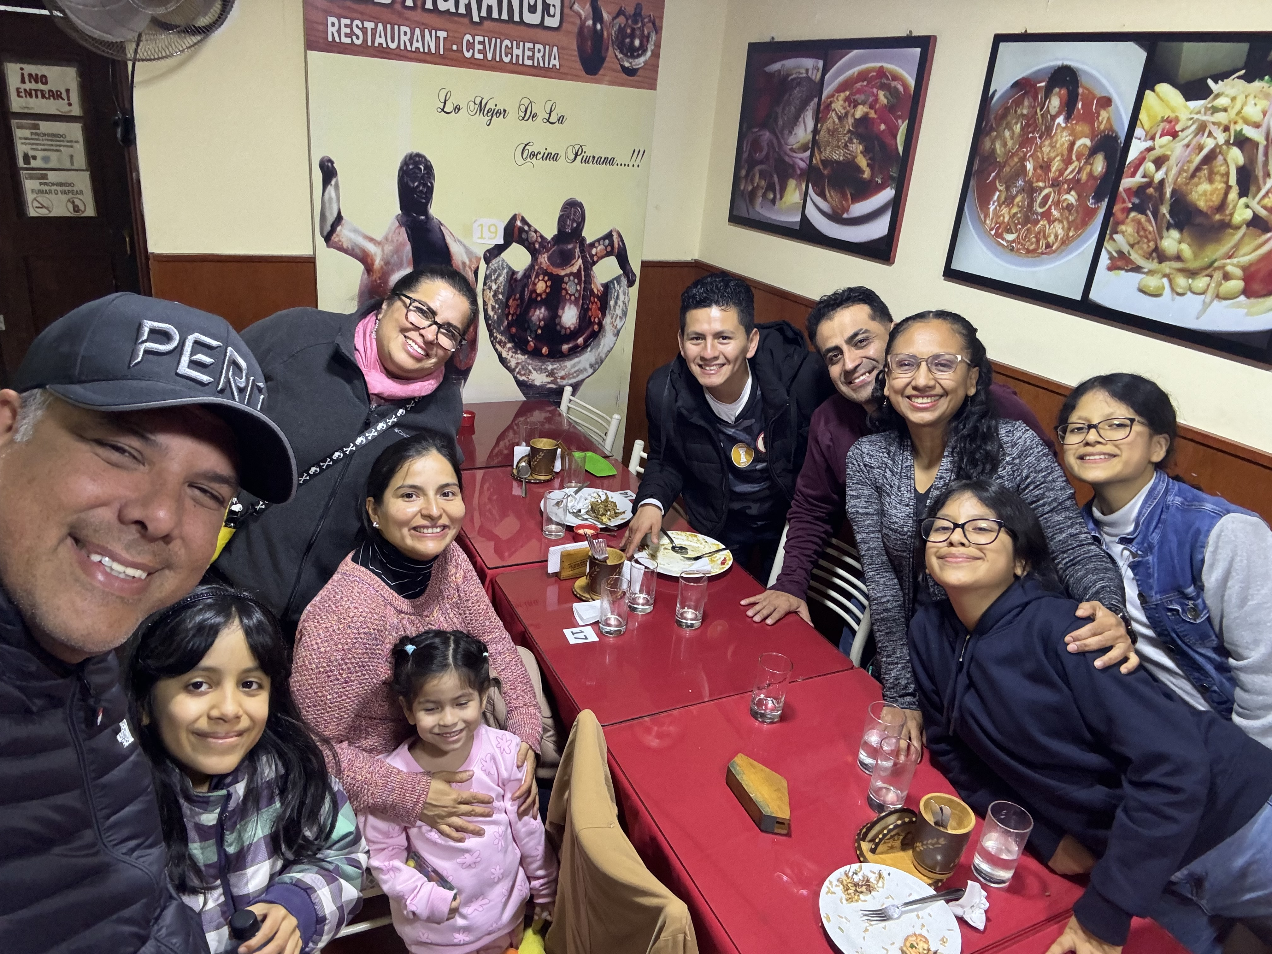
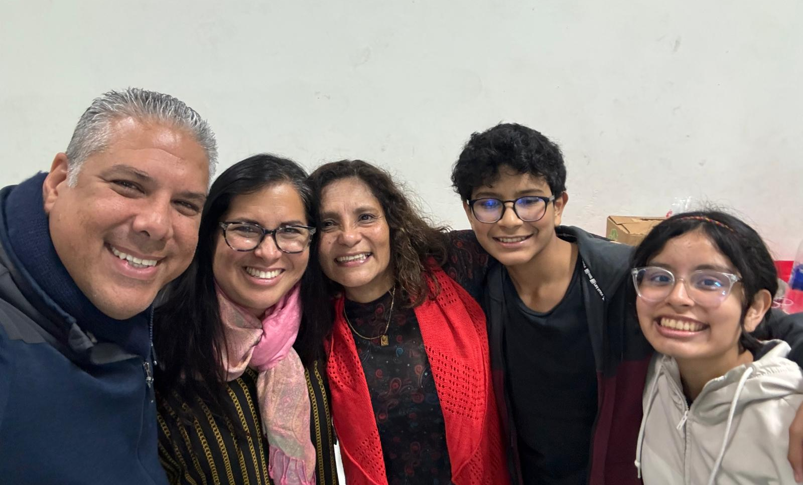
NELSON & CAROLINA
BARRETO encouragement visit
Lima, Perú
Church

Slide 18
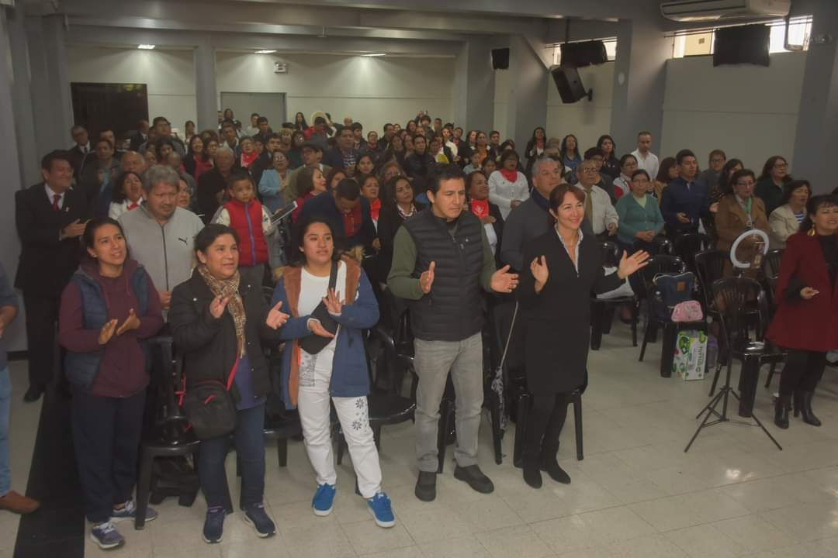
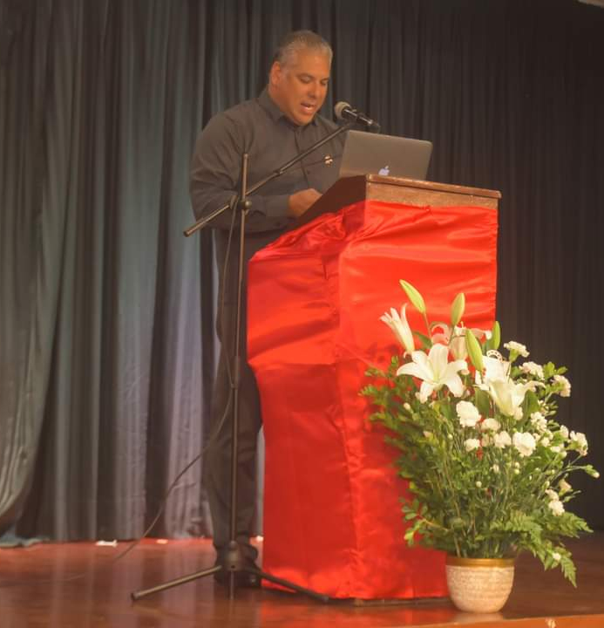
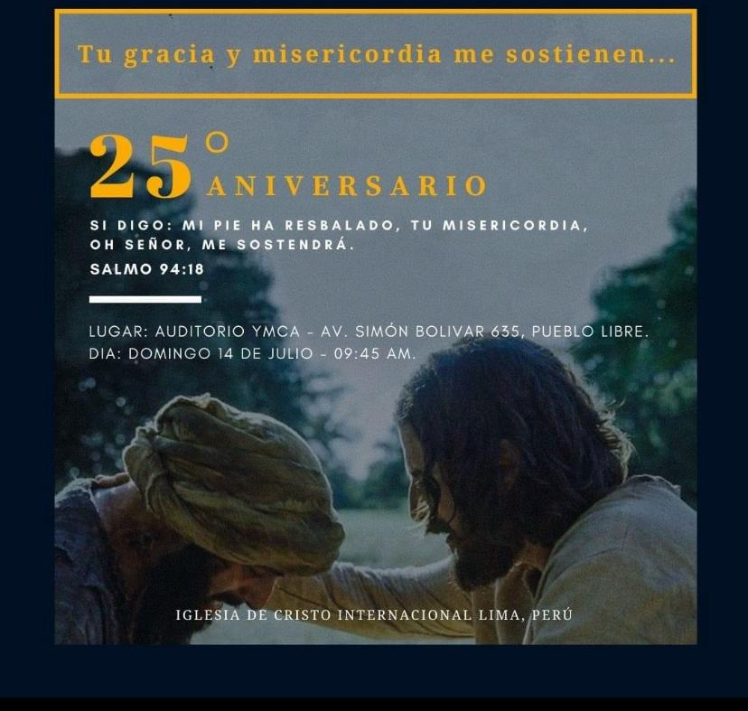
LIMA, perú Church
25th Aniversary
Nelson y Carolina Barreto visited, shared & preached.
The church is stable and united.
They have begun training for Elders, Teachers and Evangelists.
Six new preachers were presented as part of their leadership training..
By end of 2024 plan to appoint a Deacon couple to be train for future Eldership.

Slide 19
ANDEAN GrOUp GOOD NEWS

