Slide 1


LESSON #12:
THE LORD WILL ACCOMPLISH ALL THAT HE SAID
1 Samuel 31: 1 – 13
(1 CHRONICLES 10:1 – 14)
COURAGEOUS FAITH – LESSONS FROM 1 SAMUEL
7th July 2024
CLIC, 23-25 Intrepid Street, BERWICK

Slide 2


BRIEF PREAMBLE
1 Samuel 28 - 30

Slide 3

SEQUENCE OF EVENTS LEADING TO THE BATTLE
AT THE VALLEY OF JEZREEL
THE PHILISTINES DECIDE TO GO TO BATTLE AGAINST ISRAEL. KING ACHISH INSISTS DAVID ACCOMPANIES THEM | 1 Samuel 28: 1,2
THE PHILISTINE ARMY ASSEMBLES AT APHEK – DAVID IS EXCUDED | 1 Samuel 29: 1 – 10
AT THE SAME TIME, THE ISRAELITIES ASSEMBLE AT THE JEZREEL VALLEY | 1 Samuel 29:1
FROM APHEK, DAVID HEADS SOUTH TO ZIKLAG WHILE THE PHILISTINES MOVE NORTH TO MEET THE ISRAELITES | 1 Samuel 29: 11 – 30:1
THE PHILISTINES SET UP CAMP AT SHUNEM ON THE NORTHERN SIDE OF THE JEZREEL VALLEY; WHILE THE ISRAELITES GATHER IN THE HILLS OF GIBEON ON THE SOUTHERN SIDE. | ! Samuel 28: 4
A DESPERATE SAUL CONSULTS THE MEDIUM AT ENDOR | ! Samuel 28: 5 – 25

Slide 4
Saul is discovering that his refusal to obey the LORD in 1 Samuel 9:16
is about to reap its consequences.
Pride and Disobedience
never go unpunished

Slide 5
Saul discovers that because he has ignored listening to, and enquiring of, the Lord* all these years has consequences.
(*Isaiah 55: 6)
Heaven is silent
Yet, he refuses to repent of his man-made plans and ambition & turns to that which is forbidden.

Slide 6

Do not turn to mediums or necromancers;
do not seek them out, and so make yourselves unclean by them: I am the LORD your God
Leviticus 19: 31 (ESV)
And when they say to you, “Inquire of the mediums and the necromancers who chirp and mutter,” should not a people inquire of their God? Should they inquire of the dead on behalf of the living?
Isaiah 8: 19 (ESV)

Slide 7
Then Samuel said to Saul, “Why have you disturbed me by bringing me up?
Saul answered, “I am in great distress, for the Philistines are warring against me, and God has turned away from me and answers me no more, either by prophets or by dreams. Therefore, I have summoned you to tell me what I shall do.”
1 Samuel 28: 15,16 (ESV)

Slide 8
And Samuel said, “Why then do you ask me, since the LORD has turned from you and become your enemy?
The LORD has done to you as He spoke to me, for the LORD has torn the kingdom out of your hand and given it to your neighbour, David. Because you did not obey the voice of the LORD and did not carry out His fierce wrath against Amalek, therefore the LORD has done this thing to you this day.
1 Samuel 28: 17, 18 (ESV)

Slide 9
Moreover, the LORD will give Israel also with you into the hand of the Philistines, and tomorrow you and your sons shall be with me. The LORD will give the army of Israel also into the hand of the Philistines.”
1 Samuel 28: 19 (ESV)

Slide 10
A faithless heart grasps at even the most extreme measures for assurance and guidance.
Saul is oblivious to his extreme state of spiritual degradation by consulting a medium.

Slide 11
Small compromises are the beginning of major spiritual demise.
The pathway to complete alienation from God is steep and slippery.
We step onto it when we stop trusting God and begin taking things into our own hands.

Slide 12
SEQUENCE OF EVENTS LEADING TO THE BATTLE
AT THE VALLEY OF JEZREEL
THE PHILISTINES DECIDE TO GO TO BATTLE AGAINST ISRAEL. KING ACHISH INSISTS DAVID ACCOMPANIES THEM | 1 Samuel 28: 1,2
THE PHILISTINE ARMY ASSEMBLES AT APHEK – DAVID IS EXCUDED | 1 Samuel 29: 1 – 10
AT THE SAME TIME, THE ISRAELITIES ASSEMBLE AT THE JEZREEL VALLEY | 1 Samuel 29:1
FROM APHEK, DAVID HEADS SOUTH TO ZIKLAG WHILE THE PHILISTINES MOVE NORTH TO MEET THE ISRAELITES | 1 Samuel 29: 11 – 30:1
THE PHILISTINES SET UP CAMP AT SHUNEM ON THE NORTHERN SIDE OF THE JEZREEL VALLEY; WHILE THE ISRAELITES GATHER IN THE HILLS OF GIBEON ON THE SOUTHERN SIDE. | ! Samuel 28: 4
A DESPERATE SAUL CONSULTS THE MEDIUM AT ENDOR | ! Samuel 28: 5 – 25
DAVID REACHES ZIKLAG & “RECOVERS ALL” FROM THE AMALAKITES | 1 Samuel 30
THE PHILISTINES & THE ISRAELITES ENGAGE IN BATTLE AT THE SAME TIME | 1 Samuel 31: 1

Slide 13
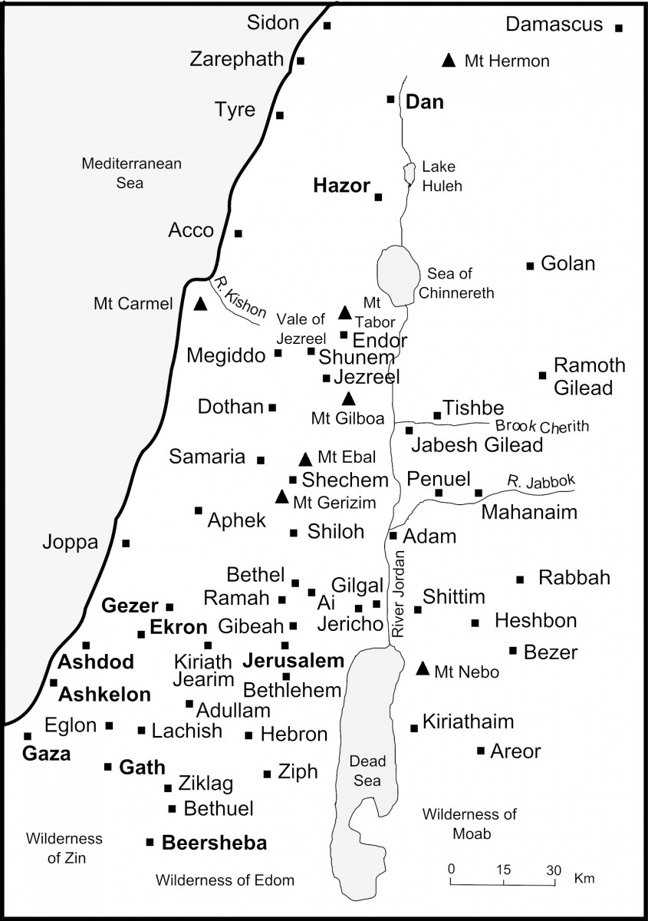
https://www.thebiblejourney.org/biblejourney2/22-the-world-of-the-old-testament-journeys/ancient-israel/

Slide 14
SCENE 1
1 Samuel 31: 1 -3

Slide 15
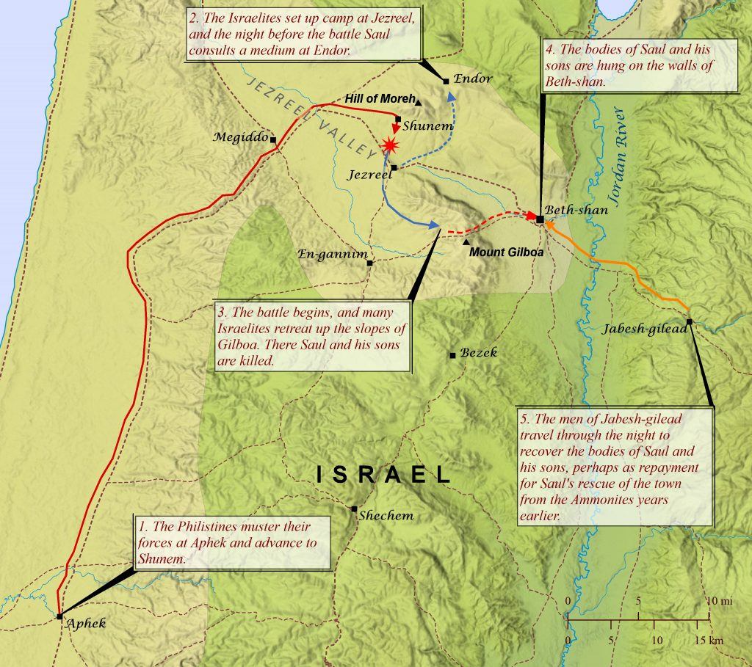

https://biblemapper.com/blog/index.php/2020/11/25/the-battle-at-mount-gilboa/

Slide 16
Now the Philistines were fighting against Israel,
and
the men of Israel fled before the Philistines
and fell slain on Mount Gilboa.
1 Samuel 31: 1; 1 Chronicles 10:1 (ESV)

Slide 17
And the Philistines overtook Saul and his sons,
and
the Philistines struck down Jonathan and Abinadab and Malchi-shua, the sons of Saul*
1 Samuel 31: 2; 1 Chronicles 10:2 (ESV)
* “..Saul fathered Jonathan, Malchi-shua, Abinadab, and Eshbaal..” 1 Chron.9: 39

Slide 18
The battle pressed hard¹ against Saul,
and the archers found him,
and he was badly wounded² by the archers.
1 Samuel 31: 3; 1 Chronicles 10:3 (ESV)
¹Lit.”the battle heavy toward Saul..”
² Some translations read “he was greatly distressed by reason of the archers”

Slide 19
SCENE 2
1 Samuel 31: 4 -6

Slide 20
Then Saul said to his armour-bearer, “Draw your sword, and thrust me through with it, lest these uncircumcised come and thrust me through, and mistreat me” But his armour bearer would not, for he feared greatly. Therefore, Saul took his own sword and fell upon it. And when his armour bearer saw that Saul was dead, he also fell upon his sword and died with him.”
1 Samuel 31: 4,5; 1 Chronicles 10:4, 5 (ESV)

Slide 21
Thus Saul died;
..and his three sons, and his armour-bearer, and all his men, on the same day together
1 Samuel 31: 6
..he and his three sons
and all his house died together
1 Chronicles 10:6

Slide 22
SCENE 3
1 Samuel 31: 7 -10

Slide 23
And when the men of Israel who were on the other side of the valley and those beyond the Jordan saw that the men of Israel had fled
and that Saul and his sons were dead,
they abandoned their cities and fled.
And the Philistines came and lived in them.
1 Samuel 31: 7; 1 Chronicles 10: 7 (ESV)

Slide 24
For individuals and churches today;
let us learn the lessons of
humility and obedience,
Otherwise
let us not be surprised when Philistines come and occupy the areas that we have tried to reign and control ourselves
1 Samuel 31: 7 (ESV)

Slide 25
The next day,
when the Philistines came to strip the dead,
they found Saul and his three sons
fallen on Mount Gilboa
1 Samuel 31: 8; 1 Chronicles 10:8 (ESV)

Slide 26
So they cut off his head
and stripped off his armour and sent messengers throughout the land of the Philistines,
to carry the good news to the house of their idols and to the people.
They put his armour in the temple of Ashtaroth, and they fastened his body to the wall of Beth-Shan.
1 Samuel 31: 9, 10; 1 Chronicles 10:9, 10 (ESV)

Slide 27
SCENE 4
1 Samuel 31: 11 -13

Slide 28
But when the inhabitants of Jabesh-gilead heard what the Philistines had done to Saul,
all the valiant men arose and went all night and took the body of Saul and the bodies of his sons from the wall of Beth-shan,
and they came to Jabesh, and buried them there. And they took their bones and buried them under the tamarisk tree in Jabesh and fasted seven days.
1 Samuel 31: 11 -13; 1 Chronicles 10: 11,12 (ESV)

Slide 29
Why did they do what they did?
1 Samuel 11: 1 - 14

Slide 30


Slide 31
REFLECTIONS -
1 Samuel 31: 1 - 13
IN THE MIDST OF DARKNESS AND FAILURE, THERE IS HOPE – GOD WILL FULFILL ALL THAT HE HAS SAID

Slide 32
REFLECTION #1:
The tragedy of death

Slide 33
Death reigned that day on Mount Gilboa when hope seemingly was lost with the death of the anointed one.
But,
many years later,
a similar situation would occur when another King would be seemingly defeated..

Slide 34
The Christ likewise
was handed over to be abused;
His body was hung as a public spectacle of horror;
there was someone who cared and came (at some risk to himself) and took His body and gave it a proper burial

Slide 35
Saul died because he did not fear the LORD and serve Him faithfully
(1 Samuel 12:24)
Jesus died as the righteous and faithful one, in complete obedience
to His Father’s will
(Matthew 26:39; Romans 5:19; Philippians 2:8;
Hebrews 5: 7-10; 12:2)

Slide 36
REFLECTION #2:
The ultimate futility and foolishness
of human power and schemes in grasping for honour

Slide 37
The people demanded a king so that they could be just like the other nations, and that their king may go out and fight their battles.
Now, behold your king!
Killed in battle,
Beheaded and hung on a wall,
Buried under a tamarisk tree in Jabesh

Slide 38
Oh the foolishness of it all..
..when we demand and insist on our own way..
..when we place all of our hopes in the cleverness and strength of man..
..for everything we insist on will come crumbling down.

Slide 39
The honour that the world offers
is an illusion.
The world pretends that honour is its to dispense as it pleases.
May we prefer the honour
that comes from God instead.

Slide 40
REFLECTION #3:
Hope
1 Samuel 2: 6, 10

Slide 41
Saul’s story is a lesson
that a reliance on human power and
human schemes will ultimately fail.
But there is another story..
&
it is a story of hope

Slide 42
The LORD kills and brings to life;
He brings down to Sheol and raises up.
The adversaries of the LORD shall be broken to pieces; against them He will thunder in heaven.
The LORD will judge the ends of the earth;
He will give strength to His king and exalt the horn of His anointed.
1 Samuel 2: 6, 10 (ESV)

Slide 43
Saul became “an adversary of the LORD”.
It was, ultimately, God who brought Saul’s reign to an end.
Life and death is in the hands of the LORD
All of Saul’s efforts to retain his kingship did not (in the end) matter

Slide 44
Israel’s hope lay in this insignificant man called David
Saul’s failure was not God’s failure.
The LORD would establish His choice as “king over Israel” and that He had “exalted his kingdom for the sake of His people Israel”
2 Samuel 5: 12 (ESV)

Slide 45
But this would be but a foreshadow of the things to come..
for David was still a man
and he would also fail
and he would die..

Slide 46
BUT
God’s plan would be fulfilled in the fulness of time
for
Israel’s hope, and all of mankind’s hope, and the inevitability of death is found in Jesus.

Slide 47
The One who died
but who was raised to life
and exalted as both Lord and Christ.
God WILL accomplish all that He has said.

Slide 48
1 Samuel 31: 1 - 13
GOD TRIUMPHS

Slide 49
So Saul died for his breach of faith.
He broke faith with the LORD in that
he did not keep the commandments of the LORD,
and also consulted a medium, seeking guidance.
He did not seek guidance from the LORD.
Therefore the LORD put him to death
and turned the kingdom over to David the son of Jesse
1 Chronicles 10: 13,14 (ESV)

Slide 50
For individuals and churches today;
may us learn the lessons of
humility and obedience.

Slide 51
What happened at Mount Gilboa
is
God’s clear warning to us today against
DISOBEDIENCE

Slide 52
God always gives us a choice.
But with that choice comes responsibility and a decision to entrust ourselves totally to
the God who is able.
What is your choice today?

Slide 53
‘Many choices are both
a temptation and a test.
Choose to turn to God.’
Dr Joye Baker, Adjunct Professor,
Dallas Theological Seminary

Slide 54


