Slide 1
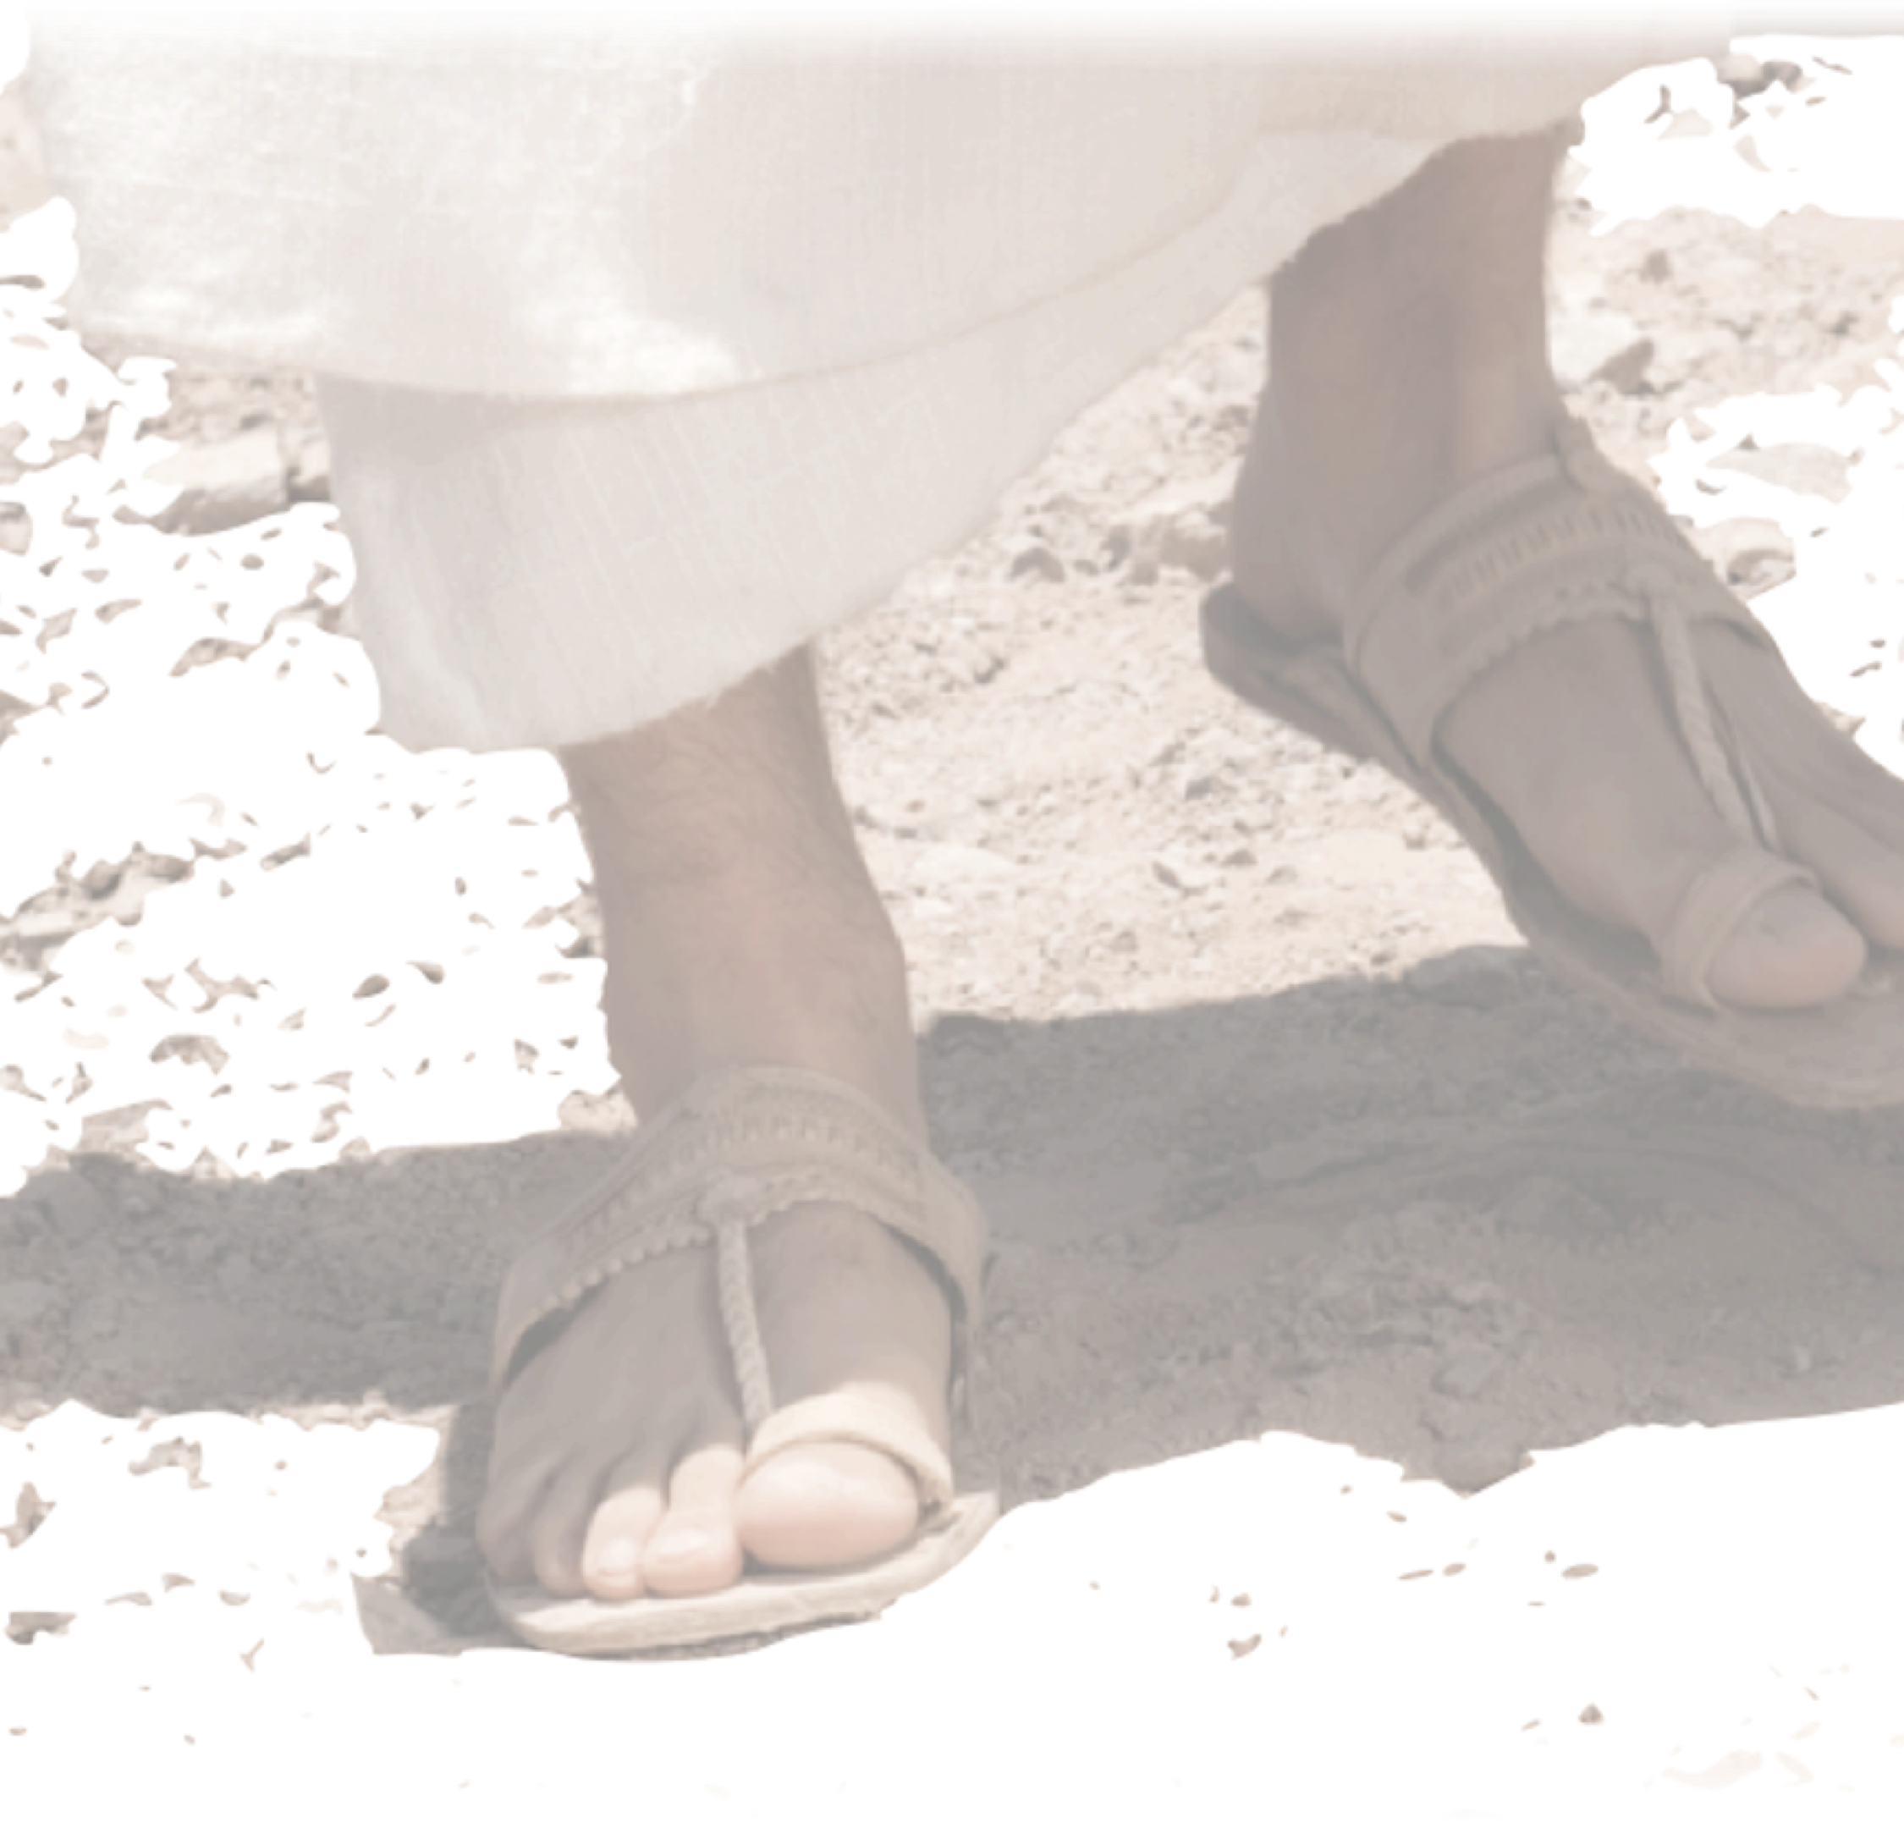





Slide 2
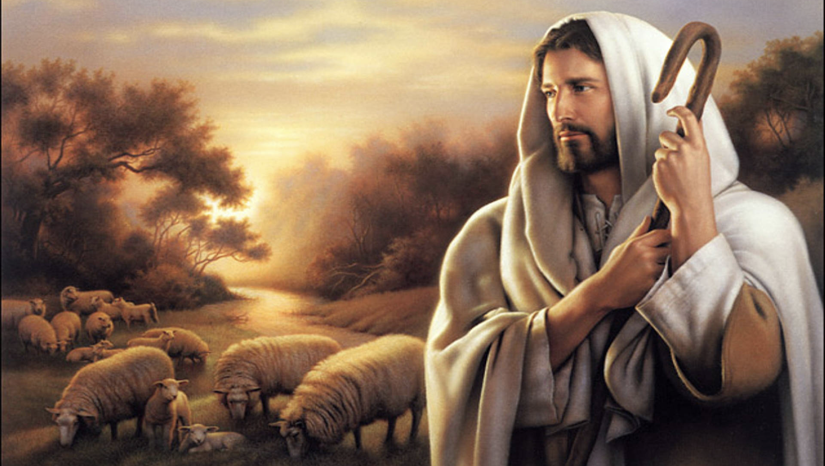

Slide 4
THE FRIEND OF TAX COLLECTORS AND SINNERS
Jesus sought out the outcasts.
The outcasts sought out Jesus.
The enemies criticized Jesus.
Jesus sought them for a reason.

Slide 6
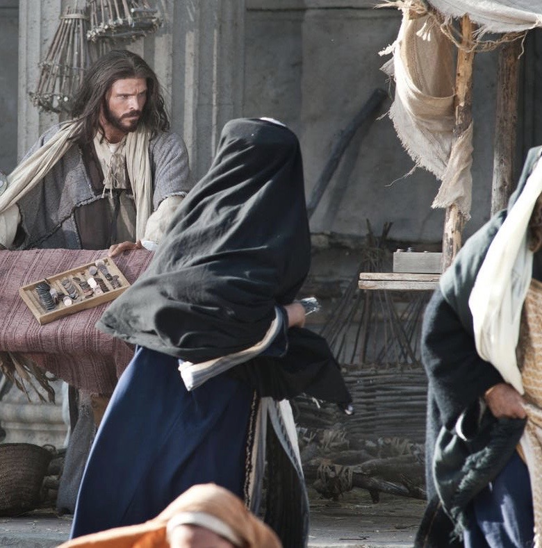

Slide 7
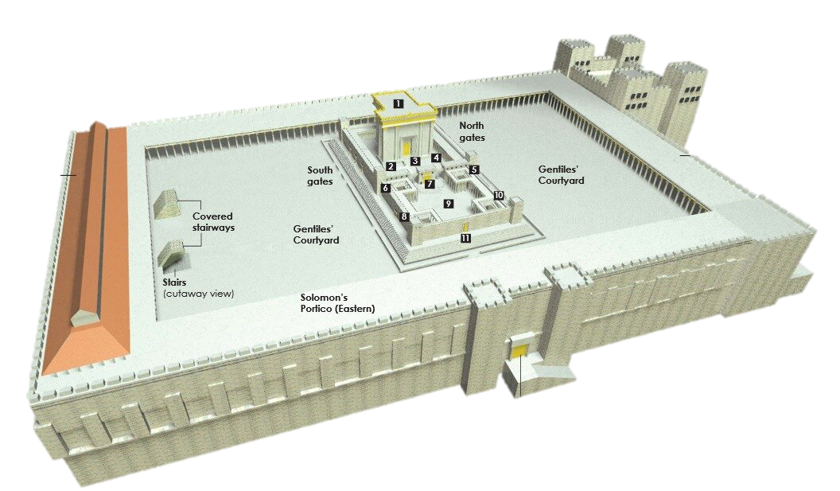

Slide 9
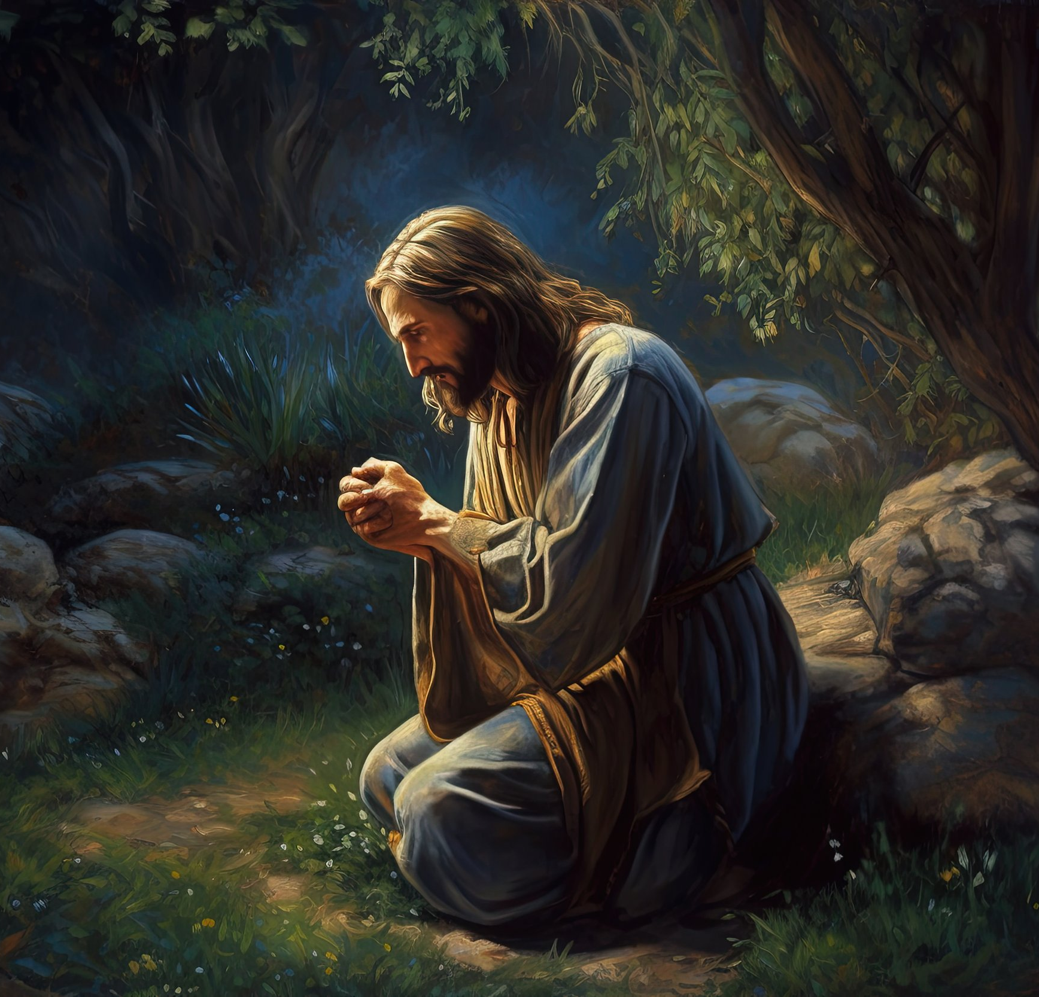



Slide 11

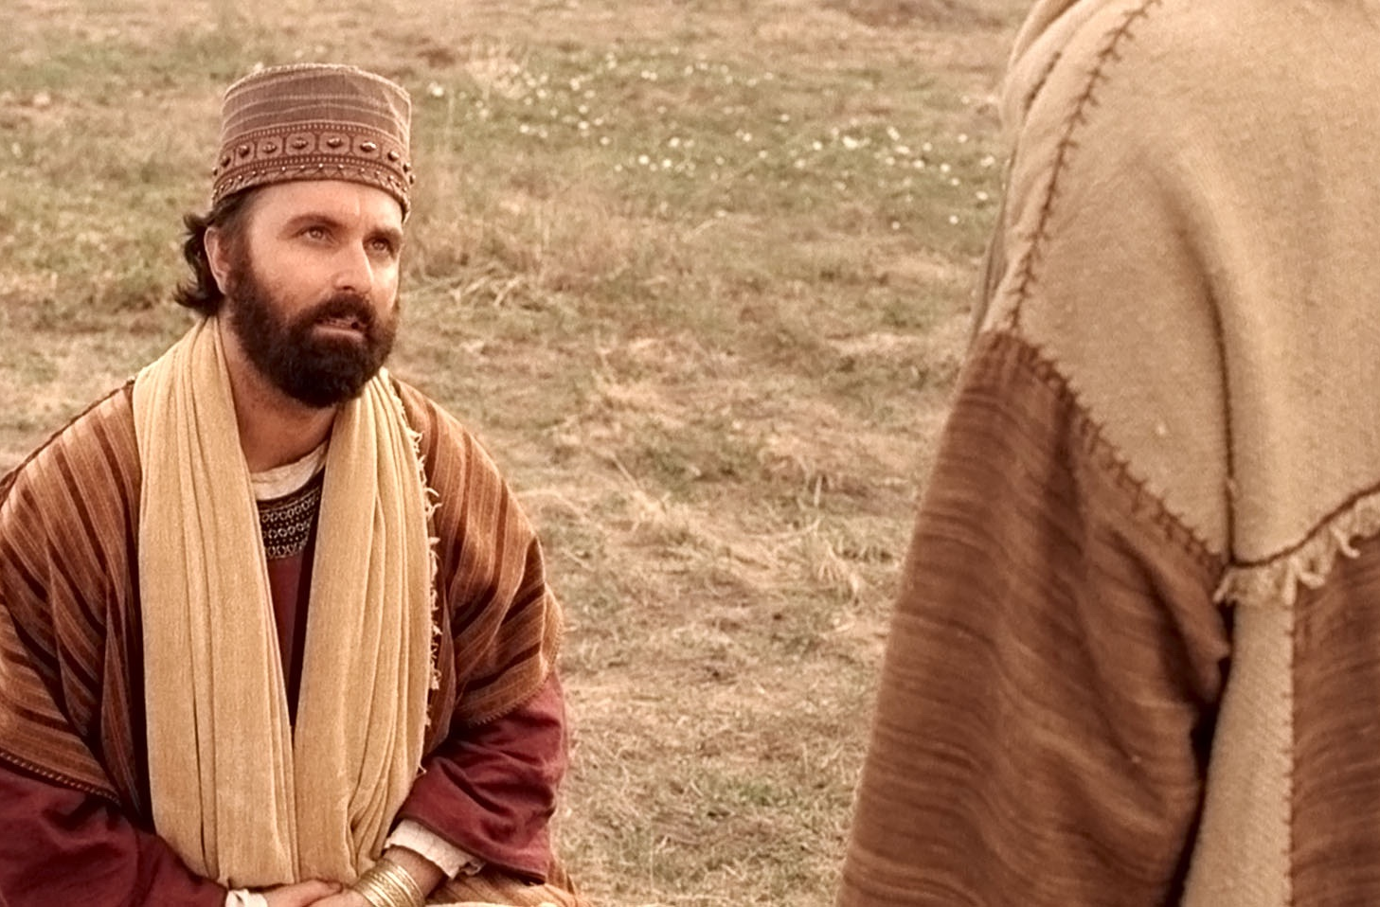
FOLLOW
BUT
FIRST

