Slide 1

You’ve Got A Mind Of Your Own
Romans 5:1-5

Slide 2
What is “The Stewardship Of Afflictions”
“The manner in which one applies the struggles, trials, and tribulations of their life to ultimately seek the will of God, thereby drawing divinely inspired peace and understanding in the midst of the situation.”
-Hozell Francis, II

Slide 3
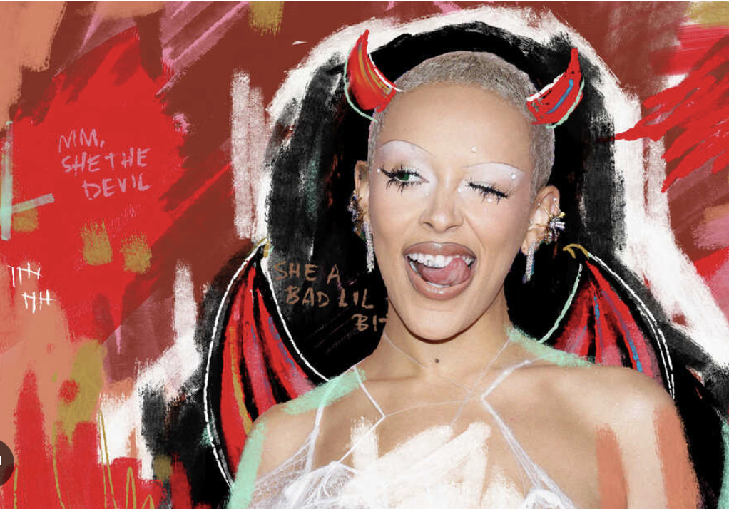
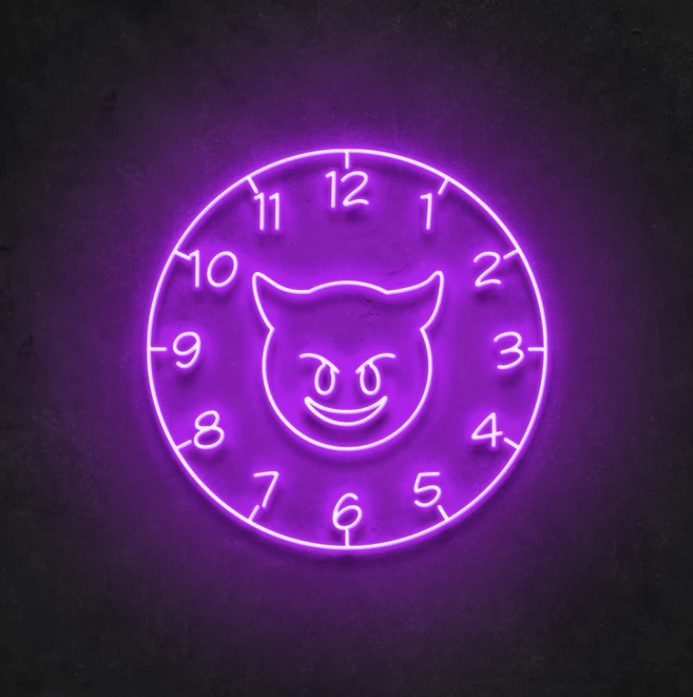
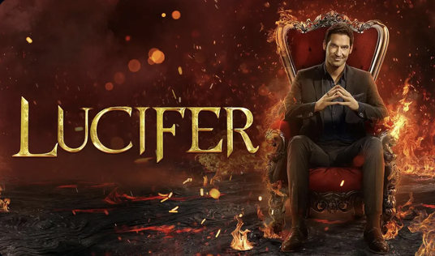

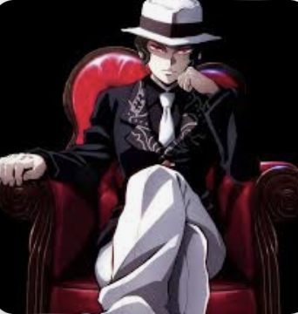
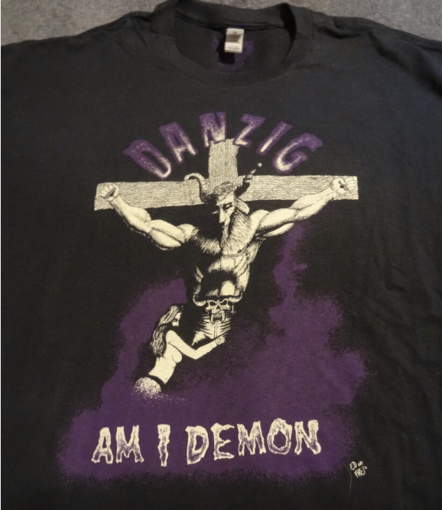
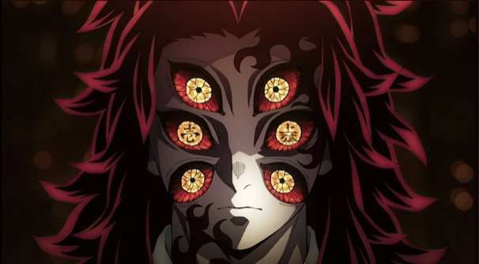
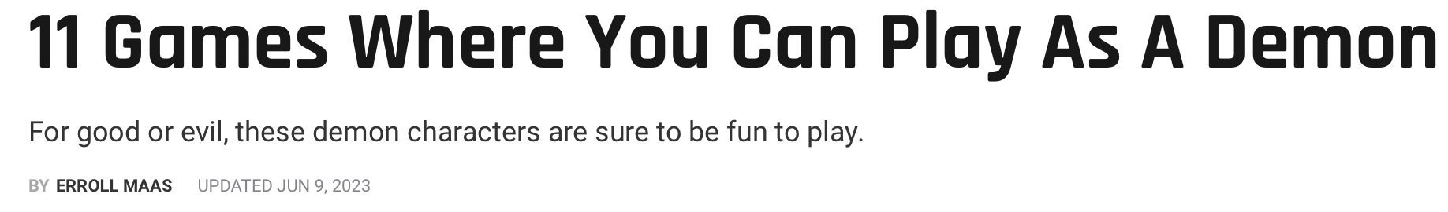
ARE YOU GLORIFYING A REPROBATE MIND?

Slide 4
A Reprobate/Depraved/Sick and Twisted Mind
Romans 1
28 And just as they did not see fit to acknowledge God, God gave them up to a depraved mind, to do those things that are not proper, 29 people having been filled with all unrighteousness, wickedness, greed, and evil; full of envy, murder, strife, deceit, and malice; they are gossips, 30 slanderers, haters of God, insolent, arrogant, boastful, inventors of evil, disobedient to parents, 31 without understanding, untrustworthy, unfeeling, and unmerciful; 32 and although they know the ordinance of God, that those who practice such things are worthy of death, they not only do the same, but also approve of those who practice them.

Slide 5
Do You Have A Mind Of Your Own?

Slide 6
Romans 5:1-2
Therefore, having been justified by faith, we have peace with God through our Lord Jesus Christ, through whom we also have obtained our introduction by faith into this grace in which we stand; and we celebrate in hope of the glory of God.

Slide 7
Romans 5:3
And not only this, but we also celebrate in our tribulations, knowing that tribulation brings about perseverance

Slide 8
Romans 5:4
and perseverance, proven character; and proven character, hope;

Slide 9
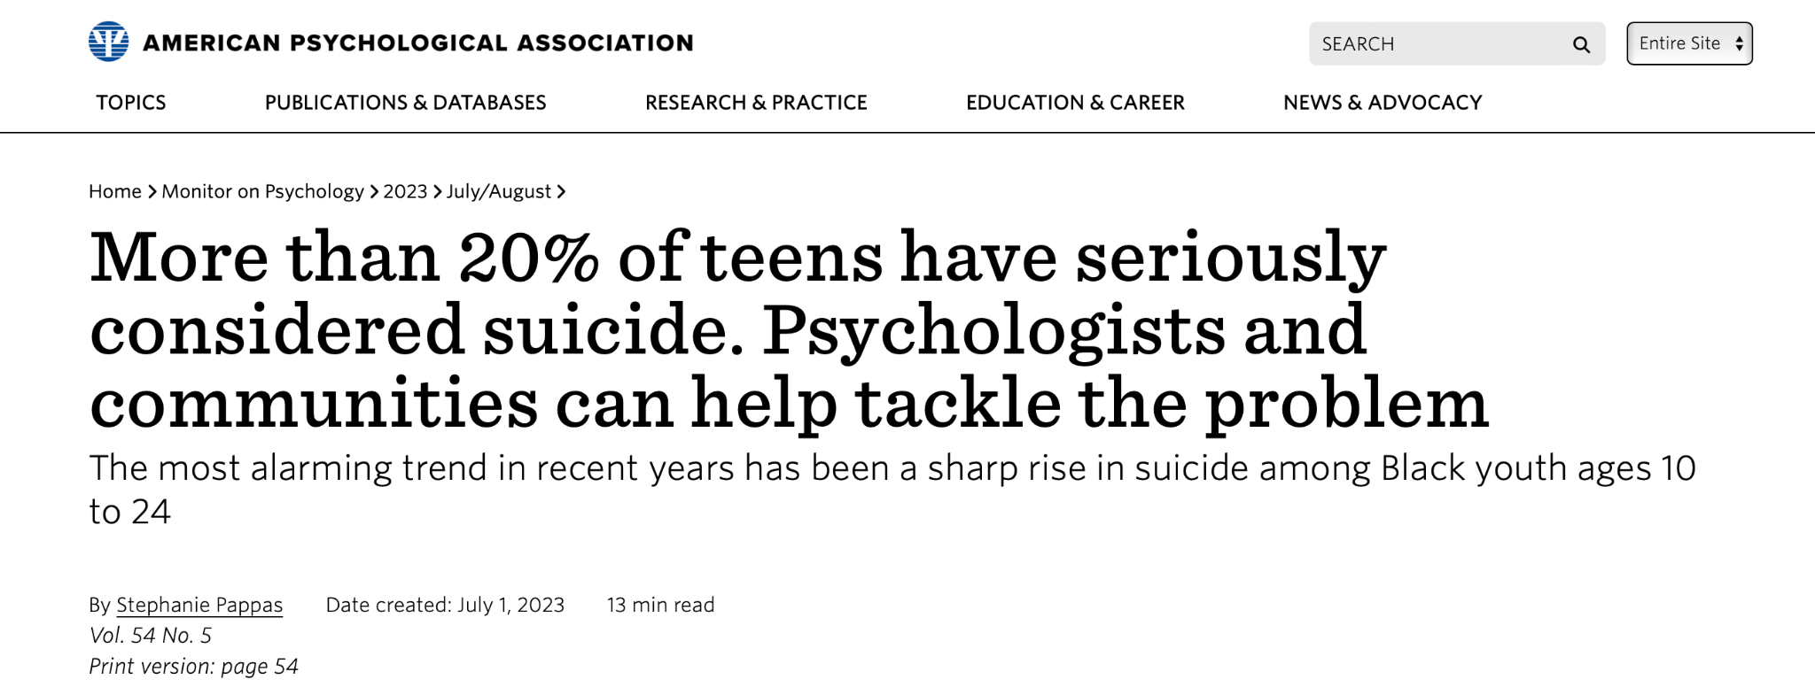

Slide 10
Romans 5:5
and hope does not disappoint, because the love of God has been poured out within our hearts through the Holy Spirit who was given to us.

Slide 11
Matthew 24
9 “Then they will hand you over to tribulation and kill you, and you will be hated by all nations because of My name. 10 And at that time many will fall away, and they will betray one another and hate one another. 11 And many false prophets will rise up and mislead many people. 12 And because lawlessness is increased, most people’s love will become cold. 13 But the one who endures to the end is the one who will be saved. 14 This gospel of the kingdom shall be preached in the whole world as a testimony to all the nations, and then the end will come.

Slide 12
Do You “Have A Mind” To Trust God?

