Slide 1
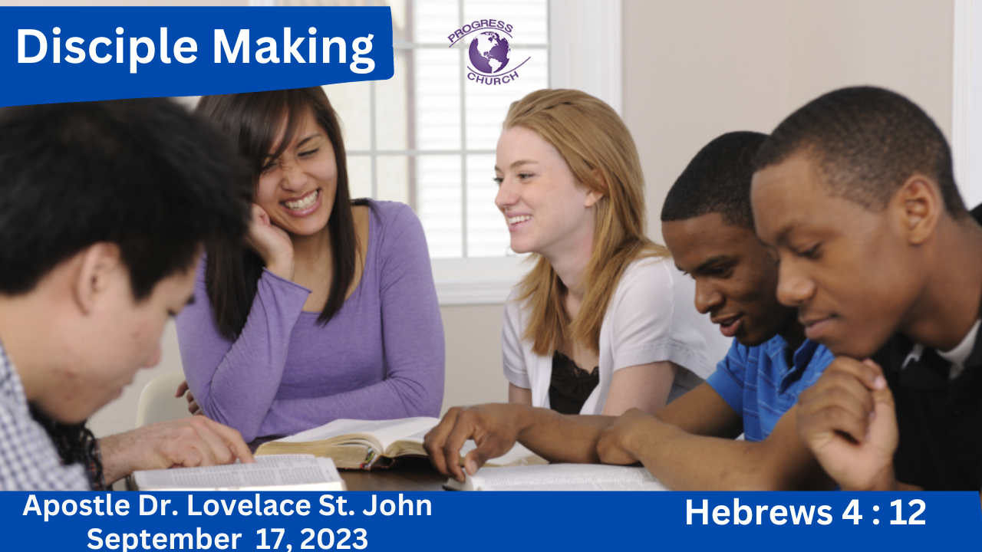

Slide 2
REVIEW
M – MISIONAL
A - ACCOUNTABLE
R - REPRODUCIBLE
C – COMMUNAL
S

Slide 3
REVIEW
A DISCIPLE is someone who is following Jesus, being changed by Jesus, and is committed to the mission of Jesus.
Disciple Making is intentionally equipping believers with the word of God, through accountable relationships, empowered by the holy Spirit, in order to replicate faithful followers of Christ.
MISSIONAL disciples are everyday believers who are intentional in the places they find themselves, constantly looking for opportunities to share Jesus with others.
ACCOUNTABLE disciples open their lives to a few carefully selected, trusted, loyal confidants who speak the truth – who have the right to examine, to question, to approve, and to give counsel.
Biblical discipleship is REPRODUCIBLE, where the disciple becomes a disciple-maker, replicating the discipleship process.
God expects us to live COMMUNALLY with other believers for spiritual growth, encouragement, and accountability.

Slide 4
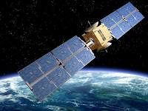
THINGS WE TAKE FOR GRANTED EVERY DAY.
SATELLITE ILLUSTRATION

Slide 5
QUOTE:
Walter Kaiser, the Hebrew historian and scholar said, “It is no secret that the church of Christ is not at all in good health in many places of the world. She has been languishing because she has been fed, as the current line has it, junk food. All kinds of artificial preservatives and all sorts of unnatural substitutes have been served up to her. And as a result, theological and biblical malnutrition has afflicted the very generation that has taken such giant steps to make sure its own physical health is not damaged by using foods or products that are harmful to their physical bodies yet neglect their spiritual bodies.”

Slide 6
In today’s Church we are seeing the results of the gradual turning away from God’s Word to an experienced based form of Christianity, one which is opposite to and therefore opposed to the sound preaching of Scripture.
Scripture is living and active; by it we encounter Jesus and learn to form our lives around Him.
Get into the Word, until the Word gets into you.
When you build your life on the bedrock of Scripture, every word and deed should be pleasing to the Lord.
Scripture is the bedrock for Spiritual growth.

Slide 7
THE SWORD
Throughout history, no technology was so carefully developed, guarded, and protected as that of sword making.
The sword itself, the most powerful weapon in the world before the advent of gunpowder.
It became a symbol both of military conquest and of the governmental power that followed it.
David said, "The sword devours one, as well as another," referring to the power of the sword to take life.
2 Samuel 11: 25 Then David said to the messenger, “Thus you shall say to Joab: ‘Do not let this thing displease you, for the sword devours one as well as another. Strengthen your attack against the city and overthrow it.’ So, encourage him.”
Swords are mentioned over 400 times in the Bible.
Swing your sword

Slide 8
1. THE WORD OF GOD IS LIVING – IT IMPARTS LIFE
First, he says that it's living. The Scripture is living. The Word of God as a living thing.
It's alive in some mysterious way, it is a mystery, there is life in the Scripture, it's a mysterious thing, but it is alive.
These are living words.
This words have hands and feet. They climb all over you, they work their way into your heart and conscience and will not be dislodged.

Slide 9
Ephesians 2:1 "But as for you, you were dead in your transgressions and sins in which you used to live."
You were the living dead.
You were biologically alive, but you were spiritually dead.
Ephesians 2:5, it says God "made us alive with Christ even when we were dead in transgressions, it is by grace you have been saved“
God used as an instrument of that spiritual life-giving, for your spiritual resurrection, the Word of God, the Word of the Gospel.
John 5:24, "I tell you the truth, whoever hears my word, and believes him who sent me, has eternal life and will not be condemned, he's crossed over from death to life."
The Word has power to give life to the dead.
2 Kings 13, where some dead person was being buried and it was a time of military turbulence, some raiders rode into that town and so the people in the middle of the funeral hurriedly took that dead body and threw it into Elisha's tomb where his bones were and suddenly that dead person sprang to life. If Elisha's bones can give life to a dead corpse, how much more can the living and enduring Word of God give life to a spiritual soul.
Just spring to life when you hear the Gospel.

Slide 10
2. THE WORD OF GOD IS ACTIVE
Secondly, the word of God is active.
The Word of God is living and active. What does it mean active?
Another translation, would be powerful or perhaps energetic. I take it to mean effective.
The word of God is effective, it's able to produce the effect it desires.
It is effective, it's an effective agent, it steps in and does what God sends it to do, every time.
Isaiah 55:10-11, "As the rain and the snow come down from heaven, and do not return to it without watering the earth and making it bud and flourish so that it yields seed for the sower and bread for the eater, so is my word that goes out from my mouth, it will not return to me empty, but will accomplish what I desire and achieve the purpose for which I sent it." God sends forth His word and it comes back to Him having done the job.

Slide 11
3. THE WORD OF GOD IS SHARP
Thirdly, the Word of God is sharp.
It says sharper than any double-edged sword, the sharpness of the Word of God.
Its ability to divide and render asunder things that ordinarily would be together, that's what's discussed here.
What is a double-edged sword? Literally, the Greek is two-mouthed sword, one that cuts both ways, two sharp edges, two honed edges. No dull side.
There are no dull passages in the Bible.
There are only dull minds as we come to those passages.

Slide 12
4. THE WORD OF GOD IS PENETRATING
And it's also penetrating. The Word of God is living and active, sharper than any double-edged sword, it penetrates to the dividing of soul and spirit, joints and marrow.
So, it's not just a slashing kind of thing, but a piercing kind of thing. There's a sense of piercing.
What's being pierced? Our hardened hearts. That's what's being pierced.
Hebrews 3:12-13, "See to it brothers that none of you has a sinful, unbelieving heart that turns away from the living God. But encourage one another daily as long as it is called today, so that none of you may be hardened by sin's deceitfulness."
Sin is deceitful. And the effect is a hardening of the heart. The Word of God has a remedy, it pierces the hardness that sin has produced.
Peter's sermon at Pentecost in Acts 2:37. When the people heard his sermon, it says, "They were cut to the heart," they were pierced in their hearts, "and they said to Peter and the other apostles, 'Brothers, what shall we do?'" "Repent and believe in Jesus" is the answer. But because they were pierced.

Slide 13
God’s Word is truth. (John 17:17; John 8:31-32)
God’s Word becomes the standard and measuring rod to test everything against. (2 Peter 1:3)
God’s Word changes our hearts. (Psalm 19:7-9)
God’s Word provides a firm foundation. (Matthew 7:24-25)
God’s Word trains us in righteousness. (2 Timothy 3:14-17)
1. God’s Word is profitable for teaching.
2. God’s Word is profitable for rebuking.
3. God’s Word is profitable for correcting.
4. God’s Word is profitable for training in righteousness.
God’s Word sustains. (Matthew 4:4)

Slide 14
Think of II Kings Chapter 22 when Josiah finds the book of the Law for the first time in a long time.
There was a reformation among the people.
Think of Ezra when the people returned from the Babylonian captivity, they were exiles in a foreign land, they come back to Israel, they come back into the Promised Land.
And Ezra gets up in the book of Nehemiah and he begins to read the Word of God and the Bible says the people stood for six hours standing and weeping because they heard God’s Word.
These weren’t words on a page, these weren’t words on a scroll, this was the Word of God.
They were hearing from God. God hadn’t forgotten them.

Slide 15
CLOSING
DON’T TAKE THE WORD FOR GRANTED
God’s Word is given to govern every aspect of our Christian life.
This would mean that our prayers, meditation, thoughts and deeds should be ruled by Scripture.
God’s Word should be hidden in our hearts. We cannot have His Word in our hearts unless we spend time in His Word.
“Thy Word have I hid in mine heart, that I might not sin against Thee.” Psalm 119:11
God’s promises have never changed. What He promised to Joshua applies also to all who submit themselves to Scripture:
“This book of the law shall not depart out of thy mouth; but thou shalt meditate therein day and night, that thou mayest observe to do all that is written therein; for then thou shalt make thy way prosperous, and then thou shalt have good success.” Joshua 1:8

Slide 16
Reverence the Word of God, revere it.
Let the Word of God convert you.
The Word of God has power to convert you
Go to the Word to derive new strength from it and let the Word of God strengthen you for His service.
Colossians 3: 15 “And let the peace of Christ rule in your hearts to which indeed you were called in one body. And be thankful. Let the word of Christ dwell in you richly, teaching and admonishing one another in all wisdom, singing psalms and hymns and spiritual songs, with thankfulness in your hearts to God. And whatever you do, in word or deed, do everything in the name of the Lord Jesus, giving thanks to God the Father through Him.”

