Slide 1

to
South Gate Alliance
1436 James McKevitt Road SW
Calgary, AB
Southgatealliance.net

Slide 2
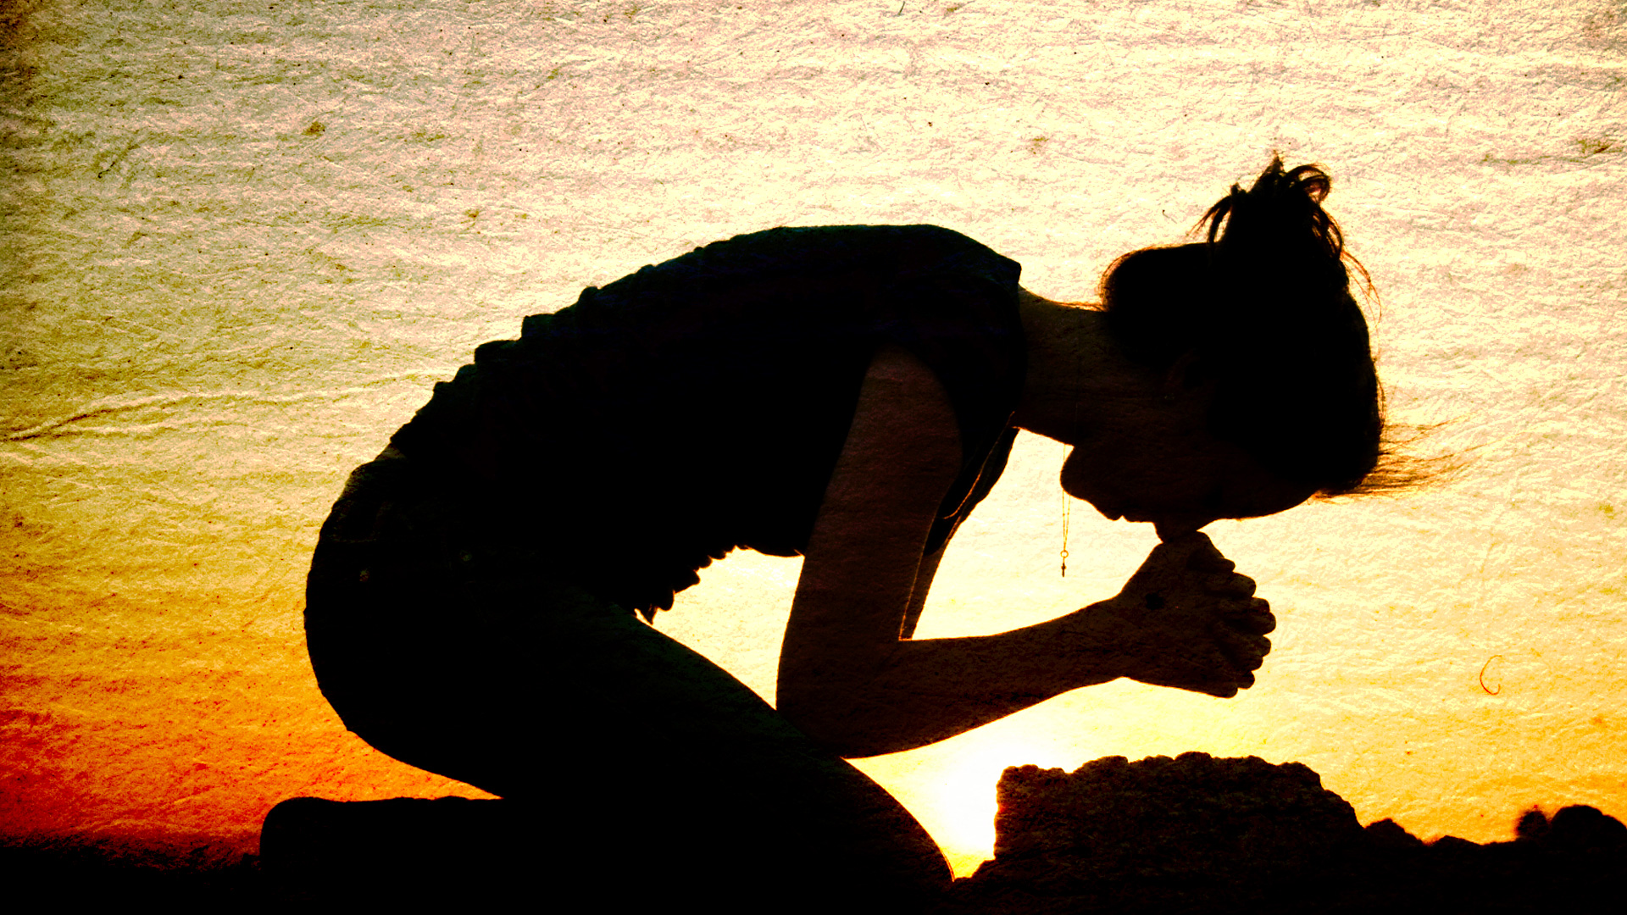
Transformed by Prayer

Slide 3

Psalm 5 (NKJV):
¹ Give ear to my words, O Lord,
Consider my meditation.
² Give heed to the voice of my cry,
My King and my God, for to You I will pray.
³ My voice You shall hear in the morning, O Lord;
In the morning I will direct it to You, and I will look up.

Slide 4
5:11(Niv)
But let all who take refuge in you be glad;
let them ever sing for joy.

Slide 5
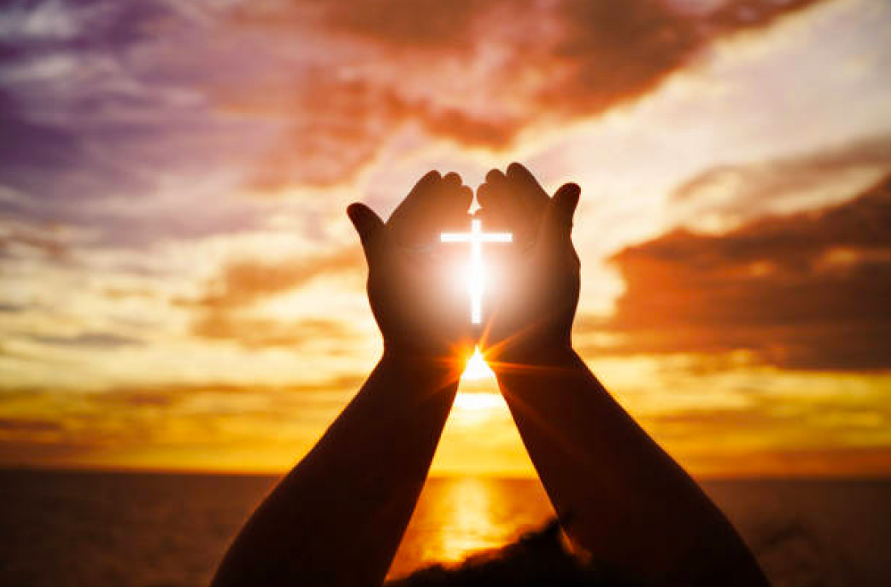

Slide 6


Slide 7

Pastor: “It’s morphing time.”
Congregation: “We shall morph indeed.”

Slide 8
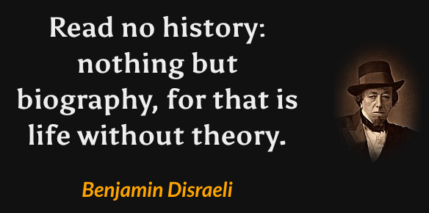

Slide 9
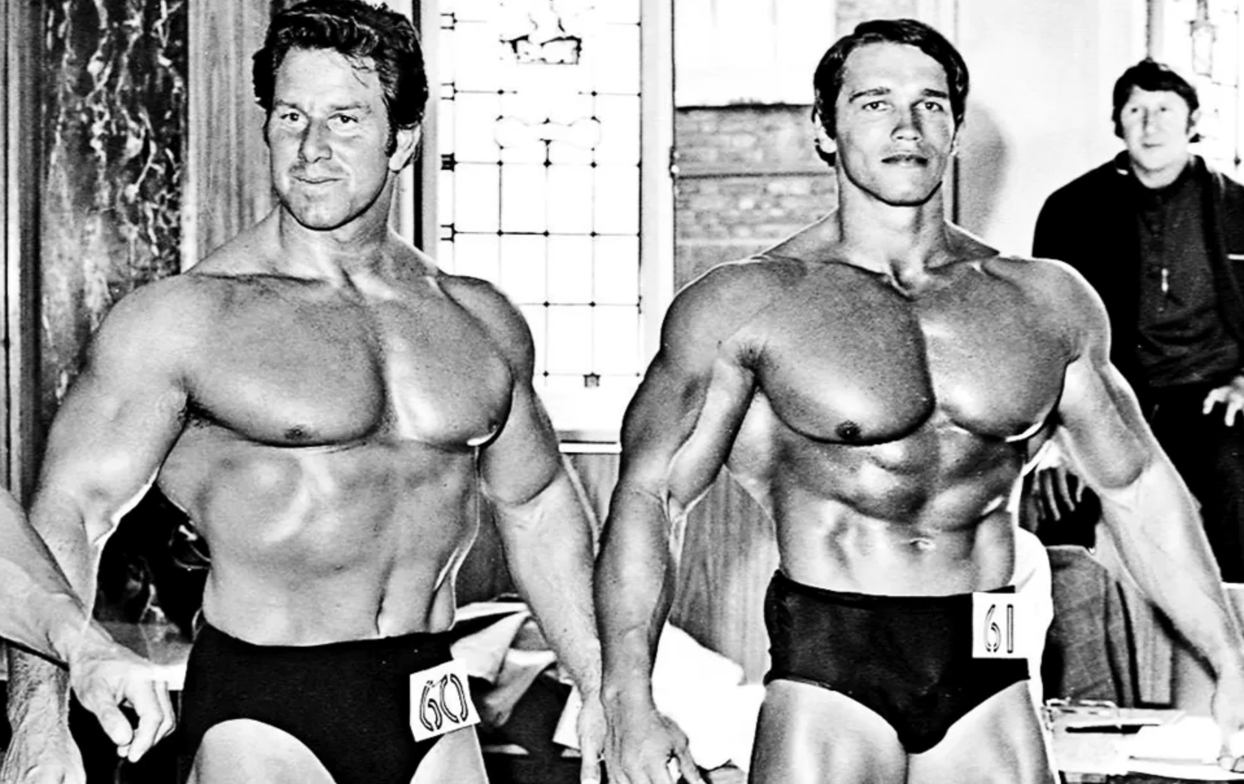
Reg Park
Arnold Schwarzenegger

Slide 10
Imitating Jesus’ spiritual habits or practices is how we follow Jesus and adopt his lifestyle.

Slide 11
Mark 1:35: “Very early in the morning, while it was still dark, Jesus got up, left the house and went off to a solitary place, where he prayed.
Matthew 14:23: “After he had dismissed them, he went up into the hills by himself to pray.”
Luke 5:16: “But Jesus often withdrew to lonely places and prayed.”
Luke 6:12: “One of those days Jesus went out into the hills to pray, and spent the night praying to God.”

Slide 12
Why did Jesus, the Son of God, need to pray?
John 5:19: “I tell you the truth, the Son can do nothing by himself; he can do only what he sees his Father doing, because whatever the Father does the Son also does.”
John 5:30: “By myself I can do nothing.”

Slide 13
Richard Foster on Prayer
“Of all the spiritual disciplines prayer is the most central because it ushers us into perpetual communion with the Father.”
“In prayer, real prayer, we begin to think God’s thoughts after Him: to desire the things He desires, to love the things he loves. Progressively we are taught to see things from His point of view.”
“To pray is to change. Prayer is the central avenue God uses to transform us… The closer we come to the heartbeat of God the more we see our need and the more we desire to be conformed to Christ.”

Slide 14
Luke 11:1: “One day Jesus was praying in a certain place. When he finished, one of his disciples said to him, ‘Lord, teach us to pray, just as John taught his disciples.’ ”
2 He said to them, “When you pray, say:
“‘Father,
hallowed be your name,
your kingdom come.
3 Give us each day our daily bread.
4 Forgive us our sins,
for we also forgive everyone who sins against us.
And lead us not into temptation.’”

Slide 15
“Our Father in Heaven…”
The Lord’s Prayer begins with God.
- “Our Father” assumes a relationship,
that we’re His children.

Slide 16
“Hallowed be your name.”
In Jesus’ culture, name implied a person’s character or reputation.
Why does God want us to praise Him?
1) Because He’s worthy
2) It develops our relationship
3) We become like what or Who we worship

Slide 17
“Your kingdom come;
(your will be done on earth as it is in heaven).”
The kingdom of God is present whenever and wherever we submit our will to the king.
“Lord, bring your kingdom into this world, and begin through me.”

Slide 18
“Give us each day our daily bread.”
First seek God’s kingdom, then your own needs.
Politely asking is a part of any relationship.
Jesus is our daily bread – we need Jesus on a daily basis!
Proverbs 30:7-9: “Give me neither poverty nor riches, give me only my daily bread.”
Proverbs 14:23: “Hard work always pays off; mere talk puts no bread on the table”

Slide 19
“Forgive us our sins, for we also forgive everyone who sins against us.”
Our readiness to forgive should match our need for forgiveness.
Where do you get the ability to forgive? From that man hanging on a cross that said, “Father, forgive them, they don’t know what they’re doing.”

Slide 20
“And lead us, not into temptation.”
Having prayed for our sins to be forgiven, we pray that we would not return to them.
When you’re tempted to sin, God will provide a way out. Prayer will show you the exit door.

Slide 21
Luke 11:5-13
“Suppose you have a friend, and you go to him at midnight and say, ‘Friend, lend me three loaves of bread; ⁶ a friend of mine on a journey has come to me, and I have no food to offer him.’ ⁷ And suppose the one inside answers, ‘Don’t bother me. The door is already locked, and my children and I are in bed. I can’t get up and give you anything.’ ⁸ I tell you, even though he will not get up and give you the bread because of friendship, yet because of the man’s persistence he will get up and give him as much as he needs.

Slide 22
Luke 11:5-13
⁹ “So I say to you: Ask and it will be given to you; seek and you will find; knock and the door will be opened to you. ¹⁰ For everyone who asks receives; the one who seeks finds; and to the one who knocks, the door will be opened.
¹¹ “Which of you fathers, if your son asks for a fish (some versions have “bread”, will give him a snake instead? ¹² Or if he asks for an egg, will give him a scorpion? ¹³ If you then, though you are evil, know how to give good gifts to your children, how much more will your Father in heaven give the Holy Spirit to those who ask him!”

Slide 23
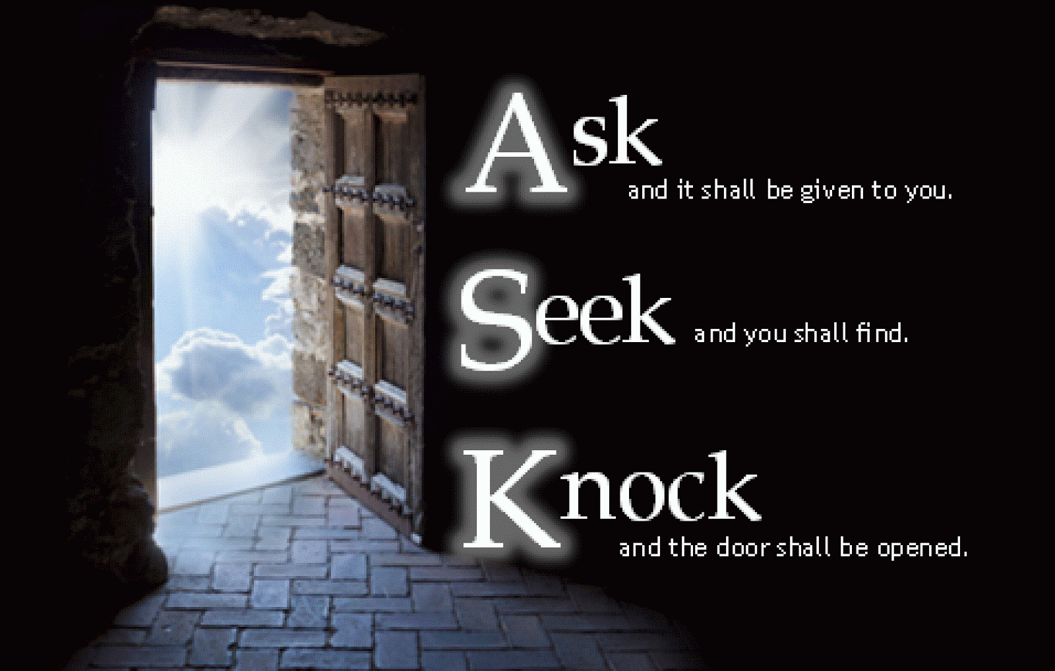

Slide 24
ASK
Ask God for what you need.
In order for you to ask with faith, you have to believe a life-changing truth: that God is for you. If you don’t believe that, you’ll pray small timid prayers; if you do believe it, then you’ll pray big audacious prayers. (Mark Batterson).

Slide 25
ASK
Ask God for what you need.
Ask for bread for others
- When you ask for what you need,
don’t forget to ask God for enough
that you can share it with others.

Slide 26
ASK
Ask God for what you need.
Ask for bread for others
Ask God for what He wants for you
Ask God: “Transform me into the image of Jesus.

Slide 27
ASK
Ask God for what you need.
Ask for bread for others
Ask God for what He wants for you
Ask Scripturally – pray Scripture
“When I look back on 40 years of walking with the Lord, I realize that pray-reading the Word – using the Scripture as the “conversational material” for my communication with Jesus – has been the single most significant activity in my spiritual life. This simple activity is essential to abiding in Christ.” Mike Bickle, director of IHOP

Slide 28
ASK
Ask God for what you need.
Ask for bread for others
Ask God for what He wants for you
Ask Scripturally – pray Scripture
Ask specifically so God gets the glory
- Your prayer list will become a praise list
if you’ll get specific.

Slide 29
SEEK
Prayer isn’t seeking the gift; it’s seeking the Giver.
Seeking God in trials – Deut.4:29
“But from there you’ll seek the LORD your God, and you’ll find Him if you seek Him with all your heart and with all your soul.” (Deut.4:29).
Seeking God in His Word – Deut. 29:29
Deut.29:29: ”The secret things belong to the LORD our God, but those things which are revealed belong to us and to our children forever, that we may do all the words of this law.”

Slide 30
KNOCK
Knock, and it will be opened to you.
- Going beyond prayer to see an answer
The third level of prayer is intercession in which you share the burden of Christ for a person, circumstance or need anywhere in the world. (Sundays, 10 am)
“We’re ambassadors for Christ, as though God were pleading through us: we implore you on Christ’s behalf, be reconciled to God.” (2 Cor.5:20)

Slide 31
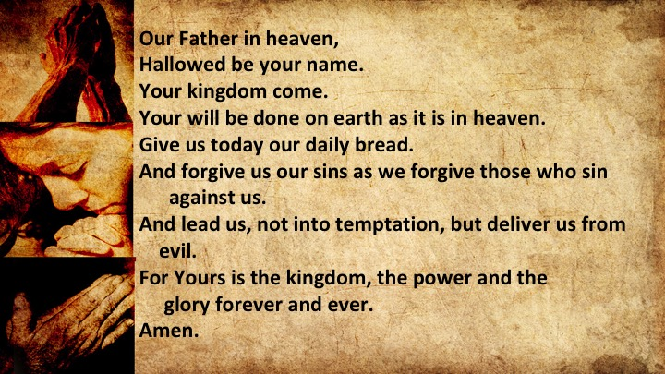

Slide 32
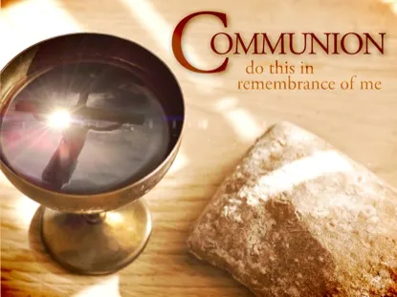

Slide 33

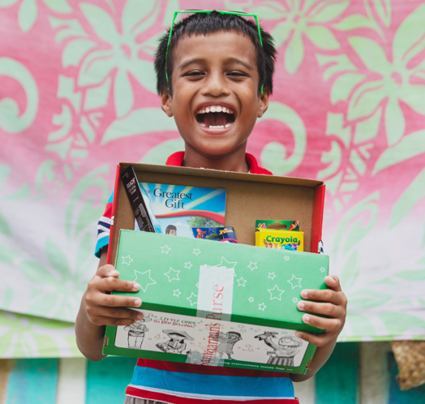
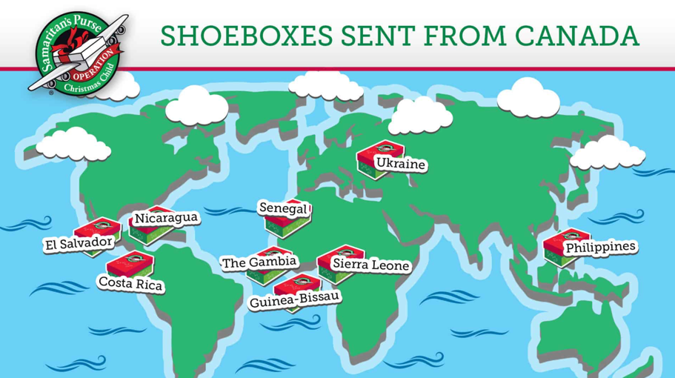
Operation Christmas Child
“Let the children come to Me; do not hinder them,
for to such belongs the kingdom of God.”
Mark 10:14, ESV
2023 South Gate Alliance target – 400 boxes!
We are in need of the following items:
Soap bars
Toothbrushes
Gloves
Erasers
Pencil sharpeners
Small toys for boys & girls
Small craft kits
Travel games
Rubber balls
Clothes pins
Bobby pins

Slide 34

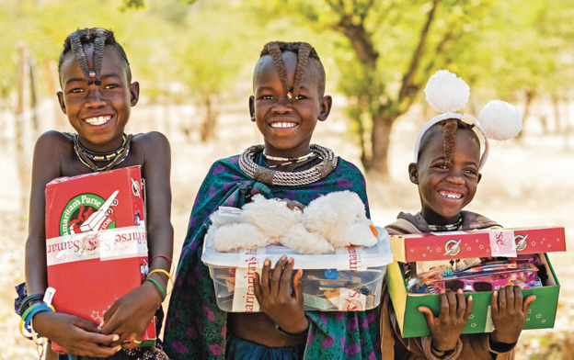
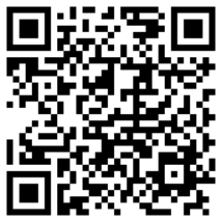
Operation Christmas Child
Shoe Box Packing Party
Saturday, November 18, 2023
1:00 – 4:00 pm
We need volunteers!
Setup/clean-up
Table supervisors
Quality Control
Fundraising/Promotion
Please sign up at our OCC Table after the service!
Fundraising Target:
$4,000 for shipping costs
Donate online today at this site:
Bring your cans & bottles!
Donation bin on Sunday Nov 5/12

Slide 35
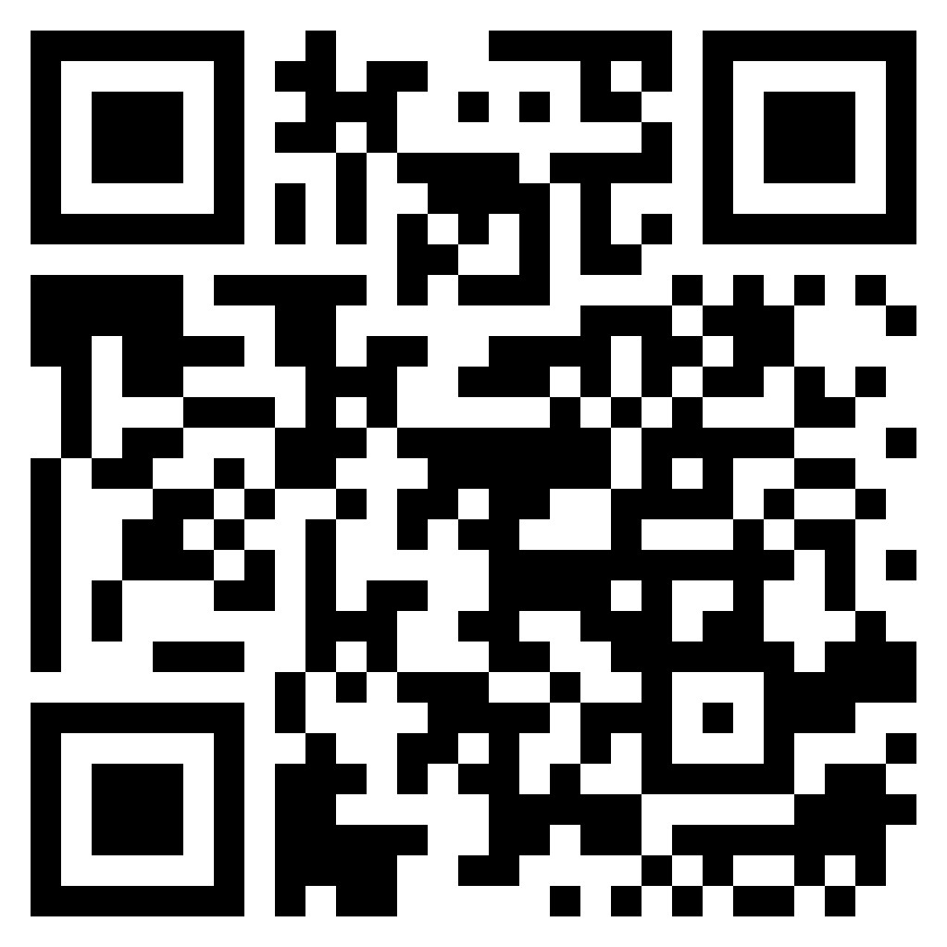
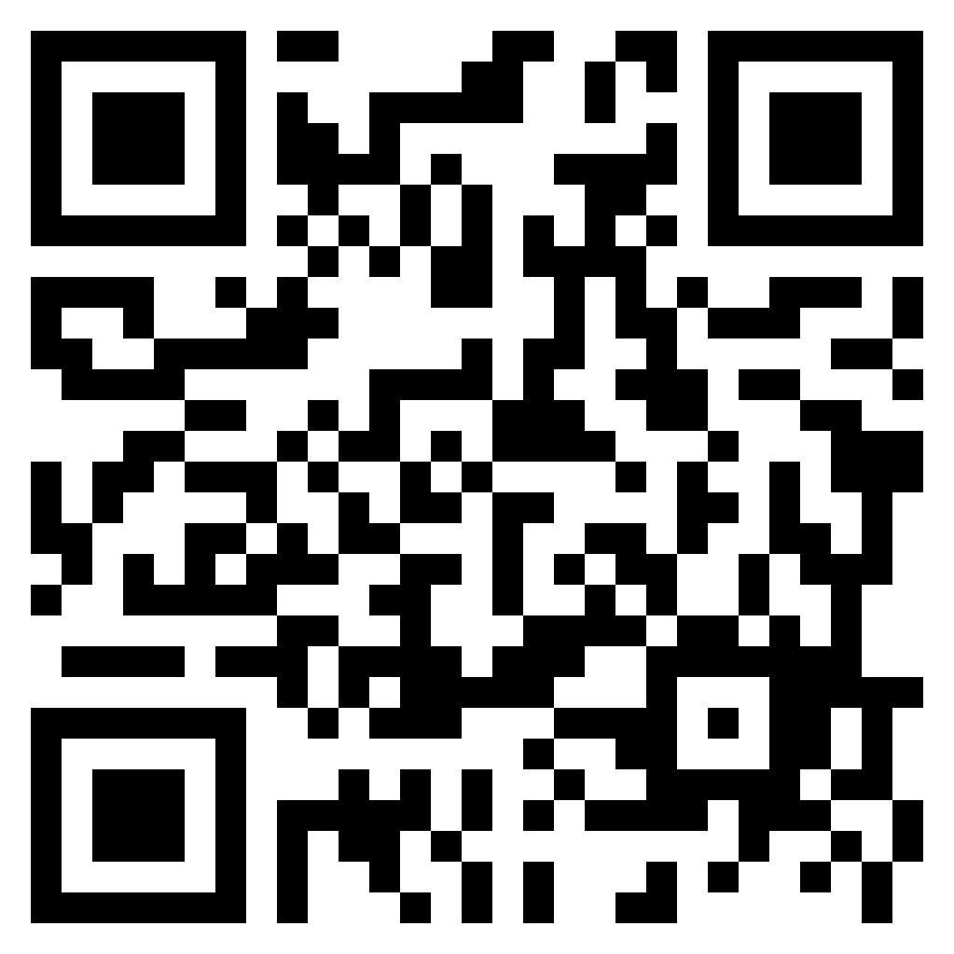
Youth Ministry Survey
Children’s Ministry Survey

Slide 36
3) Congregational Meeting on Nov. 26 at 12:15:
1) To discuss and pass the 2024 budget
2) To vote on elders for 2024 and 2025;
3) To vote on the issue of affirming women elders.
Polls will be open from 10:45 – 11:15
and again from 12:00 noon to 12:30.
We’ll have a shorter service that day.

Slide 37
4) The elder nominating committee would like to recommend 3 men for the position of elder:
Cantonese – Gary Cheung;
English – Mark Ng and Barry Poon.
Mandarin congregation has no nominees.
Any nominations from the floor have to be submitted by next Sunday and must be done in accordance with our bylaws.

Slide 38
Ephesians 3:20-21
²⁰ Now to him who is able to do immeasurably more than all we ask or imagine, according to his power that is at work within us, ²¹ to him be glory in the church and in Christ Jesus throughout all generations, for ever and ever! Amen.

