Slide 1
I Corinthians 14:8-13
Love goes on…and on…and on…

Slide 2


Europe

Slide 3

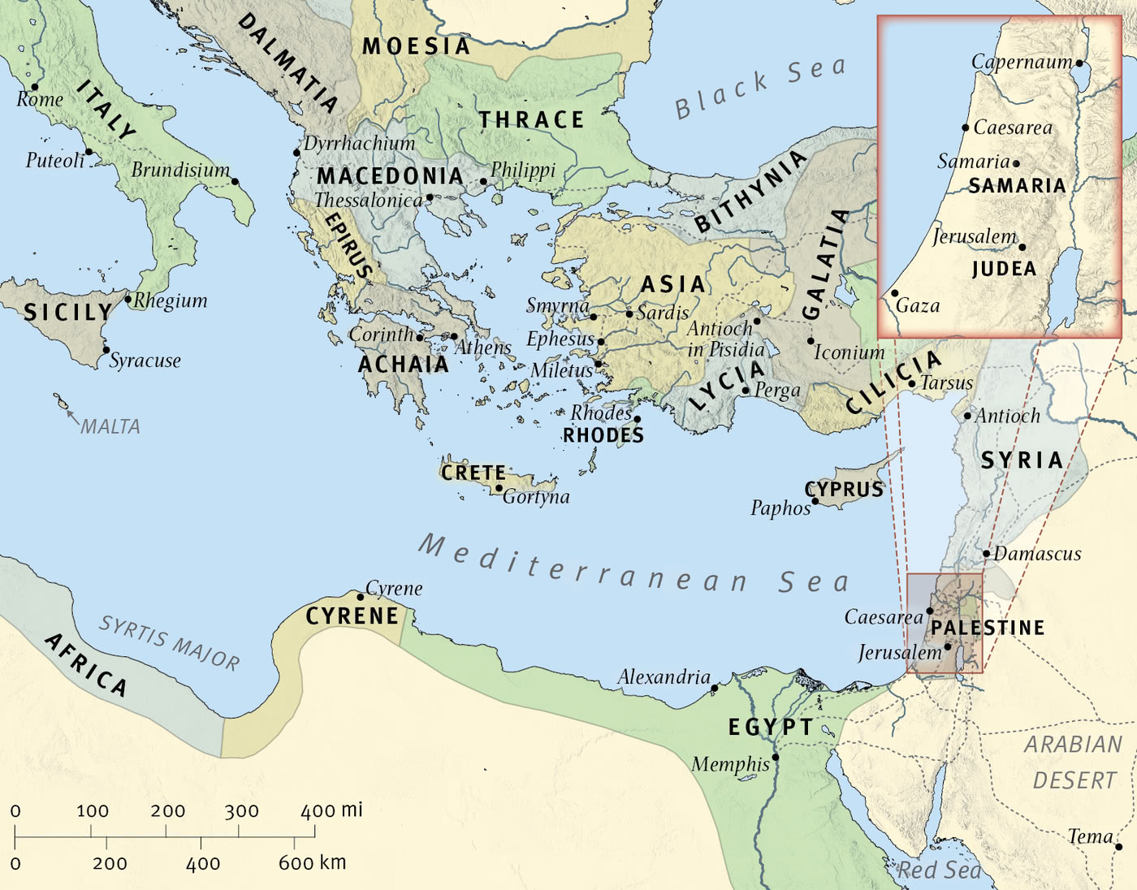
The Wide World

Slide 4

Corinth

Slide 5
8 Love never ends. As for prophecies, they will pass away; as for tongues, they will cease; as for knowledge, it will pass away. 9 For we know in part and we prophesy in part, 10 but when the perfect comes, the partial will pass away. 11 When I was a child, I spoke like a child, I thought like a child, I reasoned like a child. When I became a man, I gave up childish ways. 12 For now we see in a mirror dimly, but then face to face. Now I know in part; then I shall know fully, even as I have been fully known.
13 So now faith, hope, and love abide, these three; but the greatest of these is love.
(I Corinthians 13:8-13, ESV)

Slide 6
Main Point
Paul focuses on the eschatological understanding of love
When all these manifestations of the Spirit will end, love will remain
To promote love, to live in love, is to carry with one something that will last for eternity

Slide 7
Application Points
Love goes on, and on, and on
  Oftentimes we can speculate on the end times
  I know I have delved into the riddle
  Consider such things and how they will be is just a natural response to our finiteness
  We enjoy the pursuit of knowledge
  There will come a time when these things are fully revealed to us
  When all the pieces of the puzzle are put into place
  The final tapestry placed in this grand design
  The knowledge of these things will come to an end because they will be fulfilled
  We always can and at times should pursue this knowledge

Slide 8
Application Points
Love goes on, and on, and on (2)
  Thus as we focus on the here and now it is impossible for us not to notice our finiteness
  We are limited in our understandings because of our current natures
  God knows our inabilities and limitations
  “Nevertheless, I tell you the truth: it is to your advantage that I go away, for if I do not go away, the Helper will not come to you. But if I go, I will send him to you.” – John 16:7, ESV
  The Holy Spirit bears witness to righteousness and judgment
  The infinite God has given us the Holy Spirit as a helper in this time of finiteness
  We see how we can receive glimpses of what we cannot know in our finiteness because…the Holy Spirit gives us wisdom and knowledge
  We are also in need of help in all manners of personal and corporate faithfulness

Slide 9
Application Points
Love goes on, and on, and on (3)
  The Helper is not limited to the ethereal but can impact the physical world through various manifestations
  These are all wonderful things for us to consider in this finite time
  But what will happen when all is consummated?
  Will we need these kinds of manifestations? No
  These are for a time, for a purpose, to help us get through
  Even in time the manifestations of the Spirit will cease because our limitations will be transformed
  Our limitations will be stripped away
  What will not? Love
  Love continues into eternity
  The relational aspect of patience, kindness, rejecting evil, rejoicing in truth
  As we progress into the infinite with our God this love will continue among each of us

Slide 10
Application Points
Love goes on, and on, and on (4)
  He is not saying that this is a love versus knowledge, or love versus wisdom, or love versus other spiritual manifestations
  Right now the manifestations of the Spirit are necessary
  Paul is reminding us to emphasize love
  Love as the goal for each of us and our relationships with each other and the foundation on which our relationships are established
  Without love we personally gain nothing
  Better to do a little in love than a lot without love
  By practicing love we prepare ourselves for the future
  It won’t be through things which will cease, but only that which will last

Slide 11
Application Points
Love goes on, and on, and on (5)
  We rejoice in the manifestations of the Spirit
  We must recognize that our finiteness will pass away into something glorious
  We must resist the belief that we have already attained this glory
  We are not there yet, but that is where we are going
  There is no excuse for us
  We must be faithful and obedient in the greatest of ways by seeking to love and love well
  Not defining love with what it is not but by seeing that love is the foundation for our relationships
  That we are to be patient and kind with each other…that we are to reject evil not rejoicing in it, but rejoicing in the truth
  Let us rejoice that we can prepare ourselves for the future by loving God, each other, and ourselves
  That this love can be applied and practiced by each of us
  Our great God has shown us the greatest love by redeeming us from our sins
  Out of all these wonderful things we experience, we can know that love will go on and on and on

Slide 12
Application Points
The Gospel of Christ
  Origins
    Where we began
  Fall
    What went wrong
  Redemption
    How it is fixed
  Glorification
    Where it at leads

