Slide 1
I Corinthians 11:23-34
Concerning Communion

Slide 2

The Wide World

Slide 3

Europe

Slide 4

Looking Closer

Slide 5

Corinth

Slide 6
23 For I received from the Lord what I also delivered to you, that the Lord Jesus on the night when he was betrayed took bread, 24 and when he had given thanks, he broke it, and said, “This is my body, which is for you. Do this in remembrance of me.” 25 In the same way also he took the cup, after supper, saying, “This cup is the new covenant in my blood. Do this, as often as you drink it, in remembrance of me.” 26 For as often as you eat this bread and drink the cup, you proclaim the Lord’s death until he comes.
(I Corinthians 11:23-26, ESV)

Slide 7
27 Whoever, therefore, eats the bread or drinks the cup of the Lord in an unworthy manner will be guilty concerning the body and blood of the Lord. 28 Let a person examine himself, then, and so eat of the bread and drink of the cup. 29 For anyone who eats and drinks without discerning the body eats and drinks judgment on himself. 30 That is why many of you are weak and ill, and some have died. 31 But if we judged ourselves truly, we would not be judged. 32 But when we are judged by the Lord, we are disciplined so that we may not be condemned along with the world.
(I Corinthians 11:27-32, ESV)

Slide 8
33 So then, my brothers, when you come together to eat, wait for one another— 34 if anyone is hungry, let him eat at home—so that when you come together it will not be for judgment. About the other things I will give directions when I come.
(I Corinthians 11:33-34, ESV)

Slide 9
Main Point
These verses bring the Corinthians back to the purpose of the Lord’s Supper which is Christ
They have a responsibility to remember Jesus through active obedience
By being disobedient they have experience judgment from God because of their abuse of the Eucharist

Slide 10
Quick Guide
Lord’s Supper
Eucharist
Communion
All the same!
Bread and Cup (Elements)
Body and Blood (Jesus)

Slide 11
Application Points
Concerning Communion
  The reason for so many names reflects the differences of doctrine within the Church
  None…has caused as great a divide among the faithful than the understanding of this teaching
  So we will detail the four main views
  The first is the Roman Catholic view which is Transubstantiation
  St. Radbertus (786-860) was the first to really spell out the doctrine of Transubstantiation

Slide 12
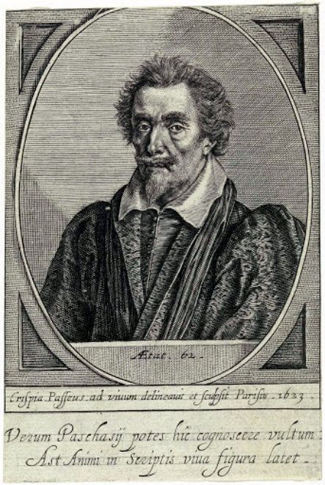

Slide 13
Application Points
Concerning Communion (2)
  The main tenant is that the elements, the bread and cup, physically become the body and blood of Christ
  Trans=change Substantiation=Substance
  “This is my body” “This is my blood”
  This is why in Roman Catholic understanding such a great emphasis is placed on the Eucharist
  This view of what happens during Communion took root and became the official teaching of the Roman Catholic Church

Slide 14
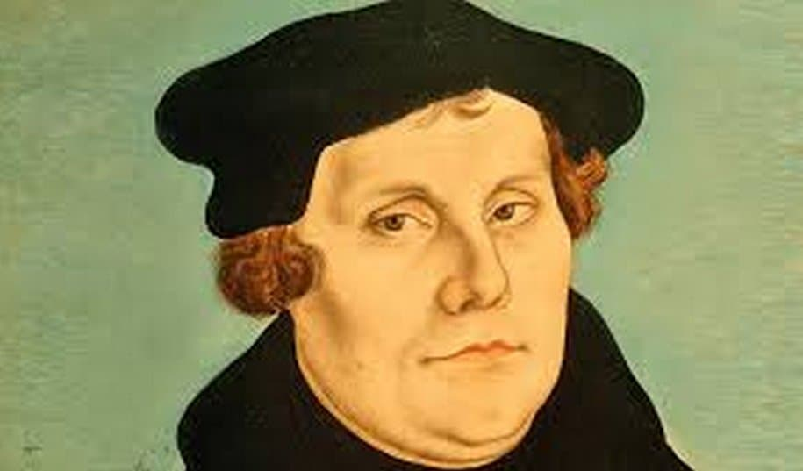

Slide 15
Application Points
Concerning Communion (3)
  The 95 Theses were primarily against Johann Tetzel and the selling of indulgences
  From this came a long back and forth between Rome and Luther
  Luther did not intend to do this from the outset
  The Papacy and other leadership within the Roman Catholic Church rejected any such changes
  Luther taught many doctrine which did not align with the Roman Catholic Church
  Luther argued against Transubstantiation with his own understanding which was Consubstantiation
  Con=With Substantiation= Substance
  Unlike the Roman Catholics who believed the elements were completely altered, Luther argued the bread and cup remained

Slide 16
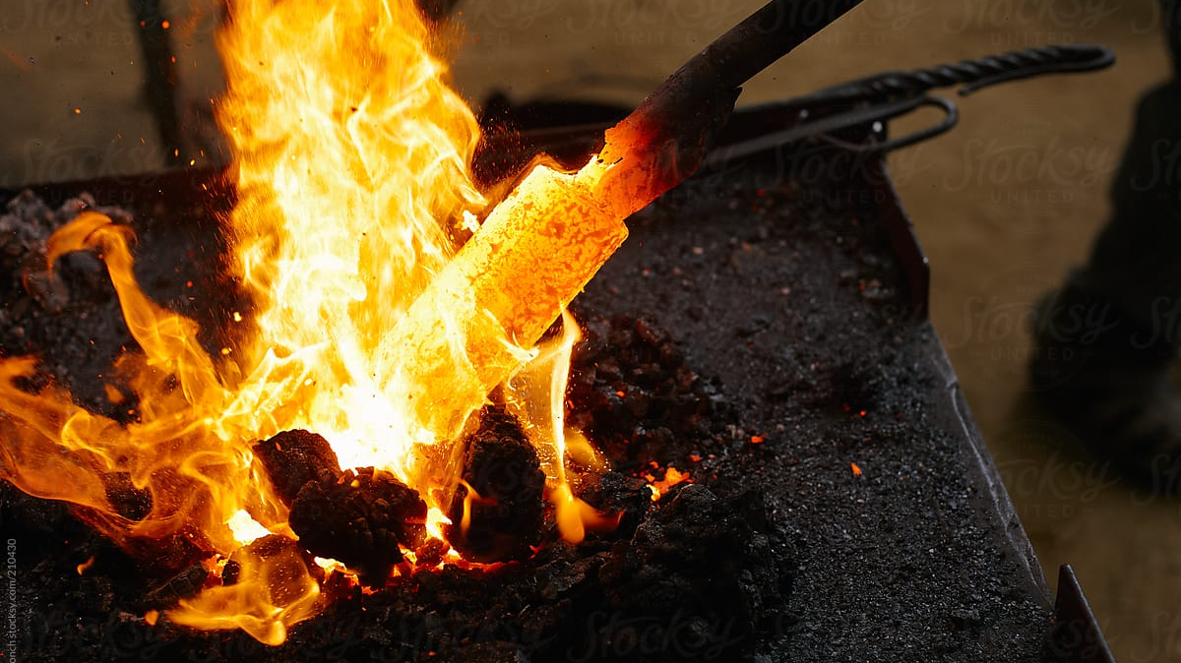

Slide 17
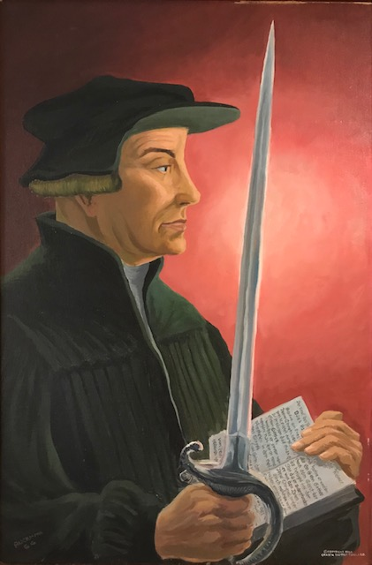

Slide 18
Application Points
Concerning Communion (4)
  Zwingli may not be as well known, but his works are just as significant
  Zwingli started preaching verse by verse through the Bible in 1519
  His dedication to the Scriptures over the authority of the Roman Catholic tradition won out
  In contrast to “Lutheranism” Zwingli taught “Reformed Theology”
  The Reformation was like little wildfires across Europe which the Roman Catholic Papacy could not extinguish
  Why didn’t the Reformation ever coalesce?
  Communion!

Slide 19
Application Points
Concerning Communion (5)
  Zwingli had a different interpretation than Luther concerning Communion
  Zwingli sought to separate the concept of Christ being physically present in the Eucharist
  Communion was nothing more than a memorial of the body and blood of Christ
  It is a symbol of a significant spiritual truth
  Christ was as far from the bread and cup as heaven from earth
  Luther and Zwingli met at the Marburg Colloquy in 1529
  Luther wrote “hoc est corpus meum” “This is my Body”
  When Zwingli argued that Luther show evidence for the belief that Jesus’ body was really present, Luther, with great flourish, lifted the table cloth “hoc est corpus meum!”

Slide 20
Application Points
Concerning Communion (6)
  Luther wrote a confession with agreements on 14 points
  The 15th, however, was communion and they could not completely agree
  We can understand both sides
  Zwingli was based on reason
  Jesus is, physically, at the right hand of the Father
  It doesn’t make sense that we should be eating the actual flesh and blood of Jesus
  Luther was seeking to be as faithful to the Scriptures as possible
  Likewise, for Luther, they were literally losing Christ

Slide 21
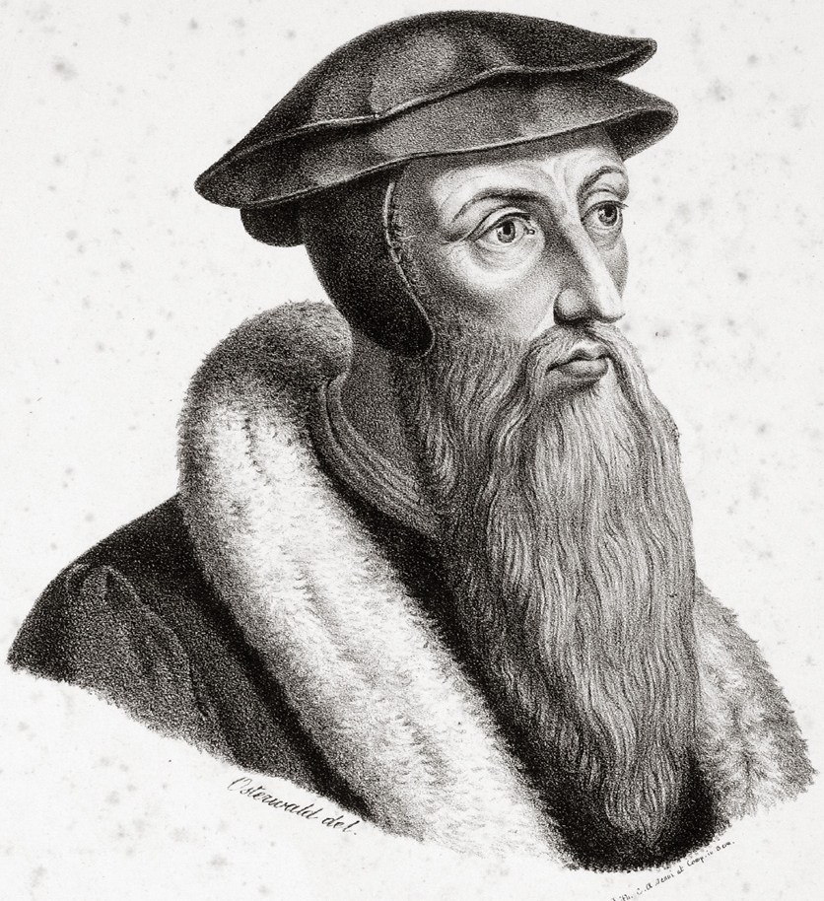

Slide 22
Application Points
Concerning Communion (7)
  Calvin had fled to Geneva because the King of France was not fond of the Reformation
  Willem Farel put so much fear of God into Calvin that he stayed as pastor of Geneva
  “This man, undoubtedly the greatest of Protestant divines, and perhaps, after St. Augustine, the most perseveringly followed by his disciples of any Western writer on theology…” (New Advent article on John Calvin)
  He agreed with Zwingli that the physical body of Christ was absent from the Eucharist
  He disagreed with Zwingli in that it was only a memorial
  The Spiritual presence of Christ is truly present in Communion
  That we are lifted up to Christ through Communion
  He goes farther than Zwingli, but not as far as the others

Slide 23
Application Points
Concerning Communion (8)
  Which view makes the most sense Biblically?
  Which view accurately depicts Christ now?
  Which view still gives weight to I Corinthians?
  We know Christ is physically seated at the right hand of the Father
  As Paul says, “We proclaim the Lord’s death until he comes”
  I find all the arguments about demeaning the body and blood of Christ by physically eating and drinking a strong case against the literal physicalist view
  Many hold to Zwingli’s view that it is nothing more than a memorial
  How could the people be getting physically ill and dying over a memorial?
  Something happens during Communion in which case God is present

Slide 24
Application Points
Concerning Communion (9)
  To me Calvin’s Spiritual view holds the greatest amount of weight Biblically
  When Jesus says, “This is my body, this is my blood, do this in remembrance of me…” we can know He is present with us through the Holy Spirit
  This stronger view also allows us to take seriously Communion
  That the Holy Spirit is with us is one of the greatest evidences with the fact that Jesus accomplished what was unattainable for us

Slide 25
Application Points
Concerning Communion (10)
  Since early on in the Christian tradition only those who were baptized were allowed to partake of Communion
  The early Church took seriously the sacraments, and most of Church history has done so also
  It is all meant to bring us back to Christ
  To remember, then, the Words of Jesus and partake with Jesus
  Regardless of one’s view of Communion, I would suspect this is the most important lesson learned
  Christ does not expect us to follow Him half-heartedly
  As we partake…we are being drawn to Christ

Slide 26
Application Points
Concerning Communion (11)
  If we are to truly remember, we should do so fully
  If we simply partake, but do not seek to live according to Christ we show we are far from Him
  We blaspheme by ignoring Communion
  We can also blaspheme by partaking and not living for Him
  Let us be a holy people who seek to honor Christ and truly remember Him
  Let us proclaim with words and deeds
  As we join together, let us give thanks for the body and blood of Christ which is given for us for the full glory of God through His redemption

Slide 27
Application Points
The Gospel of Christ
  Origins
    Where it begins
  Fall
    What went wrong
  Redemption
    How it is fixed
  Glorification
    Where it at leads

