Slide 1

I Corinthians 10:14-22
Fellowship with Demons

Slide 2

The Wide World

Slide 3

Europe

Slide 4

Looking Closer

Slide 5

Corinth

Slide 6
14 Therefore, my beloved, flee from idolatry. 15 I speak as to sensible people; judge for yourselves what I say. 16 The cup of blessing that we bless, is it not a participation in the blood of Christ? The bread that we break, is it not a participation in the body of Christ? 17 Because there is one bread, we who are many are one body, for we all partake of the one bread. 18 Consider the people of Israel: are not those who eat the sacrifices participants in the altar?
(I Corinthians 10:14-18, ESV)

Slide 7
19 What do I imply then? That food offered to idols is anything, or that an idol is anything? 20 No, I imply that what pagans sacrifice they offer to demons and not to God. I do not want you to be participants with demons. 21 You cannot drink the cup of the Lord and the cup of demons. You cannot partake of the table of the Lord and the table of demons. 22 Shall we provoke the Lord to jealousy? Are we stronger than he?
(I Corinthians 10:19-22, ESV)

Slide 8
Main Point
Paul begins to close out the argument which was started in chapter 8
Paul has shown the folly of entering pagan temples and partaking of the food
First: It is unloving toward those who (rightly) perceive this as idolatry
Second: All because one has rights it does not mean we should lack self-control or discipline
Third: Such practices in the Old Testament were forbidden and it showed through their deaths
Practicing this means communion with the demonic
Paul forbids such practices because it only leads God to jealousy

Slide 9
Application Points
Fellowship with Demons
  There was a realization that we will be dealing with all of these issues
  Thus it seemed prudent to deal with the one topic Paul would not be dealing with in depth
  The problem with dealing with demons or demonic forces is that we are so accustomed to the enlightenment
  Spiritual entities or explanations have been diminished
  In some sense this view has infected many both inside and outside of the Church
  Consider the following…

Slide 10
“That the demonic is real and powerful Paul never denies. But since he endorses both he apocalyptic tradition (Reflected in rabbinic Judaism) of demonic forces and the prophet tradition reflected in Hellenistic Judaism that false gods are “non-gods” or “empty” of reality, he is less likely to be thinking personalized entities than the power of demonic forces which reflect powers of evil greater in collective force than human resources. They represent active evil powers which are hostile to God; but they are also “nothing” in themselves. F.F. Bruce comments, “The demons, for Paul, were probably not personal beings but impersonal forces which exerted a powerful influence over unregenerate man.”
(Thiselton, 775, Emphasis his).

Slide 11
Application Points
Fellowship with Demons (2)
  The implications is that demons are not personal beings
  Instead they are impersonal forces
  This is an interesting view, but is it accurate?
  One would argue against it based upon the verses today
  How is it possible for one to have fellowship, or participate with, a force?
  Participation implies personhood
  One does not merely participate with Jesus as a force, but with Him as a Person, a being

Slide 12
“So they shall no more sacrifice their sacrifices to goat demons, after whom they whore. This shall be a statute forever for them throughout their generations.”
Leviticus 17:7, ESV
“16 They stirred him to jealousy with strange gods; with abominations they provoked him to anger. 17 They sacrificed to demons that were no gods, to gods they had never known, to new gods that had come recently, whom your fathers had never dreaded. 18 You were unmindful of the Rock that bore you, and you forgot the God who gave you birth.”
Deuteronomy 32:16-18, ESV

Slide 13
“34 They did not destroy the peoples, as the LORD commanded them, 35 but they mixed with the nations and learned to do as they did. 36 They served their idols, which became a snare to them. 37 They sacrificed their sons and their daughters to the demons; 38 they poured out innocent blood, the blood of their sons and daughters, whom they sacrificed to the idols of Canaan, and the land was polluted with blood. 39 Thus they became unclean by their acts, and played the whore in their deeds.”
-Psalm 106:34-39, ESV

Slide 14
Application Points
Fellowship with Demons (3)
  What of these verses?
  The concept of sacrifice, which was done to the pagan gods, then gives us an understanding that when the Old Testament discusses “gods” they are not “gods” but demons
  These verses still do not tell us if they are personal or impersonal
  If this is all we receive concerning the Old Testament, do we have any more information on these demonic things in the New Testament?

Slide 15
16 That evening they brought to him many who were oppressed by demons, and he cast out the spirits with a word and healed all who were sick. 17 This was to fulfill what was spoken by the prophet Isaiah: “He took our illnesses and bore our diseases.”
Mathew 8:16-17, ESV
32 As they were going away, behold, a demon-oppressed man who was mute was brought to him. 33 And when the demon had been cast out, the mute man spoke. And the crowds marveled, saying, “Never was anything like this seen in Israel.” 34 But the Pharisees said, “He casts out demons by the prince of demons.”
Matthew 9:32-34, ESV

Slide 16
21 And Jesus went away from there and withdrew to the district of Tyre and Sidon. 22 And behold, a Canaanite woman from that region came out and was crying, “Have mercy on me, O Lord, Son of David; my daughter is severely oppressed by a demon.” 23 But he did not answer her a word. And his disciples came and begged him, saying, “Send her away, for she is crying out after us.” 24 He answered, “I was sent only to the lost sheep of the house of Israel.” 25 But she came and knelt before him, saying, “Lord, help me.” 26 And he answered, “It is not right to take the children’s bread and throw it to the dogs.” 27 She said, “Yes, Lord, yet even the dogs eat the crumbs that fall from their masters’ table.” 28 Then Jesus answered her, “O woman, great is your faith! Be it done for you as you desire.” And her daughter was healed instantly.”
Matthew 15:21-28, ESV

Slide 17
14 And when they came to the crowd, a man came up to him and, kneeling before him, 15 said, “Lord, have mercy on my son, for he has seizures and he suffers terribly. For often he falls into the fire, and often into the water. 16 And I brought him to your disciples, and they could not heal him.” 17 And Jesus answered, “O faithless and twisted generation, how long am I to be with you? How long am I to bear with you? Bring him here to me.” 18 And Jesus rebuked the demon, and it came out of him, and the boy was healed instantly. 19 Then the disciples came to Jesus privately and said, “Why could we not cast it out?” 20 He said to them, “Because of your little faith. For truly, I say to you, if you have faith like a grain of mustard seed, you will say to this mountain, ‘Move from here to there,’ and it will move, and nothing will be impossible for you.”
Matthew 19:14-21, ESV

Slide 18
33 And in the synagogue there was a man who had the spirit of an unclean demon, and he cried out with a loud voice, 34 “Ha! What have you to do with us, Jesus of Nazareth? Have you come to destroy us? I know who you are—the Holy One of God.” 35 But Jesus rebuked him, saying, “Be silent and come out of him!” And when the demon had thrown him down in their midst, he came out of him, having done him no harm. 36 And they were all amazed and said to one another, “What is this word? For with authority and power he commands the unclean spirits, and they come out!” 37 And reports about him went out into every place in the surrounding region.”
Luke 4:33-37, ESV

Slide 19
40 Now when the sun was setting, all those who had any who were sick with various diseases brought them to him, and he laid his hands on every one of them and healed them. 41 And demons also came out of many, crying, “You are the Son of God!” But he rebuked them and would not allow them to speak, because they knew that he was the Christ.
Luke 4:40-41, ESV

Slide 20
26 Then they sailed to the country of the Gerasenes, which is opposite Galilee. 27 When Jesus had stepped out on land, there met him a man from the city who had demons. For a long time he had worn no clothes, and he had not lived in a house but among the tombs. 28 When he saw Jesus, he cried out and fell down before him and said with a loud voice, “What have you to do with me, Jesus, Son of the Most High God? I beg you, do not torment me.” 29 For he had commanded the unclean spirit to come out of the man. (For many a time it had seized him. He was kept under guard and bound with chains and shackles, but he would break the bonds and be driven by the demon into the desert.)

Slide 21
30 Jesus then asked him, “What is your name?” And he said, “Legion,” for many demons had entered him. 31 And they begged him not to command them to depart into the abyss. 32 Now a large herd of pigs was feeding there on the hillside, and they begged him to let them enter these. So he gave them permission. 33 Then the demons came out of the man and entered the pigs, and the herd rushed down the steep bank into the lake and drowned.
Luke 8:26-33, ESV

Slide 22
Application Points
Fellowship with Demons (4)
  First the demons have control over the physical elements
  Second, more than one demon can be possessing a singular person at a time
  The term “Legion” is a Roman military term that had over 4000 personnel
  Third, the demons have knowledge which others do not have
  Demons have knowledge which humans do not have
  They are personal beings because impersonal forces do not possess “knowledge”
  Fourth, demons fear being cast into the abyss

Slide 23
Application Points
Fellowship with Demons (5)
  We find demonic beings who are personal
  We find them having power over the physical realm
  We find them having knowledge which humans do not have
  We find them to be spiritual beings with no physical form of their own
  If these things are more powerful than humans, why are they unable to have their own physical form?
  As a speculation this may be judgment against demons
  Their only way of encountering or experience the physical world is through some object or person
  Some will think, “Ok, during Jesus’ time on earth they existed as personal agents. But, what we also know is that Jesus conquers…”

Slide 24
11 And God was doing extraordinary miracles by the hands of Paul, 12 so that even handkerchiefs or aprons that had touched his skin were carried away to the sick, and their diseases left them and the evil spirits came out of them. 13 Then some of the itinerant Jewish exorcists undertook to invoke the name of the Lord Jesus over those who had evil spirits, saying, “I adjure you by the Jesus whom Paul proclaims.” 14 Seven sons of a Jewish high priest named Sceva were doing this. 15 But the evil spirit answered them, “Jesus I know, and Paul I recognize, but who are you?” 16 And the man in whom was the evil spirit leaped on them, mastered all of them and overpowered them, so that they fled out of that house naked and wounded.”
Acts 19:11-16, ESV

Slide 25
Application Points
Fellowship with Demons (6)
  This event occurs after Jesus’ ascension
  What is the point in all of this?
  We need to be aware of the spiritual realm which exists
  It may be possible that these demonic beings only have so much power as people will allot them
  “Who believes in such demons?”
  Many!
  These gods who are not gods but demons are showing more and more influence in this world around us
  It may very well be they have always been here, or it could be that over the course of time they have used our disbelief for their advantage

Slide 26
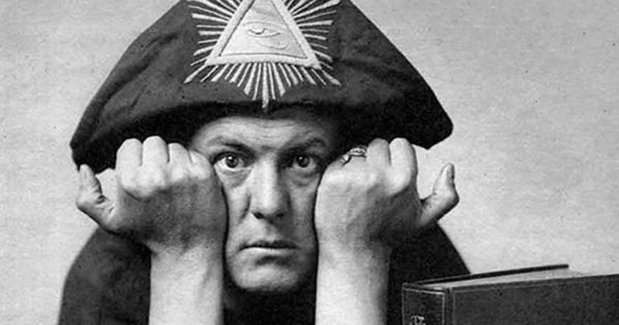

Slide 27
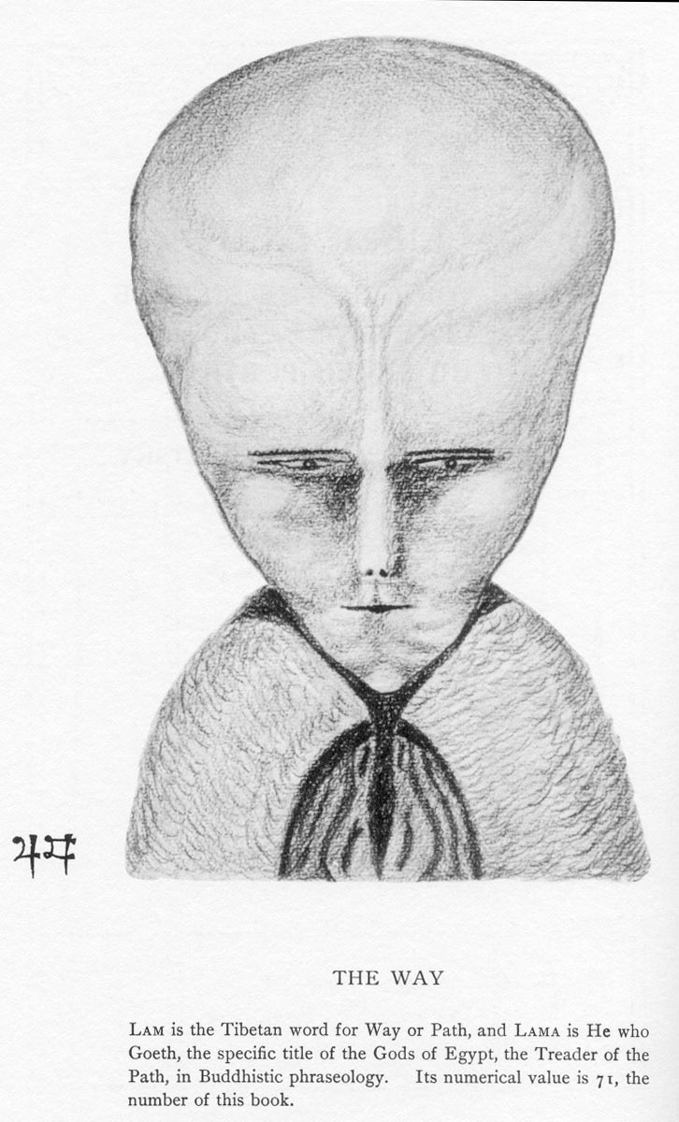

Slide 28
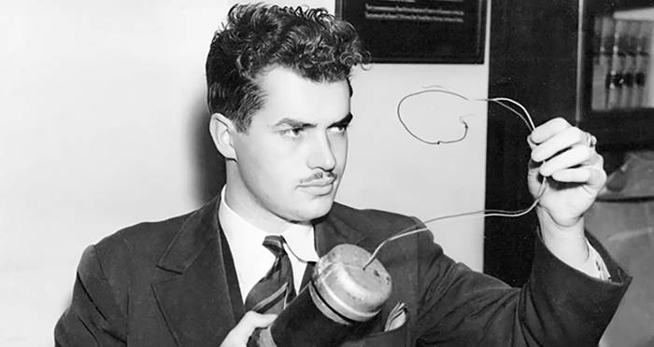

Slide 29
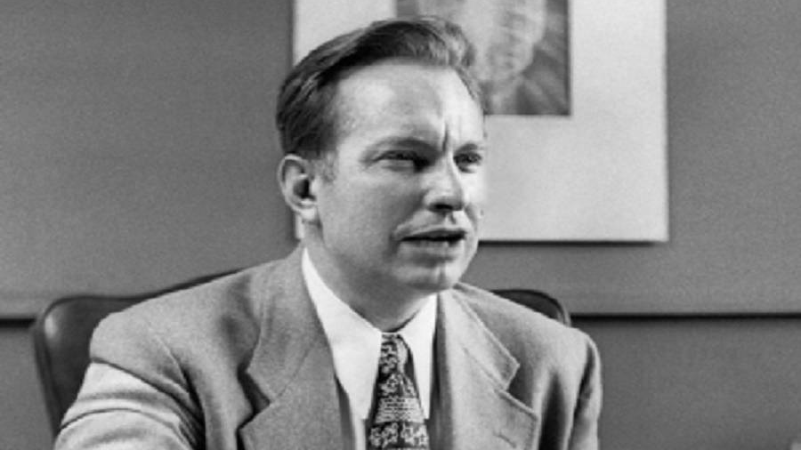

Slide 30
Application Points
Fellowship with Demons (7)
  Some will say these are just four people
  In the 1800’s there were 32 well known occultists
  In the 1900’s this increased to close to 120 well known occultist
  There are many celebrities who utilize the power of crystals to keep spiritual forces at bay
  What is the point of all this?
  Demons do exist
  The ancients practices pagan rituals at the altars, and the altars still exist
  I have no idea whether it is planned and orchestrated similar to what we find in The Screwtape Letters by CS Lewis
  Or if it is just pure anarchy and chaos

Slide 31
Application Points
Fellowship with Demons (8)
  What we can be sure of, however, is their existence, and their rise in popularity over the course of the last century
  Whatever their purposes or goals it is not the betterment of humanity
  Those possessed lose power and control
  All of this might cause some to worry
  “Aren’t you worried this puts a target on your back?”
  I am pretty sure all Christians have targets on their backs just by living in faithfulness
  I know something about these demons…they are not God
  “You believe that God is one; you do well. Even the demons believe—and shudder!” James 2:19, ESV

Slide 32
  “15 He is the image of the invisible God, the firstborn of all creation. 16 For by him all things were created, in heaven and on earth, visible and invisible, whether thrones or dominions or rulers or authorities—all things were created through him and for him. 17 And he is before all things, and in him all things hold together. 18 And he is the head of the body, the church. He is the beginning, the firstborn from the dead, that in everything he might be preeminent. 19 For in him all the fullness of God was pleased to dwell, 20 and through him to reconcile to himself all things, whether on earth or in heaven, making peace by the blood of his cross.”
  Colossians 1:15-20, ESV

Slide 33
Application Points
Fellowship with Demons (9)
  All things fall under His authority
  The devil exists, but he is on a leash, and that leash is held by God’s hand
  God is still greater than they
  He is the only necessary, all powerful, all knowing, all present Being
  These other gods, these demons, are not necessary, all powerful, all knowing, are not all present
  They are not God
  There are those who have continued, and will continue, to give themselves up to fellowship with demons
  Be prepared, then, to keep your eyes open to the unseen
  They will promise you much, resist, however, by knowing the truth and proclaiming it
  Do not be afraid of the unseen powers, but do not be unaware of them either, instead, shine the Light of Christ on them, and see how quickly they scatter

Slide 34
Application Points
The Gospel of Christ
  Origins
  Fall
  Redemption
  Glorification

