Slide 1
I Corinthians 7:10-16
The Divorce Question

Slide 2

The Wide World

Slide 3

Europe

Slide 4

Looking Closer

Slide 5

Corinth

Slide 6
10 To the married I give this charge (not I, but the Lord): the wife should not separate from her husband 11 (but if she does, she should remain unmarried or else be reconciled to her husband), and the husband should not divorce his wife.
(I Corinthians 7:10-11, ESV)

Slide 7
“Everyone who divorces his wife and marries another commits adultery, and he who marries a woman divorced from her husband commits adultery.”
Luke 16:18, ESV

Slide 8
“1 And he left there and went to the region of Judea and beyond the Jordan, and crowds gathered to him again. And again, as was his custom, he taught them. 2 And Pharisees came up and in order to test him asked, “Is it lawful for a man to divorce his wife?” 3 He answered them, “What did Moses command you?” 4 They said, “Moses allowed a man to write a certificate of divorce and to send her away.” 5 And Jesus said to them, “Because of your hardness of heart he wrote you this commandment. 6 But from the beginning of creation, ‘God made them male and female.’ 7 ‘Therefore a man shall leave his father and mother and hold fast to his wife, 8 and the two shall become one flesh.’ So they are no longer two but one flesh. 9 What therefore God has joined together, let not man separate.”
10 And in the house the disciples asked him again about this matter. 11 And he said to them, “Whoever divorces his wife and marries another commits adultery against her, 12 and if she divorces her husband and marries another, she commits adultery.”
Mark 10:1-12, ESV

Slide 9
“It was also said, ‘Whoever divorces his wife, let him give her a certificate of divorce.’ 32 But I say to you that everyone who divorces his wife, except on the ground of sexual immorality, makes her commit adultery, and whoever marries a divorced woman commits adultery.”
Matthew 5:31-32, ESV

Slide 10
“Now when Jesus had finished these sayings, he went away from Galilee and entered the region of Judea beyond the Jordan. 2 And large crowds followed him, and he healed them there.
3 And Pharisees came up to him and tested him by asking, “Is it lawful to divorce one’s wife for any cause?” 4 He answered, “Have you not read that he who created them from the beginning made them male and female, 5 and said, ‘Therefore a man shall leave his father and his mother and hold fast to his wife, and the two shall become one flesh’? 6 So they are no longer two but one flesh. What therefore God has joined together, let not man separate.” 7 They said to him, “Why then did Moses command one to give a certificate of divorce and to send her away?” 8 He said to them, “Because of your hardness of heart Moses allowed you to divorce your wives, but from the beginning it was not so. 9 And I say to you: whoever divorces his wife, except for sexual immorality, and marries another, commits adultery.”
Matthew 19:1-9, ESV

Slide 11
“And I say unto you, Whosoever shall put away his wife, except it be for fornication, and shall marry another, committeth adultery: and whoso marrieth her which is put away doth commit adultery.” KJV
“And I tell you this, whoever divorces his wife and marries someone else commits adultery—unless his wife has been unfaithful.” NLT
“And I say to you, whoever divorces his wife, except for immorality, and marries another woman Commits adultery.” NASB95
“Now I say to you that whoever divorces his wife, except for immorality, and marries another commits adultery." NET
And I say to you: whoever divorces his wife, except for unchastity, and marries another, commits adultery." RSV

Slide 12
The Problem(s) with this “unfaithful” understanding
  It makes little sense for Jesus to argue what God has brought together let not man separate…except under these conditions
  Why isn’t there an except clause in Mark and Luke when teaching on the same issue?
  Λέγω δὲ ὑμῖν· ὃς ἂν ἀπολύσῃ τὴν γυναῖκα αὐτοῦ μὴ ἐπὶ πορνείᾳ καὶ γαμήσῃ ἄλλην, μοιχᾶται. καὶ ὁ ἀπολελυμένην γαμήσας μοιχᾶται.
  πορνεία = Sexual Immorality [Shorthand for Leviticus 18-20 and similar laws in Deuteronomy]
  μοιχᾶται = Adultery
  If Jesus meant “except in marital unfaithfulness” why not simply say, “except because of adultery?”

Slide 13
A Better Understanding
  Who asked the question and how did they ask it?
  Pharisees asked saying, “Is it lawful to divorce ones wife for any cause?”
  Shammai taught that a husband could only divorce his wife if she were unchaste
  Hillel taught that if she burned supper he could divorce her
  Akiba taught if he saw a more attractive woman he could divorce and then go marry her
  If Jesus were saying, “except adultery” he would be saying nothing different than Shammai
  Yet their response is, “Why did Moses command one to give a certificate of divorce and send her away.” A question only making sense if Jesus meant no divorce

Slide 14
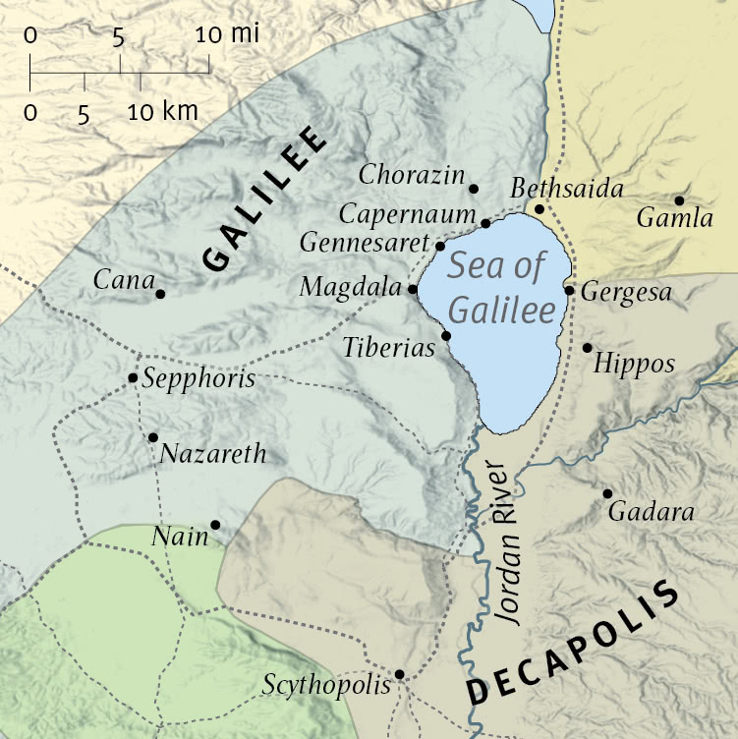

Slide 15
“At that time Herod the tetrarch heard about the fame of Jesus, 2 and he said to his servants, “This is John the Baptist. He has been raised from the dead; that is why these miraculous powers are at work in him.” 3 For Herod had seized John and bound him and put him in prison for the sake of Herodias, his brother Philip’s wife, 4 because John had been saying to him, “It is not lawful for you to have her.” 5 And though he wanted to put him to death, he feared the people, because they held him to be a prophet. 6 But when Herod’s birthday came, the daughter of Herodias danced before the company and pleased Herod, 7 so that he promised with an oath to give her whatever she might ask. 8 Prompted by her mother, she said, “Give me the head of John the Baptist here on a platter.” 9 And the king was sorry, but because of his oaths and his guests he commanded it to be given. 10 He sent and had John beheaded in the prison, 11 and his head was brought on a platter and given to the girl, and she brought it to her mother. 12 And his disciples came and took the body and buried it, and they went and told Jesus.”
Matthew 14:1-12, ESV

Slide 16
A Better Understanding (2)
  John taught that Herod should divorce Herodias because she was his brothers wife
  Leviticus 18-20 has the sexual immorality laws (see especially 18:16)
  The only way for a divorce to be truly lawful is when the relationship itself is founded on sexually immoral practices
  We can agree with Paul that according to Jesus divorce is not permissible

Slide 17
12 To the rest I say (I, not the Lord) that if any brother has a wife who is an unbeliever, and she consents to live with him, he should not divorce her. 13 If any woman has a husband who is an unbeliever, and he consents to live with her, she should not divorce him. 14 For the unbelieving husband is made holy because of his wife, and the unbelieving wife is made holy because of her husband. Otherwise your children would be unclean, but as it is, they are holy. 15 But if the unbelieving partner separates, let it be so. In such cases the brother or sister is not enslaved. God has called you to peace. 16 For how do you know, wife, whether you will save your husband? Or how do you know, husband, whether you will save your wife?
(I Corinthians 7:12-16, ESV)

Slide 18
Main Point
The main points of these verses are to give us a doctrine of divorce
The very foundation and nature of marriage is found in God
The union is to be found in God’s design not our emotions
An unbeliever may want to leave the unbeliever
In such a circumstance the believer is not culpable for the actions of the unbeliever

Slide 19
Application Points
The Divorce Question
  We are not so far removed from the first century as we might think either
  Ever since the fall anything which humanity touches can be utilized for good or evil…including marriage
  The first observation is how this leads to a better understanding of marriage
  Our culture believes two people have an emotional connection and that’s why they get married
  Emotions are an inadequate foundation for marriage
  Let’s say as time goes on I no longer have those feelings
  Based upon the culture I should be able to follow my emotions wherever they lead (Rabbi Akiba!)

Slide 20
Application Points
The Divorce Question (2)
  Emotions are fleeting
  It shows us the danger of letting our emotions be the only foundation for our marriages
  For believers emotions are not the foundation
  God has brought male and female, husband and wife, together
  It is not in ourselves, but in the design and purpose of God
  This does not mean we do not feel
  Husbands and wives should certainly seek the emotional and falling in love feeling

Slide 21
Application Points
The Divorce Question (3)
  The second observation is that divorce is not God’s will for us
  To divorce is to go directly against God’s will for us
  It would also be going against God’s will for us to be married on sexually immoral grounds
  Incest, homosexuality, bestiality etc.
  Those who claim Jesus never says anything against homosexuality are simply wrong
  He implies no such marriage is permissible

Slide 22
Application Points
The Divorce Question (4)
  The third observation…sex and sexuality are part of the marriage identity
  If they divorce and remarry they commit “Adultery”
  It is the sexual union being taken into consideration and perhaps we should take it more seriously as well
  Marriage is not what the culture tells us
  It is by definition good, very good
  By making it something we invent it lowers the meaning of marriage
  God created Adam and Eve and they became one flesh…marriage is from God

Slide 23
Application Points
The Divorce Question (5)
  The first concern is that divorce is a common occurrence in our society
  It is founded on ourselves and when the passions fade so do the marriages
  This, however, is not only common in our own culture
  Consider Jesus’ encounter with the woman at the well

Slide 24
“16 Jesus said to her, “Go, call your husband, and come here.” 17 The woman answered him, “I have no husband.” Jesus said to her, “You are right in saying, ‘I have no husband’; 18 for you have had five husbands, and the one you now have is not your husband. What you have said is true.”
John 4:16-18, ESV

Slide 25
“Sir, I perceive that you are a prophet. 20 Our fathers worshiped on this mountain, but you say that in Jerusalem is the place where people ought to worship.” 21 Jesus said to her, “Woman, believe me, the hour is coming when neither on this mountain nor in Jerusalem will you worship the Father. 22 You worship what you do not know; we worship what we know, for salvation is from the Jews. 23 But the hour is coming, and is now here, when the true worshipers will worship the Father in spirit and truth, for the Father is seeking such people to worship him. 24 God is spirit, and those who worship him must worship in spirit and truth.” 25 The woman said to him, “I know that Messiah is coming (he who is called Christ). When he comes, he will tell us all things.” 26 Jesus said to her, “I who speak to you am he.” (John 4:19-26, ESV)

Slide 26
Application Points
The Divorce Question (6)
  The point here is for those who have been divorced
  That is not the end all anymore than any other failing is
  There is hope and redemption in the marriage you have now
  Be steadfast in your marriage knowing it is from God
  Paul shows that being married to an unbeliever does not make one unholy
  Your children are holy
  This does not justify the divorce but it reminds us of God’s grace, mercy, forgiveness, and the blessings which we should all rejoice in
  The second concern is for those who are in marriages where the other is unfaithful
  Both Paul and Jesus say…no

Slide 27
. “7 They said to him, “Why then did Moses command one to give a certificate of divorce and to send her away?” 8 He said to them, “Because of your hardness of heart Moses allowed you to divorce your wives, but from the beginning it was not so.”
Matthew 19:7-8, ESV

Slide 28
Application Points
The Divorce Question (7)
  Moses does not command divorce
  Instead it was allowed
  Is it their lack of grace? Mercy? Kindness? Love?
  In Christ we relearn what it means to have a soft heart toward our spouses who are sinners
  In Paul it makes no sense to say adultery is an acceptable means for divorce
  The pagans were not against visiting temple prostitutes
  They were not against having sex outside of marriage
  Does Paul say, “Leave them?” No. He says, “Stay because you make them holy.”

Slide 29
Application Points
The Divorce Question (8)
  The third concern is for those who may be in abusive relationships
  People do terrible things
  Our perfect example is Christ Himself
  Following His Father’s will it led to His suffering and execution at the hands of sinners
  The apostles could show you the scars of their faithfulness
  We are called to be faithful regardless if it leads to a prison or a palace
  To say we would all suffer gladly for Christ but not in obedience to Him, seems antithetical to everything we proclaim

Slide 30
Application Points
The Divorce Question (9)
  Augustine wrote of his mother Monica in Confessions
  She cared deeply about her family's salvation
  His father wasn’t the best spouse, and Monica suffered
  Yet, she rejoiced in being faithful to God and ultimately being the way in which redemption came to her son…and husband
  When we consider Hosea and his call to marry a prostitute
  When we consider God being a faithful husband to a faithless bride
  It reminds us Christlikeness that comes when we sometimes suffer on behalf of obedience

Slide 31
Application Points
The Divorce Question (10)
  This does not mean that we should expect husbands and wives to die at the hands of their spouses
  In certain situations the Church should encourage a separation, though our encouragement should always hinge on celibacy during the separation with the end goal of reconciliation
  I know some are still skeptical
  You are not the only ones to be shocked by this teaching
  If you expect the disciples response to be, “Wow, Jesus, thank you for teaching us properly about marriage!” Then you’d be wrong

Slide 32
10 The disciples said to him, “If such is the case of a man with his wife, it is better not to marry.” 11 But he said to them, “Not everyone can receive this saying, but only those to whom it is given. 12 For there are eunuchs who have been so from birth, and there are eunuchs who have been made eunuchs by men, and there are eunuchs who have made themselves eunuchs for the sake of the kingdom of heaven. Let the one who is able to receive this receive it.”
(Matthew 19:10-12, ESV)

Slide 33
Application Points
The Divorce Question (11)
  What a male response
  He acknowledges it is a hard teaching
  Who can really deal with this? Eunuchs
  Those who do not have sexual passions
  One of the major problems in our congregations, and further our culture, is a lack of faithfulness
  The reason the culture doesn’t have a high view of marriage is because we don’t have a high view of marriage

Slide 34
Application Points
The Divorce Question (12)
  What would happen if the Church exhibited men and women who remained faithful?
  What would society say to see loving husbands with unfaithful wives and vice versa?
  What would the world say if they should see husbands who care about their wives needs…and vice versa
  How would our children respond to marriage if we should teach it this way?
  What if we were the examples for our children of what a good marriage looks like?
  What if we familiarized them with this view rather than the destruction view of marriage found in the world?
  Maybe they would take more time to consider the character of the person they choose to marry

Slide 35
Application Points
The Divorce Question (13)
  I think all of this would lead to good things
  The culture is in need of Christians who are obedient and faithful
  Our children can learn the right way from our mistakes
  We know we have a gracious God who is with us to teach us and our children His good ways
  Be encouraged to be the best spouse you can be for the glory of God
  We can be radically transformed as individuals and in our marriages
  Hope that through us the world would see the beauty and wonder of marriage as instituted by God
  That through our faithfulness the world would see God is good

Slide 36
Application Points
The Gospel of Christ
  Origins
  Fall
  Redemption
  Glorification

