Slide 1
I Corinthians 6:12-20
A Biblical Understanding of the Physical Body

Slide 2

The Wide World

Slide 3

Europe

Slide 4

Looking Closer

Slide 5

Corinth

Slide 6
12 “All things are lawful for me,” but not all things are helpful. “All things are lawful for me,” but I will not be dominated by anything. 13 “Food is meant for the stomach and the stomach for food”—and God will destroy both one and the other. The body is not meant for sexual immorality, but for the Lord, and the Lord for the body. 14 And God raised the Lord and will also raise us up by his power.
(I Corinthians 6:12-14, ESV)

Slide 7
12 “All things are lawful for me,” but not all things are helpful. “All things are lawful for me,” but I will not be dominated by anything. 13 “Food is meant for the stomach and the stomach for food—and God will destroy both one and the other.” The body is not meant for sexual immorality, but for the Lord, and the Lord for the body. 14 And God raised the Lord and will also raise us up by his power.
(I Corinthians 6:12-14, ESV)

Slide 8
15 Do you not know that your bodies are members of Christ? Shall I then take the members of Christ and make them members of a prostitute? Never! 16 Or do you not know that he who is joined to a prostitute becomes one body with her? For, as it is written, “The two will become one flesh.” 17 But he who is joined to the Lord becomes one spirit with him. 18 Flee from sexual immorality. Every other sin a person commits is outside the body, but the sexually immoral person sins against his own body. 19 Or do you not know that your body is a temple of the Holy Spirit within you, whom you have from God? You are not your own, 20 for you were bought with a price. So glorify God in your body.
(I Corinthians 6:15-20, ESV)

Slide 9
Main Point
These verses refute the incorrect spiritualized understanding of the Corinthians
All that matters is the “spiritual”
Thus they can utilize their bodies in complete liberty
Paul counters that the body is just as important as these inner truths because our bodies belong to Christ
We are not our own, we have been bought with a price, glorify God with your body

Slide 10
Application Points
A Biblical Understanding of the Physical Body
  It is to recognize that the issues the Corinthians dealt with are ones we deal with
  It is because of the similarities that we should, at every point, stop and ask ourselves if we are falling into similar traps
  We have often had a poor Biblical understanding of the body causing us to fall into the same or similar trap
  Part of the reason is our misunderstanding when the New Testament describes the flesh

Slide 11
4 Likewise, my brothers, you also have died to the law through the body of Christ, so that you may belong to another, to him who has been raised from the dead, in order that we may bear fruit for God. 5 For while we were living in the flesh, our sinful passions, aroused by the law, were at work in our members to bear fruit for death. 6 But now we are released from the law, having died to that which held us captive, so that we serve in the new way of the Spirit and not in the old way of the written code.”
(Romans 7:4-6, ESV [emphasis mine])

Slide 12
3 For God has done what the law, weakened by the flesh, could not do. By sending his own Son in the likeness of sinful flesh and for sin, he condemned sin in the flesh, 4 in order that the righteous requirement of the law might be fulfilled in us, who walk not according to the flesh but according to the Spirit. 5 For those who live according to the flesh set their minds on the things of the flesh, but those who live according to the Spirit set their minds on the things of the Spirit. 6 For to set the mind on the flesh is death, but to set the mind on the Spirit is life and peace. 7 For the mind that is set on the flesh is hostile to God, for it does not submit to God’s law; indeed, it cannot. 8 Those who are in the flesh cannot please God.”
(Romans 8:3-8, ESV [emphasis mine])

Slide 13
Application Points
A Biblical Understanding of the Physical Body (2)
  Unfortunately, what we have done is understand this as literally “physical” and “spiritual”
  “Physical” is bad and “spiritual” is good
  This seems antithetical to much of what we know about God
  It is more akin to Plato than the Old Testament or Apostolic teaching
  Plato’s famous cave allegory is the best way to understand his thought

Slide 14
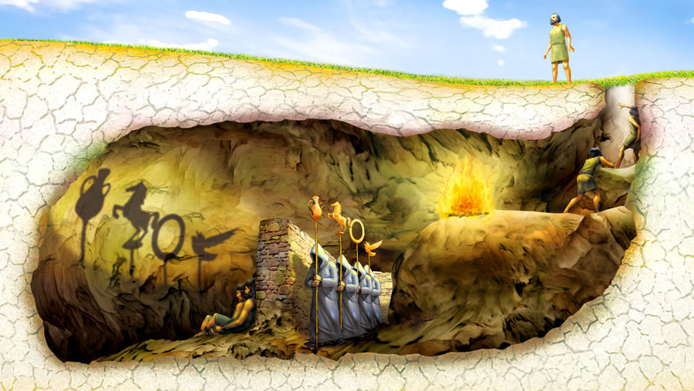

Slide 15
Application Points
A Biblical Understanding of the Physical Body (3)
  At time went on those following Plato (Stoics and Neoplatonists) described this more as physical vs. spiritual
  The physical is bad and not real
  The spiritual is good and real
  When it comes to the Church we see a similar teaching
  Is Paul just Christianizing Plato?
  Nowhere in the Old Testament do we find such a dichotomy between spiritual and physical
  God created the physical world and called it…
  We find the physical world is morally neutral in that it can be utilized for good or evil
  When it is being used as part of God’s design for it is good
  It is when we, moral agents, abuse the physical then it is bad

Slide 16
Application Points
A Biblical Understanding of the Physical Body (4)
  We are warned over and over again about how we should act with our possessions
  Things in this physical existence are described positively or negatively based upon how they are utilized
  “Whoever is slothful will not roast his game, but the diligent man will get precious wealth.” Proverbs 12:27, ESV
  “A good man leaves an inheritance to his children’s children, but the sinner’s wealth is laid up for the righteous.” Proverbs 13:22, ESV
  “Whoever oppresses the poor to increase his own wealth, or gives to the rich, will only come to poverty.” Proverbs 22:16, ESV

Slide 17
Application Points
A Biblical Understanding of the Physical Body (5)
  When we take into consider the Law and the prophets, we continue to see that blessings are often associated with the physical
  Land of milk and honey, peace in the land, inheritance of the land etc.
  Some might say this is all the Old Testament not the New
  “And the Word became flesh and dwelt among us, and we have seen his glory, glory as of the only Son from the Father, full of grace and truth.” (John 1:14, ESV)
  If the physical is purely bad and the spiritual purely good, then the coming of the Word in flesh makes no sense
  It also makes no sense for Christ to be raised physically
  If the Bible does not, then, describe a physical and spiritual dichotomy, then what does Paul mean when he says “flesh” and “Spirit?”
  Flesh is the natural inclinations of our hearts apart from God (See sins listed earlier)

Slide 18
Application Points
A Biblical Understanding of the Physical Body (6)
  To be in the Spirit represents the inclinations of the Spirit away from what is naturally evil
  Living in this way with our physical bodies
  By making the contrast between physical and spiritual we have undervalued the physical to such a degree that it has lost all value and meaning
  We cannot be so naïve as to think that the rise of transgenderism doesn’t relate to any of this
  As we overemphasized the spiritual and underemphasized the physical there would be those who become so utterly confused
  We are as much to blame as the world for our own inconsistencies
  Jesus came to redeem all of human existence
  He plays no partiality with His redemption, it covers all things

Slide 19
Application Points
A Biblical Understanding of the Physical Body (7)
  The physical is not to be cast aside
  We can rejoice in the fact that we can glorify God with our bodies
  Through kind words and encouragement with our lips and tongues
  Through servicing one another with our hands and feet
  It is time for us to learn to be thankful for this physical reality
  If we recognize just how high Christ lifts up this physical world into glory through His resurrection, then we would seek to lift up this physical world through our bodies as well
  We would not set up a false dichotomy
  That we would desire to have a better Biblical understanding of the physical body which belongs to Christ as much as our souls

Slide 20
Application Points
The Gospel of Christ
  Origins
  Fall
  Redemption
  Glorification

