Slide 1
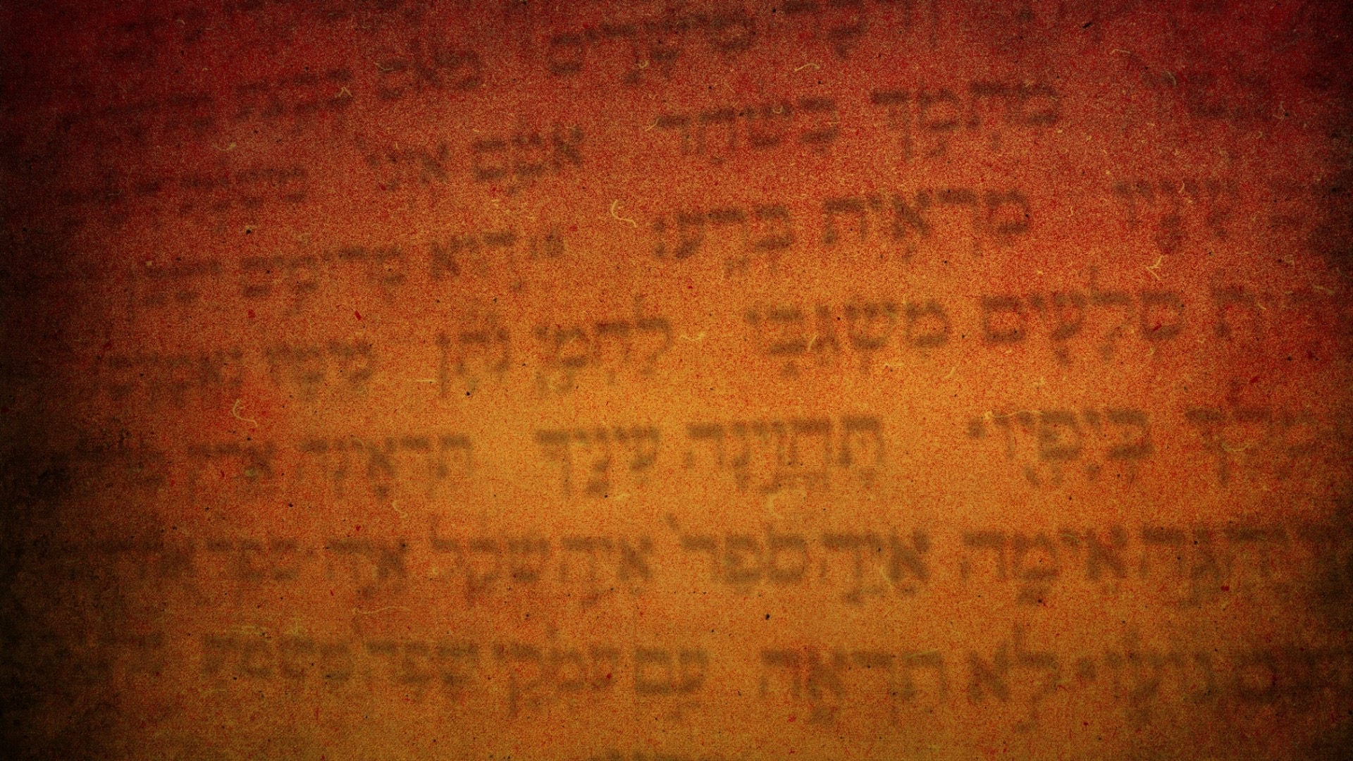
The Feast of Tabernacles
Sukkot
Leviticus 23:33-44

Slide 2
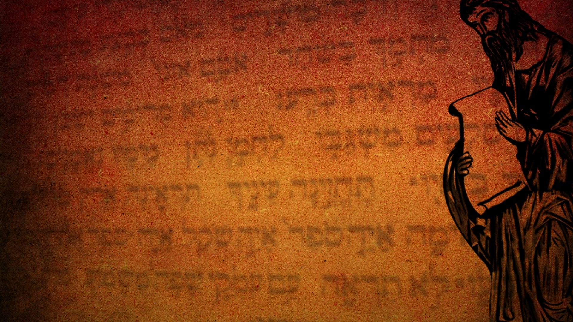
The Lord spoke to Moses: “Tell the Israelites: The Festival of Booths to the Lord begins on the fifteenth day of this seventh month and continues for seven days.
Leviticus 23:33–34
HCSB

Slide 3
There is to be a sacred assembly on the first day; you are not to do any daily work. You are to present a fire offering to the Lord for seven days. On the eighth day you are to hold a sacred assembly and present a fire offering to the Lord. It is a solemn gathering; you are not to do any daily work.
Leviticus 23:35–36
HCSB

Slide 4
“These are the Lord’s appointed times that you are to proclaim as sacred assemblies for presenting fire offerings to the Lord, burnt offerings and grain offerings, sacrifices and drink offerings, each on its designated day. These are in addition to the offerings for the Lord’s Sabbaths, your gifts, all your vow offerings, and all your freewill offerings that you give to the Lord.
Leviticus 23:37–38
HCSB

Slide 5
“You are to celebrate the Lord’s festival on the fifteenth day of the seventh month for seven days after you have gathered the produce of the land. There will be complete rest on the first day and complete rest on the eighth day. On the first day you are to take the product of majestic trees—palm fronds, boughs of leafy trees, and willows of the brook —and rejoice before the Lord your God for seven days.
Leviticus 23:39–40
HCSB

Slide 6
You are to celebrate it as a festival to the Lord seven days each year. This is a permanent statute for you throughout your generations; you must celebrate it in the seventh month. You are to live in booths for seven days. All the native-born of Israel must live in booths,
Leviticus 23:41–42
HCSB

Slide 7
so that your generations may know that I made the Israelites live in booths when I brought them out of the land of Egypt; I am Yahweh your God.” So Moses declared the Lord’s appointed times to the Israelites.
Leviticus 23:43–44
HCSB

Slide 8
On the last and most important day of the festival, Jesus stood up and cried out, “If anyone is thirsty, he should come to Me and drink! The one who believes in Me, as the Scripture has said, will have streams of living water flow from deep within him.”
John 7:37–38
HCSB

Slide 9
He said this about the Spirit. Those who believed in Jesus were going to receive the Spirit, for the Spirit had not yet been received because Jesus had not yet been glorified.
John 7:39
HCSB

Slide 10
Then Jesus spoke to them again: “I am the light of the world. Anyone who follows Me will never walk in the darkness but will have the light of life.”
John 8:12
HCSB

Slide 11
So the Lord’s anger burned that day, and He swore an oath: ‘Because they did not follow Me completely, none of the men 20 years old or more who came up from Egypt will see the land I swore to give Abraham, Isaac, and Jacob—
Numbers 32:10–11
HCSB

Slide 12
none except Caleb son of Jephunneh the Kenizzite and Joshua son of Nun, because they did follow the Lord completely.’
Numbers 32:12
HCSB

Slide 13
The Lord’s anger burned against Israel, and He made them wander in the wilderness 40 years until the whole generation that had done what was evil in the Lord’s sight was gone.
Numbers 32:13
HCSB

Slide 14
“You must carefully follow every command I am giving you today, so that you may live and increase, and may enter and take possession of the land the Lord swore to your fathers. Remember that the Lord your God led you on the entire journey these 40 years in the wilderness, so that He might humble you and test you to know what was in your heart, whether or not you would keep His commands.
Deuteronomy 8:1–2
HCSB

Slide 15
He humbled you by letting you go hungry; then He gave you manna to eat, which you and your fathers had not known, so that you might learn that man does not live on bread alone but on every word that comes from the mouth of the Lord.
Deuteronomy 8:3
HCSB

Slide 16
Your clothing did not wear out, and your feet did not swell these 40 years. Keep in mind that the Lord your God has been disciplining you just as a man disciplines his son.
Deuteronomy 8:4–5
HCSB

Slide 17
So keep the commands of the Lord your God by walking in His ways and fearing Him. For the Lord your God is bringing you into a good land, a land with streams of water, springs, and deep water sources, flowing in both valleys and hills;
Deuteronomy 8:6–7
HCSB

Slide 18
a land of wheat, barley, vines, figs, and pomegranates; a land of olive oil and honey; a land where you will eat food without shortage, where you will lack nothing; a land whose rocks are iron and from whose hills you will mine copper.
Deuteronomy 8:8–9
HCSB

Slide 19
When you eat and are full, you will praise the Lord your God for the good land He has given you.
Deuteronomy 8:10
HCSB

Slide 20
“Your heart must not be troubled. Believe in God; believe also in Me. In My Father’s house are many dwelling places; if not, I would have told you. I am going away to prepare a place for you.
John 14:1–2
HCSB

Slide 21
If I go away and prepare a place for you, I will come back and receive you to Myself, so that where I am you may be also. You know the way to where I am going.”
John 14:3–4
HCSB

Slide 22
By faith Abraham, when he was called, obeyed and went out to a place he was going to receive as an inheritance. He went out, not knowing where he was going. By faith he stayed as a foreigner in the land of promise, living in tents with Isaac and Jacob, coheirs of the same promise. For he was looking forward to the city that has foundations, whose architect and builder is God.
Hebrews 11:8–10
HCSB

Slide 23
On the last and most important day of the festival, Jesus stood up and cried out, “If anyone is thirsty, he should come to Me and drink! The one who believes in Me, as the Scripture has said, will have streams of living water flow from deep within him.”
John 7:37–38
HCSB

Slide 24
He said this about the Spirit. Those who believed in Jesus were going to receive the Spirit, for the Spirit had not yet been received because Jesus had not yet been glorified.
John 7:39
HCSB

Slide 25
For I will pour water on the thirsty land and streams on the dry ground; I will pour out My Spirit on your descendants and My blessing on your offspring.
Isaiah 44:3
HCSB

Slide 26
Yet as surely as I live and as the whole earth is filled with the Lord’s glory,
Numbers 14:21
HCSB

Slide 27
none of the men who have seen My glory and the signs I performed in Egypt and in the wilderness, and have tested Me these 10 times and did not obey Me,
Numbers 14:22
HCSB

Slide 28
will ever see the land I swore to give their fathers. None of those who have despised Me will see it. But since My servant Caleb has a different spirit and has followed Me completely, I will bring him into the land where he has gone, and his descendants will inherit it.
Numbers 14:23–24
HCSB

Slide 29
Again Jesus spoke to them, saying, “I am the light of the world. Whoever follows me will not walk in darkness, but will have the light of life.”
John 8:12
ESV

Slide 30
The Lord is my light and my salvation; whom shall I fear? The Lord is the stronghold of my life; of whom shall I be afraid?
Psalm 27:1
ESV

