Slide 1
I Corinthians 4:6-13
Be Humble

Slide 2

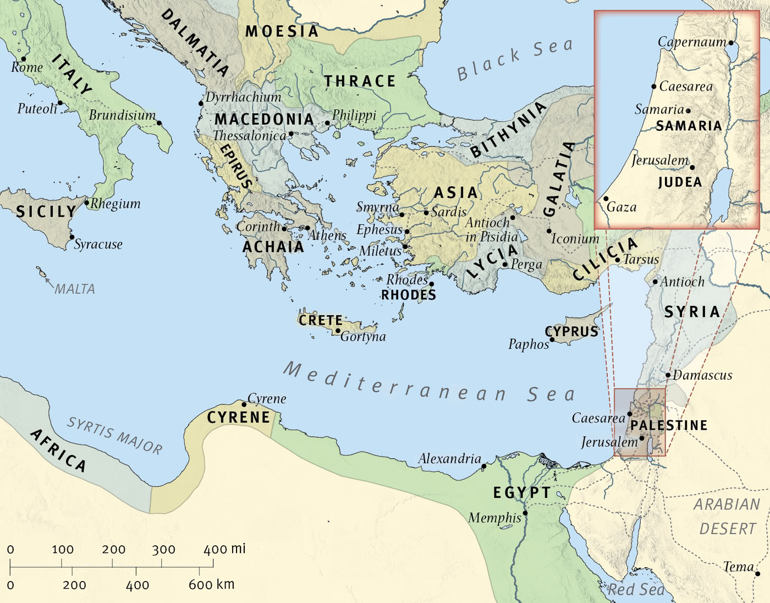
The Wide World

Slide 3

Corinth

Slide 4
6 I have applied all these things to myself and Apollos for your benefit, brothers, that you may learn by us not to go beyond what is written, that none of you may be puffed up in favor of one against another. 7 For who sees anything different in you? What do you have that you did not receive? If then you received it, why do you boast as if you did not receive it?
(I Corinthians 4:6-7, ESV)

Slide 5
8 Already you have all you want! Already you have become rich! Without us you have become kings! And would that you did reign, so that we might share the rule with you! 9 For I think that God has exhibited us apostles as last of all, like men sentenced to death, because we have become a spectacle to the world, to angels, and to men. 10 We are fools for Christ’s sake, but you are wise in Christ. We are weak, but you are strong. You are held in honor, but we in disrepute. 11 To the present hour we hunger and thirst, we are poorly dressed and buffeted and homeless, 12 and we labor, working with our own hands. When reviled, we bless; when persecuted, we endure; 13 when slandered, we entreat. We have become, and are still, like the scum of the world, the refuse of all things.
(I Corinthians 4:8-13, ESV)

Slide 6
Main Point
These verses take away the metaphors and bring them face to face with the truth
The view reigning already contrasts the view of already but not yet
They believe they have attained the fullest riches of righteousness and can live however they desire
The Apostles struggle against this world and suffer in it for Christ.

Slide 7
Application Points
Be Humble
  From these verses to the end of the chapter most see Paul as being biting
  We ignore Paul’s points to our detriment
  These are significant truths that we should take seriously
  The first and foundational principle is in verses 6-7
  Paul’s point up to now has been that they own the teachers because they are owned by Christ
  They are not their own
  While they have ben given the gift of the Spirit, they have begun to think that it is something they have done
  The same is true of physical blessings
  Everything they have received is because of God
  There are those who believe they can do whatever they want with their money
  Those who believe they have put in the hard work therefore they can do whatever they want with their prosperity

Slide 8
Application Points
Be Humble (2)
  We are very libertarian in our thinking
  What is it that has caused you to be born where you are?
  How did it come to be that you weren’t born in a country where they force you to work for pennies a day?
  You were blessed by God to be born in a place where you don’t have to work 50 hours for pennies
  You have been blessed with even the possibility of working and receiving from the fruit of your labors
  The same is true with any knowledge you have received, any wisdom which has come to you
  In God’s providence He has placed you in the time and space which allows you to learn more about Him and His ways

Slide 9
Application Points
Be Humble (3)
  We squander the blessings God has given by focusing on the blessings or thinking we deserved them
  Yet, we have been blessed
  This doesn’t mean feel guilty over it
  Instead utilize the blessings for the reason they were given
  We have been blessed therefore have a responsibility to God to utilize the blessings well
  We are in constant tension
  We can believe…we have attained perfection
  We have attained the righteousness of Christ, yet we live and die in a place where there is tension between good and evil

Slide 10
Application Points
Be Humble (4)
  This tension is not only between the world outside and us, but also within
  We are tempted to do what is wrong, to do whatever we think is right in our own eyes
  We have allowed our liberty in Christ to cause us to think wrongly about liberty
  That freedom means you are free to finally do what is right versus what is wrong (See especially Romans 3-7)
  Prior to salvation we are slaves to sin and unrighteousness
  In salvation we are freed to live in the righteousness which has saved us
  True Christian liberty leads to following what is true and right found in the character of God

Slide 11
Application Points
Be Humble (5)
  We need to be cautious about over realized eschatology
  The apostolic understanding is the best, we are there but not yet
  While we live, we can do better and seek better by being obedient to Christ with our lives given now
  Doing what is right, doing what is in the truth, will not necessarily lead to what we consider “best”
  It may lead to us being mocked, scorned, and jeered
  As a bivocational pastor I can understand the sentiment
  I have heard joke upon joke
  Paul the tentmaker working among the slaves and how that looks to the world
  In all of this I could become bitter
  I have learned more about God through these experiences
  If I can do even an ounce of good and speak truth then it will be worth it

Slide 12
Application Points
Be Humble (6)
  I have learned how to endure
  No one should feel guilty over not having to learn these hard lessons
  The Corinthians are blessed, you may be blessed as well
  It is possible in speaking the truth you will not experience these things
  We cannot possibly know the ramifications for following Christ
  It is possible you will find hardships, it is possible you will find blessings (both?)
  In the end our responsibility is to do what is right regardless of circumstances or results
  Our only concern is the Owner
  If people around us reject the message and laugh at us, then let us respond with grace, kindness, love, and patience
  If we receive blessing then let us be thankful to remember where the blessing comes from

Slide 13
Application Points
Be Humble (7)
  This is how it all comes back around
  We are to remain humble no matter the circumstance
  Everything we have, our entire existence, and all things that make up that existence, are because of God
  We can continue to seek faithfulness above all, by proclaiming the truth, and living in the truth
  We need to be shocked out of our complacency
  We need to be reminded who we are, and who God is
  Be humble before God, for He is truly God Almighty, worthy of all glory from all that He has created, including us

Slide 14
Application Points
The Gospel of Christ
  Origins
    Where we began
  Fall
    What went wrong
  Redemption
    How it is fixed
  Glorification
    Where it at leads

