Slide 1
I Corinthians 3:18-23
All Are Yours

Slide 2

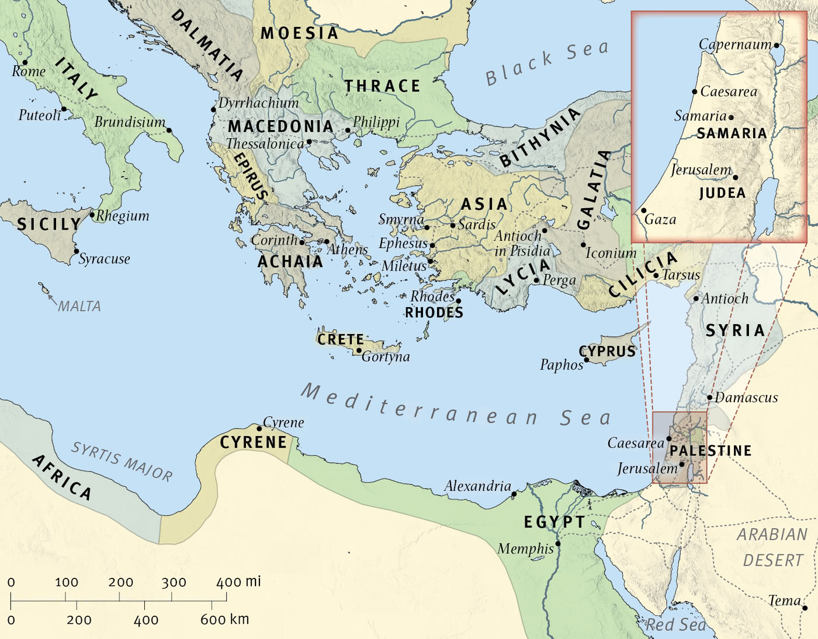
The Wide World

Slide 3

Corinth

Slide 4
18 Let no one deceive himself. If anyone among you thinks that he is wise in this age, let him become a fool that he may become wise. 19 For the wisdom of this world is folly with God. For it is written, “He catches the wise in their craftiness,” 20 and again, “The Lord knows the thoughts of the wise, that they are futile.” 21 So let no one boast in men. For all things are yours, 22 whether Paul or Apollos or Cephas or the world or life or death or the present or the future—all are yours, 23 and you are Christ’s, and Christ is God’s.
(I Corinthians 3:18-23, ESV)

Slide 5
Main Point
These verses bring may threads of Paul’s argument together
All the congregation belongs to Christ
To identify with one leader makes no sense since all belong to Christ
They bind themselves to the leaders as though the leaders own them
The leaders belong to the congregation, which belongs to Christ, who belongs to God

Slide 6
Application Points
All Are Yours
  Something we have, likely, talked about before is a logical fallacy which permeates our culture
  The fallacy is the “genetic fallacy”
  Let’s say politically with legislation
  A Democrat proposed it? It’s a lie
  A Republican? It’s evil
  The ancients were a backwards people
  Therefore anything they say about God is wrong
  We as Baptists might say anything a Methodist says is false
  Methodist will do the same
  Pentecostals and Charismatics the same [insert any denomination]
  Over and over the genetic fallacy comes into play
  The reason why it is a fallacy is that where a truth claim originates does not negate the claim itself
  Truth is true regardless of where it comes from

Slide 7
Application Points
All Are Yours (2)
  When Paul says, “All is yours” we should be encouraged by the news
  We do not need to put truth in a box
  I am sure reading Wesley will lead me to finding some insight into the truth
  The same is true for Charismatics and Pentecostals
  If what they say about a particular topic is true, then I can accept that truth even if it doesn’t stem from my own tradition
  This is true even more broadly in the world
  Humans are made in the image of God and are capable of proclaiming some amount of truth
  The world is capable of coming to certain truths about the reality God has made

Slide 8
“22 So Paul, standing in the midst of the Areopagus, said: “Men of Athens, I perceive that in every way you are very religious. 23 For as I passed along and observed the objects of your worship, I found also an altar with this inscription: ‘To the unknown god.’ What therefore you worship as unknown, this I proclaim to you. 24 The God who made the world and everything in it, being Lord of heaven and earth, does not live in temples made by man, 25 nor is he served by human hands, as though he needed anything, since he himself gives to all mankind life and breath and everything. 26 And he made from one man every nation of mankind to live on all the face of the earth, having determined allotted periods and the boundaries of their dwelling place, 27 that they should seek God, and perhaps feel their way toward him and find him. Yet he is actually not far from each one of us, 28 for
“‘In him we live and move and have our being’;
as even some of your own poets have said,
“‘For we are indeed his offspring.’
(Acts 17:22-28, ESV)

Slide 9
Application Points
All Are Yours (3)
  Both are quotations from Greek poets
  “In him we live and move and have our being” comes from a hymn to Zeus by Epimenides of Crete
  “‘For we are indeed his offspring’ comes from the poem Phainomena by the Stoic poet Aratus.
  Why was Paul quoting Greek poets?
  All things belong to Christians, because all Christians belong to Christ who belongs to God
  Paul recognizes what is true because he has the truth of God and His Christ and can compare his experiences in the world against this foundation
  Paul doesn’t agree with the pagans that Zeus exists
  It is all founded upon Jesus Christ and the God who has revealed Himself through Christ and the Scriptures
  I could use a more modern example
  There is a song from Alanis Morissette which has stuck with me called “Princes Familiar”

Slide 10
First Chorus: “Papa, love your princess, So that she will find loving princes familiar. Papa, cry for your princess, So that she will find gentle princes familiar.”
Second Chorus: “Papa, listen to your princess So that she will find attentive princes familiar. Papa, hear your princess so that she will find curious princes familiar.”
Final Chorus: “Papa, laugh with your princess So that she will find funny princes familiar. Papa, respect your princess So that she will find respectful princes familiar. Papa, love your princess So that she will find loving princes familiar. Papa, cry for your princess So that she will find gentle princes familiar.”
-Alanis Morissette

Slide 11
Application Points
All Are Yours (4)
  It is blatantly true
  Our daughters will be influenced by their fathers
  If we treat them poorly they will seek that out
  Make good things familiar that way she can see them in someone else and know that person does care for her
  Do I agree with her on anything else? I doubt it
  This is a reflection of the Proverbs and what God calls me to be as a father
  I am sure there are times in the art world you can think, “That sounds awfully Christian”
  We know where the truth comes from and we rejoice
  We weep because what they are trying so hard to attain they keep missing for something else
  We could use another example
  Friedrich Nietzsche was a German philosopher in the 1800’s
  Whenever I hear or read his parable of the madman I can’t help but conclude he hit on the truth

Slide 12
Have you not heard of that madman who lit a lantern in the bright morning hours, ran to the market place, and cried incessantly: "I seek God! I seek God!" -- As many of those who did not believe in God were standing around just then, he provoked much laughter. Has he got lost? asked one. Did he lose his way like a child? asked another. Or is he hiding? Is he afraid of us? Has he gone on a voyage? emigrated? -- Thus they yelled and laughed.

Slide 13
The madman jumped into their midst and pierced them with his eyes. "Whither is God?" he cried; "I will tell you. We have killed him -- you and I. All of us are his murderers. But how did we do this? How could we drink up the sea? Who gave us the sponge to wipe away the entire horizon? What were we doing when we unchained this earth from its sun? Whither is it moving now? Whither are we moving? Away from all suns? Are we not plunging continually? Backward, sideward, forward, in all directions? Is there still any up or down? Are we not straying, as through an infinite nothing? Do we not feel the breath of empty space? Has it not become colder? Is not night continually closing in on us? Do we not need to light lanterns in the morning? Do we hear nothing as yet of the noise of the gravediggers who are burying God? Do we smell nothing as yet of the divine decomposition? Gods, too, decompose. God is dead. God remains dead. And we have killed him.

Slide 14
"How shall we comfort ourselves, the murderers of all murderers? What was holiest and mightiest of all that the world has yet owned has bled to death under our knives: who will wipe this blood off us? What water is there for us to clean ourselves? What festivals of atonement, what sacred games shall we have to invent? Is not the greatness of this deed too great for us? Must we ourselves not become gods simply to appear worthy of it? There has never been a greater deed; and whoever is born after us -- for the sake of this deed he will belong to a higher history than all history hitherto."

Slide 15
Here the madman fell silent and looked again at his listeners; and they, too, were silent and stared at him in astonishment. At last he threw his lantern on the ground, and it broke into pieces and went out. "I have come too early," he said then; "my time is not yet. This tremendous event is still on its way, still wandering; it has not yet reached the ears of men. Lightning and thunder require time; the light of the stars requires time; deeds, though done, still require time to be seen and heard. This deed is still more distant from them than most distant stars -- and yet they have done it themselves.
It has been related further that on the same day the madman forced his way into several churches and there struck up his requiem aeternam deo. Led out and called to account, he is said always to have replied nothing but: "What after all are these churches now if they are not the tombs and sepulchers of God?"
-Friedrich Nietzsche

Slide 16
Application Points
All Are Yours (5)
  The idea that God is dead, or nothing more than a myth, causes the human race to deal with the significant loss of purpose, value, meaning, and morals
  If God is dead we have no foundation for any of these things
  We drift aimlessly in nothingness
  He knew it would lead to the 21st century becoming the “bloodiest in history.”
  Two devastating world wars, the rise of communistic totalitarianism, the extermination of hundreds of millions
  The logical conclusion of having no meaning, purpose, value, or morals leads humans to nothing more than cattle to be used for those in power
  What does this have to do with anything?
  It has to do with the fact that we could commit the genetic fallacy
  The Bible points repeatedly to societies which reject God and it leads to what Nietzsche described

Slide 17
Application Points
All Are Yours (6)
  As Christians we are going to encounter things in this world
  We do not need to accept every truth claim
  But we can know that it is from God we can know truth
  This leads back to what Paul states, “Whether Paul or Apollos or Cephas or the world or life or death or the present or the future—all are yours.”
  Everything in this world is ours not because we are so great or grand but because we belong to Christ
  So…

Slide 18
So, we can read Moses, we can read the prophets, we can read the writings of the Old Testament, we can read the Gospels, we can read the letters of the Apostles in the New Testament, we can read the Church fathers like Origen, Tertullian, Augustine, the Cappadocians, we can read the authors of the middle ages like Bernard of Clairvaux , Francis of Assisi, and Aquinas and Lombard, we can read the Reformers like Luther, Zwingli, Calvin, Simmons, we can read the post-reformers like Bunyon, Rutherford, Whitfield, the Wesleys, we can read more recent authors such as Chesterton, Lewis, Schaefer, or even closer to our own time with Plantinga, Craig, Moreland, Sproul, Packer, Piper, Macarthur, and the list goes on.

Slide 19
Application Points
All Are Yours (7)
  We can read them because they belong to us
  We can check them against a greater authority which is the Scriptures
  It goes to the world around us
  Something we have considered before is that this world is morally neutral
  There is nothing intrinsically evil about electricity, computers, phones, guns [insert invention]
  All things can be utilized by a moral agent for either moral or immoral purposes
  They are all ours
  We can utilize any tool, any resource, any invention
  Everything in this world belongs to God and can be utilized by us to glorify Him
  The warning is do not let them control you

Slide 20
Application Points
All Are Yours (8)
  We can read them because they belong to us
  We can check them against a greater authority which is the Scriptures
  It goes to the world around us
  Something we have considered before is that this world is morally neutral
  There is nothing intrinsically evil about electricity, computers, phones, guns [insert invention]
  All things can be utilized by a moral agent for either moral or immoral purposes
  They are all ours
  We can utilize any tool, any resource, any invention
  Everything in this world belongs to God and can be utilized by us to glorify Him
  The warning is do not let them control you
  Because we belong to Christ we can accomplish so many amazing things, utilizing the blessings for their ultimate purpose which is to glorify God

Slide 21
“19 For the creation waits with eager longing for the revealing of the sons of God. 20 For the creation was subjected to futility, not willingly, but because of him who subjected it, in hope 21 that the creation itself will be set free from its bondage to corruption and obtain the freedom of the glory of the children of God. 22 For we know that the whole creation has been groaning together in the pains of childbirth until now.”
(Romans 8:19-22, ESV)

Slide 22
Application Points
All Are Yours (9)
  Nature, creation, were subjected to us
  Even creation hates darkness
  It wants to be utilized to the glory of it’s Creator for good
  We know what is good, just, and righteous because we know God
  In our own time we can begin to utilize these things for this purpose
  This is why we train ourselves
  We can see the truth in this world, and we can utilize this world for the truth
  It is not that all things are ours in some selfish way
  Christ is the owner, and He has given us the opportunity to glorify Him
  If we belong to Jesus all things are ours
  Let us seek to utilize what God has given for His glory
  Seeking to be the ones this whole world has waited for
  All are yours
  It all belongs to us
  Let’s not squander it in sin, but instead, seek to honor God in all these things

Slide 23
Application Points
The Gospel of Christ
  Origins
    Where we began
  Fall
    What went wrong
  Redemption
    How it is fixed
  Glorification
    Where it at leads

