Slide 1
I Corinthians 3:16-17
The Holy Temple of God

Slide 2

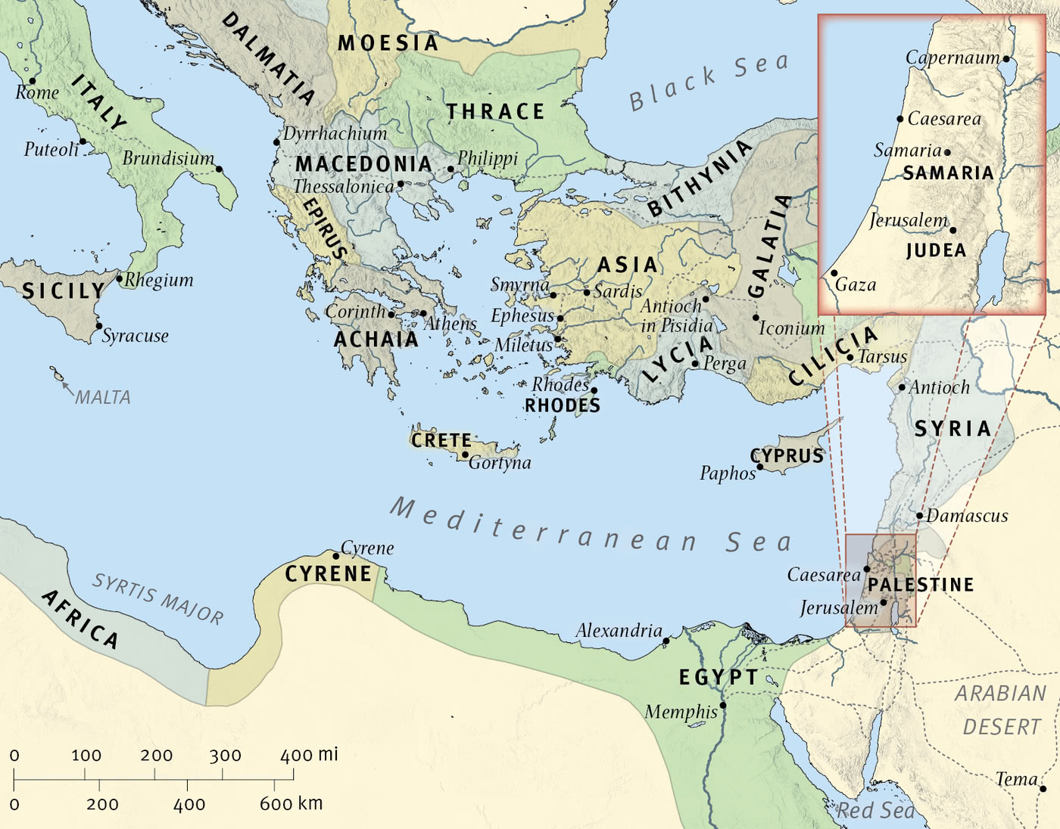
The Wide World

Slide 3

Corinth

Slide 4
16 Do you not know that you are God’s temple and that God’s Spirit dwells in you? 17 If anyone destroys God’s temple, God will destroy him. For God’s temple is holy, and you are that temple.
(I Corinthians 3:16-17, ESV)

Slide 5
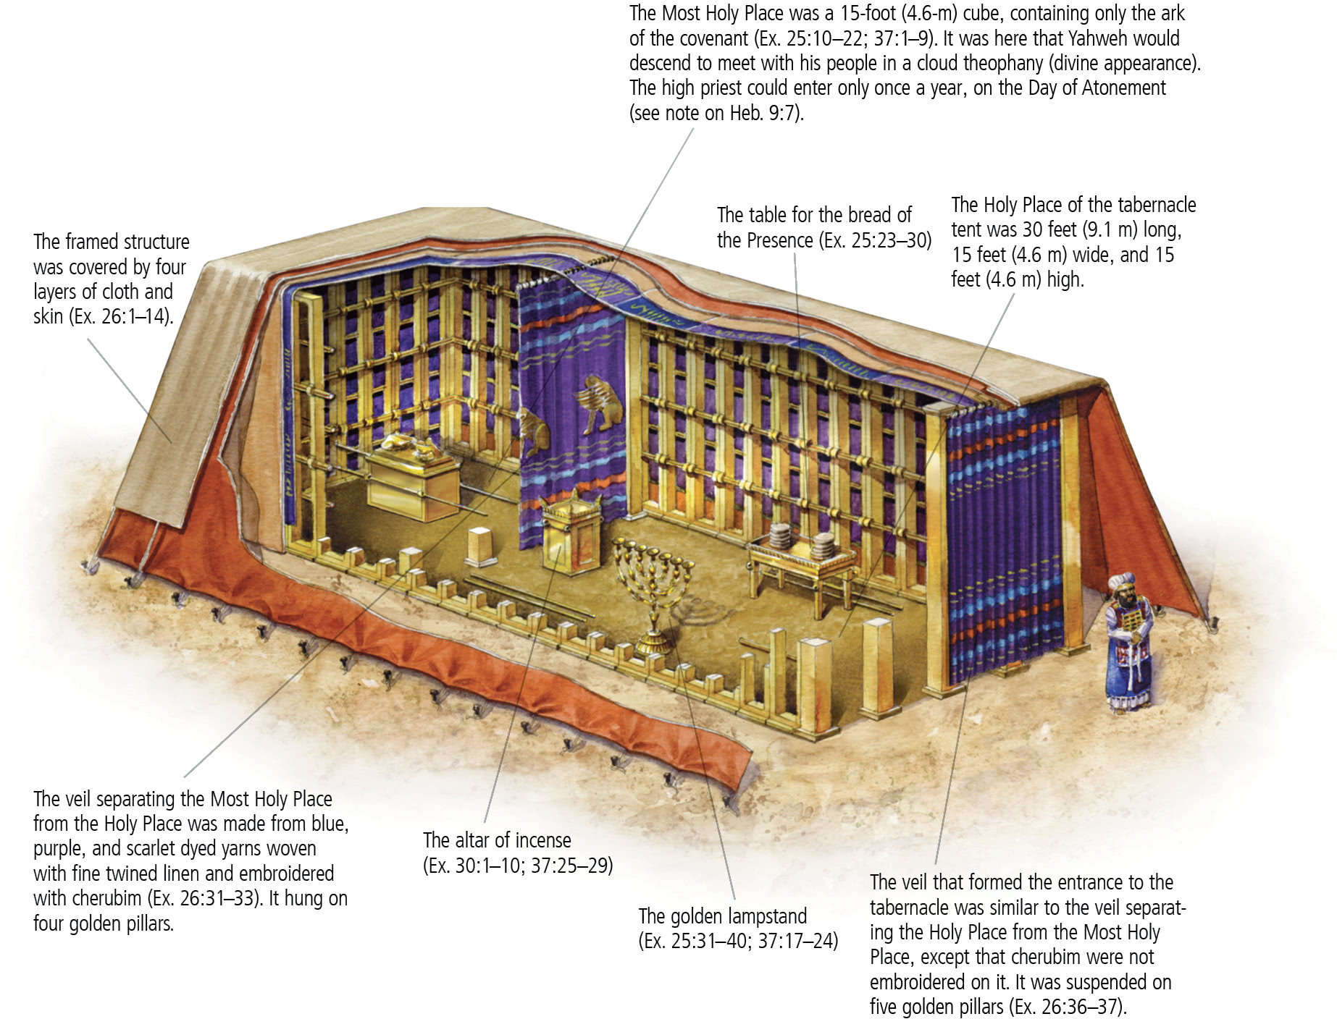
Corinth

Slide 6
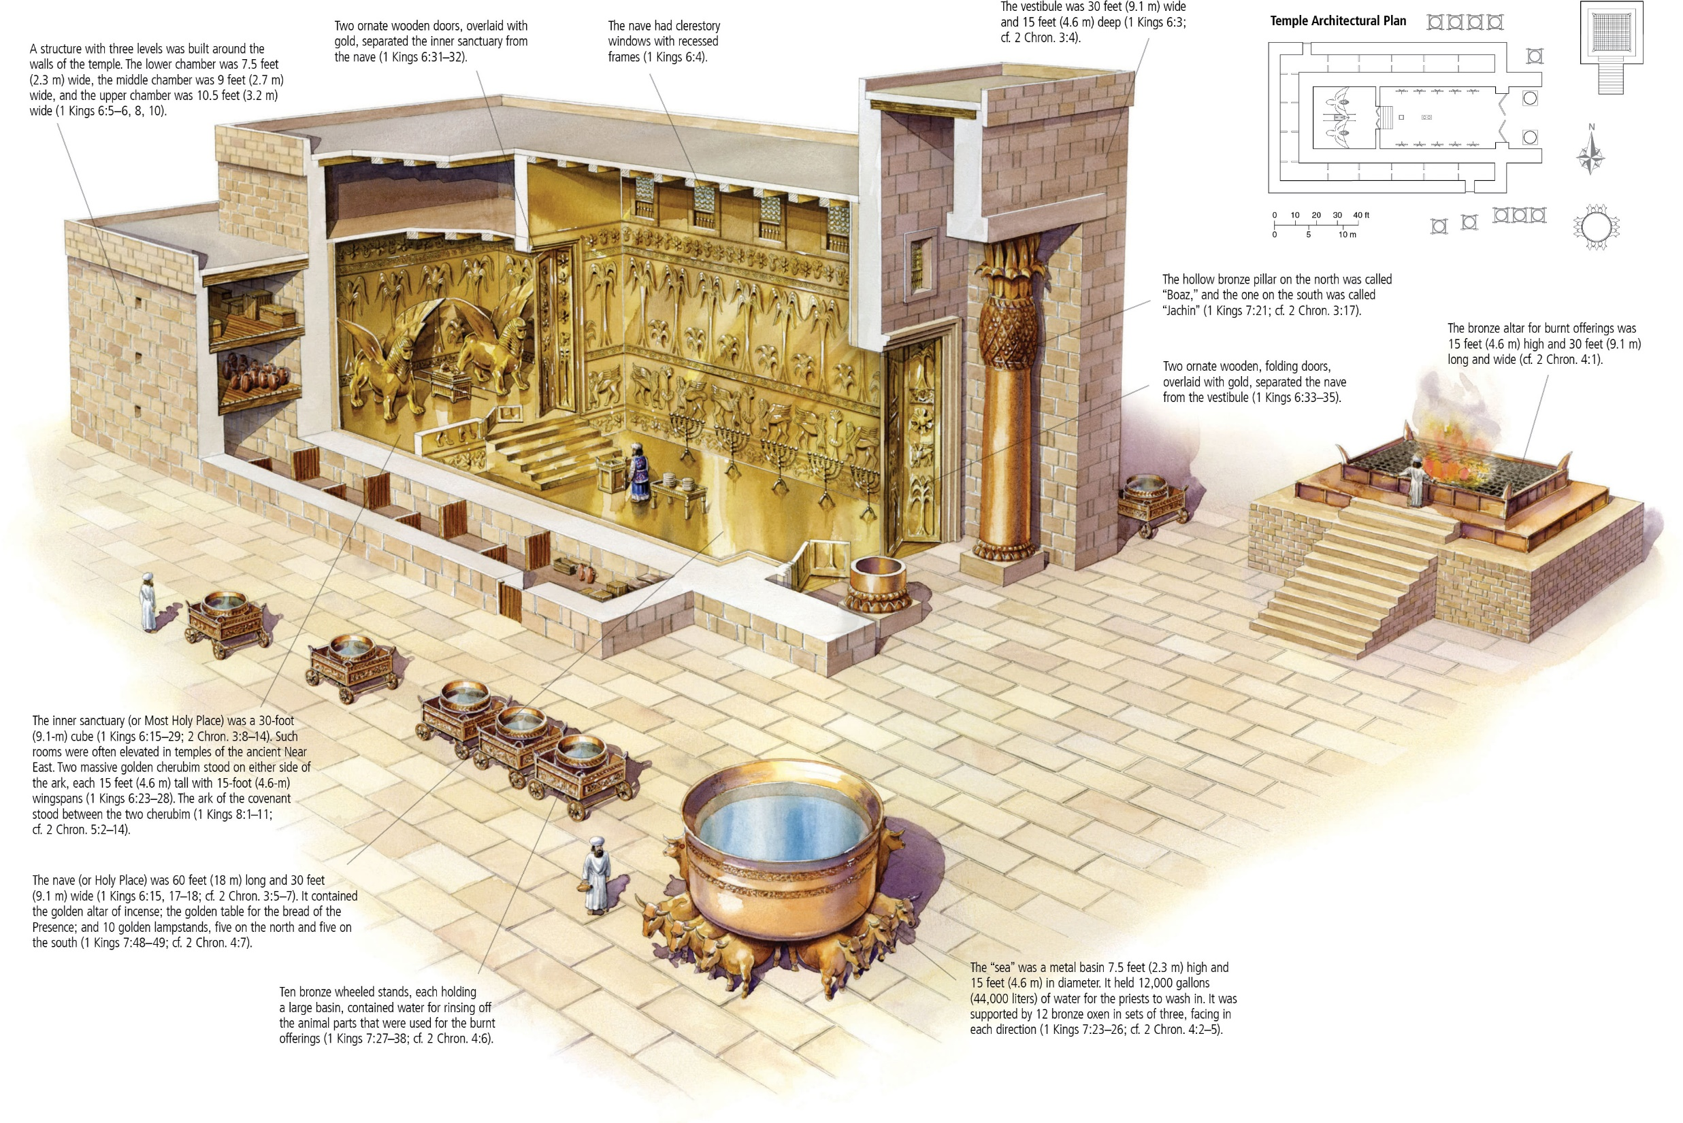
Corinth

Slide 7
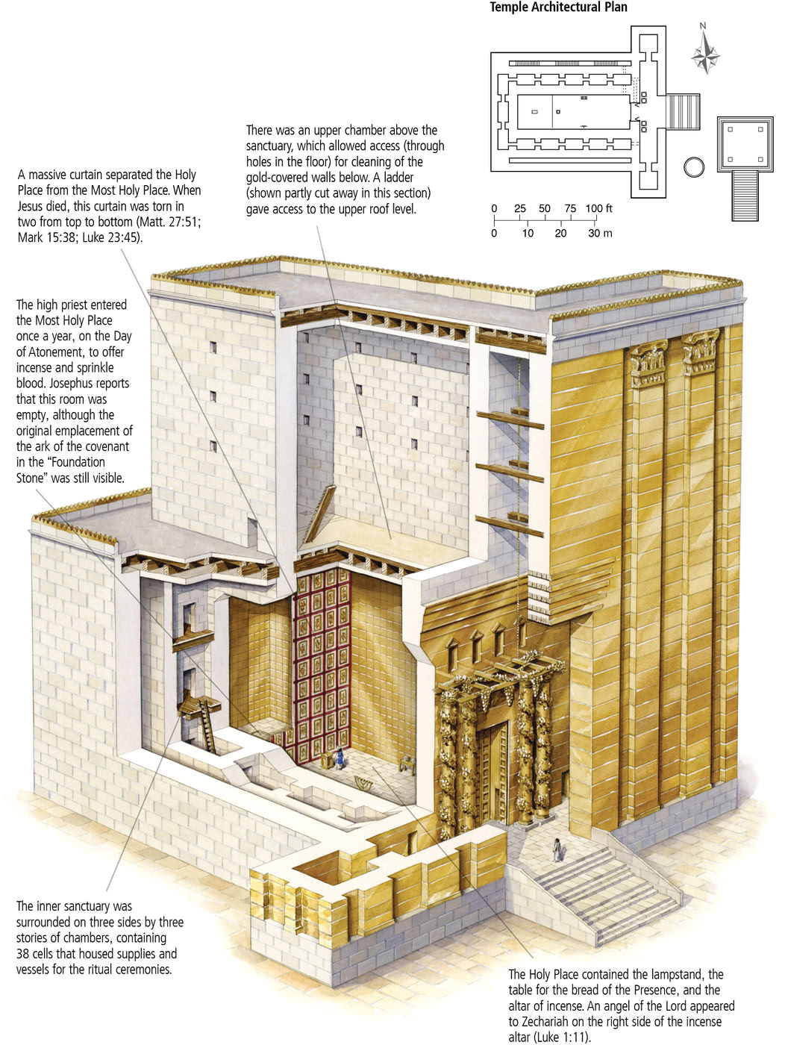
Corinth

Slide 8
16 Do you not know that you are God’s temple and that God’s Spirit dwells in you? 17 If anyone destroys God’s temple, God will destroy him. For God’s temple is holy, and you are that temple.
(I Corinthians 3:16-17, ESV)

Slide 9
Main Point
These verses describe the type of building the Corinthians are
They are the very temple of God
Those who continue seeking to abolish the foundation will find themselves abolished by God
God’s temple is holy, so too are they

Slide 10
Application Points
The holy temple of God
  Throughout the 20th century it would be possible to preach a sermon on individualism and the dangers
  We still hold onto this individualism
  We must be accepting of all things including bad ideas and beliefs
  Yet we also live in a culture that desperately desires community
  We see it in politics to musical preferences
  The high degree of individual has not…will not…eradicate the desperate desire to be in community
  We have had a hard time reconciling the fact that each person’s body is the temple of God…and that the fellowship is as well
  There are many who prefer the individualistic side
  They believe their relationship with God is enough
  We have often forgotten that the person who is saved should desire a strong community where they can grow in this salvation

Slide 11
Application Points
The holy temple of God (2)
  This is the definition of the local Church
  If I have the Spirit of God in me, and you have the Spirit of God in you, then together we have the Spirit among us
  Why are we so hesitant with the local Church?
  We think of the dangers of the papacy and priesthood
  What if in focusing so greatly on the individual in fear of such a dominating force we have failed to properly appreciate the message Paul gives today?
  What if we have pushed people right into the arms of the world?
  The world offers community as well
  It was religiously, politically, philosophically
  The world is ripe to offer community

Slide 12
Application Points
The holy temple of God (3)
  In contrast to this world, however, there is another community
  A community which seeks to build what will last, seeks growth through obedience and faithfulness
  It is called a holy temple of God because God dwells within it
  Are we seeking to emulate this God who is holy?
  When others come, do they encounter God?
  We have seen the need to be responsible…together
  To be the holy temple of God…together
  To desire to honor God…together
  It takes a community seeking God together for this temple to be secure
  It requires us to recognize who we are instead
  We are not some dark or dim lit structure
  We have this great light of the Holy Spirit within us
  What do we have to fear from each other in our struggles?
  What have to we to fear in our various gifts?
  What have we to fear from the world outside?

Slide 13
Application Points
The holy temple of God (4)
  Together we are the temple of God Almighty
  It is because God has bestowed His Spirit upon us that makes it so
  Nothing can stand against the power of God
  This love of God conquers all
  You are a temple, the Spirit is in you
  We remember that we together form the temple of God
  It means God has brought us together not for some unforeseen purpose
  What a joy we have in knowing that our great God is here with us even now!
  We are called to be part of this holy assembly
  Knowing we are the holy temple of God

Slide 14
Application Points
The Gospel of Christ
  Origins
    Where we began
  Fall
    What went wrong
  Redemption
    How it is fixed
  Glorification
    Where it at leads

