Slide 1
I Corinthians 3:5-9
Spiritual Growth

Slide 2

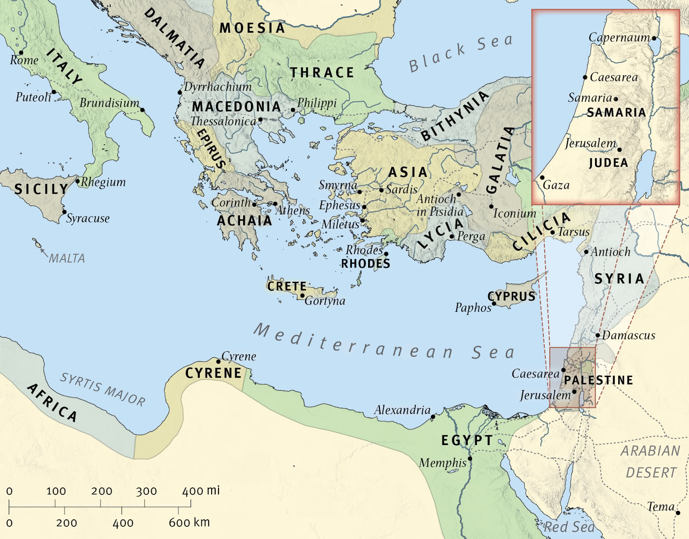
The Wide World

Slide 3

Corinth

Slide 4
5 What then is Apollos? What is Paul? Servants through whom you believed, as the Lord assigned to each. 6 I planted, Apollos watered, but God gave the growth. 7 So neither he who plants nor he who waters is anything, but only God who gives the growth. 8 He who plants and he who waters are one, and each will receive his wages according to his labor. 9 For we are God’s fellow workers. You are God’s field, God’s building.
(I Corinthians 3:5-9, ESV)

Slide 5
Main Point
No Church leader has the right to claim any sort of following
Both the laborer (leadership) and the field (congregation) belong to God
The growth that comes is from God alone

Slide 6
Application Points
Spiritual Growth
  In America we have been blessed with influence and affluence
  This ease has even bled its way into our spirituality
  Once we had an association meeting
  He had been on sabbatical and went to a European nation
  He studied their growth
  He created a program which emulated what he learned
  While there he learned to create fire in a new way
  By following the program we will have fire in our congregations again

Slide 7
Application Points
Spiritual Growth (2)
  Not only the American Baptists but all denominations and Churches seem to be having issues with attendance and growth
  Our response is to set up a program
  We can change issues by making a different plan
  Physically (getting in shape, taking meds, having surgery)
  Financially (talking to a specialist, plans/programs to achieve goals)
  If we have the right model…then we will see the growth we desire
  We heed the words of others in order to come up with some system
  We read the experts books
  We will follow their blog posts and their Facebook pages

Slide 8
Application Points
Spiritual Growth (3)
  Do not doubt that God has blessed these congregations
  The concern is missing the forest for the tree
  Another regional pastor was focused greatly on missions trips
  I asked why he was so sure that everyone should go on a missions trip?
  The justification for continued missions trips was that it caused something good
  I responded with, “Shouldn’t we be asking why people need to get away from our congregations in order to have this growth?”
  “Maybe there is something wrong with our congregations and what we are doing and teaching?”
  He just shrugged

Slide 9
Application Points
Spiritual Growth (4)
  RC Sproul one time answered a question similar to, “What is a concern for the modern Church?”
  His response was to reflect on the final sermon of Martin Luther
  Luther warned about the dangers of relics
  A relic would be nails from the cross, bones of the apostles, milk from the breast of Mary
  The belief was these relics had power
  Sproul then said that was the danger, the concern, for the Church
  Not in relics, but the program
  By seeking the right program we will finally have power and true Spiritual growth
  This leads to the important question
  “How can we have true Spiritual growth?”
  “Where can growth be found?”

Slide 10
Application Points
Spiritual Growth (5)
  Paul does not expect Apollos to do everything Paul did
  Paul recognizes something and that is how each leader is gifted and then utilizing their gifts faithfully
  It isn’t going to be in a program, but whether or not we are being faithful to our callings
  Not everyone is gifted in teaching/preaching or called to this particular aspect of ministry
  Some pastors are better at vision, some pastors are better at outreach
  I trust by being faithful to my calling there will be growth within the congregation
  To be in line with the Scriptures and proclaim what God has entrusted to us, the Gospel
  Growth comes not because Paul is more like Apollos…growth comes because both are fulfilling their callings faithfully
  If this is the case with the greatest leaders of the Church, how much more will it be the truth for each of us?
  I have a responsibility to God to lead in truth

Slide 11
Application Points
Spiritual Growth (6)
  This may be a reason why Paul begins the letter with Church leadership
  He can set up the reality for everyone else within the congregation
  There is a “program”
  We are going to be faithful in what we are called to be
  We are going to encourage everyone to be faithful in what they are called to be
  By seeking God’s grace and wisdom through faith, we trust we will see the growth God has promised
  You want to grow as a Christian?
  You want to grow as a congregation?
  Be faithful. That’s it.
  It might lead to new things, praise the Lord!
  Praise the Lord that He has given us a simple program to follow
  Be faithful to God, and you will find true spiritual growth

Slide 12
Application Points
The Gospel of Christ
  Origins
    Where we began
  Fall
    What went wrong
  Redemption
    How it is fixed
  Glorification
    Where it at leads

