Slide 1
I Corinthians 2:6-16
True Spiritual Wisdom

Slide 2

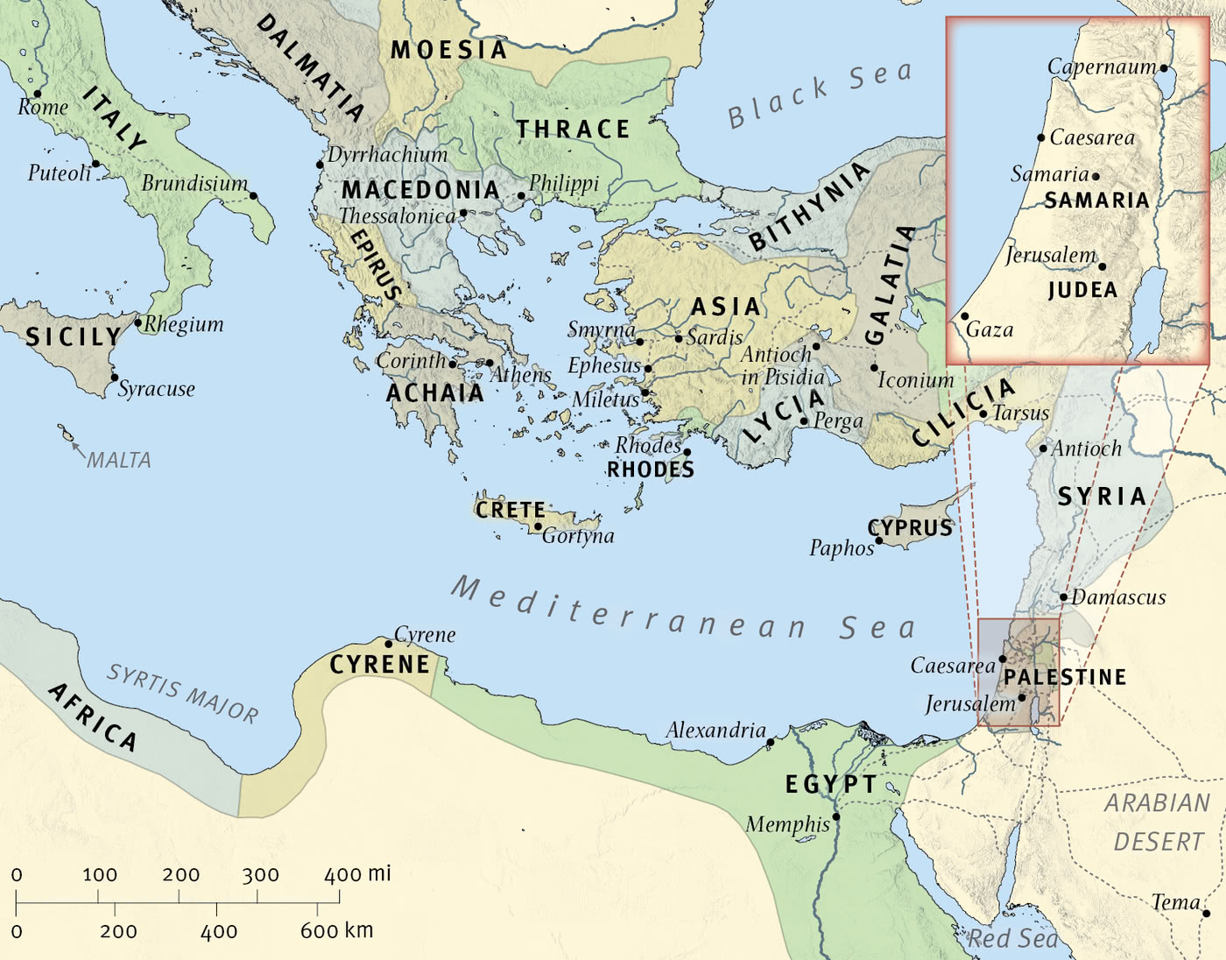
The Wide World

Slide 3

Corinth

Slide 4
6 Yet among the mature we do impart wisdom, although it is not a wisdom of this age or of the rulers of this age, who are doomed to pass away. 7 But we impart a secret and hidden wisdom of God, which God decreed before the ages for our glory. 8 None of the rulers of this age understood this, for if they had, they would not have crucified the Lord of glory. 9 But, as it is written,
“What no eye has seen, nor ear heard,
nor the heart of man imagined,
what God has prepared for those who love him”—
(I Corinthians 2:6-9, ESV)

Slide 5
10 these things God has revealed to us through the Spirit. For the Spirit searches everything, even the depths of God. 11 For who knows a person’s thoughts except the spirit of that person, which is in him? So also no one comprehends the thoughts of God except the Spirit of God. 12 Now we have received not the spirit of the world, but the Spirit who is from God, that we might understand the things freely given us by God. 13 And we impart this in words not taught by human wisdom but taught by the Spirit, interpreting spiritual truths to those who are spiritual.
(I Corinthians 2:10-13, ESV)

Slide 6
14 The natural person does not accept the things of the Spirit of God, for they are folly to him, and he is not able to understand them because they are spiritually discerned. 15 The spiritual person judges all things, but is himself to be judged by no one. 16 “For who has understood the mind of the Lord so as to instruct him?” But we have the mind of Christ.
(I Corinthians 2:14-16, ESV)

Slide 7
Main Point
These verses show the difference between the world and the Spirit of God
Those who have the Spirit are gaining more understanding into the mind of God
The wisdom attained is not from this world, but God Himself from the Spirit concerning the crucified Christ

Slide 8
Application Points
True Spiritual Wisdom
  Some conclude those who belong to the Spirit are “super spiritual people”
  Paul is emphasizing there is a transformation which occurs
  It is all focused on the truth of the Gospel of Jesus Christ
  In this current age we can either follow the wisdom of this world, or the wisdom of God Almighty
  The “world” represents the ways of the world
  “Power” is the ability to accomplish something
  This world claims to be able to accomplish much
  All that matters is the “power” to do what one wants to do
  There is a spiritual element because false beliefs play their part (like divine energies from crystals)
  This is the way of the spirit of the world

Slide 9
Application Points
True Spiritual Wisdom (2)
  It is no surprise then that Paul would say that the wisdom of this world is coming to nothing
  If I believe something which is not true, then I believe in nothing because it does not actually exist
  If I believe in something and trust in the wisdom of the world to…give life or liberty…in the end it will come to nothing because the world cannot do what it claims
  If we contrast this with what we learn today we will find a complete alternative in the Gospel of Jesus
  The Spirit comes upon those who believe and they can discern what is real
  The truths we speak every week is not a matter of being wise enough to understand, but whether God has given His Spirit to understand these truths

Slide 10
Application Points
True Spiritual Wisdom (3)
  We do not need any greater amount of deeper truth
  All we really need to know is God
  I know I do not understand everything perfectly
  The more I walk with God the more truth I come to understand
  The more it causes me to love Jesus who saves
  The way of the world is all about you
  The way of the Spirit is all about Jesus Christ
  With God He does accomplish what He sets out to do
  We know this because we understand the height, and depth, and width of the love of God through Jesus

Slide 11
Application Points
True Spiritual Wisdom (4)
  Be warned against falling prey to anything that would cause you to turn away from Jesus
  Be warned against the wisdom of this world
  I know it can be hard to believe that this world is coming to nothing
  Many of us see that hideous strength of darkness
  In the end of all things those who belong to Christ are being ushered into glory
  All the ways of the world can never attain the glory of God which lasts forever
  We have the truth, and we have hope
  God gifts us with the Spirit, and with this comes true Spiritual Wisdom to understand God
  Praise God for His Spirit

Slide 12
Application Points
The Gospel of Christ
  Origins
    Where we began
  Fall
    What went wrong
  Redemption
    How it is fixed
  Glorification
    Where it at leads

