Slide 1
I Corinthians 1:18-25
Salvation in Folly and Weakness

Slide 2

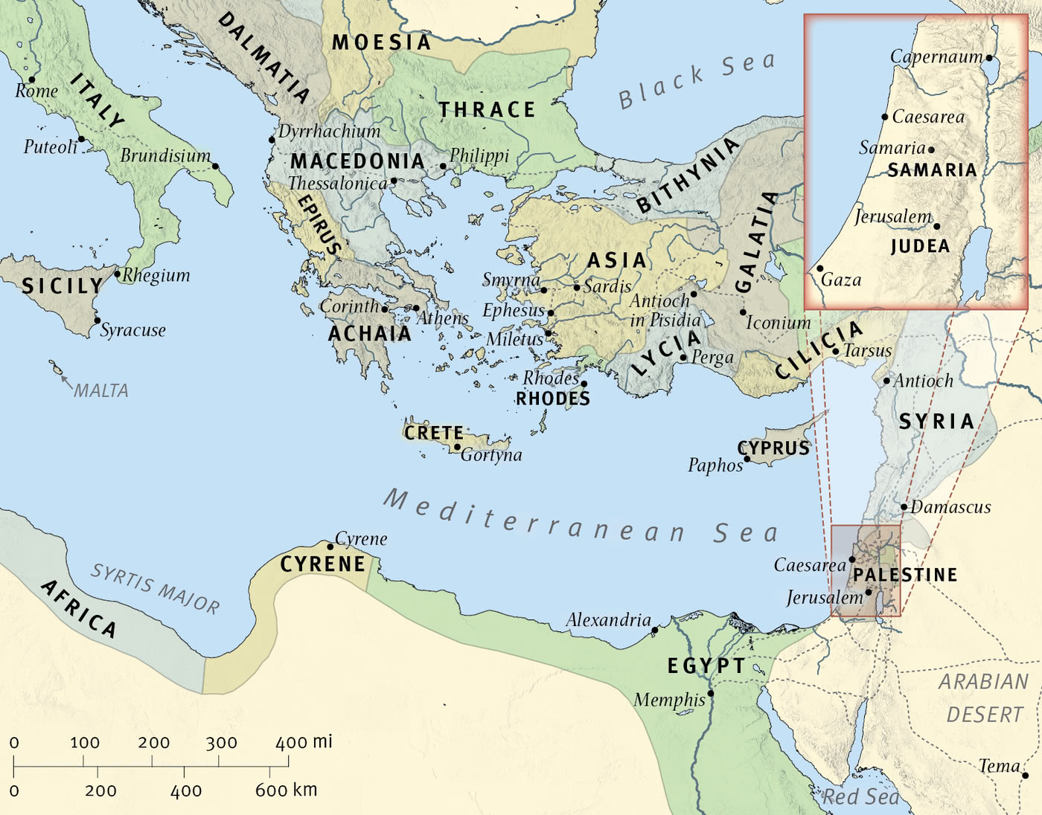
The Wide World

Slide 3

Corinth

Slide 4
18 For the word of the cross is folly to those who are perishing, but to us who are being saved it is the power of God. 19 For it is written, “I will destroy the wisdom of the wise, and the discernment of the discerning I will thwart.”
20 Where is the one who is wise? Where is the scribe? Where is the debater of this age? Has not God made foolish the wisdom of the world? 21 For since, in the wisdom of God, the world did not know God through wisdom, it pleased God through the folly of what we preach to save those who believe. 22 For Jews demand signs and Greeks seek wisdom, 23 but we preach Christ crucified, a stumbling block to Jews and folly to Gentiles, 24 but to those who are called, both Jews and Greeks, Christ the power of God and the wisdom of God. 25 For the foolishness of God is wiser than men, and the weakness of God is stronger than men.
(I Corinthians 1:18-25, ESV)

Slide 5
For the word of the cross is folly to those who are perishing, but to us who are being saved it is the power of God.
(I Corinthians 1:18, ESV)

Slide 6
For it is written, “I will destroy the wisdom of the wise, and the discernment of the discerning I will thwart.”
(I Corinthians 1:19, ESV)

Slide 7
Where is the one who is wise? Where is the scribe? Where is the debater of this age? Has not God made foolish the wisdom of the world?
(I Corinthians 1:20, ESV)

Slide 8
For since, in the wisdom of God, the world did not know God through wisdom, it pleased God through the folly of what we preach to save those who believe.
(I Corinthians 1:21, ESV)

Slide 9
22 For Jews demand signs and Greeks seek wisdom, 23 but we preach Christ crucified, a stumbling block to Jews and folly to Gentiles, 24 but to those who are called, both Jews and Greeks, Christ the power of God and the wisdom of God.
(I Corinthians 1:22-24, ESV)

Slide 10
For the foolishness of God is wiser than men, and the weakness of God is stronger than men.
(I Corinthians 1:25, ESV)

Slide 11
Main Point
These verses present an argument against the rhetorical wisdom in Corinth
God has brought salvation not by human ingenuity
Instead He has done it through what is considered foolish and weak…the cross of Christ
God has accomplished what was not even possible for the best of humanity to achieve

Slide 12
Application Points
Salvation in Folly and Weakness
  This displays the understanding of the Apostles concerning the cross of Christ
  When Paul declares the cross…it is shorthand for the whole purpose of God concerning salvation
  This Gospel is folly and weakness to the eyes of the world
  All we need to do is look at the wise, the scribe, and the debater in our own time
  The wise, the modern day sages, tell us the way to salvation is through personal happiness
  We are in need of being set free from anything that would cause us to be unhappy

Slide 13
Application Points
Salvation in Folly and Weakness (2)
  Whether naturalist, classical liberal, and onward to the sexual revolutionists religion was the problem
  We couldn’t always follow our own happiness because we had a right and wrong when it came to life
  This was atrocious because it purposefully limited human freedom
  The sexual revolution comes to mind with the rise of all kinds of sexual immoral lifestyles
  Interestingly enough such sexual freedom was not unknown in ancient times
  The only difference is that today we do not have sex to appease the goddess Athena, but instead on the altar of personal liberation and happiness

Slide 14
Application Points
Salvation in Folly and Weakness (3)
  Even moreso we have let go of truth
  We allow people to believe whatever they want as long as it makes them happy
  The self is the ultimate, and nothing should stop it
  To be utterly free is the greatest salvation we can achieve…so says the wise
  What about the Scribe?
  We have seen the scientist and futurist encourage humanity ever onward to that promised land of biological and technical achievement
  Trans (change) human (human persons)
  Through technology we will find our greatest salvation
  Salvation through human technological progress

Slide 15
Application Points
Salvation in Folly and Weakness (4)
  For the debater, salvation is found in politics
  The right representatives, the right president, the right policy
  Salvation through human political power
  Imagine a world where we have selfish people with almost unending technological progress dedicating themselves to politics
  It is the wisdom of the world to look at these different places for our salvation
  Has selfishness brought about any lasting salvation?
  When I am focused only on myself I tend to not have enough and always want more

Slide 16
Application Points
Salvation in Folly and Weakness (5)
  Where does morality play into this?
  What if someone found personal happiness in polluting?
  Or an individual who was only happy when causing others harm?
  Has the endless search for personal happiness brought about anyone's salvation?
  What about technology?
  There are many who credit technology with the rise of all sorts of psychological malfunction
  Has technology brought about the great salvation?
  Should we even ask about politics?
  Has such a salvation come from the political world?

Slide 17
Application Points
Salvation in Folly and Weakness (6)
  These are ways the world promises salvation
  It never can achieve what it claims
  Do you know what has not failed?
  What has caused the greatest salvation is not found in human selfishness, human ingenuity, or political powers, but in the cross
  When compared to the ways of the world it is utter folly and weakness
  The Gospel claims we are incapable of achieving our own salvation
  He does this by selflessly carrying the burden of sin and death

Slide 18
“21 From that time Jesus began to show his disciples that he must go to Jerusalem and suffer many things from the elders and chief priests and scribes, and be killed, and on the third day be raised. 22 And Peter took him aside and began to rebuke him, saying, “Far be it from you, Lord! This shall never happen to you.” 23 But he turned and said to Peter, “Get behind me, Satan! You are a hindrance to me. For you are not setting your mind on the things of God, but on the things of man.”

Slide 19
24 Then Jesus told his disciples, “If anyone would come after me, let him deny himself and take up his cross and follow me. 25 For whoever would save his life will lose it, but whoever loses his life for my sake will find it. 26 For what will it profit a man if he gains the whole world and forfeits his soul? Or what shall a man give in return for his soul? 27 For the Son of Man is going to come with his angels in the glory of his Father, and then he will repay each person according to what he has done. 28 Truly, I say to you, there are some standing here who will not taste death until they see the Son of Man coming in his kingdom.”
(Matthew 16:21-28, ESV)

Slide 20
Application Points
Salvation in Folly and Weakness (7)
  The apostles were thinking in the ways of the world
  Yet it would be through death that salvation would come and bring transformation
  This salvation would lead to them not activing selfishly, but selflessly
  They would live for God
  To desire what is good, right, and just and seek it in this world
  In all this we do not want to be misled
  These things are not necessarily of this world
  Paul is showing us that these things are not capable of providing what we need which is salvation

Slide 21
Application Points
Salvation in Folly and Weakness (8)
  The world will claim what we believe is folly and weakness
  “For the word of the cross is folly to those who are perishing, but to us who are being saved it is the power of God.”
  We rejoice because we recognize this salvation brought about by the power of God through Christ is the greatest power for it actually does what it claims
  It also reminds us that the scope of salvation is greater than we often realize
  Paul shows us that these things are not capable of providing the salvation we need
  Once we recognize this and turn toward Christ, then we can utilize these things to follow God
  In this way the salvation of Christ extends to these things as well, so that as we are being saved so too are our pursuits in these areas

Slide 22
Application Points
Salvation in Folly and Weakness (9)
  Thus as Christians we seek wisdom, knowledge, and what is good for society
  The Christian understands none of these things are good or bad in and of themselves but relying on them to do what they cannot we will fall into the ways of the world
  Christ crucified is our foundation
  Without Him we would still be seeking the ways of the world to find salvation
  Because of this supposed folly and weakness, we find God’s own wisdom and power

Slide 23
Application Points
The Gospel of Christ
  Origins
    Where it begins
  Fall
    What went wrong
  Redemption
    How it is fixed
  Glorification
    Where it at leads

