Slide 1
I Corinthians 1:10-17
Schism of a Lesser Kind

Slide 2

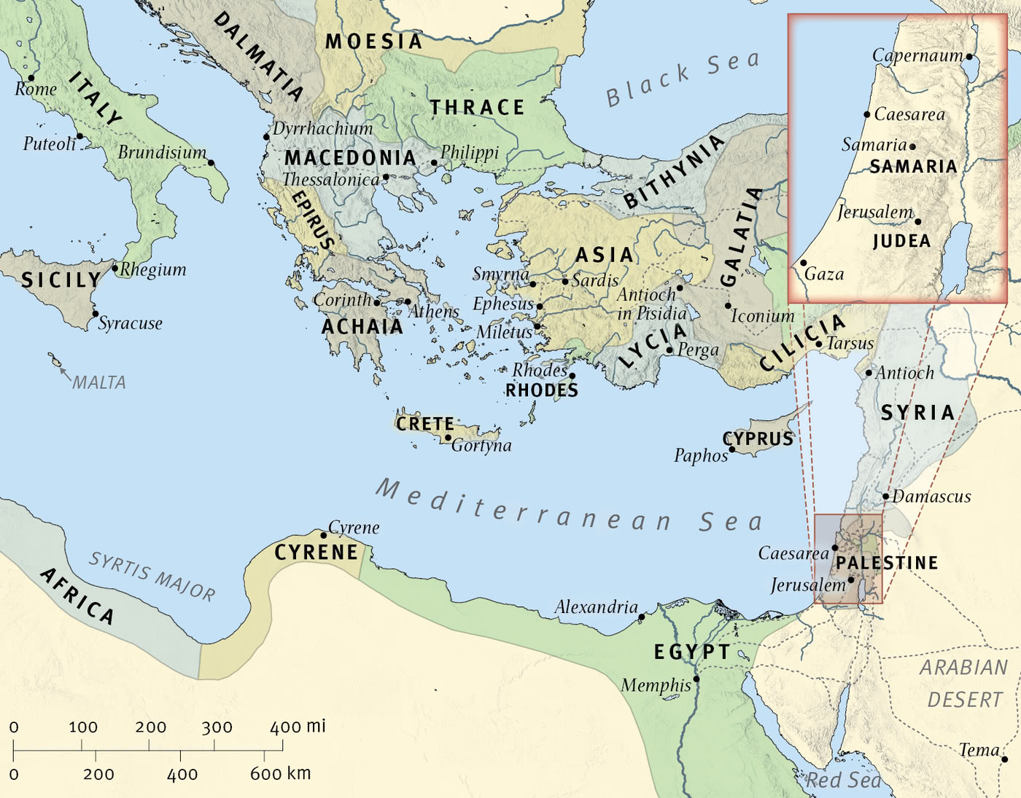
The Wide World

Slide 3

Corinth

Slide 4
10 I appeal to you, brothers, by the name of our Lord Jesus Christ, that all of you agree, and that there be no divisions among you, but that you be united in the same mind and the same judgment. 11 For it has been reported to me by Chloe’s people that there is quarreling among you, my brothers. 12 What I mean is that each one of you says, “I follow Paul,” or “I follow Apollos,” or “I follow Cephas,” or “I follow Christ.” 13 Is Christ divided? Was Paul crucified for you? Or were you baptized in the name of Paul? 14 I thank God that I baptized none of you except Crispus and Gaius, 15 so that no one may say that you were baptized in my name. 16 (I did baptize also the household of Stephanas. Beyond that, I do not know whether I baptized anyone else.) 17 For Christ did not send me to baptize but to preach the gospel, and not with words of eloquent wisdom, lest the cross of Christ be emptied of its power.
(I Corinthians 1:10-17, ESV)

Slide 5
I appeal to you, brothers, by the name of our Lord Jesus Christ, that all of you agree, and that there be no divisions among you, but that you be united in the same mind and the same judgment.
(I Corinthians 1:10, ESV)

Slide 6
For it has been reported to me by Chloe’s people that there is quarreling among you, my brothers.
(I Corinthians 1:11, ESV)

Slide 7
What I mean is that each one of you says, “I follow Paul,” or “I follow Apollos,” or “I follow Cephas,” or “I follow Christ.”
(I Corinthians 1:12, ESV)

Slide 8
Is Christ divided? Was Paul crucified for you? Or were you baptized in the name of Paul?
(I Corinthians 1:13, ESV)

Slide 9
I thank God that I baptized none of you except Crispus and Gaius, so that no one may say that you were baptized in my name.
(I Corinthians 1:14-15, ESV)

Slide 10
(I did baptize also the household of Stephanas. Beyond that, I do not know whether I baptized anyone else.)
(I Corinthians 1:16, ESV)

Slide 11
For Christ did not send me to baptize but to preach the gospel, and not with words of eloquent wisdom, lest the cross of Christ be emptied of its power.
(I Corinthians 1:17, ESV)

Slide 12
Main Point
These verses describe the schism occurring in the Corinthian Church
It seems to be focused on leadership
Paul reminds them that this is nonsensical since all are bound to Christ

Slide 13
Application Points
Schism of a Lesser Kind
  Schisms have happened throughout Church history
  We hope and pray that the schisms which have occurred would one day be mended through Christ
  We want to be cautious not to assume that the schism is based on theological differences
  There are many who say…our denominations are an example of the schism here
  There is no evidence that there was some teaching that was causing the divisions to occur
  We know they agreed in doctrine
  They all knew the truth
  We can rule out theology is the issue
  Instead the issue seems to be a focus on persona

Slide 14
Application Points
Schism of a Lesser Kind (2)
  In Corinth we know they held a high view when it comes to rhetoric and personal prominence
  The sway of the crowd was more important than the truth
  They are finding leaders who appeal to them…identifying with the leader
  This is seen when Paul describes baptism
  An individual who has a special affinity for Paul above any other teacher
  To Paul this is a schism of a lesser kind because all the leaders are in accord in Christ

Slide 15
Application Points
Schism of a Lesser Kind (3)
  How can we refrain from such schism?
  There are ways to guard ourselves and each other from allowing ourselves to be deceived
  First: We cannot cling to any one particular leader’s persona
  Our congregation is filled with leaders
  I should be thankful for all the leaders we do have and what they each bring to the table
  Second: Do not think too highly of our preachers (including me!)
  Love us by walking with us, praying for us, and reminding us of the Gospel
  Proclaim the truth to us as we seek to proclaim the truth to you

Slide 16
Application Points
Schism of a Lesser Kind (4)
  Third: We can seek the truth
  Are our leaders proclaiming the truth?
  If we are seeking the truth then we can be thankful for the many different leaders because our goal is…to adhere to the truth
  All of the leaders throughout Church history can offer us something if they proclaim the truth, and so it is today
  Finally: We are not alone
  We are called to fellowship with each other
  Some are teachers and preachers and God has given them to us to learn from
  They need the gifts and abilities God has given to each other person
  We rejoice in what God has done through Christ for each of us personally and how that overflows corporately

Slide 17
Application Points
Schism of a Lesser Kind (5)
  “Finally, brothers, whatever is true, whatever is honorable, whatever is just, whatever is pure, whatever is lovely, whatever is commendable, if there is any excellence, if there is anything worthy of praise, think about these things.” Philippians 4:8, ESV
  These are what we should be judging our leaders by
  If they do, praise God for this!
  Schisms are bound to occur
  Let us be divided over what is true rather than the persona
  Let us cling ever more to the truth of God
  Knowing He will keep us from the schism of a lesser kind

Slide 18
Application Points
The Gospel of Christ
  Origins
    Where it begins
  Fall
    What went wrong
  Redemption
    How it is fixed
  Glorification
    Where it at leads

