Slide 1
I Corinthians 1:4-9
The Space Between

Slide 2

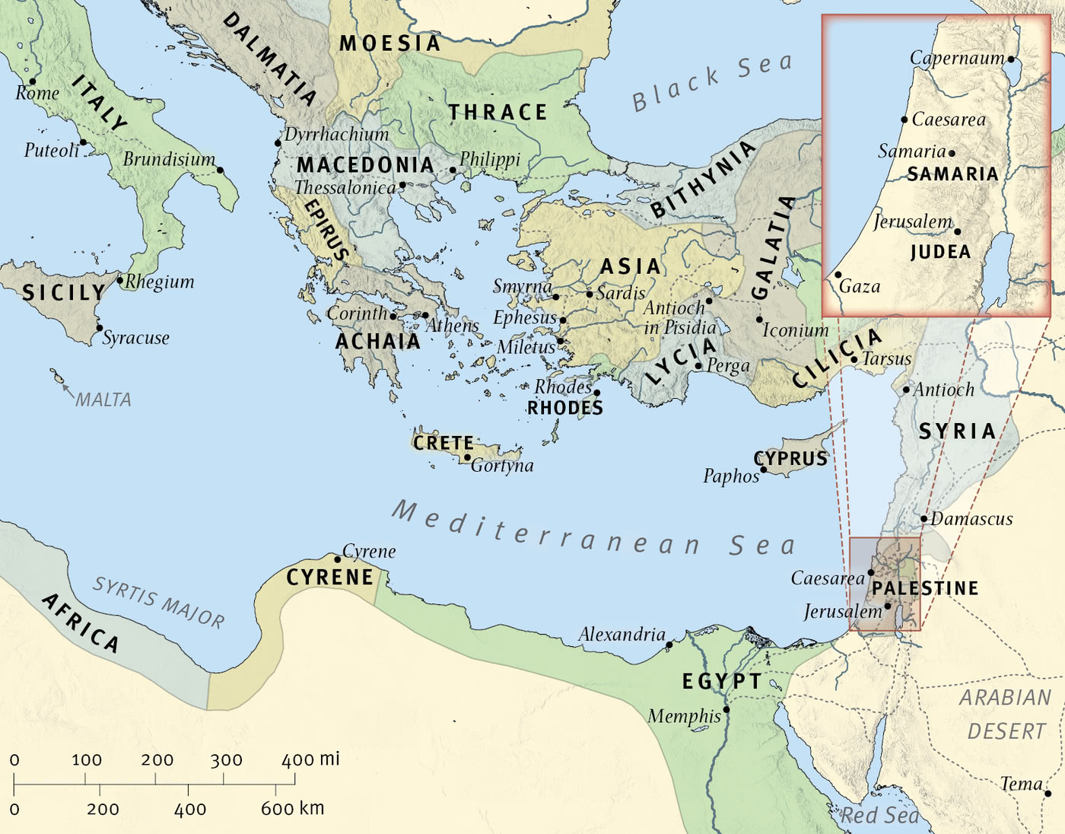
The Wide World

Slide 3

Corinth

Slide 4
4 I give thanks to my God always for you because of the grace of God that was given you in Christ Jesus, 5 that in every way you were enriched in him in all speech and all knowledge— 6 even as the testimony about Christ was confirmed among you— 7 so that you are not lacking in any gift, as you wait for the revealing of our Lord Jesus Christ, 8 who will sustain you to the end, guiltless in the day of our Lord Jesus Christ. 9 God is faithful, by whom you were called into the fellowship of his Son, Jesus Christ our Lord.
(I Corinthians 1:4-9, ESV)

Slide 5
I give thanks to my God always for you because of the grace of God that was given you in Christ Jesus,
(I Corinthians 1:4, ESV)

Slide 6
that in every way you were enriched in him in all speech and all knowledge—
(I Corinthians 1:5, ESV)

Slide 7
even as the testimony about Christ was confirmed among you—
(I Corinthians 1:6, ESV)

Slide 8
so that you are not lacking in any gift, as you wait for the revealing of our Lord Jesus Christ,
(I Corinthians 1:7, ESV)

Slide 9
who will sustain you to the end, guiltless in the day of our Lord Jesus Christ.
(I Corinthians 1:8, ESV)

Slide 10
God is faithful, by whom you were called into the fellowship of his Son, Jesus Christ our Lord.
(I Corinthians 1:9, ESV)

Slide 11
Main Point
This portion offers thankfulness
The thanks given is to God
Specifically God’s grace given to them

Slide 12
Application Points
The Space Between
  Christ is very much the focus for Paul and the desire to honor Him above all else is apparent
  Christ is our ultimate foundation
  Without Jesus…we would still be in our sins and utter darkness
  The illumination Christ provides is worthy of rejoicing over
  We can be transformed into the likeness of Jesus by the power of the Holy Spirit within us
  Paul reminds us when the transformation begins
  It is the Gospel that ushers us into the kingdom of God
  That is also the first warning
  We forget that we have been changed here and now, and that right now we are in the kingdom of God

Slide 13
Application Points
The Space Between (2)
  Yet we recognize the great tension of being in the space between
  We have been saved from sin, yet we struggle with sin
  We have salvation from death, and yet we still die
  “Someone may have been saved (past) decisively from a sinking ship but as the lifeboat brings him or her through choppy, uncomfortable seas (present), the final safe landing on the solid shore lies still ahead (future).” –Thiselton, 99
  We are in the choppy waters
  We are in the struggle of the world in which darkness and light are in flux
  Despite the ability for us to go wrong even after the illumination of Christ…we can still be thankful
  It is when we focus off Christ and onto ourselves, we find our greatest problems occurring

Slide 14
Application Points
The Space Between (3)
  This is the case with many when it comes to congregations
  They will begin to let the cracks take up the whole
  Rejecting the Church as hypocrites
  It also leads to people separating themselves from the Church body
  They do not need the body of Christ, they do not need others in fellowship
  They believe they have made it to the shore, but they are still in the life boat
  Is this what Paul does, does he focus only on the cracks?
  He focuses on the good graces of God and gives thanks for the good knowing the good comes from God

Slide 15
Application Points
The Space Between (4)
  If only we could do the same
  Not a bland faulty love…that leads to death
  But love that sees God’s grace in others and trusting God’s ways lead to righteousness and life
  What about the individual who believes they do not need others?
  There is thankfulness over the corporate identity of the kingdom of God as there is the individual
  The “you” in these verses are the “you all” and “you all” have been enriched
  Each person being enriched in a particular way encouraging and blessing one another showing the faithfulness of God

Slide 16
Application Points
The Space Between (5)
  God has graced us with Himself personally, but He has also enriched us with each other
  We can remain humble recognizing we are not perfect in our own lives
  God has given us Himself and each other in order to help us in the space between
  “As you wait for the revealing of our Lord Jesus Christ, who will sustain you to the end.”
  We will be sustained through the person of Jesus who is with us
  If we take our eyes off Christ then we will be swallowed up in the cracks

Slide 17
Application Points
The Space Between (6)
  How do we know we will be sustained should we follow Christ?
  Because God is faithful
  We know Christ laid down His life for the glory of His Father which leads to our salvation, our fellowship, with Him and each other
  The space between is a hard place for us
  “O to grace how great a debtor daily I’m constrained to be, let Thy goodness like a fetter bind my wandering heart to thee, Prone to wander, Lord I feel it, prone to leave the God I love, here’s my heart, O, take and seal it, seal it for Thy courts above”
  If we are honest we will acknowledge we have such wandering hearts, yet by God’s grace in our humility He binds us to Himself

Slide 18
Application Points
The Space Between (7)
  As such we can know we are not alone
  We can give thanks because we know the way is secure
  It is in Him we find sanctification
  We have fellowship with Him, and each other
  The foreshadowing is clear
  We are going to be warned that we are not there yet, and that we are responsible day in and day out to walk humbly before our God
  The space between is a place such as this, a place of struggle, a place of failure, and a place of incredible victory and joy in Christ
  It is in Him we find our satisfaction
  Our God is faithful, and we rejoice knowing that this is true even in the space between

Slide 19
Application Points
The Gospel of Christ
  Origins
    Where it begins
  Fall
    What went wrong
  Redemption
    How it is fixed
  Glorification
    Where it at leads

