Slide 1
I Corinthians Bibliography

Slide 2
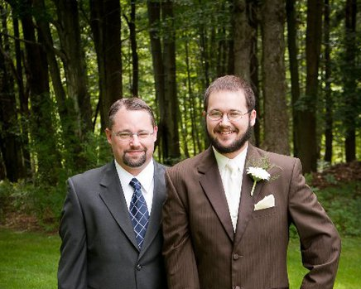
Carl Mosser
“I wanted to teach a class on Christian ethics, but the idea was rejected. Then I realized I Corinthians is basically Christian ethics. So here we are.”

Slide 3
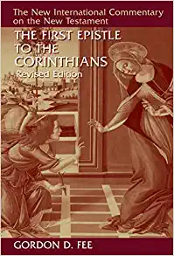
Fee, Gordon D. The First Epistle to the Corinthians Revised Edition, The New International Commentary on the New Testament, Eerdmans, 1987, 2014.

Slide 4
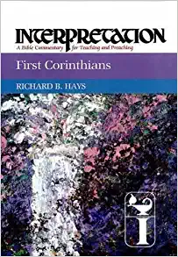
Hays, Richard B. First Corinthians, Interpretation A Biblical Commentary for Teaching and Preaching, Westminster John Knox Press, 1997, 2011.

Slide 5
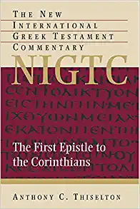
Thiselton, Anthony C. The First Epistle to the Corinthians, The New International Greek Testament Commentary. Eerdmans, 2000.

Slide 6
I Corinthians Bibliography
[Supplemental List]

Slide 7

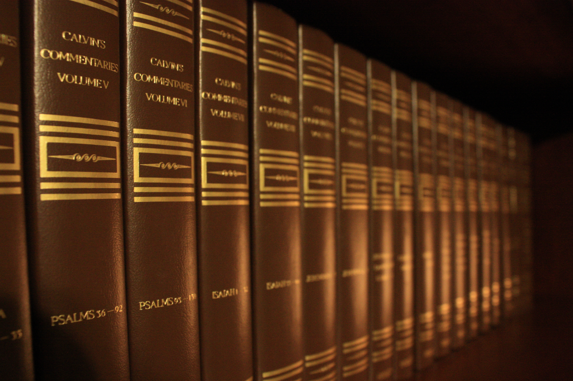
Calvin, John. Commentary on the Book of the Prophet Isaiah. Translated by Pringle, William. Baker Books. Reprinted 2009.

Slide 8

English Standard Version Study Bible. Crossway. 2012.

Slide 9
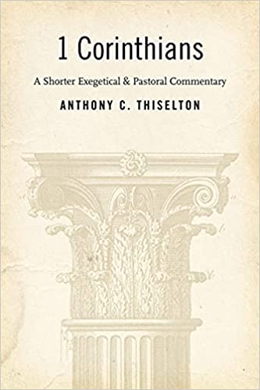
Thiselton, Anthony C. 1 Corinthians, A Shorter Exegetical & Pastoral Commentary, Eerdmans, 2006.

Slide 10
I Corinthians 1:1-3
Introduction to I Corinthians (Why Corinthians?)

Slide 11
1 Paul, called by the will of God to be an apostle of Christ Jesus, and our brother Sosthenes,
2 To the church of God that is in Corinth, to those sanctified in Christ Jesus, called to be saints together with all those who in every place call upon the name of our Lord Jesus Christ, both their Lord and ours:
3 Grace to you and peace from God our Father and the Lord Jesus Christ.
(I Corinthians 1:1-3, ESV)

Slide 12
Paul, called by the will of God to be an apostle of Christ Jesus, and our brother Sosthenes,
(I Corinthians 1:1, ESV)

Slide 13
Authorship
Concerning Paul
“But Saul was ravaging the Church, and entering house after house, he dragged off men and women and committed them to prison.” (Acts 8:3, ESV)
But Saul, still breathing threats and murder against the disciples of the Lord, went to the high priest 2 and asked him for letters to the synagogues at Damascus, so that if he found any belonging to the Way, men or women, he might bring them bound to Jerusalem.” (Acts 9:1-2, ESV)

Slide 14
Authorship
“3 Now as he went on his way, he approached Damascus, and suddenly a light from heaven shone around him. 4 And falling to the ground, he heard a voice saying to him, “Saul, Saul, why are you persecuting me?” 5 And he said, “Who are you, Lord?” And he said, “I am Jesus, whom you are persecuting. 6 But rise and enter the city, and you will be told what you are to do.” 7 The men who were traveling with him stood speechless, hearing the voice but seeing no one.” (Acts 9:3-7, ESV)
15 But the Lord said to him, “Go, for he is a chosen instrument of mine to carry my name before the Gentiles and kings and the children of Israel. 16 For I will show him how much he must suffer for the sake of my name.”
(Acts 9:15-16)

Slide 15
Authorship
“26 And when he had come to Jerusalem, he attempted to join the disciples. And they were all afraid of him, for they did not believe that he was a disciple. 27 But Barnabas took him and brought him to the apostles and declared to them how on the road he had seen the Lord, who spoke to him, and how at Damascus he had preached boldly in the name of Jesus. 28 So he went in and out among them at Jerusalem, preaching boldly in the name of the Lord. 29 And he spoke and disputed against the Hellenists. But they were seeking to kill him. 30 And when the brothers learned this, they brought him down to Caesarea and sent him off to Tarsus.” (Acts 9:26-30, ESV)

Slide 16
Authorship
“1 Now there were in the church at Antioch prophets and teachers, Barnabas, Simeon who was called Niger, Lucius of Cyrene, Manaen a lifelong friend of Herod the tetrarch, and Saul. 2 While they were worshiping the Lord and fasting, the Holy Spirit said, “Set apart for me Barnabas and Saul for the work to which I have called them.” 3 Then after fasting and praying they laid their hands on them and sent them off.” (Acts 13:1-3, ESV)

Slide 17
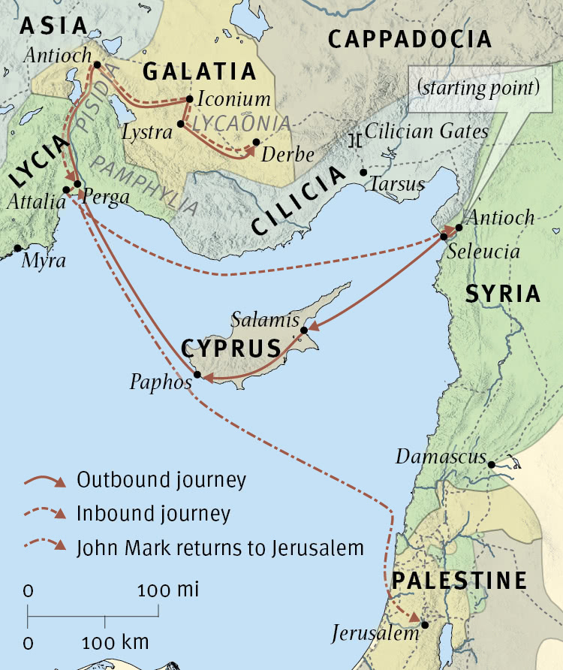
First Missionary Journey

Slide 18
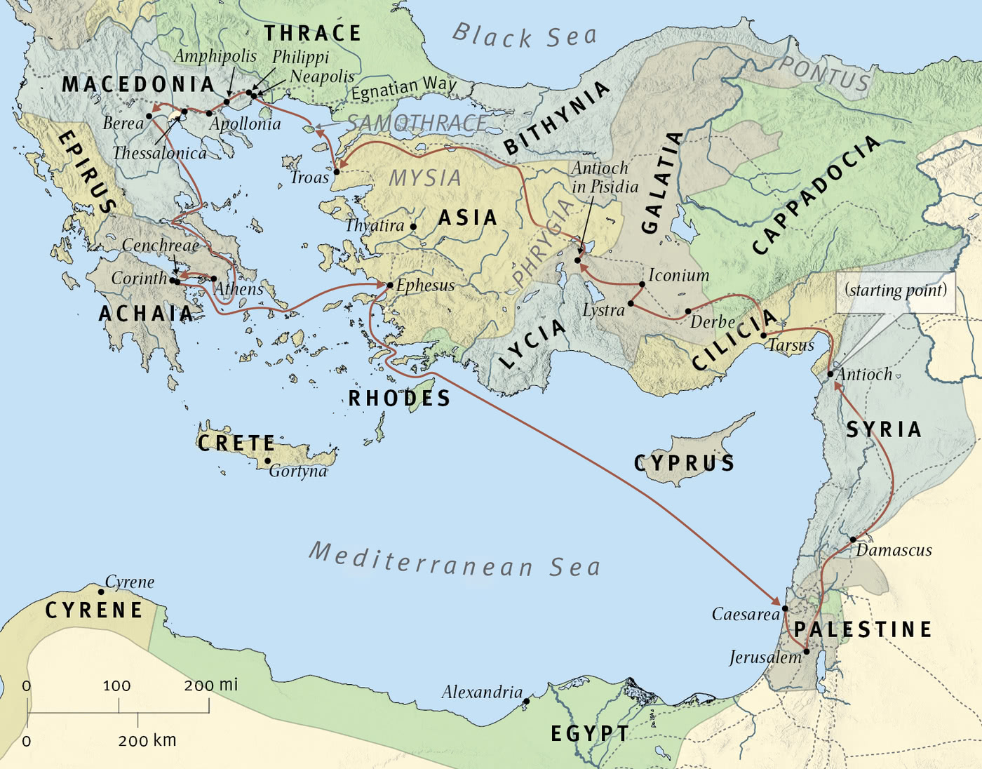
Second Missionary Journey

Slide 19
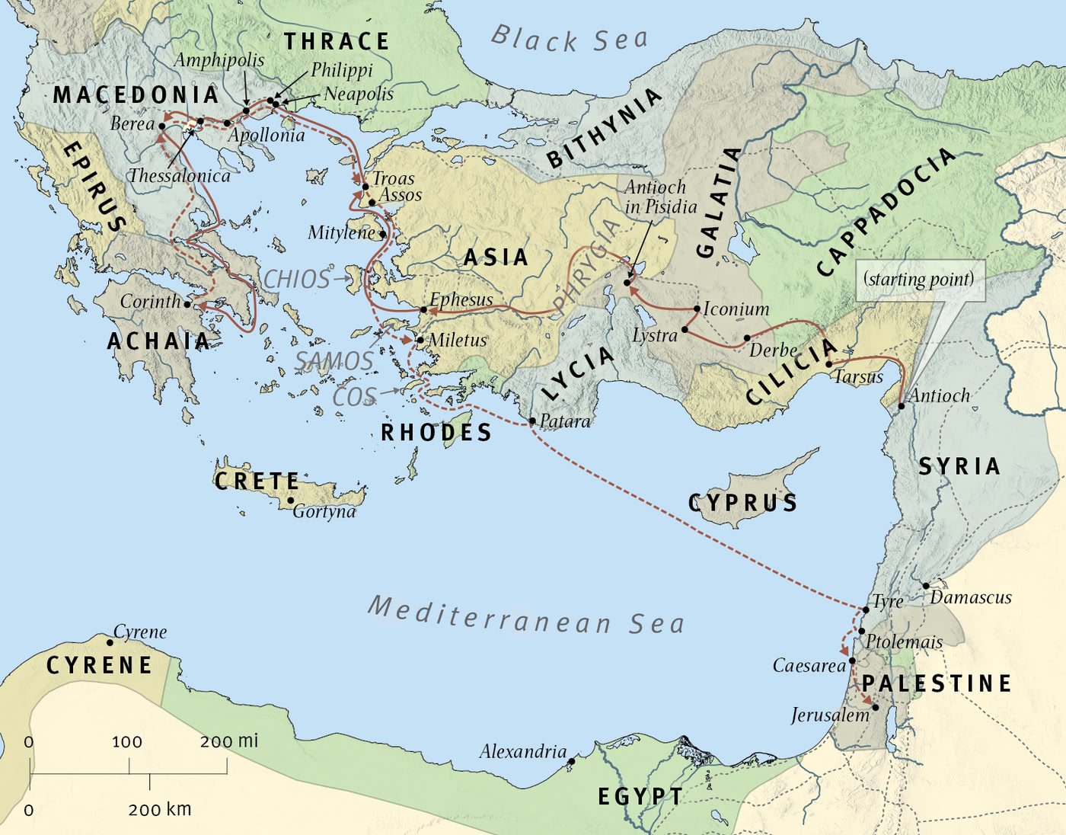
Third Missionary Journey

Slide 20
Authorship
But whatever anyone else dares to boast of—I am speaking as a fool—I also dare to boast of that. 22 Are they Hebrews? So am I. Are they Israelites? So am I. Are they offspring of Abraham? So am I. 23 Are they servants of Christ? I am a better one—I am talking like a madman—with far greater labors, far more imprisonments, with countless beatings, and often near death. 24 Five times I received at the hands of the Jews the forty lashes less one. 25 Three times I was beaten with rods. Once I was stoned. Three times I was shipwrecked; a night and a day I was adrift at sea; 26 on frequent journeys, in danger from rivers, danger from robbers, danger from my own people, danger from Gentiles, danger in the city, danger in the wilderness, danger at sea, danger from false brothers; 27 in toil and hardship, through many a sleepless night, in hunger and thirst, often without food, in cold and exposure. 28 And, apart from other things, there is the daily pressure on me of my anxiety for all the churches. 29 Who is weak, and I am not weak? Who is made to fall, and I am not indignant?
(II Corinthians 11:21a-29, ESV)

Slide 21
1 Paul, called by the will of God to be an apostle of Christ Jesus, and our brother Sosthenes,
(I Corinthians 1:1, ESV)

Slide 22
Authorship
Sosthenes
“If it were a matter of wrongdoing or vicious crime, O Jews, I would have reason to accept your complaint. 15 But since it is a matter of questions about words and names and your own law, see to it yourselves. I refuse to be a judge of these things.” 16 And he drove them from the tribunal.” (Acts 18:14b-16)

Slide 23
Authorship
17 And they all seized Sosthenes, the ruler of the synagogue, and beat him in front of the tribunal. But Gallio paid no attention to any of this.” (Acts 18:17, ESV)

Slide 24
Paul, called by the will of God to be an apostle of Christ Jesus, and our brother Sosthenes,
(I Corinthians 1:1, ESV)

Slide 25
To the church of God that is in Corinth, to those sanctified in Christ Jesus, called to be saints together with all those who in every place call upon the name of our Lord Jesus Christ, both their Lord and ours:
(I Corinthians 1:2, ESV)

Slide 26

Corinth

Slide 27
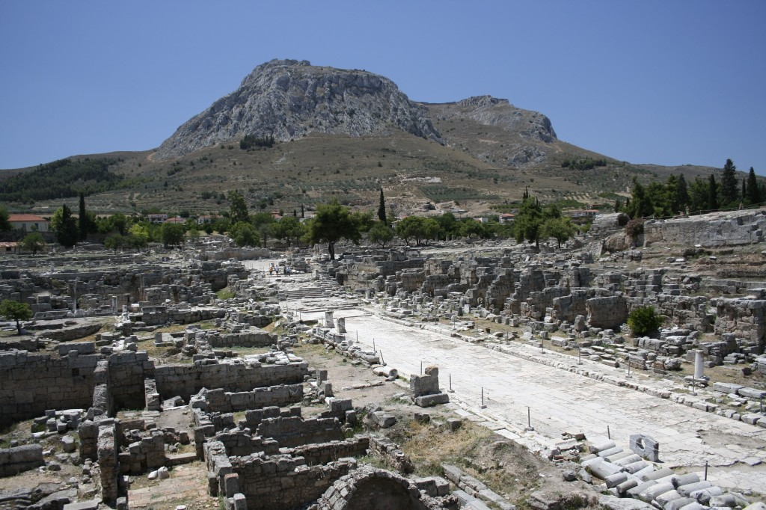
Acrocorinth

Slide 28
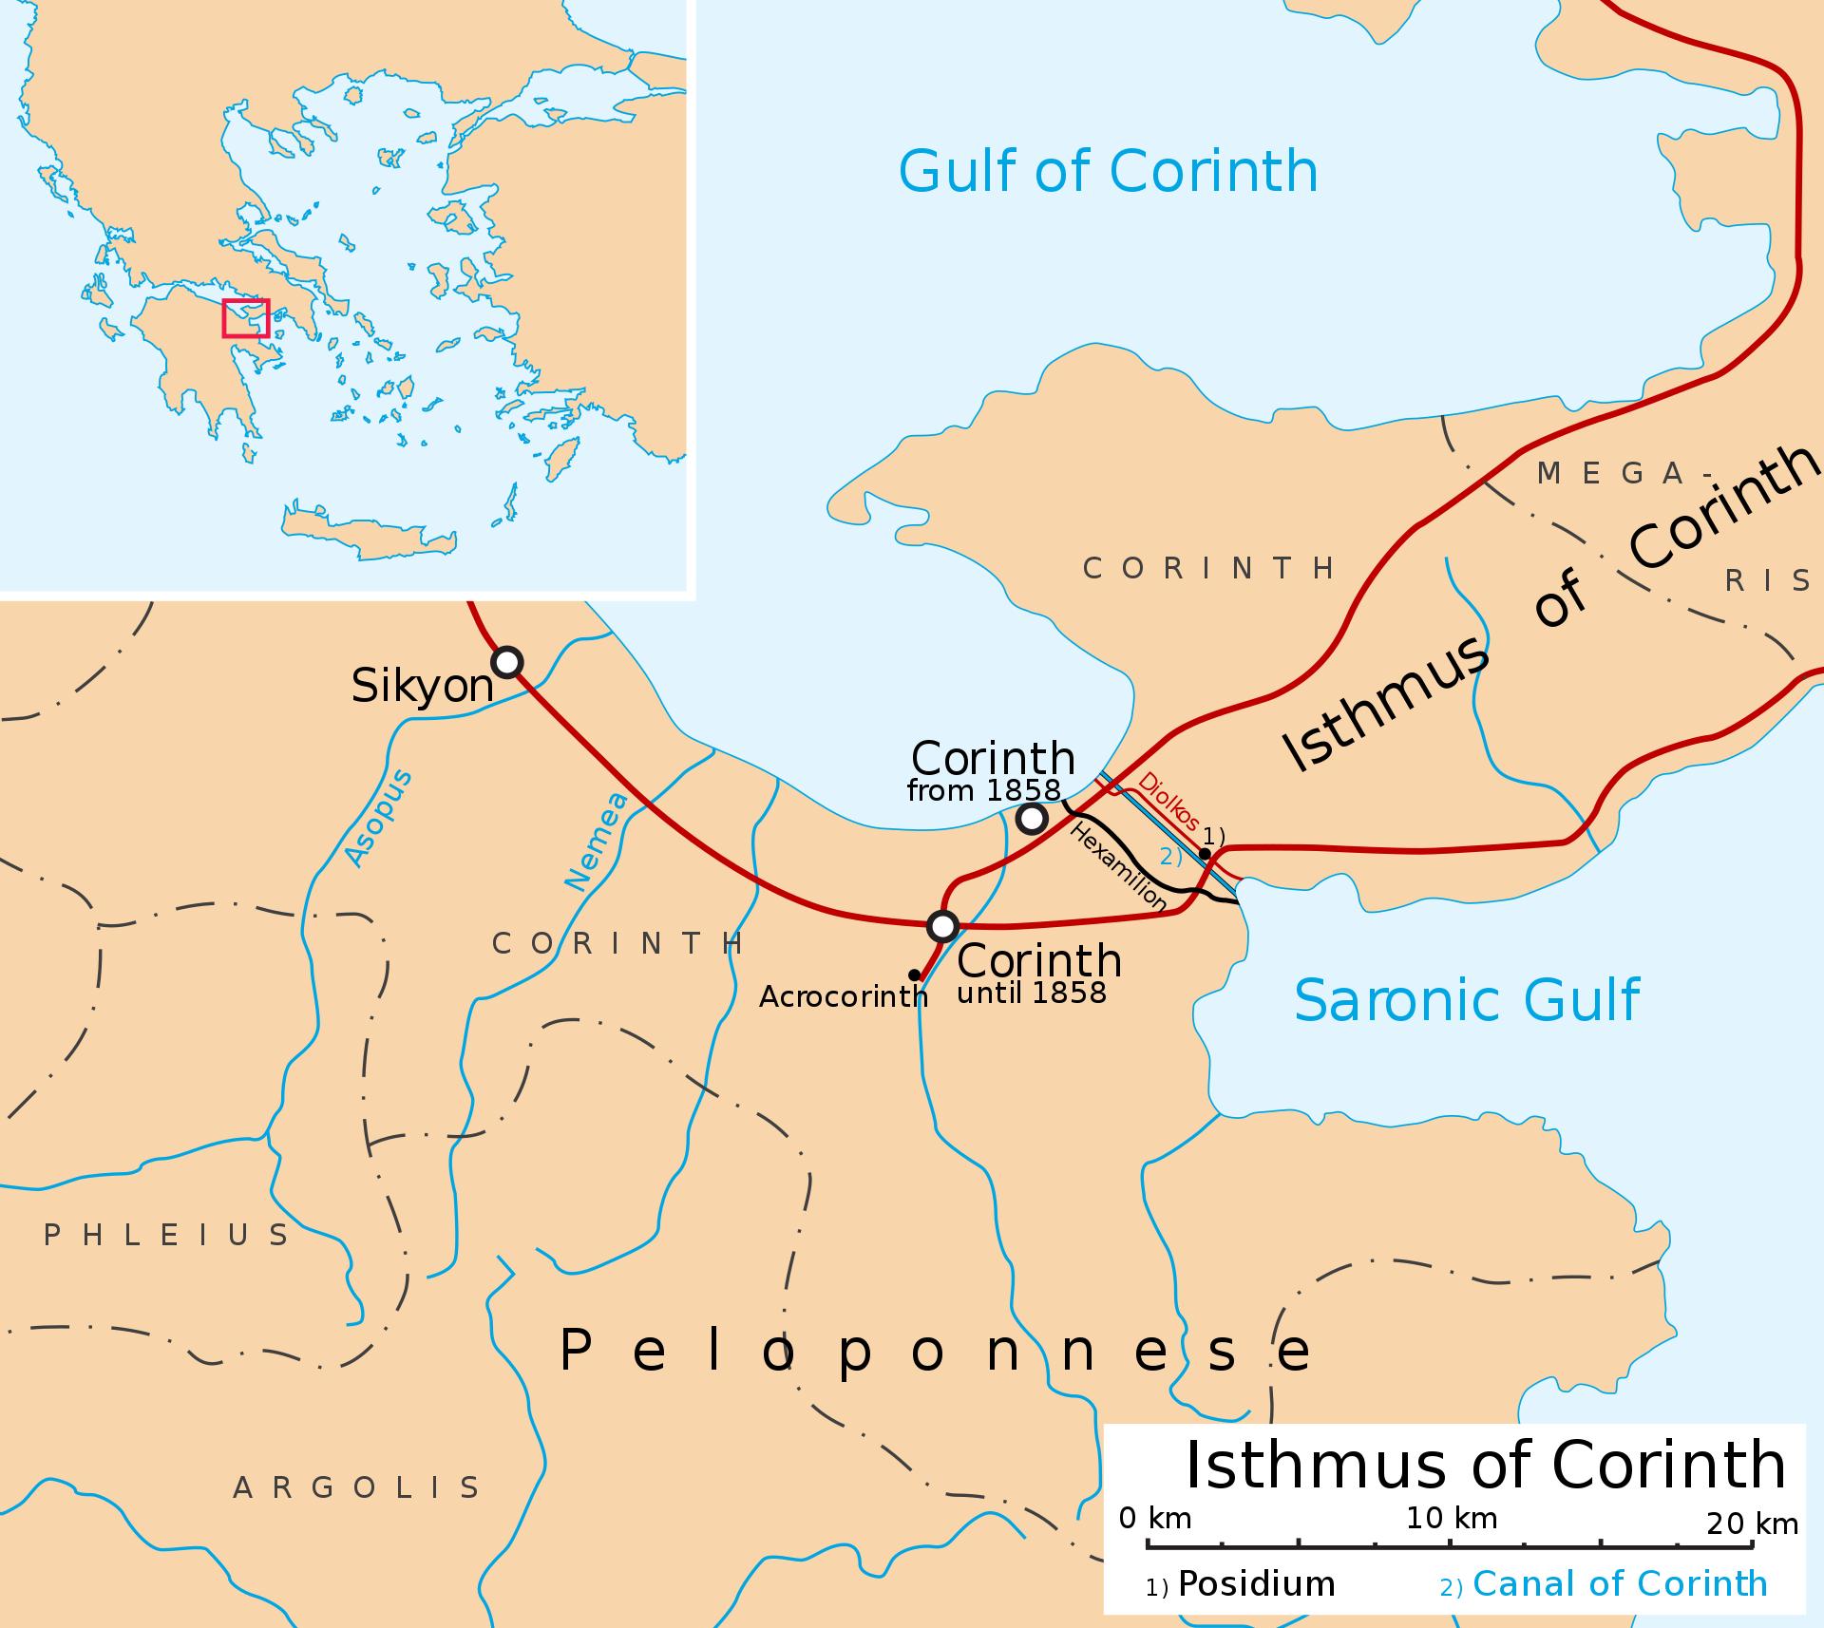
Diolkos

Slide 29
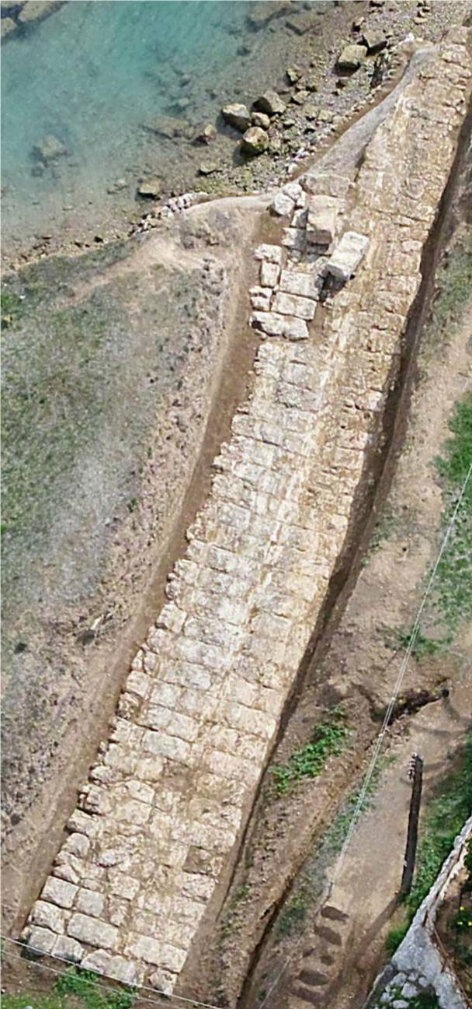
Diolkos 2

Slide 30
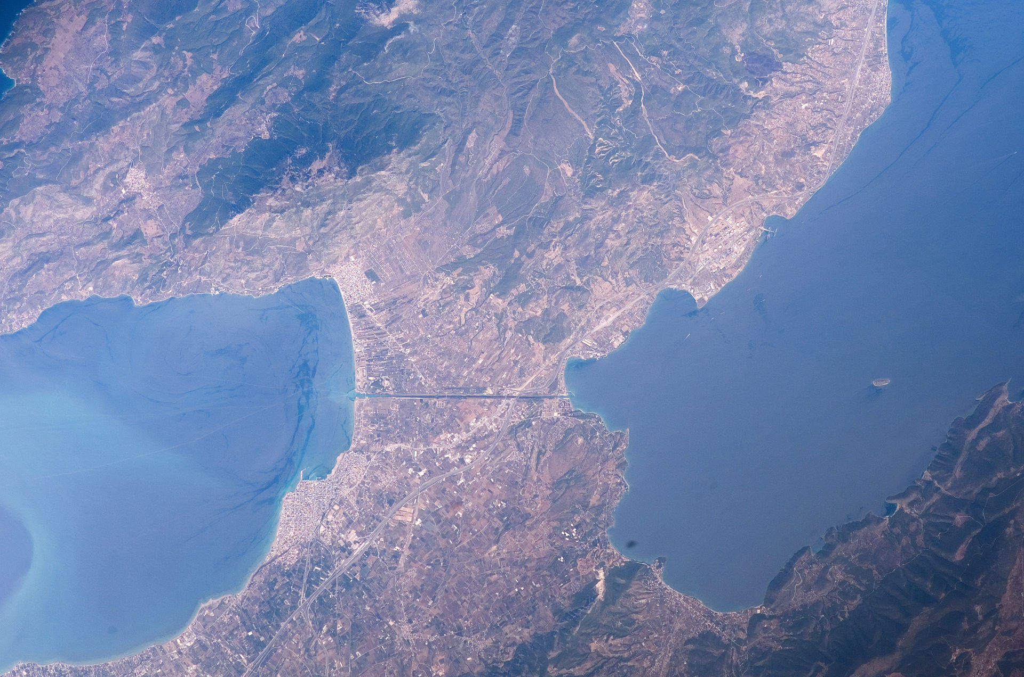
Diolkos 3

Slide 31
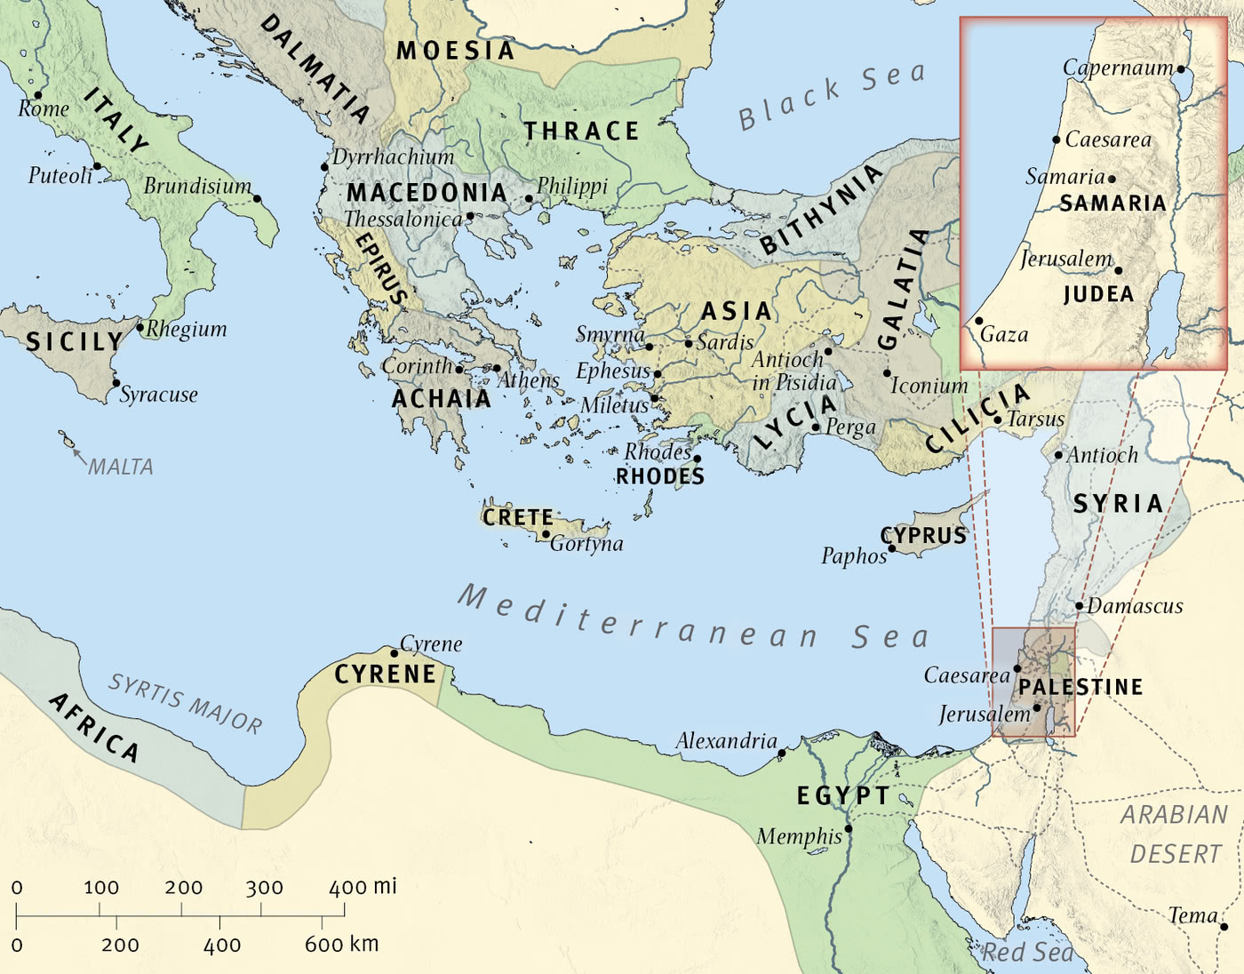
Preferable Travels

Slide 32
Corinth

Slide 33
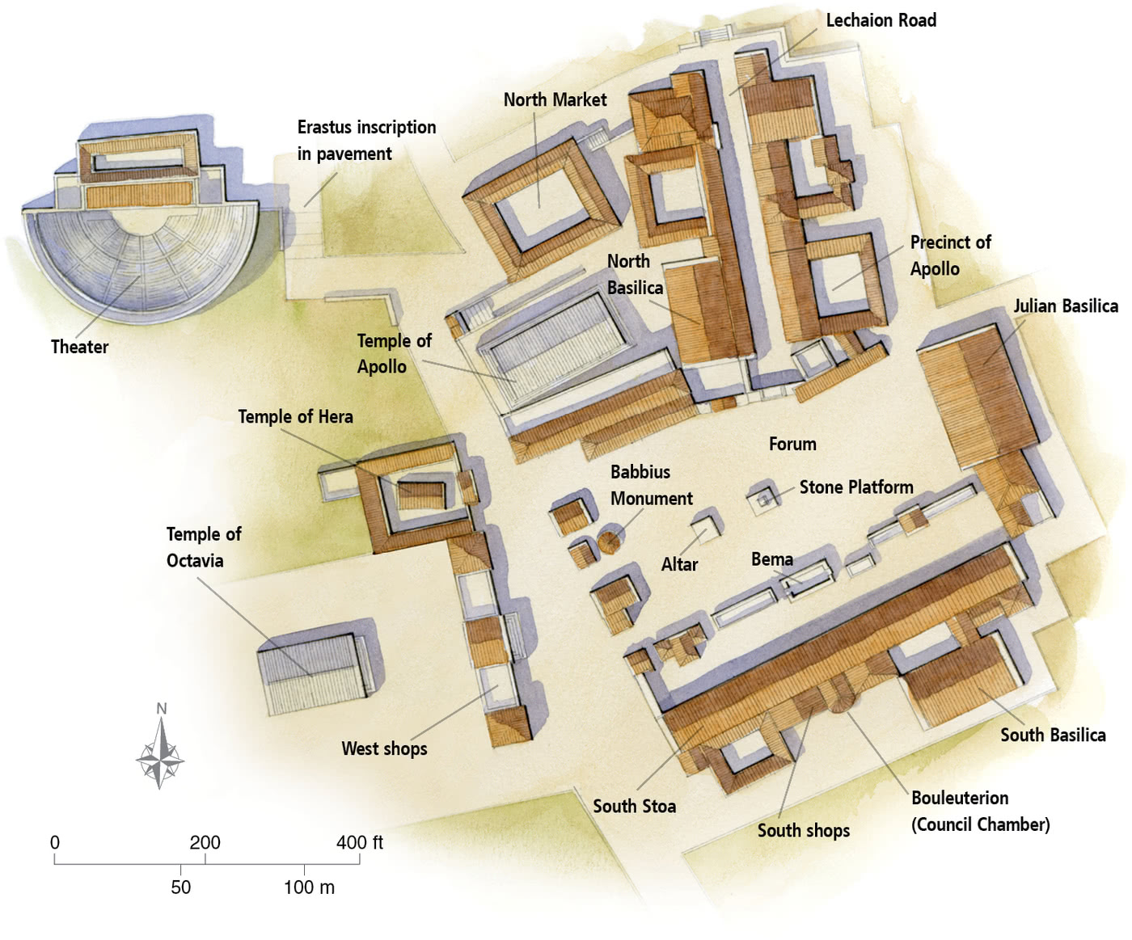
Corinth

Slide 34
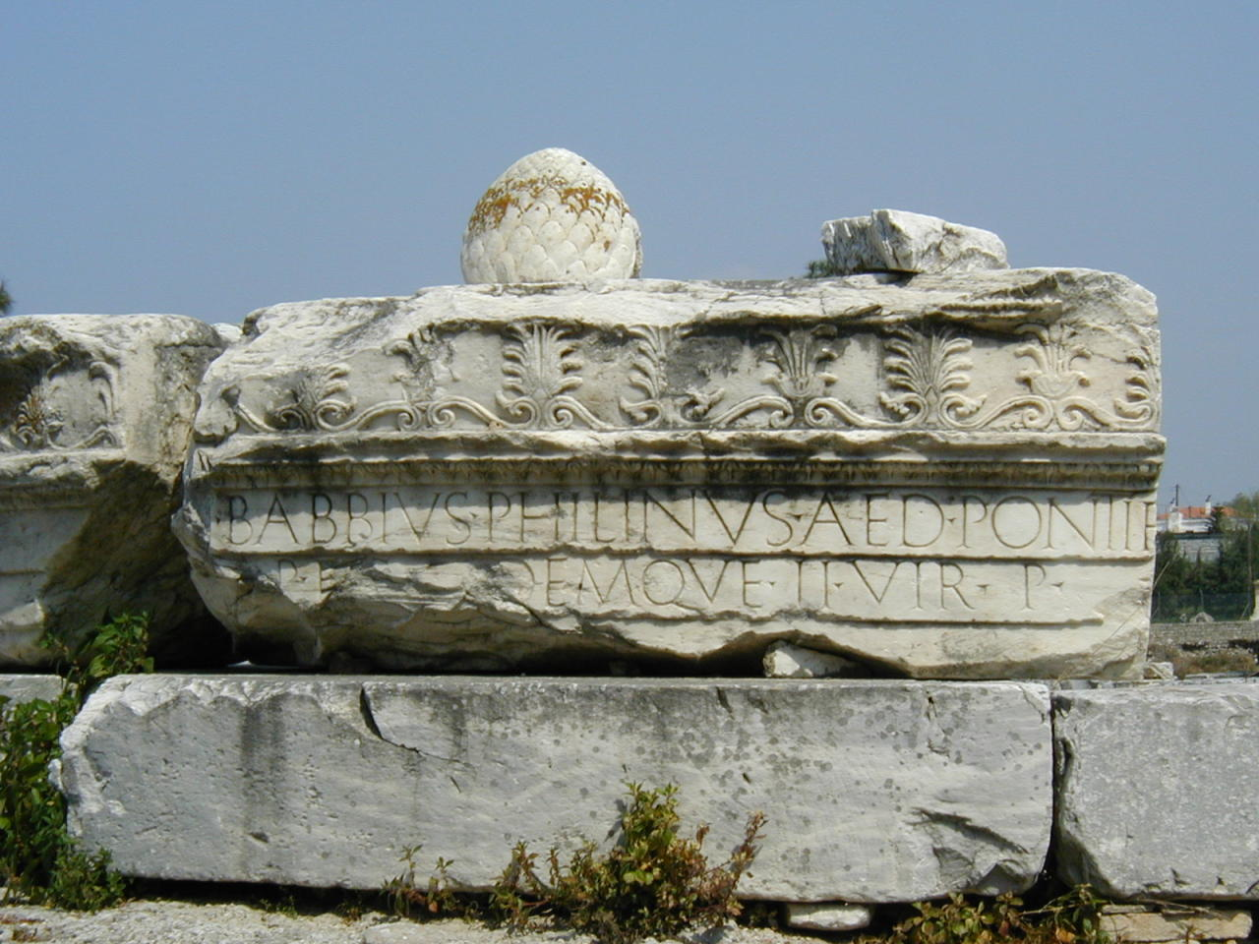
Babbius

Slide 35
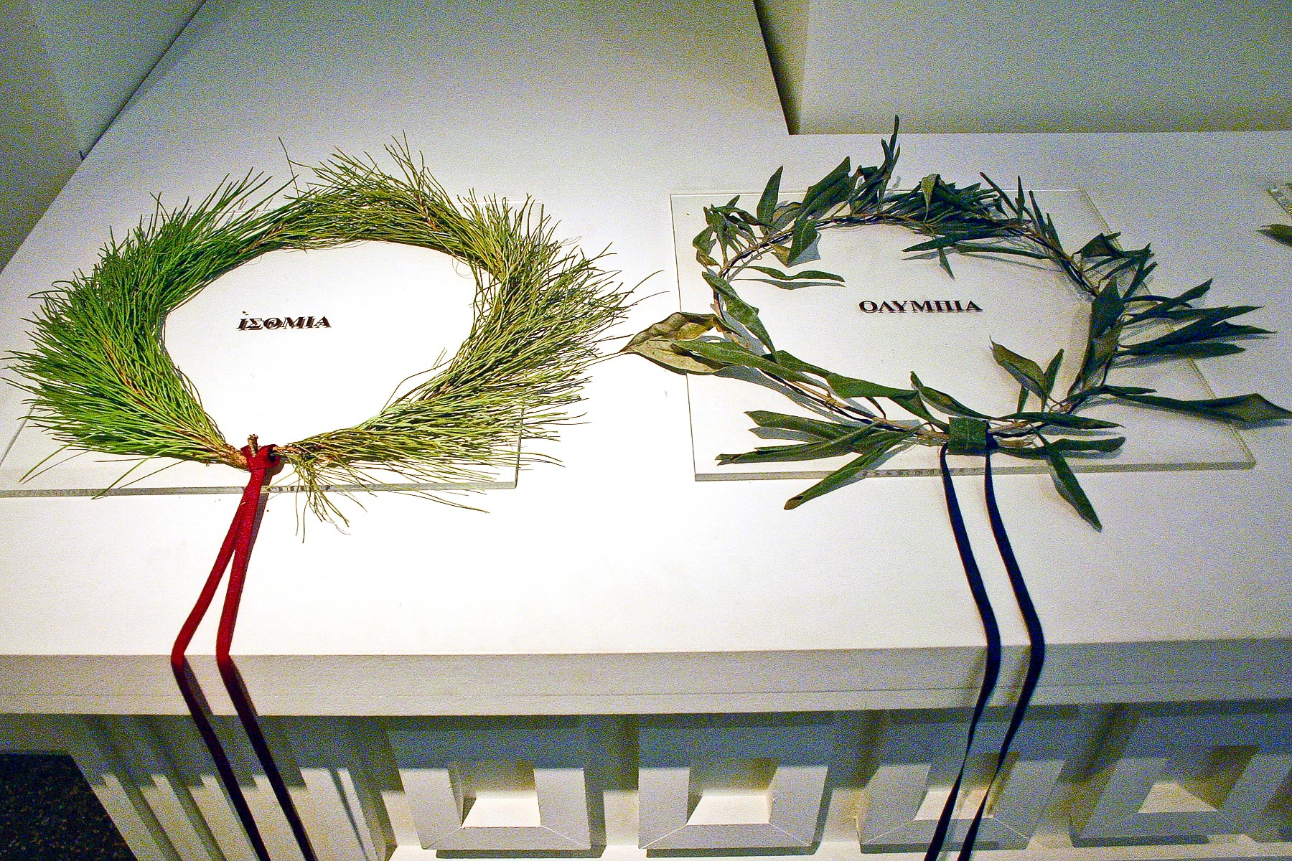
Isthmian Crown

Slide 36
To the church of God that is in Corinth, to those sanctified in Christ Jesus, called to be saints together with all those who in every place call upon the name of our Lord Jesus Christ, both their Lord and ours:
(I Corinthians 1:2, ESV)

Slide 37
Grace to you and peace from God our Father and the Lord Jesus Christ.
(I Corinthians 1:3, ESV)

Slide 38
1 Paul, called by the will of God to be an apostle of Christ Jesus, and our brother Sosthenes,
2 To the church of God that is in Corinth, to those sanctified in Christ Jesus, called to be saints together with all those who in every place call upon the name of our Lord Jesus Christ, both their Lord and ours:
3 Grace to you and peace from God our Father and the Lord Jesus Christ.
(I Corinthians 1:1-3, ESV)

Slide 39
Main Point
These verses give us important information on this letter
Who wrote the letter
Who it is written to
By whose authority, the author speaks
It all hinges on God the Father and His Son our Lord Jesus Christ

Slide 40
Application Points
Introduction to Corinthians (Why I Corinthians?)
  Has anyone wondered what kind of letter the apostles would write to the American Church?
  Personally I think if there were a specific letter written to the American Church it would be I Corinthians
  It is full of God’s grace, mercy, rationality, morality, focus on truth above rhetoric, the necessity of the cross and resurrection of Jesus, to a people very much like us

Slide 41
“Given the issues of (1) status inconsistency, (2) religious pluralism, (3) cosmopolitan immigration and trade, (4) priority of market forces not only in business but also in rhetoric, and (5) the emphasis upon recognition and perception of honor or shame within a socially constructed world, Paul would been surely astonished at either (a) early twenty-first century laments about the problem of having to address a pluralist culture supposedly for the first time or (b) early twenty-first celebrations over the demise of a transcontexual rationality in favor of “local,” social constructions of truth. With today’s “postmodern” mood we may compare the self-sufficient, self-congratulatory culture of Corinth coupled with an obsession about peer-group prestige, success in competition, their devaluing of tradition and universals, and near contempt for those without standing in some chosen value system.

Slide 42
All this provides an embarrassingly close model of a postmodern context for the gospel in our own times, even given the huge historical differences and distances in so many other respects. Quite apart from its rich theology of grace, the cross, the Holy Spirit, the ministry, love, and resurrection, as an example of communicative action between the gospel and the world of given time, I Corinthians stands in a distinctive position of relevance to our own times.”
-Thiselton, Anthony C. The First Epistle to the Corinthians, The New International Greek Testament Commentary. Eerdmans, 2000. Pages 16-17

Slide 43
Application Points
Introduction to Corinthians (Why I Corinthians?) 2
  In other words, our own culture is very similar to that of ancient Corinth
  They became subject to whatever philosophical winds blew, or whatever rhetoric could win the day
  In seminary I asked a student why they were voting for a particular candidate
  “I like the way he makes me feel when he speaks.”
  It wasn’t about truth…it was about the sway of the crowd

Slide 44
Application Points
Introduction to Corinthians (Why I Corinthians?) 3
  Many of the most popular preachers are more rhetoricians than teachers
  If the pastor is unable to cause emotion to rise up within the congregation, then that pastor is perceived as not being a very good pastor
  Never mind if the pastor is speaking truth, or is theologically sound
  Manipulation has become a key ingredient to preaching
  What has this done to the American Churches soul?
  We can no longer withstand the pluralism of our own times
  We do not know how to answer the many pressing philosophical and theological issues plaguing us
  We become easily duped by the culture because we do not know how to reason from the cross

Slide 45
Application Points
Introduction to Corinthians (Why I Corinthians?) 4
  I Corinthians is perfect for us because it challenges all these things
  By God through Christ there is sanctification
  If we are in Christ then we are being sanctified day by day by God’s truth
  Corinthians is about truth claims
  Which will we build our lives upon?
  I Corinthians gives us a basis for truth, and in this, morality, love, righteousness, and all good things
  It pits God and His ways against the world
  Why I Corinthians?
  We are in need of being reminded of the truth of God
  Buckle up, we’re about to be handed a hard dish of Christian ethics for the ages

Slide 46
Application Points
The Gospel of Christ
  Origins
    Where it begins
  Fall
    What went wrong
  Redemption
    How it is fixed
  Glorification
    Where it at leads

