Slide 1
Isaiah 65:17-25
Age Upon Age Made New

Slide 2


Slide 3
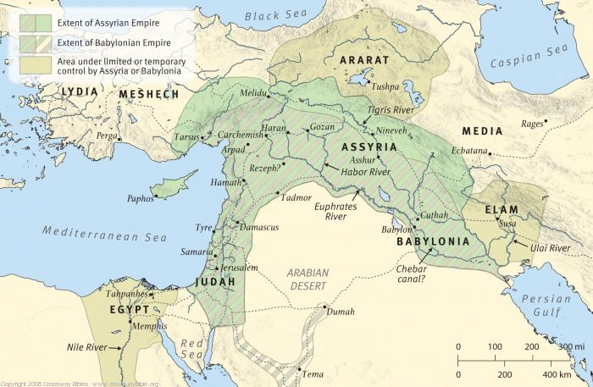

Slide 4
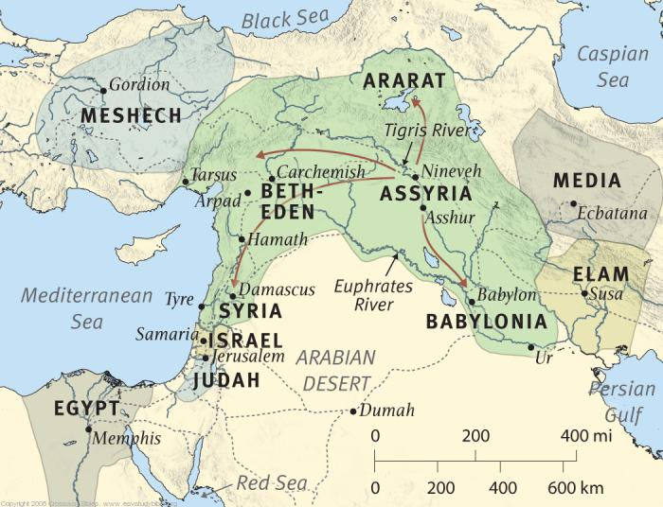

Slide 5


Slide 6


Slide 7


Slide 8
17 “For behold, I create new heavens
and a new earth,
and the former things shall not be remembered
or come into mind.
18 But be glad and rejoice forever
in that which I create;
for behold, I create Jerusalem to be a joy,
and her people to be a gladness.
19 I will rejoice in Jerusalem
and be glad in my people;
no more shall be heard in it the sound of weeping
and the cry of distress.
20 No more shall there be in it
an infant who lives but a few days,
or an old man who does not fill out his days,
for the young man shall die a hundred years old,
and the sinner a hundred years old shall be accursed.
21 They shall build houses and inhabit them;
they shall plant vineyards and eat their fruit.
22 They shall not build and another inhabit;
they shall not plant and another eat;
for like the days of a tree shall the days of my people be,
and my chosen shall long enjoy the work of their hands.
23 They shall not labor in vain
or bear children for calamity,
for they shall be the offspring of the blessed of the LORD,
and their descendants with them.
24 Before they call I will answer;
while they are yet speaking I will hear.
25 The wolf and the lamb shall graze together;
the lion shall eat straw like the ox,
and dust shall be the serpent’s food.
They shall not hurt or destroy
in all my holy mountain,”
says the LORD
(Isaiah 65:17-25, ESV)

Slide 9
Main Point
These verses describe a future time of newness
God promises a time when those who follow the Servant Messiah will experience all the blessings
Most important of which is God being with His people bringing peace

Slide 10
Application Points
Age Upon Age Made New
  These verses should encourage us in dark times
  We are capable of following the Servant Messiah into righteousness and light or turning toward unrighteousness and darkness
  God is capable of doing far more than we could ever begin to imagine and here promises such a newness
  Where we will rejoice, and God will rejoice with us, and there will be gladness
  I think we can all look to the future and think that this is all talking about the second coming of Christ
  But there is so much found here that is applicable to the here and now
  Because the Kingdom of God has already begun
  We live in the age where it has not yet been fully realized
  As long as Christ reigns, we will experience some of what all is being described here
  Let me give an example from Dr. Moreland

Slide 11
"One night, in Central Africa, I had worked hard to help a mother in the labor ward; but in spite of all that we could do, she died leaving us with a tiny, premature baby and a crying, two-year-old daughter.
We would have difficulty keeping the baby alive. We had no incubator. We had no electricity to run an incubator, and no special feeding facilities. Although we lived on the equator, nights were often chilly with treacherous drafts. A student-midwife went for the box we had for such babies and for the cotton wool that the baby would be wrapped in. Another went to stoke up the fire and fill a hot water bottle. She came back shortly, in distress, to tell me that in filling the bottle, it had burst. Rubber perishes easily in tropical climates. “… and it is our last hot water bottle!” she exclaimed. As in the West, it is no good crying over spilled milk; so, in Central Africa it might be considered no good crying over a burst water bottle. They do not grow on trees, and there are no drugstores down forest pathways. “All right,” I said, “Put the baby as near the fire as you safely can; sleep between the baby and the door to keep it free from drafts. Your job is to keep the baby warm.”

Slide 12
The following noon, as I did most days, I went to have prayers with many of the orphanage children who chose to gather with me. I gave the youngsters various suggestions of things to pray about and told them about the tiny baby. I explained our problem about keeping the baby warm enough, mentioning the hot water bottle. The baby could so easily die if it got chilled. I also told them about the two-year-old sister, crying because her mother had died. During the prayer time, one ten-year-old girl, Ruth, prayed with the usual blunt consciousness of our African children. “Please, God,” she prayed, “send us a water bottle. It’ll be no good tomorrow, God, the baby’ll be dead; so, please send it this afternoon.” While I gasped inwardly at the audacity of the prayer, she added by way of corollary, “and while You are about it, would You please send a dolly for the little girl so she’ll know You really love her?”
As often with children’s prayers, I was put on the spot. Could I honestly say, “Amen”? I just did not believe that God could do this. Oh, yes, I know that He can do everything: The Bible says so, but there are limits, aren’t there? The only way God could answer this particular prayer would be by sending a parcel from the homeland. I had been in Africa for almost four years at that time, and I had never, ever received a parcel from home. Anyway, if anyone did send a parcel, who would put in a hot water bottle? I lived on the equator!

Slide 13
Halfway through the afternoon, while I was teaching in the nurses training school, a message was sent that there was a car at my front door. By the time that I reached home, the car had gone, but there, on the veranda, was a large twenty-two pound parcel! I felt tears pricking my eyes. I could not open the parcel alone; so, I sent for the orphanage children. Together we pulled off the string, carefully undoing each knot. We folded the paper, taking care not to tear it unduly. Excitement was mounting. Some thirty or forty pairs of eyes were focused on the large cardboard box. From the top, I lifted out brightly colored, knitted jerseys. Eyes sparkled as I gave them out. Then, there were the knitted bandages for the leprosy patients, and the children began to look a little bored. Next came a box of mixed raisins and sultanas — that would make a nice batch of buns for the weekend. As I put my hand in again, I felt the … could it really be? I grasped it, and pulled it out. Yes, “A brand-new rubber, hot water bottle!” I cried. I had not asked God to send it; I had not truly believed that He could.
Ruth was in the front row of the children. She rushed forward, crying out, “If God has sent the bottle, He must have sent the dolly, too!” Rummaging down to the bottom of the box, she pulled out the small, beautifully dressed dolly. Her eyes shone: She had never doubted! Looking up at me, she asked, “Can I go over with you, Mummy, and give this dolly to that little girl, so she’ll know that Jesus really loves her?”

Slide 14
That parcel had been on the way for five whole months, packed up by my former Sunday School class, whose leader had heard and obeyed God’s prompting to send a hot water bottle, even to the equator. One of the girls had put in a dolly for an African child — five months earlier in answer to the believing prayer of a ten-year-old to bring it “That afternoon!” “And it shall come to pass, that before they call, I will answer; and while they are yet speaking, I will hear.” Isaiah 65:24 1“
(JP Moreland, Kingdom Triangle)

Slide 15
Application Points
Age Upon Age Made New (2)
  I think this story encapsulates what is being described in this passage in Isaiah
  It describes…
  God being with His people
  Rejoicing
  Gladness
  Not laboring in vain
  Salvation of an infant
  God knowing what we need before we even ask for it
  Newness
  All of these things we are eagerly anticipating for a future event happening right here and now in this current world

Slide 16
Application Points
Age Upon Age Made New (3)
  There are other aspects that have not yet happened (like living forever)
  Christ reigns now
  God was victorious when Christ lived, died, and rose again and is victorious now
  We forget that God is so great, so might, and that the newness which God has described in these verses has already begun
  Truly miraculous and wonderful things can occur even in this time and place with you and I
  It started with the live, death, and resurrection of Jesus, and continues on through each of us
  In other words, it is both and rather than either or scenario
  The Kingdom doesn’t lead to devastation, but to the glorious Kingdom of God where He dwells with His people forever

Slide 17
Application Points
Age Upon Age Made New (4)
  I think this is something which Isaiah had glimpses of
  He was able to see a people like us who were indwelled by the Holy Spirit
  Who would know that true power doesn’t come from bowing to the rulers of this world, but to submit in humble obedience to God
  If this is the case then that gives us incredible motivation when it comes to all things presented
  It means we can begin to see the world new, and live in this world as new creatures who have been redeemed for God’s glory
  It means…
  God will rejoice over us today
  We can be glad today
  We can hear His voice today
  Our children are the children of blessing today

Slide 18
Application Points
Age Upon Age Made New (5)
  Indeed there is a temptation to be like John the Baptist
  2 Now when John heard in prison about the deeds of the Christ, he sent word by his disciples 3 and said to him, “Are you the one who is to come, or shall we look for another?” (Matthew 11:2-3, ESV)
  John is overwhelmed by the darkness
  Is this not like us here and now when we experience the same or similar things?
  Jesus responds, “4 And Jesus answered them, “Go and tell John what you hear and see: 5 the blind receive their sight and the lame walk, lepers are cleansed and the deaf hear, and the dead are raised up, and the poor have good news preached to them. 6 And blessed is the one who is not offended by me.” (Matthew 11:4-6, ESV)
  They can experience it with their own lives
  It was happening for them NOW
  It is still happening NOW
  Let us heed the Words and life of Christ knowing…things can be changed for good and newness can come NOW

Slide 19
Application Points
Age Upon Age Made New (6)
  What else can we do when we consider all of what Isaiah has declared?
  What more can we do than rejoice?
  To spread the truth wherever we go
  To be bold in the face of tyranny
  To be steadfast against hatred
  To be resolute in opposing sin
  To be prepared in the truth to fight against the Devil and his lies
  To be ready to engage in justice and righteousness in order to subdue unrighteousness and injustice

Slide 20
Application Points
Age Upon Age Made New (7)
  What else can we do when we consider all of what Isaiah has declared?
  What more can we do than rejoice?
  To spread the truth wherever we go
  To be bold in the face of tyranny
  To be steadfast against hatred
  To be resolute in opposing sin
  To be prepared in the truth to fight against the Devil and his lies
  To be ready to engage in justice and righteousness in order to subdue unrighteousness and injustice

Slide 21
Application Points
Age Upon Age Made New (8)
  To be glad for we have God on our side
  To rejoice because He has already begun to make new
  Let us not cling to old ways
  Let us be made new starting in this age and to be perfected in the ages to come

Slide 22
Application Points
The Gospel of Christ
  Origins
    Where we began
  Fall
    What went wrong
  Redemption
    How it is fixed
  Glorification
    Where it at leads

