Slide 1
Isaiah 65:1-16
The Heart of the Matter

Slide 2



Slide 3
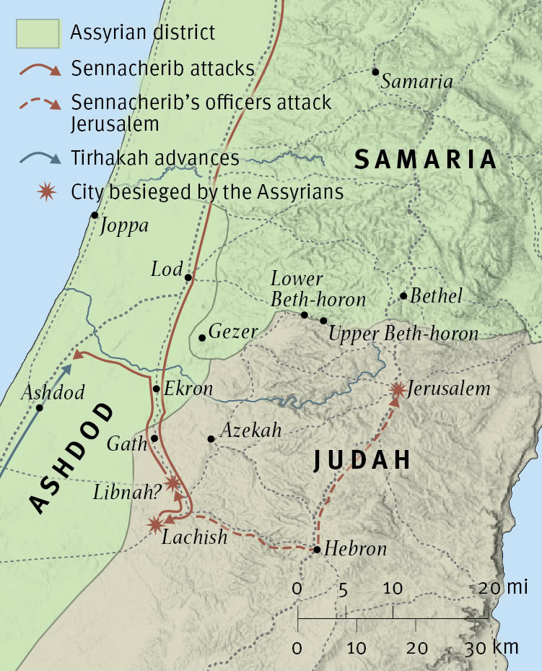

Slide 4



Slide 5


Slide 6


Slide 7
1 I was ready to be sought by those who did not ask for me;
I was ready to be found by those who did not seek me.
I said, “Here I am, here I am,”
to a nation that was not called by my name.
2 I spread out my hands all the day
to a rebellious people,
who walk in a way that is not good,
following their own devices;
3 a people who provoke me
to my face continually,
sacrificing in gardens
and making offerings on bricks;
4 who sit in tombs,
and spend the night in secret places;
who eat pig’s flesh,
and broth of tainted meat is in their vessels;
5 who say, “Keep to yourself,
do not come near me, for I am too holy for you.”
These are a smoke in my nostrils,
a fire that burns all the day.
6 Behold, it is written before me:
“I will not keep silent, but I will repay;
I will indeed repay into their lap
7 both your iniquities and your fathers’ iniquities together,
says the LORD;
because they made offerings on the mountains
and insulted me on the hills,
I will measure into their lap
payment for their former deeds.”
(Isaiah 65:1-7, ESV)

Slide 8
8 Thus says the LORD:
“As the new wine is found in the cluster,
and they say, ‘Do not destroy it,
for there is a blessing in it,’
so I will do for my servants’ sake,
and not destroy them all.
9 I will bring forth offspring from Jacob,
and from Judah possessors of my mountains;
my chosen shall possess it,
and my servants shall dwell there.
10 Sharon shall become a pasture for flocks,
and the Valley of Achor a place for herds to lie down,
for my people who have sought me.
11 But you who forsake the LORD,
who forget my holy mountain,
who set a table for Fortune
and fill cups of mixed wine for Destiny,
12 I will destine you to the sword,
and all of you shall bow down to the slaughter,
because, when I called, you did not answer;
when I spoke, you did not listen,
but you did what was evil in my eyes
and chose what I did not delight in.”
13 Therefore thus says the Lord GOD:
“Behold, my servants shall eat,
but you shall be hungry;
behold, my servants shall drink,
but you shall be thirsty;
behold, my servants shall rejoice,
but you shall be put to shame;
14 behold, my servants shall sing for gladness of heart,
but you shall cry out for pain of heart
and shall wail for breaking of spirit.
15 You shall leave your name to my chosen for a curse,
and the Lord GOD will put you to death,
but his servants he will call by another name,
16 so that he who blesses himself in the land
shall bless himself by the God of truth,
and he who takes an oath in the land
shall swear by the God of truth;
because the former troubles are forgotten
and are hidden from my eyes.
(Isaiah 65:8-16, ESV)

Slide 9
Main Point
These verses challenge the idea presented in the previous chapter
They lamented God not being with them
God, however, has always made Himself known
Humanity has continued to reject God
Despite the many who reject God, those who turn toward Him will find salvation
Those who seek and follow their own ways will find judgment, darkness, and death
Those who seek and follow God will find all they could possibly desire, God Himself

Slide 10
Application Points
The Heart of the Matter
  Isaiah speaks to a world we are a familiar with
  God is the same God
  We humans are no different than our predecessors
  We have been placed in our place and time with the expectation to turn toward God and trust Him
  Unfortunately, we fail at this
  The first half of today’s text deals with this reality
  The majority follow their own way
  As a whole humanity has failed to do what is necessary, trust in God
  Whereas everything from the smallest atom to the largest star obeys God’s commands, humanity ignores the beckoning call of God

Slide 11
Application Points
The Heart of the Matter (2)
  “The heavens declare the glory of God and the sky above proclaims His handiwork” (Psalm 19:1)
  This is the purpose of the created order, to praise God
  When we reject God it says to Him, “I am the holy one, you are the unholy” and “I am better than you, and your ways.”
  So we turn from what we ought to do
  We are just as guilty as the pagans who worship sticks and stones
  Like them we worship how we want believing that is what God wants
  Does He want us to invent our own forms of worship?
  Does He want us to reinvent the fire?
  No, He has established what He desires of us

Slide 12
Application Points
The Heart of the Matter (3)
  Imagine Isaiah speaking to the Church today in America
  What if he told us our meetings on Sunday is like meeting in the tomb?
  We might respond, “why?” or “What is the reason for this?”
  His response would be that far too many of us are relying on the meetings, on the fellowship, trying to cull God’s favor
  He would warn us because it looks similar to his own day when they would sacrifice not because they loved God, but because they wanted something from God
  He would say, “Things have not changed.”
  Just as there is nothing wrong with the form of worship, there is something wrong with the heart
  Do we meet because God is worthy? Or do we think by doing it we can get something from God?

Slide 13
Application Points
The Heart of the Matter (4)
  If we fellowship, do we do it because we know God is honored in all these ways?
  Or do we do it because we think if we fellowship then we’ve done something which now God owes us for?
  One is true religion and worship
  One is false religion and pagan worship
  We can worship and fellowship for show
  If it is for ourselves alone, then He knows
  If it is for Him, He knows
  Unfortunately there are many who are more pagan than not, but thanks be to God for those within the cluster who are faithful
  Who believe the blessing is God Himself

Slide 14
Application Points
The Heart of the Matter (5)
  They know that they have received the greatest of blessings
  God Himself who has created all these things and who has given all these things as a gift is the One they seek
  Their hearts are changed by God
  Their worship is new and purposeful, for it is their very lives which are the vessels of worship to their Creator
  They seek Him in all His ways
  They will receive all the promises God gives

Slide 15
Application Points
The Heart of the Matter (6)
  The dichotomy of the heart is set before us
  What is our substance in the cluster?
  Are we good grapes or bad?
  The only way to know is to examine yourself against the Scriptures
  To ask honest questions
  Am I worshipping the one true God, or am I truly worshipping the false gods of this world?
  These are hard questions because they come to the very essence of our motivations and purposes
  But they must be asked
  Because as Isaiah describes above, God is the God of truth
  And the truth will reveal the heart of the matter

Slide 16
Application Points
The Gospel of Christ
  Origins
  Fall
  Redemption
  Glorification

