Slide 1
Isaiah 63:15-64:12
Our Only Hope

Slide 2



Slide 3
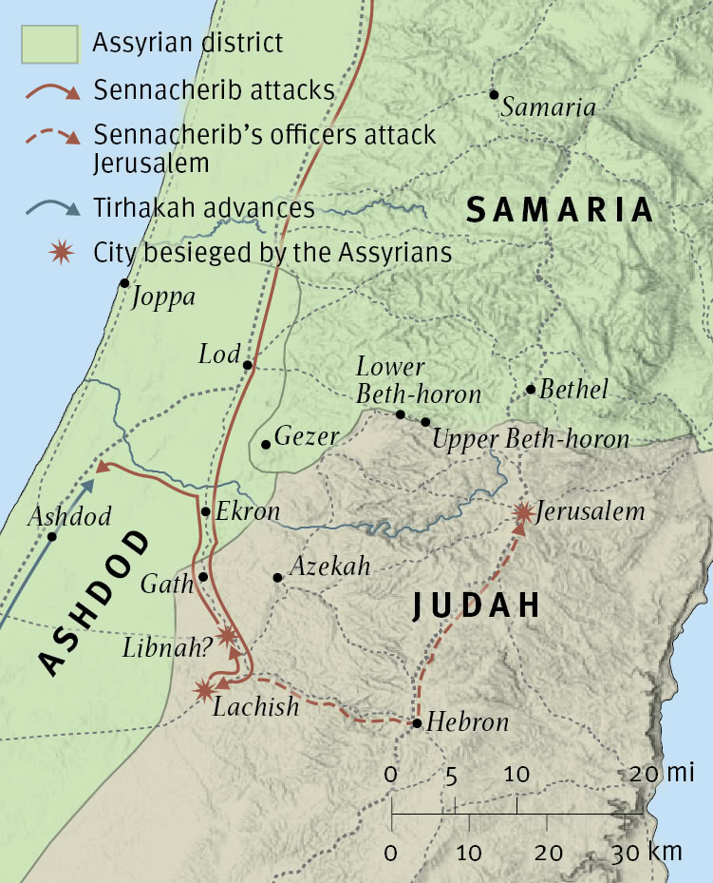

Slide 4



Slide 5


Slide 6


Slide 7
15 Look down from heaven and see,
from your holy and beautiful habitation.
Where are your zeal and your might?
The stirring of your inner parts and your compassion
are held back from me.
16 For you are our Father,
though Abraham does not know us,
and Israel does not acknowledge us;
you, O LORD, are our Father,
our Redeemer from of old is your name.
17 O LORD, why do you make us wander from your ways
and harden our heart, so that we fear you not?
Return for the sake of your servants,
the tribes of your heritage.
18 Your holy people held possession for a little while;
our adversaries have trampled down your sanctuary.
19 We have become like those over whom you have never ruled,
like those who are not called by your name.
(Isaiah 63:15-19, ESV)

Slide 8
1 Oh that you would rend the heavens and come down,
that the mountains might quake at your presence—
2 as when fire kindles brushwood
and the fire causes water to boil—
to make your name known to your adversaries,
and that the nations might tremble at your presence!
3 When you did awesome things that we did not look for,
you came down, the mountains quaked at your presence.
4 From of old no one has heard
or perceived by the ear,
no eye has seen a God besides you,
who acts for those who wait for him.
5 You meet him who joyfully works righteousness,
those who remember you in your ways.
Behold, you were angry, and we sinned;
in our sins we have been a long time, and shall we be saved?
6 We have all become like one who is unclean,
and all our righteous deeds are like a polluted garment.
We all fade like a leaf,
and our iniquities, like the wind, take us away.
7 There is no one who calls upon your name,
who rouses himself to take hold of you;
for you have hidden your face from us,
and have made us melt in the hand of our iniquities.
(Isaiah 64:1-7, ESV)

Slide 9
8 But now, O LORD, you are our Father;
we are the clay, and you are our potter;
we are all the work of your hand.
9 Be not so terribly angry, O LORD,
and remember not iniquity forever.
Behold, please look, we are all your people.
10 Your holy cities have become a wilderness;
Zion has become a wilderness,
Jerusalem a desolation.
11 Our holy and beautiful house,
where our fathers praised you,
has been burned by fire,
and all our pleasant places have become ruins.
12 Will you restrain yourself at these things, O LORD?
Will you keep silent, and afflict us so terribly?
(Isaiah 64:8-12, ESV)

Slide 10
Main Point
These verses remind us of the ramification of sin in the world
We are incapable of overcoming our sinful inclinations on our own
If God hides His face and speaks not then there is no hope for us
If God relents and makes Himself known then there is true salvation

Slide 11
Application Points
Our Only Hope
  In speaking out against his own society he effectively spoke out against all societies
  Sin always leads to the same conclusion…destruction
  The people are helpless in their state to overcome the true issue of their lives
  It is their own inclinations…their own sinfulness
  They become susceptible to all the other forms of darkness because they cannot even overcome the darkness within themselves
  There is only…the ramifications of their disobedience
  If God hides his face, doesn’t act, doesn’t show Himself, then they are lost
  There is no way of knowing truth, what is right or wrong

Slide 12
Application Points
Our Only Hope (2)
  In our own society we have seen this steady increase of the lost knowledge of God
  Our society is ripe, then, for all powers of darkness
  If it is true that this is the case, then we should be seeing an increase of things God detests
  We should be seeing an increase of sinfulness
  We should be seeing what Paul declares in Romans 1

Slide 13
18 For the wrath of God is revealed from heaven against all ungodliness and unrighteousness of men, who by their unrighteousness suppress the truth. 19 For what can be known about God is plain to them, because God has shown it to them. 20 For his invisible attributes, namely, his eternal power and divine nature, have been clearly perceived, ever since the creation of the world, in the things that have been made. So they are without excuse. 21 For although they knew God, they did not honor him as God or give thanks to him, but they became futile in their thinking, and their foolish hearts were darkened. 22 Claiming to be wise, they became fools, 23 and exchanged the glory of the immortal God for images resembling mortal man and birds and animals and creeping things.

Slide 14
24 Therefore God gave them up in the lusts of their hearts to impurity, to the dishonoring of their bodies among themselves, 25 because they exchanged the truth about God for a lie and worshiped and served the creature rather than the Creator, who is blessed forever! Amen.

Slide 15
26 For this reason God gave them up to dishonorable passions. For their women exchanged natural relations for those that are contrary to nature; 27 and the men likewise gave up natural relations with women and were consumed with passion for one another, men committing shameless acts with men and receiving in themselves the due penalty for their error.

Slide 16
28 And since they did not see fit to acknowledge God, God gave them up to a debased mind to do what ought not to be done. 29 They were filled with all manner of unrighteousness, evil, covetousness, malice. They are full of envy, murder, strife, deceit, maliciousness. They are gossips, 30 slanderers, haters of God, insolent, haughty, boastful, inventors of evil, disobedient to parents, 31 foolish, faithless, heartless, ruthless. 32 Though they know God’s righteous decree that those who practice such things deserve to die, they not only do them but give approval to those who practice them.”

Slide 17
Application Points
Our Only Hope (3)
  We have to ask ourselves whether we are in a sate of judgment where God has hidden Himself from society
  Is our own society in a state of disarray?
  Is the temple desolate?
  Is where there was once p raise, worship, and adoration, now an increasing silence?
  Have we seen an increase of sin?
  Do we see outside influences?
  These are legitimate questions to ask a society, and as a Church
  If God allows these things to occur then we can know that our society, as a whole, is in such a state
  The question then becomes what do we do about this?
  We recognize that God is not hidden arbitrarily, but because we have rejected Him

Slide 18
Application Points
Our Only Hope (4)
  We recognize that God is not hidden arbitrarily, but because we have rejected Him
  We must seek repentance (to turn toward God and His ways)
  We continue on in faithfulness
  We rely not on our own ability, but rest fully on God
  It is by seeking God alone, that we find exactly what we need
  It will be by clinging to the truth He has given to us…that we find the answer to Isaiah’s question
  We think of God afflicting us primarily through famine, through suffering
  We should also be far more concerned when God gives people to what they want
  The severe affliction is the lack of knowledge of God

Slide 19
Application Points
Our Only Hope (5)
  Is there a greater judgment than this?
  Give me famine Lord, give me suffering of any kind, but please do not take away from the knowledge of You
  Do not take away the truth
  Anything but that for me, anything but that for all others
  Let the mountains quake, let the world see the truth, let us know that you are goodness itself and nothing is greater than You and Your ways
  You alone can do what we cannot do
  Raise us up to the Light, and let us remember the truth
  You alone, Lord, are our only hope

Slide 20
Application Points
The Gospel of Christ
  Origins
  Fall
  Redemption
  Glorification

