Slide 1
Isaiah 63:7-14
A Forgetful People

Slide 2



Slide 3
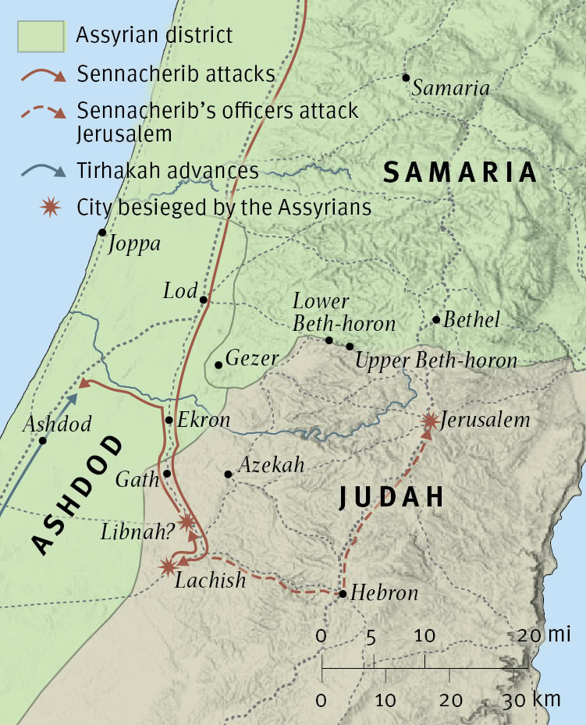

Slide 4



Slide 5


Slide 6


Slide 7
7 I will recount the steadfast love of the LORD,
the praises of the LORD,
according to all that the LORD has granted us,
and the great goodness to the house of Israel
that he has granted them according to his compassion,
according to the abundance of his steadfast love.
8 For he said, “Surely they are my people,
children who will not deal falsely.”
And he became their Savior.
9 In all their affliction he was afflicted,
and the angel of his presence saved them;
in his love and in his pity he redeemed them;
he lifted them up and carried them all the days of old.
10 But they rebelled
and grieved his Holy Spirit;
therefore he turned to be their enemy,
and himself fought against them.
(Isaiah 63:7-10, ESV)

Slide 8
11 Then he remembered the days of old,
of Moses and his people.
Where is he who brought them up out of the sea
with the shepherds of his flock?
Where is he who put in the midst of them
his Holy Spirit,
12 who caused his glorious arm
to go at the right hand of Moses,
who divided the waters before them
to make for himself an everlasting name,
13 who led them through the depths?
Like a horse in the desert,
they did not stumble.
14 Like livestock that go down into the valley,
the Spirit of the LORD gave them rest.
So you led your people,
to make for yourself a glorious name.
(Isaiah 63:11-14, ESV)

Slide 9
Main Point
These verses reflect on the ways of God
They rejected God spurning the hand that held them
This caused enmity between God and His people
They remember that God was with them
When compared to their own devices, God’s ways are far greater than their own

Slide 10
Application Points
A Forgetful People
  Isaiah has a way of speaking to the people that it is hard to remember the historical context
  Their society sounds far too similar to our own
  It is not that history repeats, but that people do not change
  The ancients experience with God was wonderful
  He provided for the people all their needs
  What occurred? Rebellion
  The people who experienced God and still rebelled against Him
  Sinfulness is rebellion by definition
  We have been given our own Law which that freedom should adhere to
  While nature is not free to disobey its laws, we are
  The sun will continue to shine until it’s energy has been depleted…it will not choose to stop shining

Slide 11
Application Points
A Forgetful People (2)
  Humans, however, are quire different
  We openly reject the Law which is given
  Rebels is the right word to use
  Just as it was for them so it is with us
  We find ourselves squandering all that He gives
  We owe all loyalty to God yet we rebel because we prefer sin, darkness, pride, rather than what is good
  “Surely we’re different! We have Christ!”
  We are living in a different time, after the coming of the Servant
  How often is it that Christ Himself is our Exodus?
  How many times is the temptation there to say, “No more.”
  I see many people who turn away from the fruit of all goodness, prefer the ways of the world rather than God

Slide 12
Application Points
A Forgetful People (3)
  If one were to look at the state of Christian music today, one would be hard pressed to find many faithful artists
  What is causing these individuals to falter?
  To spurn the Exodus of our souls and the love of God?
  It’s not just the artists
  I know of a man who was actively involved in his Church
  He now has a running group who drinks
  He says that he experiences the same feeling of fellowship with them
  How is it that we have so many who are so interested in what is spiritual, yet being misled by demons?
  Another individual I know actively seeking…now she’s a Wiccan
  Ancient paganism is rearing its ugly head at an alarming rate

Slide 13
Application Points
A Forgetful People (4)
  Is it happening because people are different, or is it happening because people are exactly the same?
  Is this not something new, but something quite common
  What we are seeing is the same thing Isaiah saw
  A people who have redemption right in front of them, and then shut the door
  They prefer the prison cell of sin rather than the freedom found in the love of God
  A few weeks ago we had our friends from family life here
  We were reminded of the necessity of perseverance
  He warned of those running so well only to be moved from their present course
  The world will seek to eat you up and spit you out
  It will seek to enlist you into open rebellion against God
  We have every reason to consider these words from Isaiah
  We would be wise to take heed from their own failures, as to not stumble into the same pits, traps, and snares

Slide 14
“17 But if some of the branches were broken off, and you, although a wild olive shoot, were grafted in among the others and now share in the nourishing root of the olive tree, 18 do not be arrogant toward the branches. If you are, remember it is not you who support the root, but the root that supports you. 19 Then you will say, “Branches were broken off so that I might be grafted in.” 20 That is true. They were broken off because of their unbelief, but you stand fast through faith. So do not become proud, but fear. 21 For if God did not spare the natural branches, neither will he spare you. 22 Note then the kindness and the severity of God: severity toward those who have fallen, but God’s kindness to you, provided you continue in his kindness. Otherwise you too will be cut off. 23 And even they, if they do not continue in their unbelief, will be grafted in, for God has the power to graft them in again. 24 For if you were cut from what is by nature a wild olive tree, and grafted, contrary to nature, into a cultivated olive tree, how much more will these, the natural branches, be grafted back into their own olive tree.”
(Romans 11:17-24, ESV)

Slide 15
Application Points
A Forgetful People (5)
  Paul recognizes what Isaiah says in this passage
  God loves you, He saved you…but you spurned Him
  Kindness to redeem
  Severity to those who would rebel
  We have every reason to consider Paul’s warning
  Remember God’s kindness
  Thanks be to God that we have the memory of them, for it reminds us God has done incredible things
  The past reminds us that no darkness is stronger than His light
  We are a repetitious people
  We can find freedom from our rebellion by recognizing He alone is King
  Let us join Isaiah in recognizing what God has done, so we can know His great love here and now

Slide 16
Application Points
The Gospel of Christ
  Origins
  Fall
  Redemption
  Glorification

