Slide 1
Isaiah 63:1-6
Crushing the Grapes

Slide 2



Slide 3


Slide 4



Slide 5


Slide 6
1 Who is this who comes from Edom,
in crimsoned garments from Bozrah,
he who is splendid in his apparel,
marching in the greatness of his strength?
“It is I, speaking in righteousness,
mighty to save.”
2 Why is your apparel red,
and your garments like his who treads in the winepress?
(Isaiah 63:1-2, ESV)

Slide 7
3 “I have trodden the winepress alone,
and from the peoples no one was with me;
I trod them in my anger
and trampled them in my wrath;
their lifeblood spattered on my garments,
and stained all my apparel.
(Isaiah 63:3, ESV)

Slide 8
4 For the day of vengeance was in my heart,
and my year of redemption had come.
5 I looked, but there was no one to help;
I was appalled, but there was no one to uphold;
so my own arm brought me salvation,
and my wrath upheld me.
6 I trampled down the peoples in my anger;
I made them drunk in my wrath,
and I poured out their lifeblood on the earth.”
(Isaiah 63:4-6, ESV)

Slide 9
Main Point
These verses detail the destruction of God’s, and His peoples, enemies
Those who continue in sin will find the repercussions for their choices
They have spurned God’s salvation, and have nothing left to cling to when the day of vengeance comes

Slide 10
Application Points
Crush the Grapes
  In Isaiah we have seen a depiction of a people who are blind
  In rejecting the One ultimate foundation for justice, righteousness, and truth they continue to live as the blind
  This hasn’t only been a problem for the people of Isaiah’s day
  We have seen societies excuse the very things God hates
  We wonder about Nazi Germany and the ashes
  We consider the Soviet Union where secrecy was so important truth itself had no value
  A former Soviet Bob was asked if he knew Sam, someone he once worked with
  Instead of saying, “yes” or “no” or “I don’t know” they responded with, “Sam never existed”

Slide 11
"We knew that the Soviets claimed they had religious freedom. They also claimed to print Bibles for their own people. We also knew that both claims were false, which gave us an advantage in the conversation.
“Don’t you have freedom of religion in the Soviet Union?” we asked, parroting the propaganda.
“Yes, of course we have religious freedom,” the interpreter shot back with some indignation, “but we have separation of church and state.”
Now, it wasn’t clear to us how bringing Bibles across the border interfered with that principle. Yet it was the interpreter’s stock reply to just about every objection we raised.

Slide 12
“It is forbidden to bring Bibles and other religious material into the Soviet Union,” she continued. “In schools, we teach the children that there is no God. Only old people believe that. Our people are taught Marxist-Leninism. We don’t allow any other propaganda. We have separation of church and state.”
“But you print Bibles in the Soviet Union, right?” I asked.
“Yes, we do,” she answered. “Our believers get all the Bibles they need.”
“And you have religious freedom?”
“Yes, we have religious freedom, but we have separation of church and state.”
“But we can’t bring Bibles across the border?”

Slide 13
“No, we don’t allow that propaganda in our country.”
“The Bible is propaganda?”
“Yes.”
“But you print Bibles in your own country.”
“Yes.”
“Now I’m confused,” I remarked. “You say you have religious freedom, but we are not allowed to bring Bibles into your country because they are propaganda. Then you tell me you print Bibles in the Soviet Union.”
She nodded in agreement to each point. I was surprised she couldn’t see what was coming.
“Then apparently your government is printing anti-communist propaganda right in your own country.”
“No, you don’t understand,” she replied. “We have separation of church and state.”
(From Tactics by Greg Koukl)

Slide 14
Application Points
Crush the Grapes (2)
  How often have we seen our culture try to excuse every kind of sinfulness, injustice, while justifying wickedness
  Truth is no longer important, instead it is about power
  Power in this world no matter the cost
  It is upon a world like this that God looks down and is disgusted
  A world without truth has no good, no evil, no right, no wrong
  A world where smoke and ashes rain down on each person
  Aren’t the oppressed freed from scrutiny?
  Because even the poor, the oppressed, the fatherless, the widow, have responsibility to seek what is good
  Interestingly such individuals continue to seek power rather than truth

Slide 15
17 Therefore the Lord does not rejoice over their young men,
and has no compassion on their fatherless and widows;
for everyone is godless and an evildoer,
and every mouth speaks folly.
For all this his anger has not turned away,
and his hand is stretched out still.”
(Isaiah 9:17, ESV)

Slide 16
Application Points
Crush the Grapes (3)
  Is it any wonder why a text as this exists?
  God hates evil
  To those who continue to strive in these ways the only reasonable conclusion is to have them crushed like grapes
  Vengeance is coming, judgment is coming
  There is going to come a time when all the wickedness is cast aside forever
  Many doubt and think, “How could God do something so dreadful to humanity?”
  Have you ever stopped and considered humanity?
  Have you ever stopped and considered God is truth itself, and all untruth is hated by Him?

Slide 17
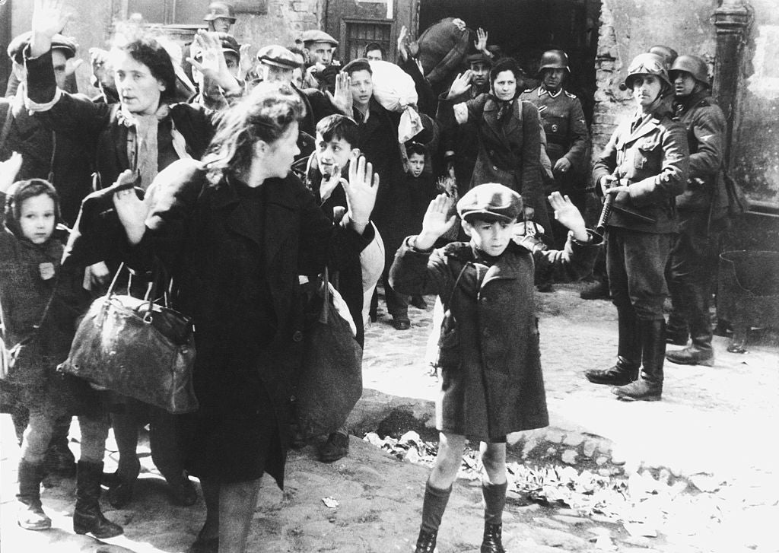
Warsaw

Slide 18
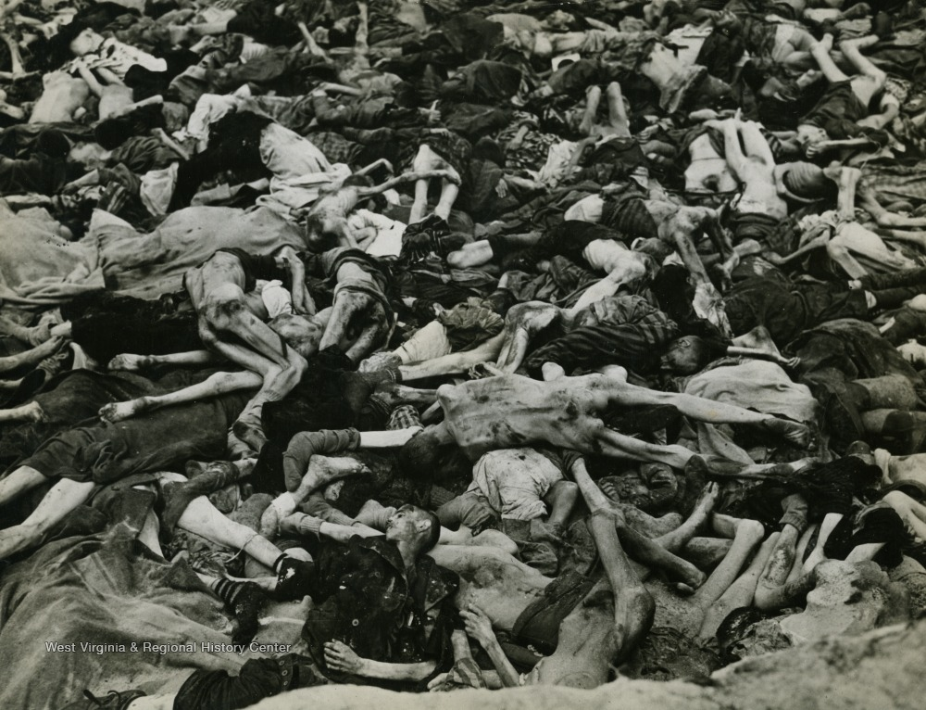
Dachau

Slide 19
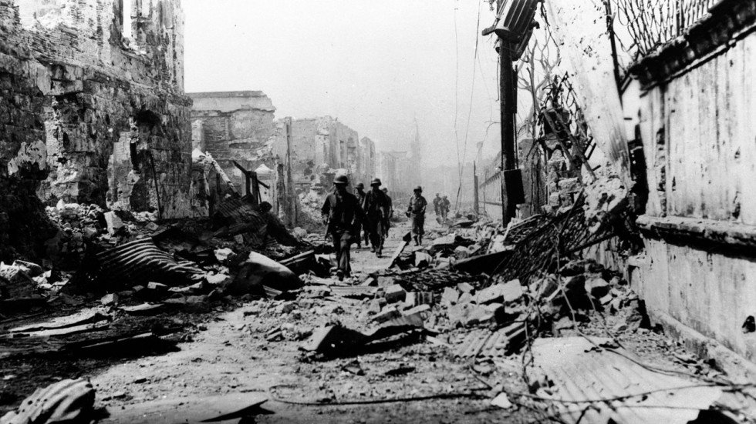
Manila

Slide 20
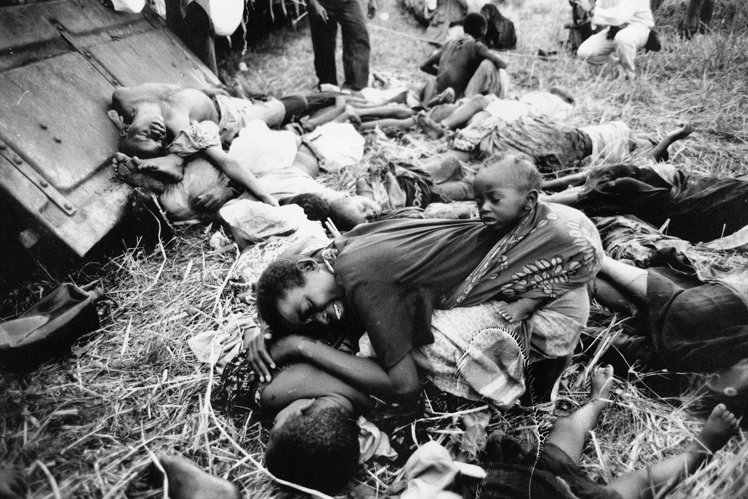
Rwanda

Slide 21
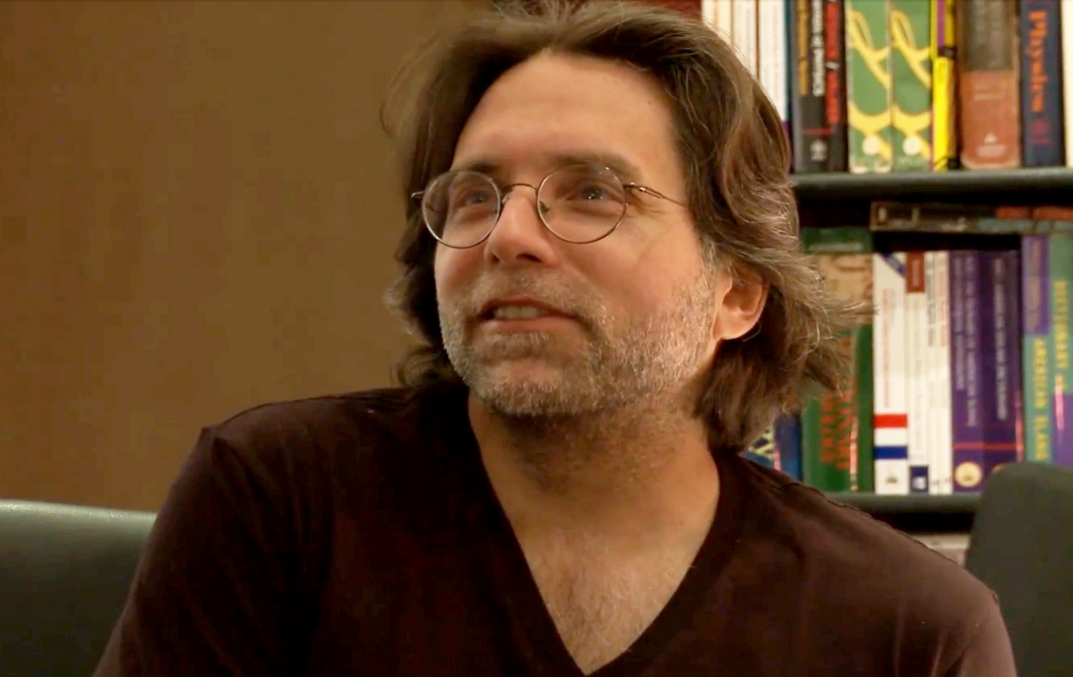

Keith Raniere

Slide 22
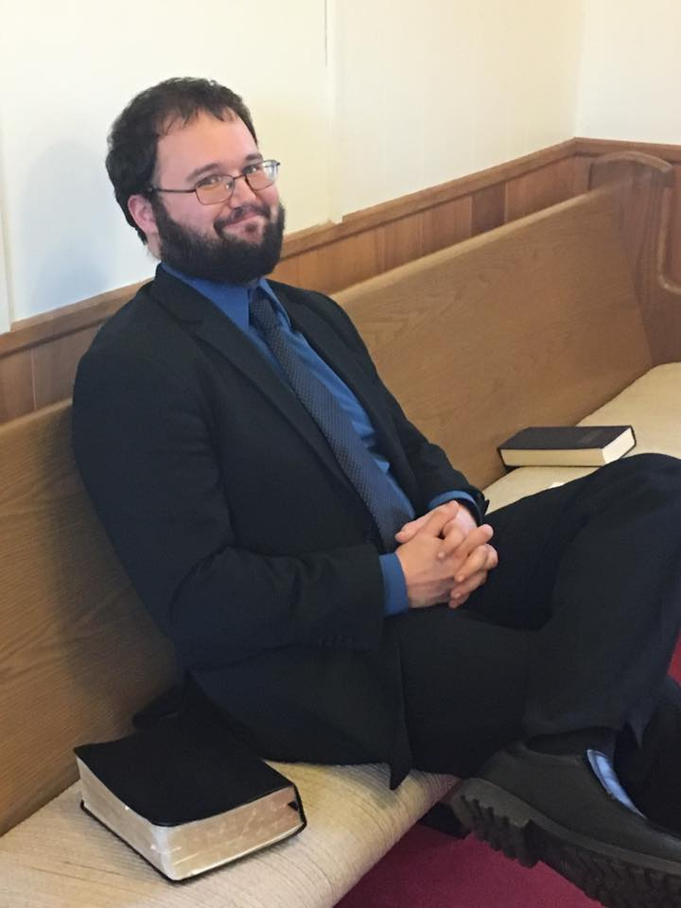

Slide 23
Application Points
Crush the Grapes (4)
  Make no mistake about it, we are bent toward evil
  We can whine, complain, say it isn’t true, but it is true
  If we are honest we will say we are utterly blind and we are all truly worthy of being crushed like the grapes
  We are prisoners who, when the gate is opened, try to keep the gate closed
  It isn’t just that we are in wickedness, we are wicked
  This text reminds us of these things
  It also reminds us that God is good
  He is not to be trifled with
  If we should remain in our sin, we have every reason to fear
  Praise God for this, for it means justice truly does come
  He alone can do it, and He will do it, for this Divine Vengeance will come from His Mighty Arm
  He will crush the grapes

Slide 24
Application Points
The Gospel of Christ
  Origins
  Fall
  Redemption
  Glorification

