Slide 1
Isaiah 59:16-21
Our Only Hope for Redemption

Slide 2
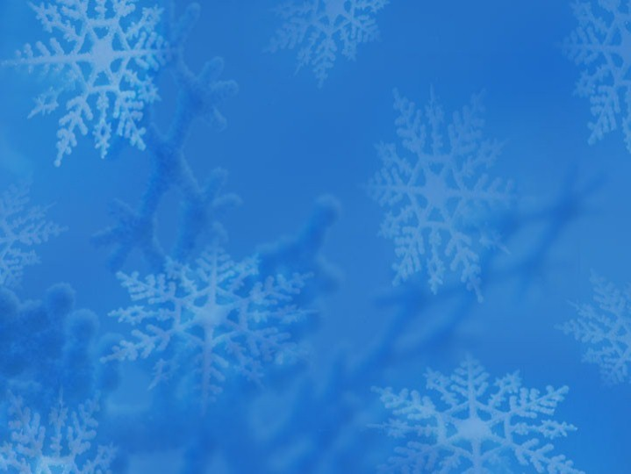


Slide 3


Slide 4



Slide 5


Slide 6
15 Truth is lacking,
and he who departs from evil makes himself a prey.
The LORD saw it, and it displeased him
that there was no justice.
16 He saw that there was no man,
and wondered that there was no one to intercede;
then his own arm brought him salvation,
and his righteousness upheld him.
17 He put on righteousness as a breastplate,
and a helmet of salvation on his head;
he put on garments of vengeance for clothing,
and wrapped himself in zeal as a cloak.
18 According to their deeds, so will he repay,
wrath to his adversaries, repayment to his enemies;
to the coastlands he will render repayment.
19 So they shall fear the name of the LORD from the west,
and his glory from the rising of the sun;
for he will come like a rushing stream,
which the wind of the LORD drives.
20 “And a Redeemer will come to Zion,
to those in Jacob who turn from transgression,” declares the LORD.
(Isaiah 59:15-20, ESV)

Slide 7
21 “And as for me, this is my covenant with them,” says the LORD: “My Spirit that is upon you, and my words that I have put in your mouth, shall not depart out of your mouth, or out of the mouth of your offspring, or out of the mouth of your children’s offspring,” says the LORD, “from this time forth and forevermore.”
(Isaiah 59:21, ESV)

Slide 8
Main Point
These verses remind us of our situation before God
We let go of the truth and righteousness for lies and unrighteousness
He has promised redemption to those who have faith in His deliverance and who responsibly turn from their sins
God will be with those who do forever, and nothing can separate them from their God

Slide 9
Application Points
Our Only Hope for Redemption
  Isaiah knows the human condition
  Recall in chapter 6 Him saying, “Woe is me I am undone!” and “I am a man of unclean lips amongst a people of unclean lips!”
  He recognizes his own state as well as the state of his people
  Yet, his lips are cleansed and he told to proclaim a message his people will not like
  That message has been nothing more than the truth
  This truth was true for them as well as their neighbors and the nations around them
  God is God of all and only He can demand total allegiance
  Isaiah has reminded us that we continue to go our own way
  We give definitions for things that only God Himself is able to define

Slide 10
Application Points
Our Only Hope for Redemption (2)
  It is this world which God looks down into
  Without truth there is no justice, and without justice evil runs amuck
  We are not a suitable foundation for all these good and delightful things
  If this is our state…what can pull us from it?
  What can save us from our failed attempts at understanding the world?
  “His own arm brought him salvation, and his righteousness upheld him.”
  God acting in this world…to bring about the destruction of that which plagues us
  God alone can do this

Slide 11
Application Points
Our Only Hope for Redemption (3)
  This is the answer provided by Isaiah, it is provided throughout the Scriptures
  That which is unattainable is capable of reaching us
  God is capable of breaking our chains and setting us truly free
  Free to what?
  Our liberty is something we cherish
  We can believe what we want to believe
  We are created with this autonomy, this personal liberty
  We must also concede that is the extent of it
  No matter how hard I try, I will not be able to jump off the roof and fly
  Whether I believe it, or feel it, or try to succeed in these things, in the end I will fail
  There is a limit to my autonomy, there is no limit to God’s
  God could give me these gifts, though I suspect He will not!

Slide 12
Application Points
Our Only Hope for Redemption (4)
  We cannot attain freedom from our sin on our own the same way I cannot attain any of the physical realities above
  We are not able to do it any of it
  God, however, is capable of it
  He has promised to set us free from the bondage of sin we experience
  Sin is the great enemy, but we also must remember sin has an effect
  If God takes away the root problem which is sin then that means the effects will change as well
  We often discuss how God saves us from the guilt of sin
  He has done this through Jesus Christ
  Sin causes injustices and evil
  God causes justice, righteousness, goodness, holiness, instead of evil
  By putting His Spirit in us, and His words in our mouths, we are able to perceive what is true and right
  This does not mean it is whatever we think it is
  We are warned of false prophets in the past and in the present and future

Slide 13
Application Points
Our Only Hope for Redemption (5)
  No, it will reflect what God has already told, already said, already done
  It will be a reflection, not a transformation, of the Word already spoken
  We have the foundation for all truth, all reality
  All things we desire and know are good, which comes from God, the Source of all good things
  He is our only hope concerning the guilt of our sin
  We know that the promise to do what He has proclaimed today has been accomplished…through Jesus of Nazareth
  Let us, then, rejoice over the covenant
  Our hope is founded in Him, all things come back to Him
  Let us continue to seek Him and know Him more and desire all that is pleasing to His sight

Slide 14
Application Points
The Gospel of Christ
  Origins
  Fall
  Redemption
  Glorification

